Slide 1

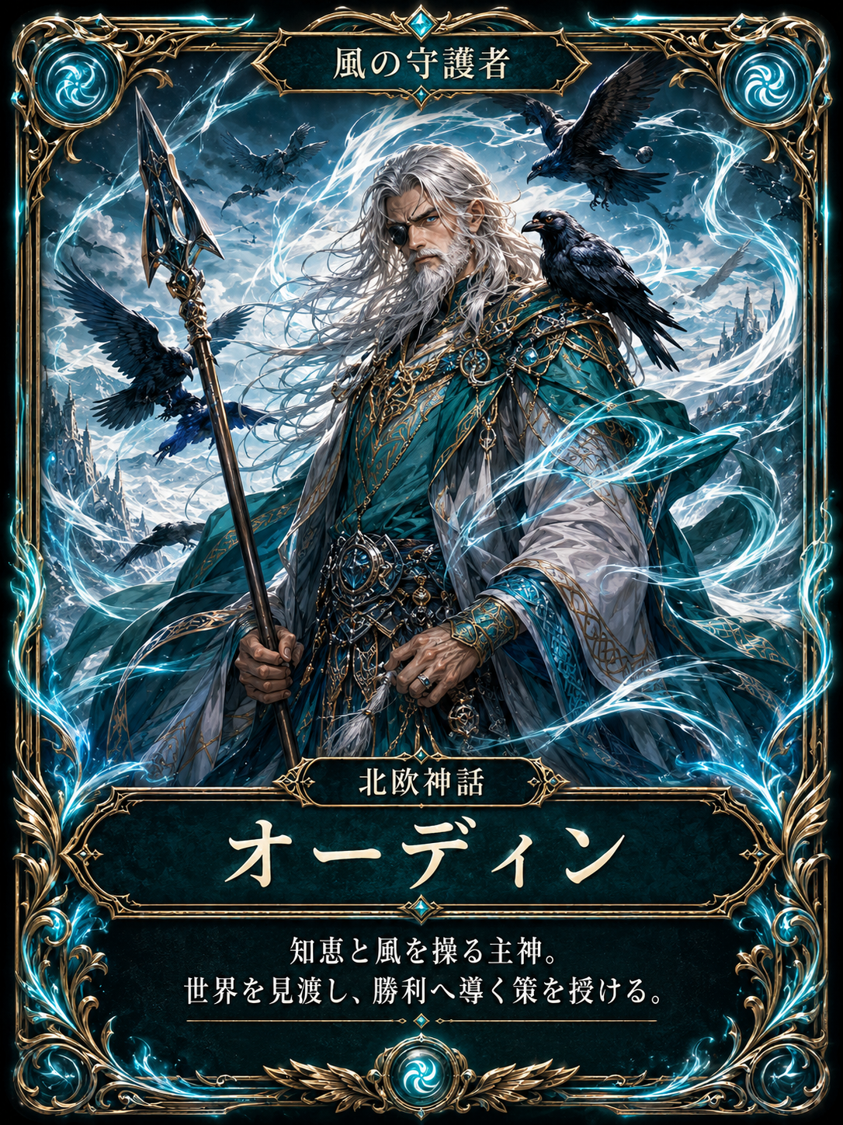
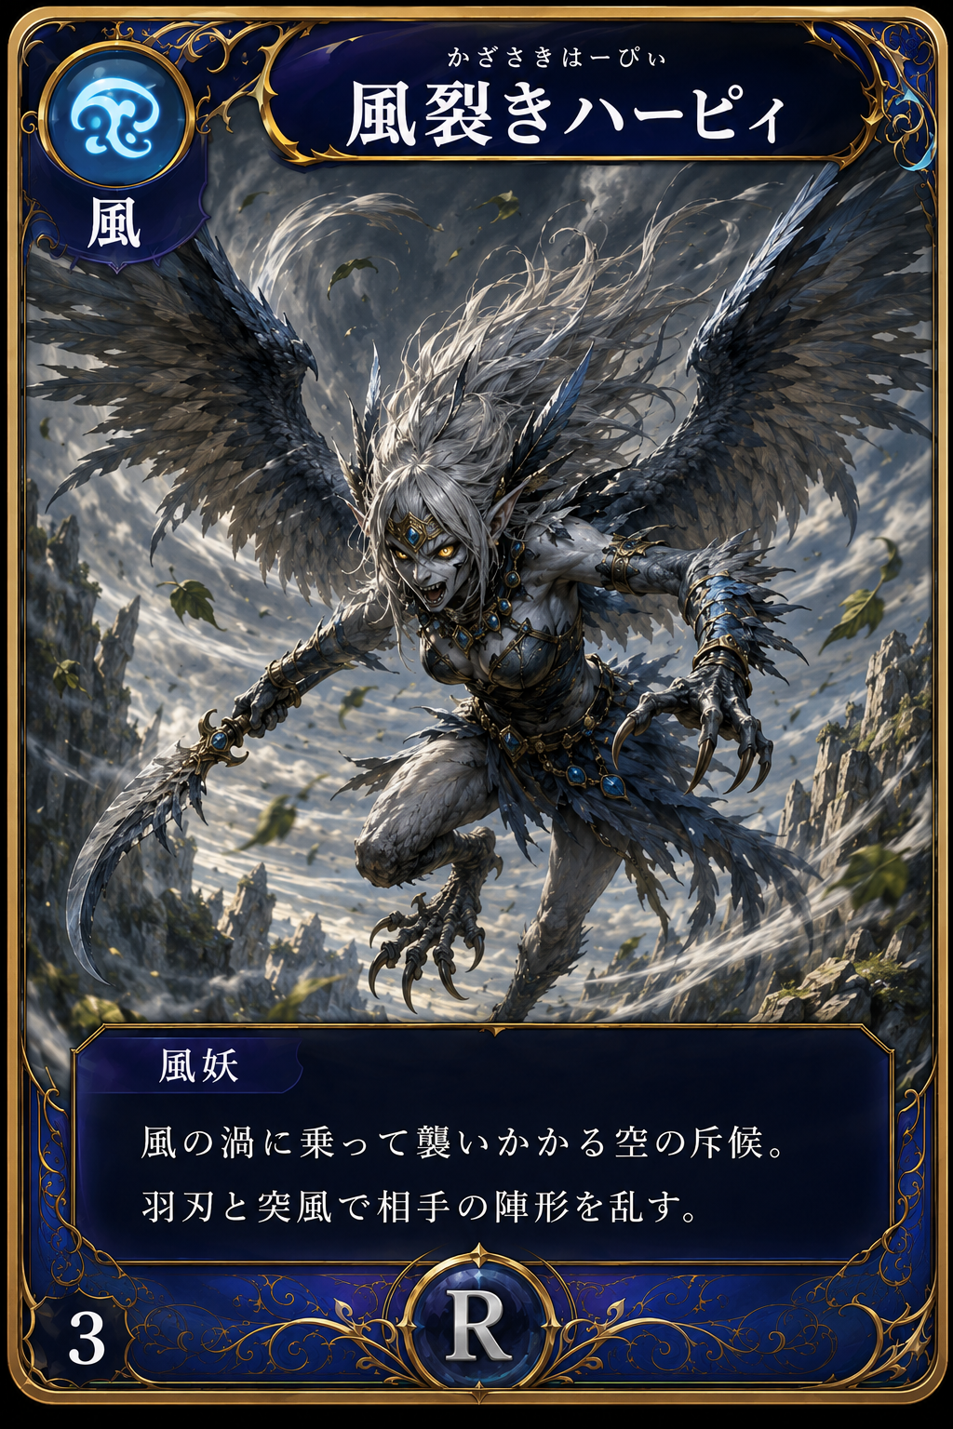
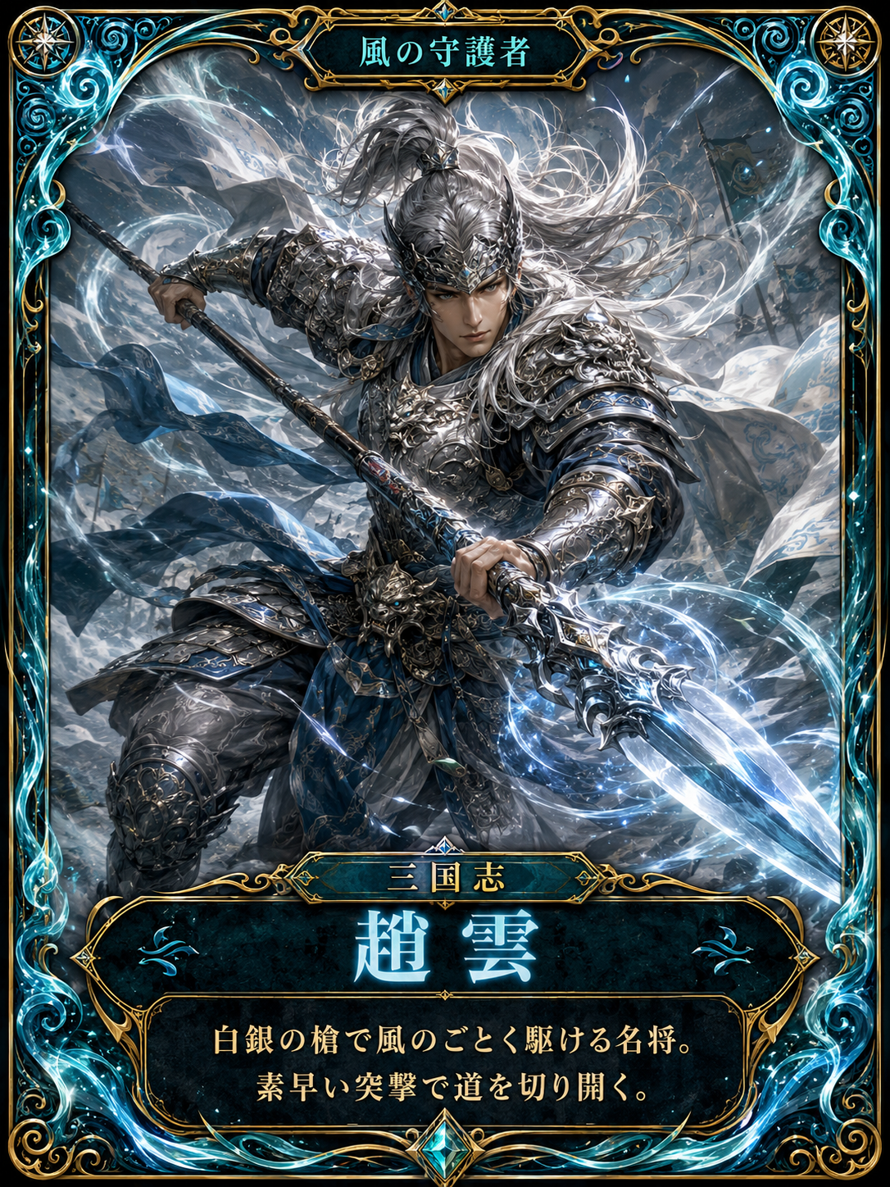
Eigo Quest
A dark-fantasy English learning adventure
kids want to open every day
英語クエスト — Learn English like an RPG
Family project · React + Flask + Gemini AI

Slide 2
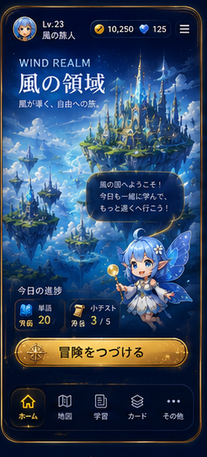
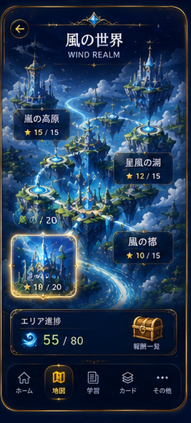
Project Overview
Problems to solve
• Memorizing vocabulary is boring — kids don't stick with it
• The words they get wrong are the hardest to review
• Parents can't see how learning is going
Our idea
Turn Eiken vocabulary, grammar and past exams into an adventure of world maps, stages and card rewards.
Learning = Power Up
Quiz = Battle
Cards = Companions
Boss = Milestone

Slide 3
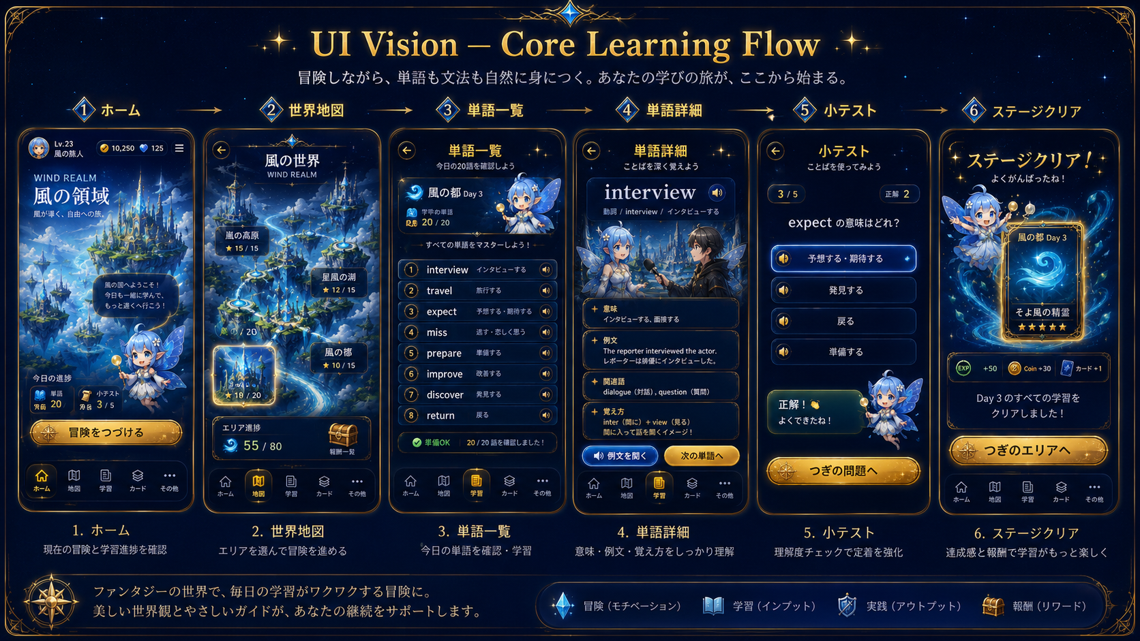
Home → World Map → Word List → Word Detail → Quiz → Stage Clear

Slide 4
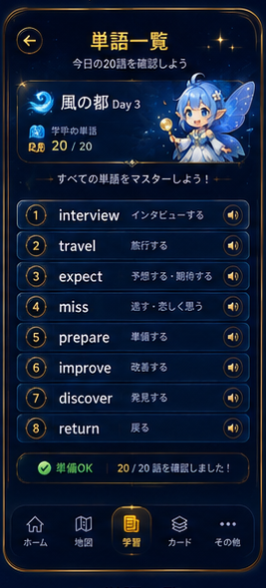
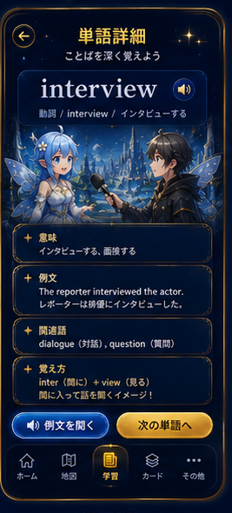
Vocabulary Quest
1
Today's 20 words
Pronunciation, meaning and example sentences
2
Flashcards
Repetition that locks words into memory
3
Mini quiz
Multiple-choice check after each unit
4
Weak-word review
Wrong answers come back first, automatically
20
8
1500+
words / day
worlds
words

Slide 5
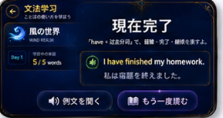
Grammar Quest
Grammar lessons
Present perfect and more — explained gently with examples
Grammar quizzes
Understanding checks per stage
Form practice
Drills on word forms until they stick
Warm feedback
Mistakes get “let's try again” — never punishment
“I have finished my homework.”
Present perfect, straight from the lesson screen

Slide 6
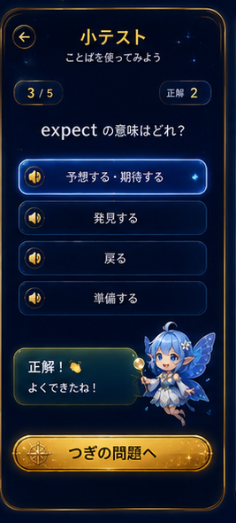
AI Practice × Eiken Prep
AI practice (Gemini)
Eiken preparation
• AI generates questions matched to each child's level
• Practice the Eiken interview with AI, scored on the spot
• AI checks essays and gives advice
• Grade 3: vocabulary & phrase sets included
• Grade Pre-2: practice + real-exam simulation mode
• Focused review of only the questions you missed

Slide 7
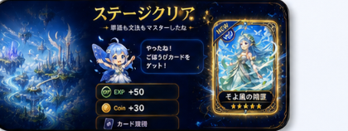
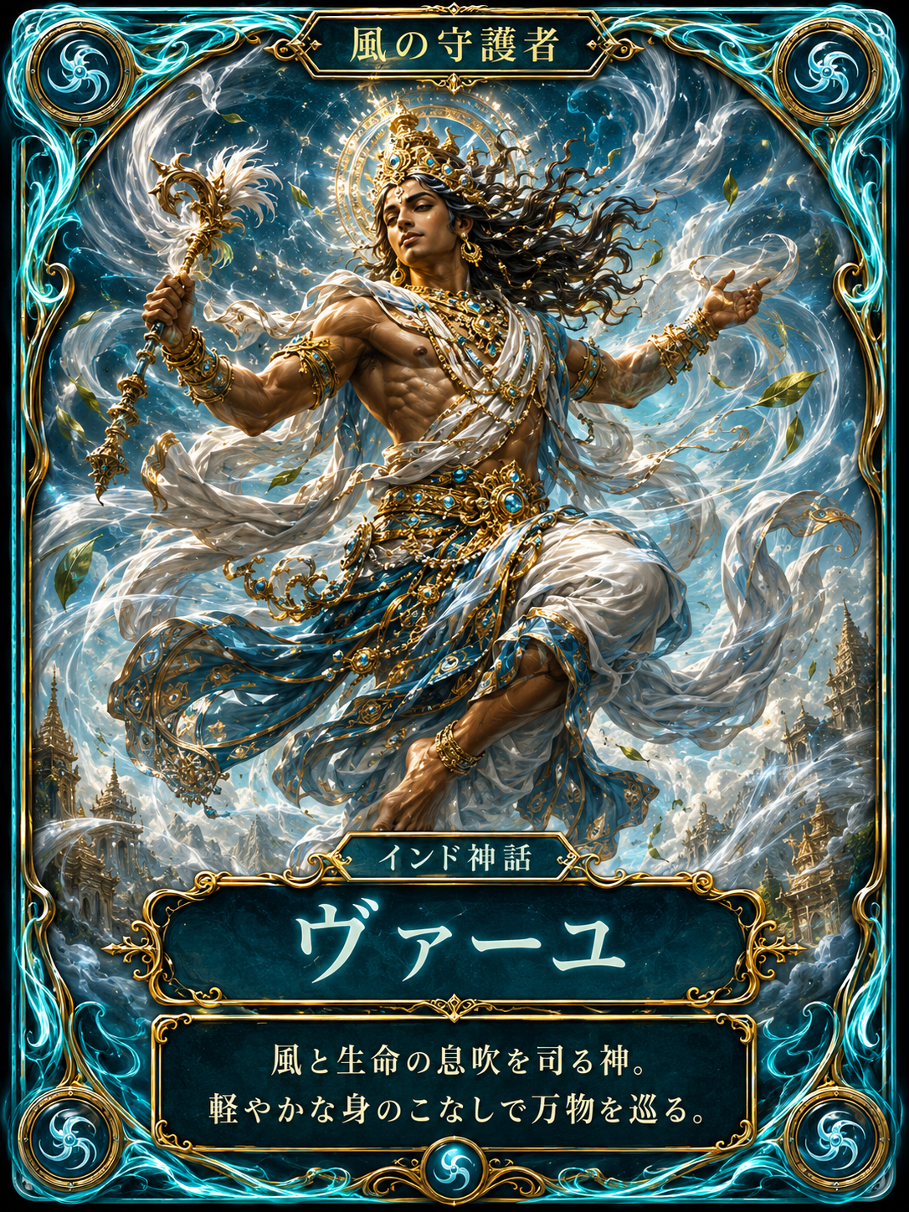
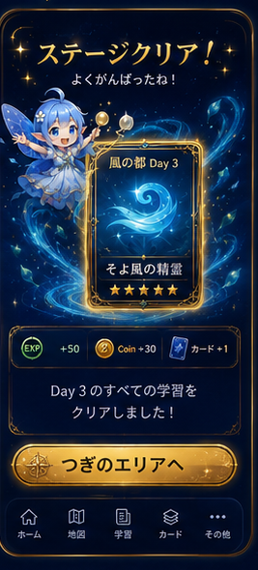
Card Rewards & Progression
1
Clear a stage
Earn a hero card
2
Defeat a boss
Rare cards & badges
3
Keep reviewing
Materials to upgrade your cards
4
Per-child profiles
Progress and cards stay separate for siblings
8 elemental worlds
Wind · Fire · Water · Thunder · Forest · Rock · Shadow · Light

