Slide 1
Petlje

Slide 2
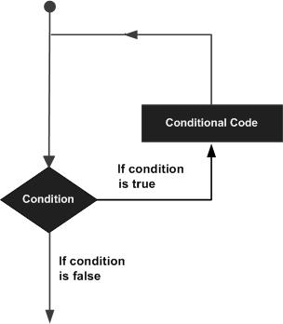
While
public static void main(String args[]) {
int x = 10;
while( x < 20 ) {
System.out.print("value of x : " + x );
x=x+1;
System.out.print("\n");
}
}

Slide 3
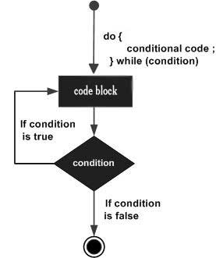
Do-While
public static void main(String args[]) {
int x = 10;
do {
System.out.print("value of x : " + x );
x++;
System.out.print("\n");
}while( x < 20 );
}

Slide 4
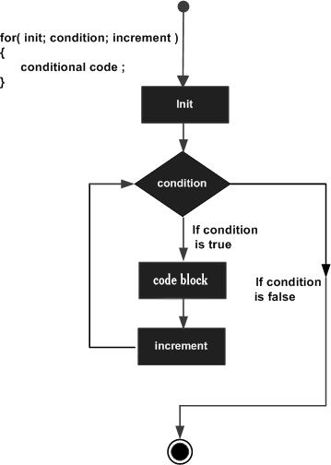
For
public static void main(String args[]) {
for(int x = 10; x < 20; x = x + 1) {
System.out.print("value of x : " + x );
System.out.print("\n");
}
}

