Slide 1
WEBDRIVER COMMANDS

Slide 2
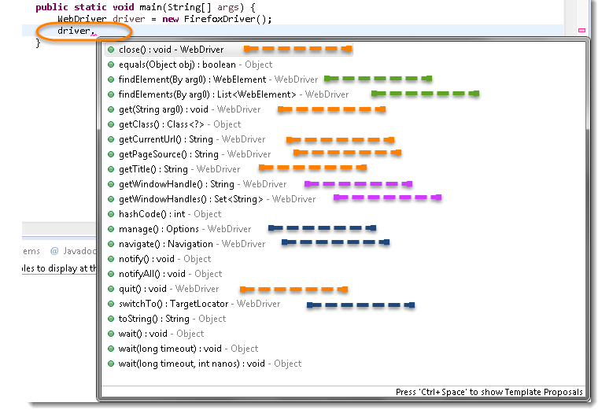
HOW TO ACCESS THE METHODS OF WEBDRIVER?
driver object with dot
Notes:
Kako da pristupimo metodama webdrivera?
Da bismo proverili sta sve imamo u webdriveru, napravicemo objekat koji se zove driver I staviti tacku, tada ce nam se izlistati spisak metoda koje postoje u webdriveru.

Slide 3
WEBDRIVER COMMANDS – BROWSER
get(String arg0): void – this method load a new web page. Accepts strings as parameter and returns nothing Example: driver.get(“www.google.com”);
getTitle() : String – this method fetches the title of the current page. Accepts nothing as parameter and returns string
Example: driver.getTitle();
getPageSource() : String – this method returns source code of page. Accept nothings as parameter and returns string Example: driver.getPageSource();

Slide 4
WEBDRIVER COMMANDS - BROWSER
getCurrentUrl(): String - this method fetches the string representing the Current URL which is opened in the browser. Accepts nothing as a parameter and returns a String value.
close(): void – this method Close only the current window. Accepts nothing as parameter and returns nothing Example: driver.close();
quit() : void – this method Close all windows. Accepts nothing as parameter and returns nothing Example: driver.quit();
Zadatak!!!

Slide 5
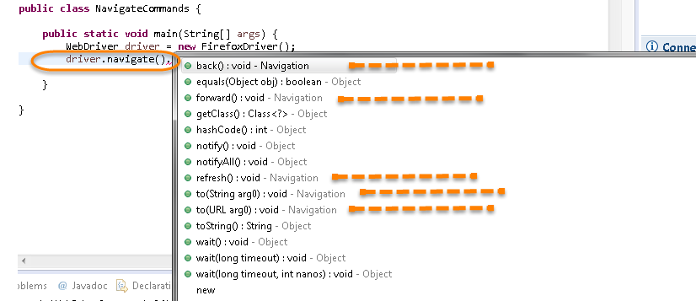
WEBDRIVER COMMANDS - NAVIGATION
navigate method
Notes:
Da bi pristupili metodi navigate ukucajte driver.navigate. I eclipse ce prikazati sve public metode navigate interfejsa koje su prikazane na slici

Slide 6
WEBDRIVER COMMANDS - NAVIGATION
to(String arg0) : void – this method load a new web page. Accepts strings as parameter and returns nothing Example: driver.navigate().to(“www.google.com”);
forward() : void – this method does the same operation as clicking on the Forward Button of any browser. Accepts nothing as parameter and returns nothing Example: driver.navigate().forward();
back() : void – same method as forward, just doing back action Example: driver.navigate().back();

Slide 7
WEBDRIVER COMMANDS - NAVIGATION
refresh() : void – this method load a new web page. Accepts strings as parameter and returns nothing Example: driver.navigate().refresh();
Zadatak!!!

Slide 8
WEBDRIVER COMMANDS – FIND ELEMENT
locating elements in WebDriver is done by using the findElement(By.locator()) method
the findElement methods take a locator or query object called ‘By’
in the eclipse code window type driver.findElement(By dot), eclipse intellicense will populate the list of different locators
findElements

Slide 9
WEBDRIVER COMMANDS – WEBELEMENT
WebElement can be text, link, button, dropdown...
clear(): void – if this element is a text entry element, this will clear the value. Accepts nothing as parameter and returns nothing Example: driver.findElement(By.id("UserName")).clear();
sendKeys(CharSequence… keysToSend ) : void – This simulate typing into an element, which may set its value. Accepts CharSequence as a parameter and returns nothing
Example: driver.findElement(By.id("UserName")).sendKeys("QA user");

Slide 10
WEBDRIVER COMMANDS - WEBELEMENT
click( ) : void - this simulates the clicking of any element. Accepts nothing as a parameter and returns nothing. Example: driver.findElement(By.linkText("google")).click();
isDisplayed( ) : boolean - this method determines if an element is currently being displayed or not. Accepts nothing as a parameter but returns boolean value(true/false). Example: boolean status = driver.findElement(By.id("UserName")).isDisplayed();

Slide 11
WEBDRIVER COMMANDS - WEBELEMENT
isEnabled( ) : boolean - this determines if the element currently is Enabled or not? Accepts nothing as a parameter, but returns boolean value(true/false). Example: boolean status = driver.findElement(By.id("UserName")).isEnabled();
isSelected( ) : boolean - Determine whether or not this element is selected or not. Accepts nothing as a parameter but returns boolean value(true/false). Example: boolean status = driver.findElement(By.id("Yes")).isSelected();

Slide 12
WEBDRIVER COMMANDS - WEBELEMENT
getText( ) : String - This method will fetch the visible (i.e. not hidden by CSS) innerText of the element. Accepts nothing as a parameter, but returns a String value. Example: WebElement element = driver.findElement(By.xpath("anyLink")); String linkText = element.getText();
similar to getText are getCssValue and getTagName

Slide 13
WEBDRIVER COMMANDS - WEBELEMENT
getAttribute(String Name) : String - this method gets the value of the given attribute of the element. Accepts the String as a parameter and returns a String value. Example: WebElement element = driver.findElement(By.id("SubmitButton")); String attValue = element.getAttribute("id");
getSize( ) : Dimension - this method fetch the width and height of the rendered element. Accepts nothing as a parameter but returns the Dimension object. Example: WebElement element = driver.findElement(By.id("SubmitButton")); Dimension dimensions = element.getSize(); System.out.println(“Height :” + dimensions.height + ”Width : "+ dimensions.width);

Slide 14
WEBDRIVER COMMANDS - WEBELEMENT
getLocation( ) : Point - this method locate the location of the element on the page. Accepts nothing as a parameter, but returns the Point object. Example: WebElement element = driver.findElement(By.id("SubmitButton")); Point point= element.getLocation(); System.out.println("X cordinate : " + point.x + "Y cordinate: " + point.y));
Zadatak!!!

Slide 15
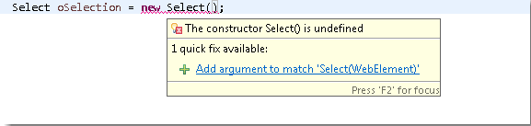
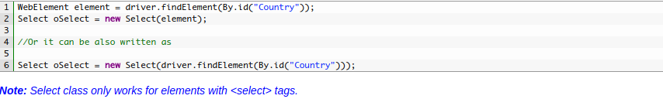
WEBDRIVER COMMANDS – DROPDOWN&MULTIPLE
import org.openqa.selenium.support.ui.Select
Select oSelect = new Select();

Slide 16
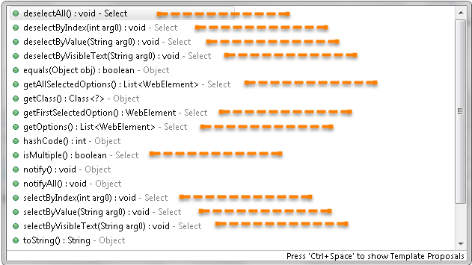
WEBDRIVER COMMANDS – DROPDOWN&MULTIPLE
oSelect + dot

Slide 17
WEBDRIVER COMMANDS - DROPDOWN&MULTIPLE
selectByVisibleText(String arg0) : void - it takes a parameter of String which is one of the Value of Select element and it returns nothing. Example: oSelect.selectByVisibleText(“text”);
selectByIndex(int arg0) : void - It takes a parameter of int which is the index value of Select element and it returns nothing Example: oSelect.selectByIndex(int);
selectByValue(String arg0) : void - It takes a parameter of String which is on of the value of Select element and it returns nothing. Example: oSelect.selectByValue(“text”);

Slide 18
WEBDRIVER COMMANDS – DROPDOWN&MULTIPLE
getOptions( ) : List<WebElement> –this gets the all options belonging to the Select tag. It takes no parameter and returns List<WebElements>.
same for deSelect
isMultiple() : boolean - this tells whether the SELECT element support multiple selecting options at the same time or not. This accepts nothing but returns boolean value(true/false). Example: oSelect.isMultiple();

