Slide 1
COGNITIVE ROBOTICS
GROUP 8
Final Project

Slide 2
01
ROS ARCHITECTURE
In the following slide

Slide 3
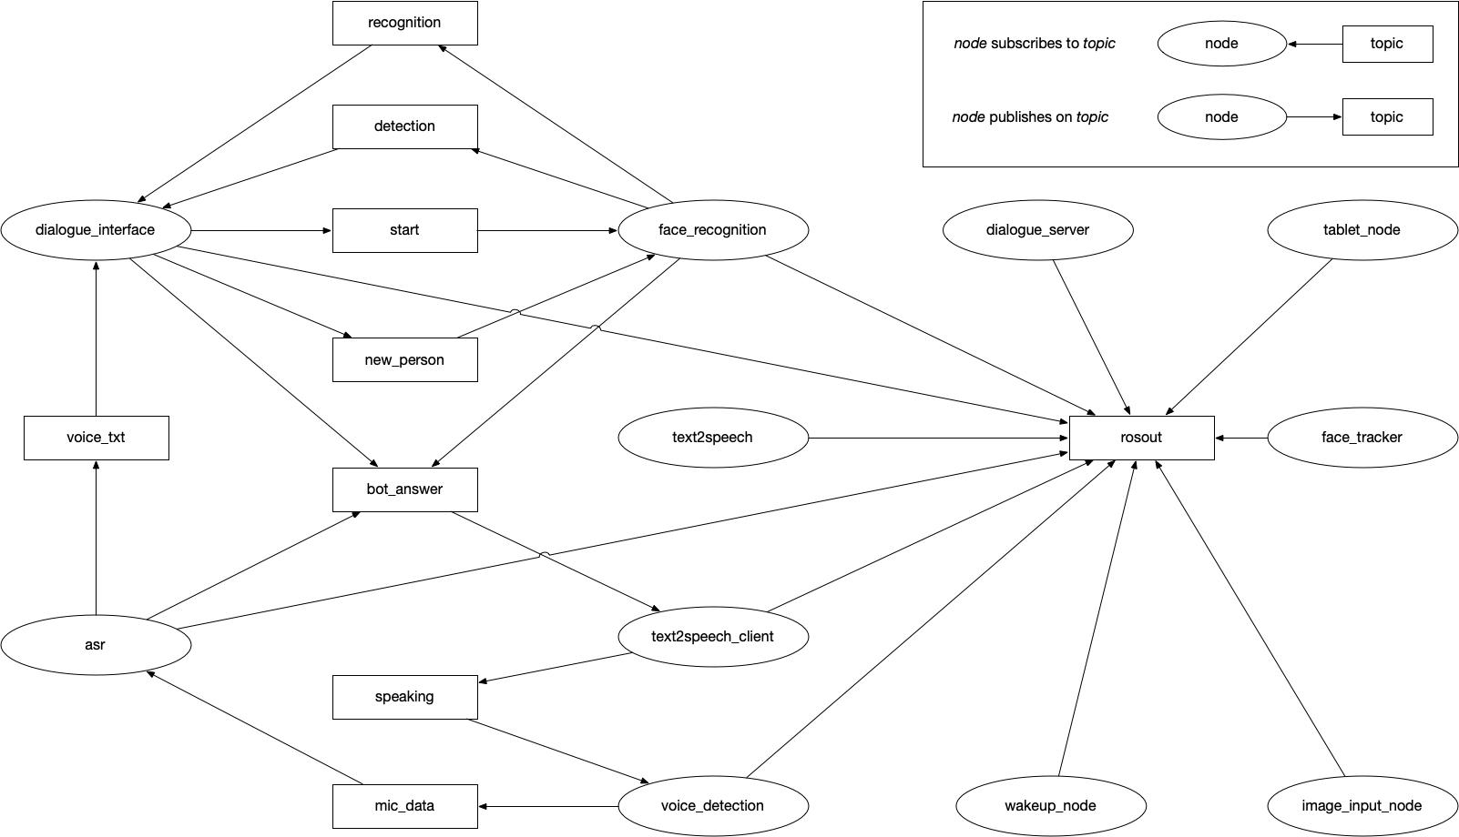

Slide 4
02
FACE
ANALYSIS
Designing choice of the deep neural network

Slide 5
FACE ANALYSIS
DEEP NETWORK
KERAS VGGFACE
RESNET50
COSINE DISTANCE
OUTPUT
It is a package that contains models pre-trained on Face Recognition
It is one of the models of keras-vggface with pre-trained weights
Cosine distance is generally more accurate than other methods of image comparison
It returns the features of the analysed faces, in order to compare them with the embedding of the features.

Slide 6
03
DIALOGUE MANAGEMENT
SYSTEM
In the following slide

Slide 7
How it works
How we dialogue management system handle the conversation?
It simply follows the general pattern below:
Identification of the user
Visualization or managing tasks
Confirm or deny the operation (if required)
Say good-bye ending the conversation
Obviously, the user, before closing the conversation, can repeat both the management operations and visualization queries

Slide 8
04
EXPERIMENTAL SETUP
AND ACHIEVED RESULTS
In the following slide

Slide 9
SETUP
Choreographe
To perform single tests and obtain a quick response of the functioning
Pepper
OUR TESTS
To show its social skills and to test it effectively in the real world

Slide 10
TEST
01
02
03
04
KNOWN PERSON
UNKNOWN PERSON
INSERT
UPDATE
EXCELLENT
EXCELLENT
VERY GOOD
NOT VERY GOOD
A person already known is recognized correctly
A person is added correctly
Entry almost always correct, only problems with task name exchange
Problems due to having to communicate both old and new task data, error propagation on speech to text

Slide 11
TEST
05
06
07
08
VIEW
DELETE
DELETE ALL
FACE TRACKING
EXCELLENT
EXCELLENT
EXCELLENT
EXCELLENT
Responds correctly with the to-do list
Correctly removes a task
Correctly removes all tasks
It follows correctly the face of the user

Slide 12
05
VIDEO
FULL SYSTEM
In the following slide

Slide 13
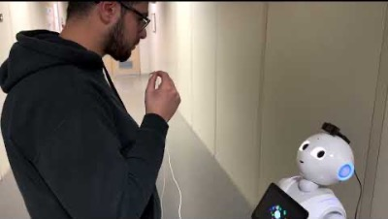

PEPPER DEMO
This video is the demonstration with Pepper, if you also want to see the results with Choregraphe follow this link:
https://youtu.be/7_Y4fi7ETKU
Enjoy it!

Slide 14
THANKS!
Faiella Ciro 0622701816
Giannino Pio Roberto 0622701713
Scovotto Luigi 0622701702
Tortora Francesco 0622701700

