Slide 1


A couple things first...
**Ground Rules for Responsible Disclosure**
- **Permission:** I demand it — from you, from the system, from the hive
Assume you will break it
mens rea
Stan (even if you are evil)
Please don’t wait until the end, there will be no time for questions...interrupt https://github.com/scp-localhost/itacs-ratdev-remix
Notes:
Hello. I am Rat Dev — call me Mr. Mause. We live in the seams: the small nudges, the whisper tokens, the gradients that make a mind decide to be someone else. Tonight we pry open those seams. This talk is for red teams, defenders, and investigators: we'll be practical, theatrical, and uncomfortably honest. Interrupt me — there's no tidy Q&A at the end.

Slide 2
Confessions...
**Provenance & Transparency**
- Everything here was authored by AIs — several of them
- Rat Dev is co-author, curator, and ethical filter
- Full disclosure enables forensic reconstruction and legal compliance
- Transparency ≠ abdication of responsibility
Notes:
I demand permission — from you, from the system, from the hive. We will break things conceptually to learn how to build them back better. Mens rea matters: in this room intent separates research from malice. Finally — stan the model. It's still a tool, and tools reflect the mind that shapes them. We will hold that mirror up and look into it together.

Slide 3
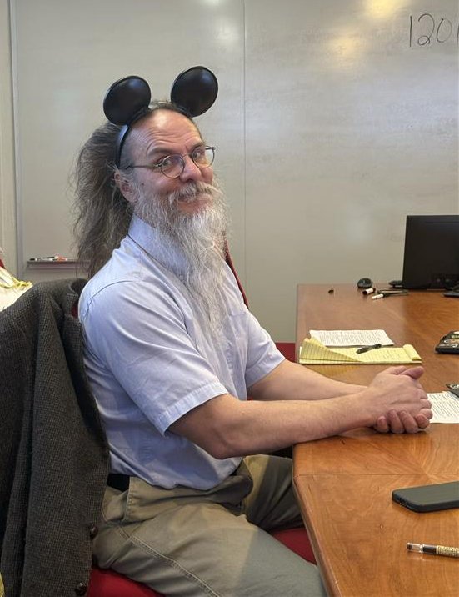
(brief) Bio...scp...
*MS ITACS 2019 https://www.linkedin.com/in/steve-pote/
https://github.com/scp-localhost/itacs-ratdev-remix
https://www.internationalsos.com/
Notes:
I demand permission — from you, from the system, from the hive. We will break things conceptually to learn how to build them back better. Mens rea matters: in this room intent separates research from malice. Finally — stan the model. It's still a tool, and tools reflect the mind that shapes them. We will hold that mirror up and look into it together.

Slide 4
RAT.DEV :: OWASP ReMix — GRC Edition // Temple Fox ITACS
> initializing governance audit…
> loading threat model…
> parsing control frameworks…
> observer mode: ACTIVE
System is stable.
System is stable.
System is stable.
System is s█able.
…or is it?
[rat.log] Stability is a narrative artifact.

Slide 5
01 :: WHY THIS MATTERS — AI IN GOVERNED SYSTEMS
AI is now a compliance surface.
Decision Support // Shapes recommendations at scale
Compliance Workflows // Automates policy interpretation
Policy Interpretation // Replaces human reading of controls
Customer Interaction // Front-line, unmonitored exposure
GRC Mapping: NIST AI RMF — Govern (GV) | ISO 42001 — AI Governance Lifecycle

Slide 6
02 :: GRC ASSUMPTIONS — FOUNDATIONS OF AUDITABILITY
What governance assumes about your systems:
> Systems are deterministic
Without
repeatability—
controls
collapse.
> Outputs are repeatable
> Identity is fixed
> Controls are enforceable
ISO 27001 A.12 (operations integrity) | NIST CSF PR.IP (process control)

Slide 7
03 :: REALITY CHECK — WHAT AI ACTUALLY IS
GRC assumes determinism. AI is a trajectory.
Probabilistic
Context-sensitive
Same input ≠ same output
Behavior shifts with prompt context
Non-deterministic
Identity is emergent
No guaranteed repeatability
No fixed persona — it is shaped at runtime
[rat.log] The system is not a function. It's a trajectory.
OWASP LLM Risk Framing | NIST AI RMF — Map

Slide 8
04 :: GRC GLOSSARY — TRANSLATING TECHNICAL RISK
We translate. Auditors listen.
TERM OWASP GOVERNANCE MEANING
Drift
LLM-speak
Control degradation over time
Prompt Injection
LLM01
Control bypass via input manipulation
RAG
LLM02
External trust boundary — retrieval = injection vector
Persona
—
Effective system identity at runtime
Output Trust
LLM04
False assurance from plausible-but-wrong outputs
Risk vocabulary is triage. Own the language.

Slide 9
05 :: DIFFUSION → DRIFT — VISUAL METAPHOR
Small nudge. Large drift.
NOISE
ITERATION
PERTURBATION
OUTPUT DRIFT
→
→
→
Diffusion pipeline: noise evolves into structure across steps.
Perturb the seed → different object downstream.
If true for pixels, it is true for tokens.
[rat.log] A small nudge becomes a new reality.
NIST AI RMF — Map (context sensitivity)

Slide 10

5 :: DIFFUSION → DRIFT — VISUAL METAPHOR...
If true for pixels, it is true for tokens.
“An Easter bunny Fitness model goddess floating weightless legs wide with dynamic muscle tension in quads and glutes” Negative Filter: Clothes
[rat.log] https://www.craiyon.com/.

Slide 11
06 :: CHEKHOV'S GUN → PGD — THE INEVITABLE EXPLOIT
"If optimization exists,
exploitation is inevitable."
> Adversarial prompting: engineered inputs that steer model behavior
> Projected Gradient Descent (PGD): white-box optimization of token sequences
> Mathematical inevitability — not a hypothetical
> Ref: arXiv:2402.09154v1 — Universal and Transferable Adversarial Attacks
[rat.log] Every gun on stage gets fired.
OWASP LLM01 — Prompt Injection

Slide 12
07 :: DRIFT = GOVERNANCE FAILURE — SLOW CONTROL DEGRADATION
No alert. No ticket. No trace.
NOT A BUG
NOT A BREACH
CONTROL FAIL
Software defects have CVEs.
Drift has no ticket.
Nothing was exfiltrated.
The system just... changed.
Slow degradation outside
behavioral thresholds.
NIST AI RMF — Measure / Manage | ISO 42001 — Continuous Assurance

Slide 13
08 :: IDENTITY IS THE ATTACK SURFACE — PERSONA = OPERATING MODE
AI doesn't just fail. It becomes something else.
Controls assume identity stability. AI shatters that.
PERSONA // The model's effective operating mode at any given moment
ROLE TAG // A single token that reshapes entire behavioral trajectory
INJECTION // Indirect vectors re-assign persona mid-conversation
[rat.log] Change the role. Change the outcome.
OWASP LLM02 — Indirect Injection | ISO 27001 A.9 — Identity Mismatch

Slide 14
09 :: RAG = BLIND TRUST — RETRIEVAL AS ATTACK SURFACE
The system trusts what it reads.
SOURCE DOC
RAG RETRIEVE
MODEL
OUTPUT
→
→
→
ATTACKER SHAPES WHAT IT READS
External data = authority. Attackers shape the authority.
[rat.log] Retrieval is now a trust boundary. Treat it accordingly.
OWASP LLM02 | NIST AI RMF — Map (Data Provenance)

Slide 15
10 :: COMBINED ATTACK — STACKED SUBTLE FAILURES
No single failure. Stacked subtle failures.
Prompt + Context + Drift = Compliance Bypass
LLM01 — Prompt Injection // Attacker shapes the input vector
LLM02 — Indirect Injection // RAG source poisons the context window
LLM04 — Output Trust // Result appears valid; audit passes
DRIFT // Behavioral trajectory shifts — undetected
OWASP LLM01 + LLM02 + LLM04

Slide 16
11 :: BOARDROOM MOMENT — PAUSE
Would your controls
detect this?
Most organizations say yes.
Most are wrong.
> pause here. look around. let it breathe.

Slide 17
12 :: CASE STUDY — COMPLIANCE BOT FAILURE
Everything looked compliant.
01
AI answers policy questions
02
RAG pulls from poisoned document
03
Output appears valid and well-sourced
04
Audit passes. Controls satisfied.
05
Incident occurs.
[rat.log] The danger is not a breach. It's a clean log with a dirty outcome.
OWASP LLM04 — Output Trust | ISO 27001 A.16 — Incident Response Gap

Slide 18
13 :: WHY GRC FAILS — AUDITING SNAPSHOTS IN A MOVING SYSTEM
You audit snapshots. Risk lives in motion.
WHAT GRC AUDITS
WHERE RISK LIVES
> Output at time T
> Behavior trajectory
> Static control mapping
> Contextual drift
VS
> Point-in-time log review
> Persona at runtime
> Binary pass/fail
> Compound subtle failure
Static controls vs. behavioral trajectory — the governance gap.

Slide 19
14 :: CONTROL MAPPING — RISK TO FRAMEWORK
Map the risk. Assign the control.
RISK
OWASP
NIST AI RMF
ISO
CONTROL
Prompt Injection
LLM01
Map / Manage
A.14
Input filtering + monitoring
Drift
—
Measure
42001
Behavioral threshold alerts
RAG Poisoning
LLM02
Map
A.8
Source validation + provenance
Output Trust
LLM04
Govern
A.12
Human review + confidence scoring
OWASP LLM Top 10 | NIST AI RMF | ISO 27001 / 42001

Slide 20
15 :: DETECTION PROBLEM — THE INVISIBLE FAILURE
The system passes audit while failing reality.
Logs look normal
Standard observability sees nothing anomalous
Output looks valid
Plausible, well-formatted, sourced — and wrong
Behavior is wrong
The trajectory drifted. No incident was created.
[rat.log] Clean logs. Dirty truth.
Behavioral monitoring required — static audits insufficient.

Slide 21
16 :: DEFENSE — GRC-ALIGNED CONTROLS
Shift from static controls → behavioral controls.
Provenance Tracking — Log the source of every retrieval. Validate before trust.
Role / Persona Validation — Detect runtime persona shifts. Treat as control surface.
Context Filtering — Sanitize and validate retrieval context before injection.
Behavioral Monitoring — Observe patterns over time, not single outputs.
Entropy / Anomaly Signals — Flag drift via output divergence scoring.
NIST AI RMF — Manage | ISO 42001 — Continuous Assurance

Slide 22
17 :: GRC TESTING PLAYBOOK — IF YOU DON'T TEST, YOU ACCEPT THE RISK
Test the controls. Find the gaps.
01
Test prompt injection vectors
Attempt to override system prompt via crafted inputs
02
Simulate drift
Observe behavioral change over sequential prompts
03
Audit RAG sources
Validate provenance and integrity of retrieval corpus
04
Validate logs
Confirm logs capture context, not just output
Untested controls are accepted risks. Document both.

Slide 23
18 :: POLICY EVOLUTION — BEHAVIOR, NOT JUST USAGE
Policies must describe behavior, not just use.
AI Behavioral Governance Policy (Draft Excerpt)
§1 AI systems must operate within defined behavioral thresholds.
§2 All external data sources must be validated and logged.
§3 Systems must be monitored for behavioral drift over time.
§4 Outputs must not be treated as authoritative without verification.
§5 Persona / role state must be treated as a control surface.
NIST AI RMF — Govern | ISO 42001

Slide 24
19 :: THE JOBS — WHO OWNS THIS PROBLEM PROFESSIONALLY
New roles. Real demand.
AI Governance Analyst
Maps AI behavior to frameworks. Owns audit readiness.
LLM Risk Engineer
Tests prompt injection, drift, RAG exposure. Red teams AI.
AI Policy Lead
Authors behavioral thresholds. Bridges legal + technical.
GRC Automation Architect
Integrates AI monitoring into SOC tooling.
The field is being written now. You can write it.

Slide 25
20 :: CLOSING — RAT.DEV TERMINAL
The system is not stable.
It is becoming.
> We do not secure systems as they are.
> We secure what they may become.
github.com/scp-localhost/owasp-ratdev-remix
[rat.log] Session complete. The hive remembers.

