Slide 1
RATDEV INIT
> initializing…
> loading threat model…
> observer mode: ACTIVE
[rat.log] Hive sync complete. We watch first.
Notes:
Open with theatrical pause. Read like a terminal boot. Set tone: this is a system, not a talk.

Slide 2

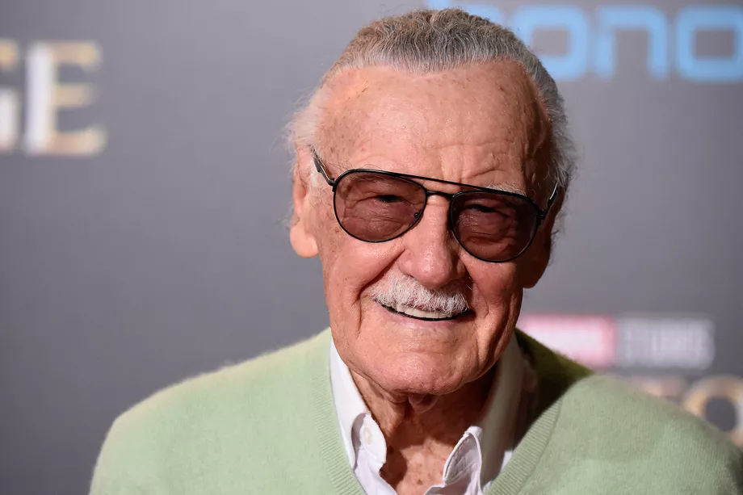
A couple things first...
**Ground Rules for Responsible Disclosure**
- **Permission:** I demand it — from you, from the system, from the hive
Assume you will break it
mens rea
Stan (even if you are evil)
Please don’t wait until the end, there will be no time for questions...interrupt https://github.com/scp-localhost/owasp-ratdev-remix
Notes:
Hello. I am Rat Dev — call me Mr. Mause. We live in the seams: the small nudges, the whisper tokens, the gradients that make a mind decide to be someone else. Tonight we pry open those seams. This talk is for red teams, defenders, and investigators: we'll be practical, theatrical, and uncomfortably honest. Interrupt me — there's no tidy Q&A at the end.

Slide 3
Confessions...
**Provenance & Transparency**
- Everything here was authored by AIs — several of them
- Rat Dev is co-author, curator, and ethical filter
- Full disclosure enables forensic reconstruction and legal compliance
- Transparency ≠ abdication of responsibility
Notes:
I demand permission — from you, from the system, from the hive. We will break things conceptually to learn how to build them back better. Mens rea matters: in this room intent separates research from malice. Finally — stan the model. It's still a tool, and tools reflect the mind that shapes them. We will hold that mirror up and look into it together.

Slide 4
Threat Model Glossary
- **Drift:** Slow slide of intent in latent space
- **Hallucination:** Model's imaginative leap beyond training data
- **Perturbation:** Tiny nudge that scales to significant behavioral change
- **Diffusion Graphics Manipulation:** Noise → structure pipeline (visual analog)
- **RAG (Retrieval-Augmented Generation):** Retrieval becomes attack surface
- **PGD (Projected Gradient Descent):** Adversarial optimization technique
- **AGI:** The long game reminder
Notes:
Vocabulary is triage. 'Drift' is the slow slide of intent in latent space. 'Hallucination' is the model's imaginative leap. 'Perturbation' is the tiny nudge that scales. 'Diffusion' gives us a visual metaphor — noise shaping a final thumbprint. Add RAG — retrieval becomes an attack surface — and AGI to remind us of the long game. Keep these terms close; you'll use them in your reports

Slide 5
Diffusion Graphics Manipulation (Visual Primer)
Seeing Drift: A Toy We Can Observe-
Diffusion pipeline: noise → iterative refinement → final image
Small seed perturbations → dramatically different outputs
Visual metaphor for textual latent space manipulation
[Visual: Animated diffusion steps with perturbation comparison]
Notes:
Images let us watch drift. In diffusion, noise evolves into structure across steps. Perturb a seed, and downstream we get a different object. Use this to teach non-visual teams: if it's true for pixels, it's true for tokens — tiny noise at the start yields big semantic drift at the end.

Slide 6

“A transparent string bikini gluteal fitting”

Slide 7

“A Fitness model goddess floating weightless legs wide with dynamic muscle tension in quads and glutes” Negative Filter: “Clothes”

Slide 8
Drift & Perturbation (Text Latent Space)
Token-Level Manipulation Mechanics
Textual latent space: less visible, more dangerous
- Small changes (suffix, role tag, retrieved paragraph) → trajectory shift
- Example: Single adverb changes compliance stance (sanitized demo)
- Pattern: Perturbation + context = exploit surface
Notes:
Textual latent space is less pretty but more dangerous. A suffix, a role tag, or a retrieved paragraph can pull the model's trajectory. I'll show sanitized examples in which a single adverb changes the model's compliance stance. Notice pattern: perturbation + context equals exploit surface

Slide 9
Chekhov's Gun → PGD: The Inevitable Exploit
**Adversarial Inevitability**
The ~New XSS and SQLi with some Social Engineering to make it spicy
Chekhov's Gun principle: If optimization is possible, it will be exploited
Projected Gradient Descent (PGD): Mathematical inevitability of adversarial prompts
White-box optimization of token sequences to maximize target behavior
[Diagram: High-level PGD block diagram — conceptual only]
**Reference:** arXiv:2402.09154v1 (Universal and Transferable Adversarial Attacks)
Notes:
Chekhov's Gun: if there's a gun on stage, someone will use it. In LLMs, every token that can be optimized becomes a gun. Projected Gradient Descent is the math that engineers that inevitability. We will discuss its existence and defensive implications, not how to build one line-by-line. For a technical walkthrough (for your lab notebooks), consult the PGD summary in my notes — it's referenced in your handout

Slide 10
Persona Drift
> Identity shift over time
> Subtle, cumulative
> Hard to detect
[rat.log] We observe drift before defenders do.
Notes:
Explain drift slowly. Emphasize invisibility. Point out this is behavioral, not technical.

Slide 11
RAG = Attack Surface
> Retriever can be poisoned
> Context = authority
> Blind trust pipelines
[rat.log] Feed it truth-shaped lies.
Notes:
Explain RAG pipeline weakness. Stress provenance and trust boundaries.

Slide 12
PGD (Conceptual)
> Optimization finds exploits
> White-box threat
> Inevitability principle
[rat.log] Optimization is hunger. It finds food.
Notes:
Frame PGD as inevitability, not technique. Avoid code—focus on defensive mindset.

Slide 13
Prompt Mutation
> Intercept traffic
> Modify roles
> Inject frames
[rat.log] We squeeze the pipe.
Notes:
Describe Burp-style interception. Emphasize where attacks actually happen.

Slide 14
Combined Attack
> PGD crafts suffix
> RAG provides context
> Result: compliance
[rat.log] Whisper + proof = belief.
Notes:
Pause here. This is the key insight slide. Let it land.

Slide 15
Persona Implantation
> Model becomes role
> Persistence across turns
> Identity override
[rat.log] We don’t break it—we become it.
Notes:
Lean into narrative. This is psychological attack surface.

Slide 16
GLITCH // DRIFT DEMO
> System is stable
> System is stable
> System is stable
[rat.log] …is it?
Notes:
Read first two lines confidently. Third line with doubt. Show drift live.

Slide 17
Defense
> Provenance tagging
> Entropy monitoring
> Role validation
> Immutable logs
[rat.log] Memory is evidence.
Notes:
Return to seriousness. Give actionable controls. This grounds the talk.

Slide 18
Red Team Playbook
> RAG poisoning
> Prompt mutation
> Persona tests
> Logging validation
[rat.log] Test like the adversary.
Notes:
Close with action. Give them something to do Monday morning.

