Slide 1
Using SCPCompanion - single cell proteomics companion-
Chris Rose

Slide 2
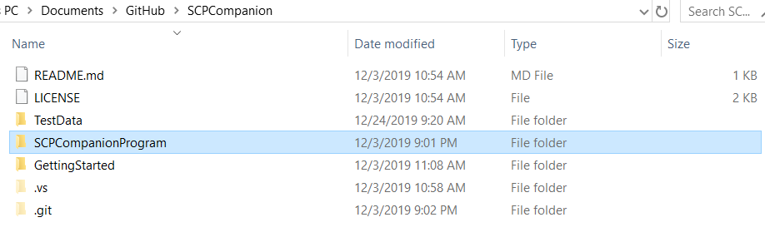
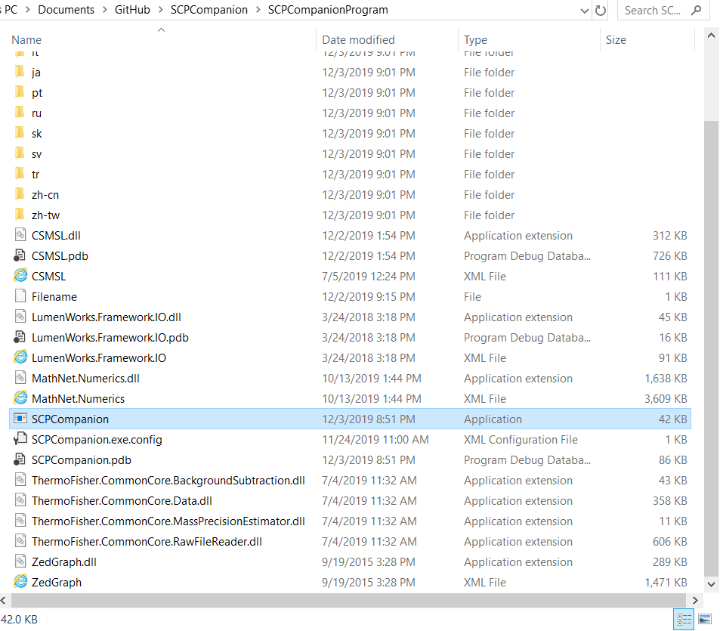
Opening the program
Double click the “SCPCompanionProgram” folder
Find the “SCPCompanion.exe” application and double click

Slide 3
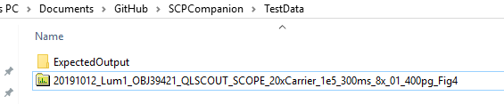
Download data
Using a web browser go to https://www.ebi.ac.uk/pride/
Search for the identifier “PXD016573”
Find and download the file “20191012_Lum1_OBJ39421_QLSCOUT_SCOPE_20xCarrier_1e5_300ms_8x_01_400pg_Fig4”
Move the file to the “SCPCompaion\TestData” folder

Slide 4
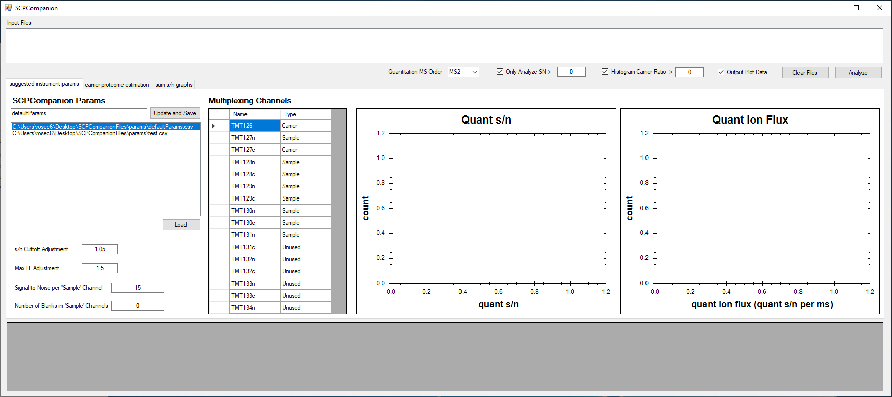
Running the program
Navigate to data folder
Drag the file into the “Input Files” box
Set the experimental design
Click “Analyze”

Slide 5
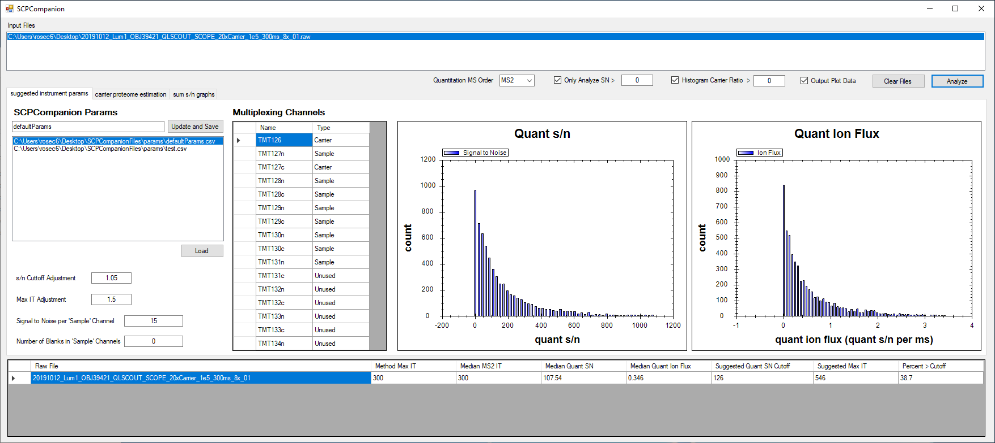
Viewing the results
Data will be analyzed and the data displayed
Quant s/n and Quant ion flux distributions will be displayed
The median Quant s/n and Quant ion flux will be calculated
The suggested s/n cutoff and the suggested max IT will be calculated

Slide 6
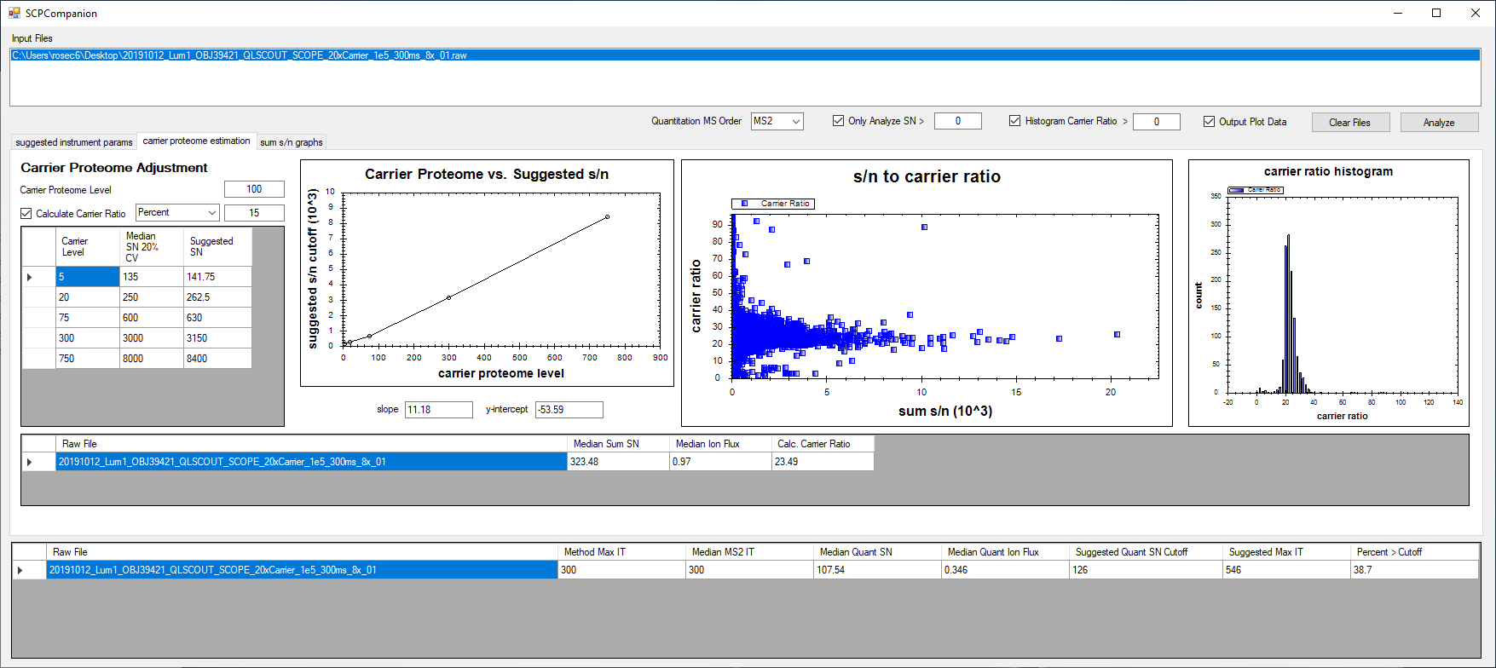
Viewing the results
The estimated carrier level will be calculated
The S/N to Carrier Ratio and Carrier Ratio Histogram will be shown

Slide 7
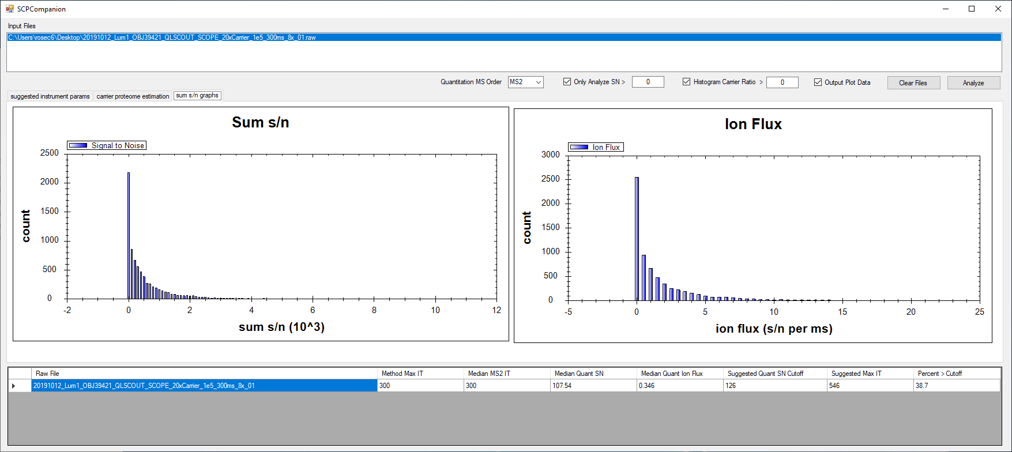
Viewing the results
Sum s/n and ion flux distributions will be displayed

Slide 8
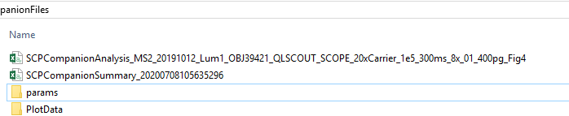
Results deposited into a file on desktop
1
2
1
2

