Slide 1
Using SCPCompanion - single cell proteomics companion-
Chris Rose

Slide 2
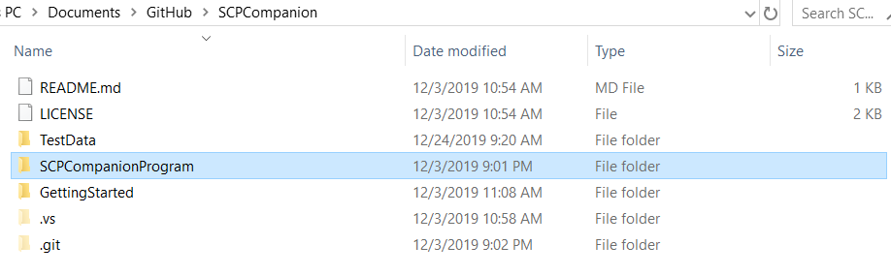
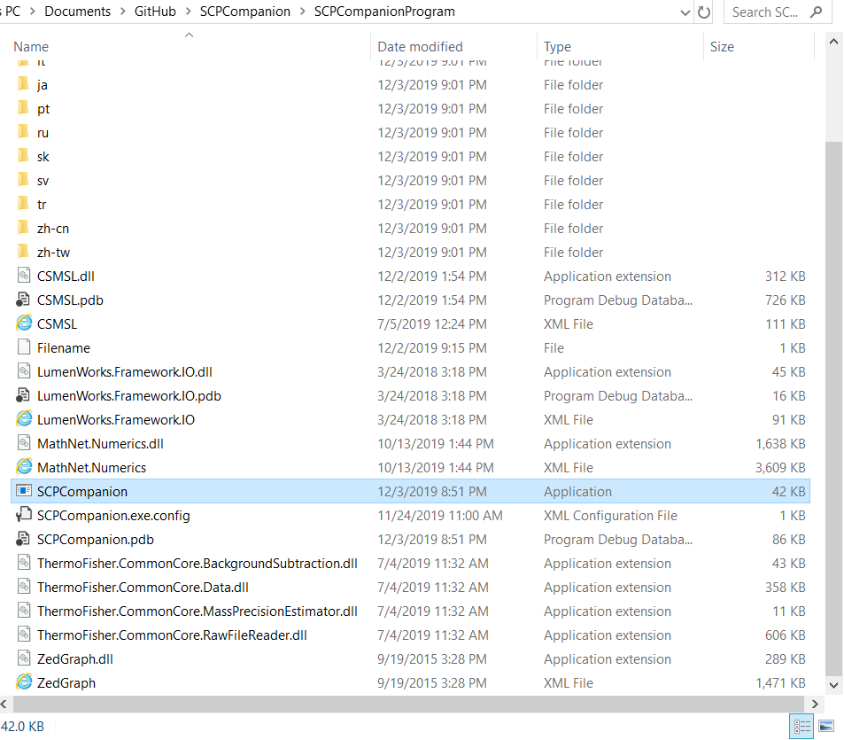
Opening the program
Double click the “SCPCompanionProgram” folder
Find the “SCPCompanion.exe” application and double click

Slide 3
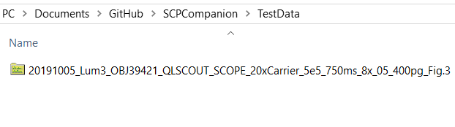
Download data
Using a web browser go to https://www.ebi.ac.uk/pride/
Search for the identifier “PXD016573”
Find and download the file “20191005_Lum3_OBJ39421_QLSCOUT_SCOPE_20xCarrier_5e5_750ms_8x_05_400pg_Fig.3”
Move the file to the “SCPCompaion\TestData” folder

Slide 4
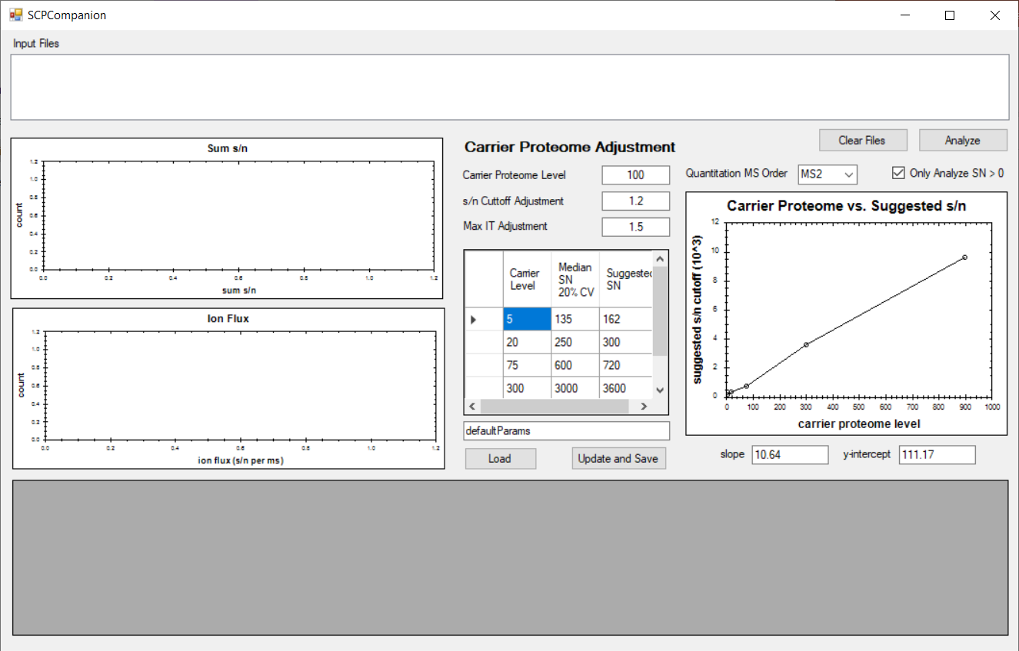

Running the program
Navigate to data folder
Drag the file into the “Input Files” box
Set the correct carrier level
Click “Analyze”

Slide 5
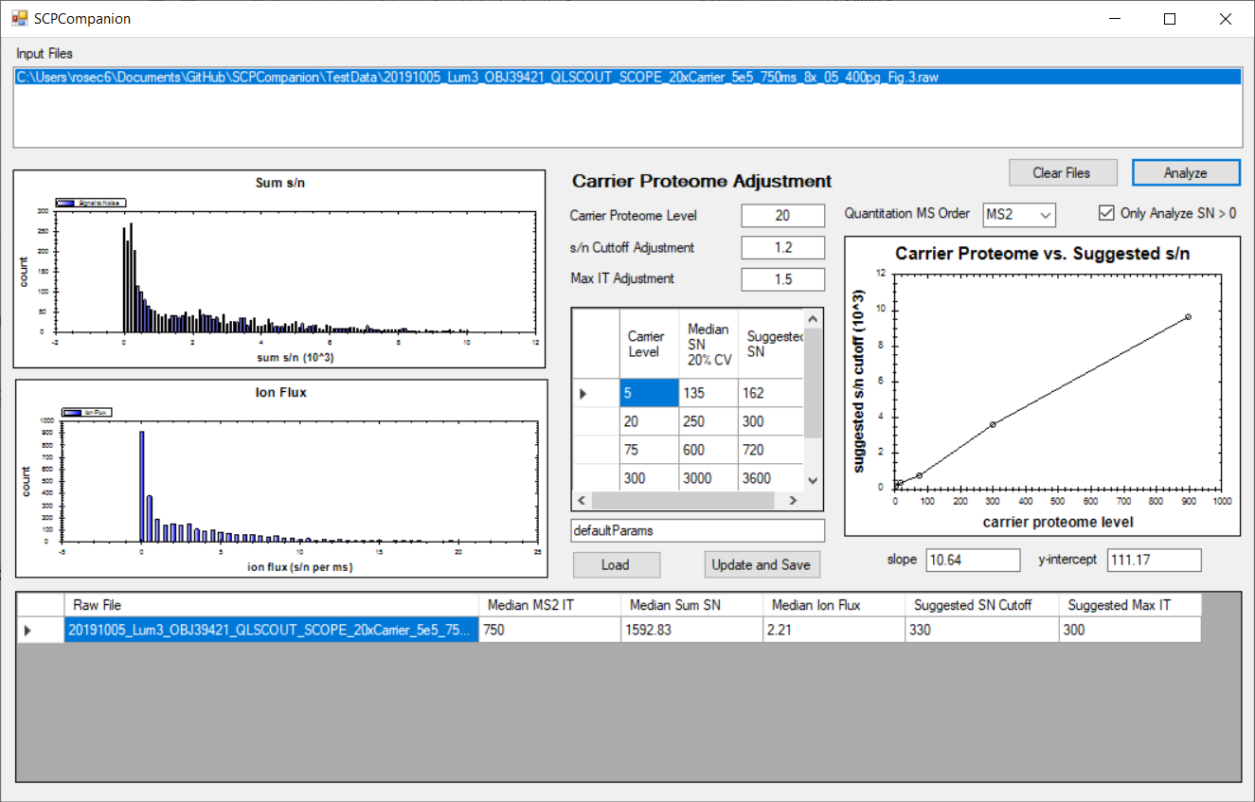
Viewing the results
Data will be analyzed and the data displayed
Sum s/n and ion flux distributions will be displayed
The median Sum s/n and ion flux will be calculated
The suggested s/n cutoff and the suggested max IT will be calculated

Slide 6
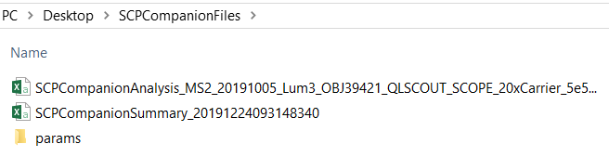
Results deposited into a file on desktop
1
2
1
2

