Slide 1
SHOPP-E
Online Shopping Portal

Slide 2
Team Members
Online Shopping Portal
Shraddha Powar
Bitadru Maitra
Gautam Ruikar
Manohar Jethani

Slide 3
Problem Statement
Online Shopping Portal
Think about e-shopping , think SHOPP-E
The goal is to provide a quick and easy to use interface for all users:
Customers
Visitors
Retailers
Admin

Slide 4

Approach Followed
Online Shopping Portal
Sprint 1
Login Module
Home Module
Product Module
Sprint 2
Cart Module
Admin Module
Retailer Module
Order Module

Slide 5
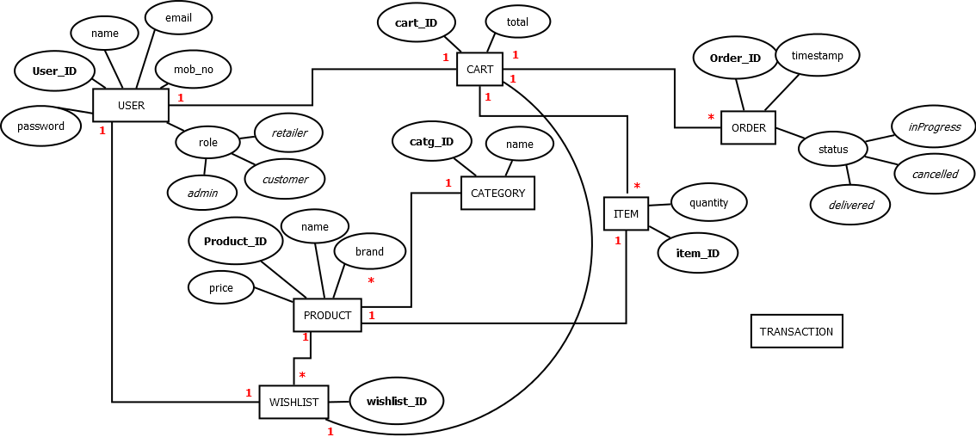

Slide 6
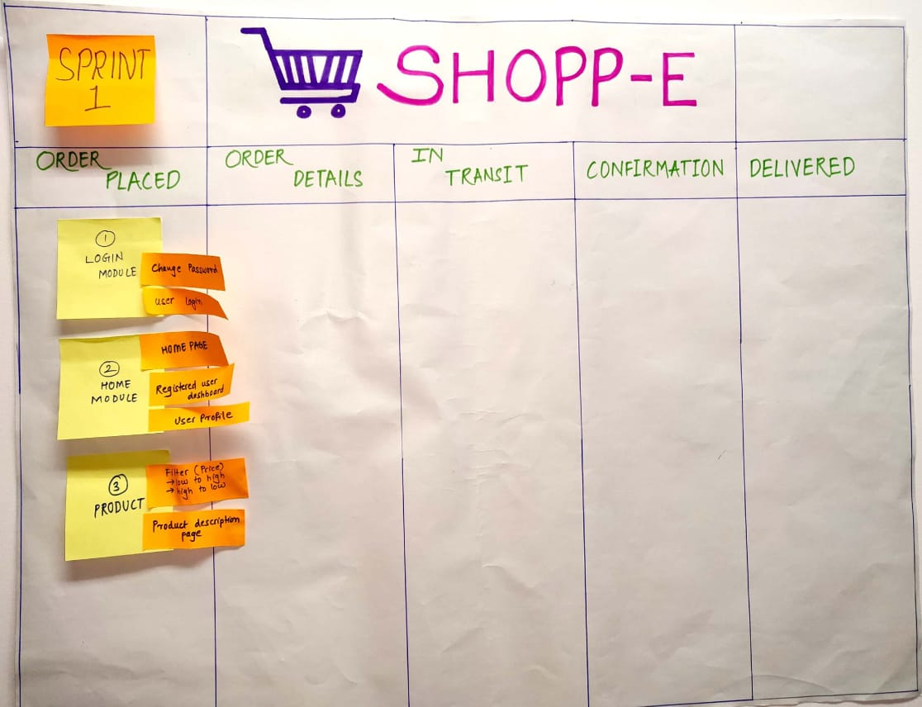
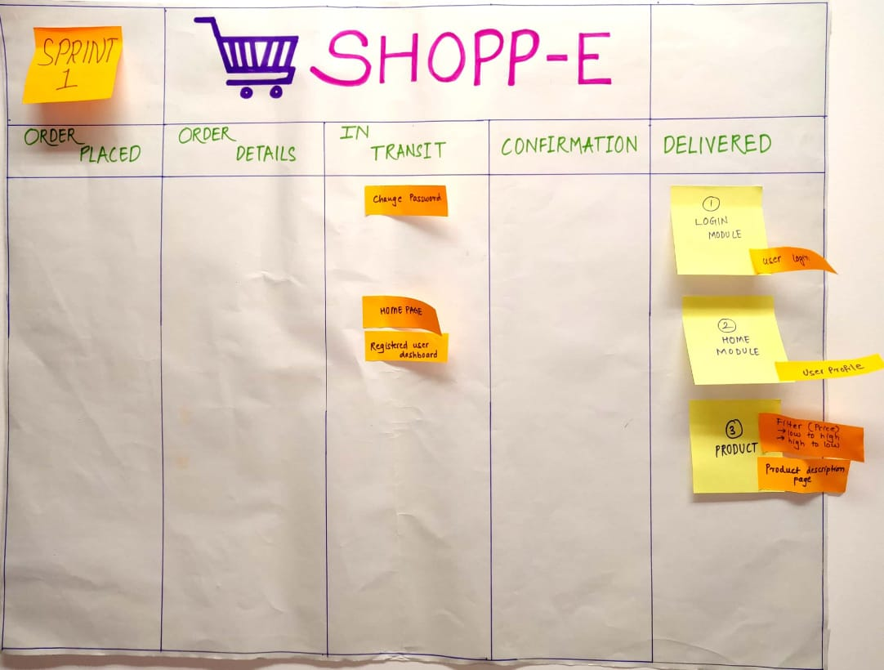
SPRINT-1

Slide 7
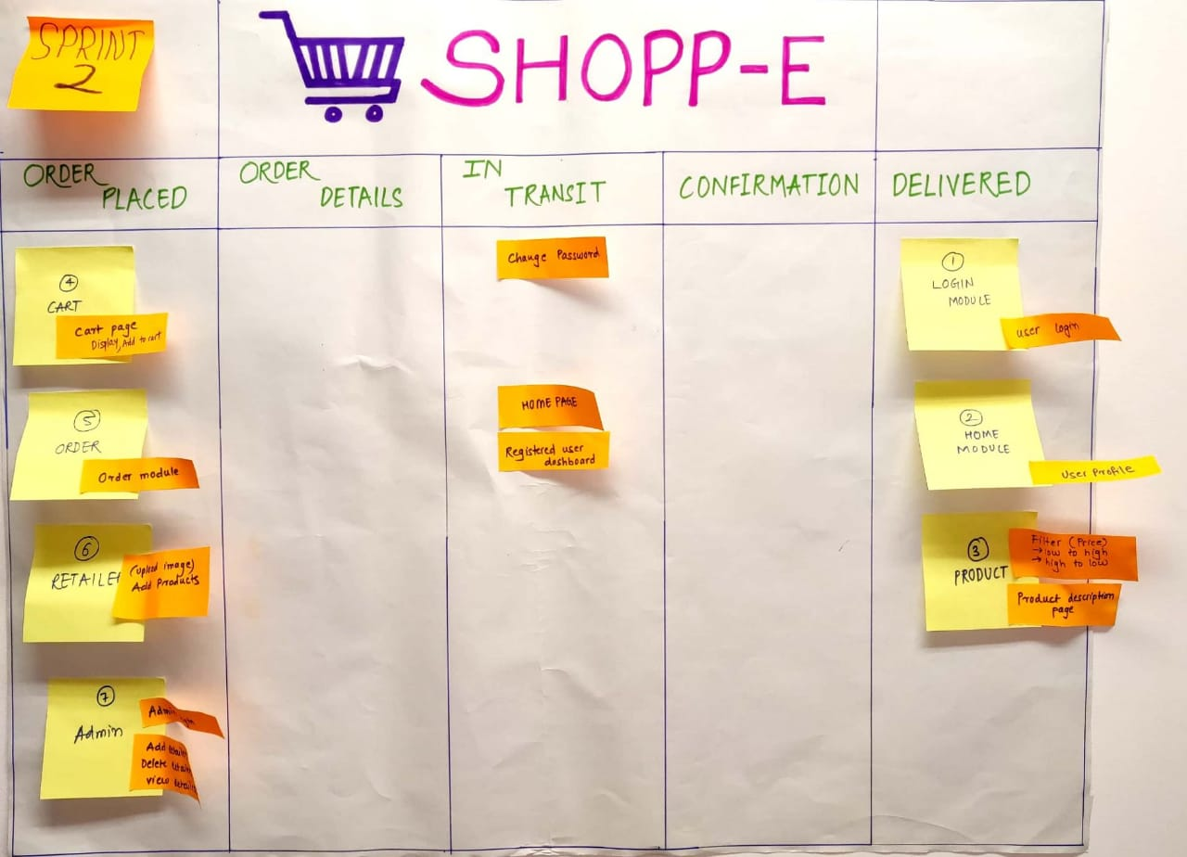
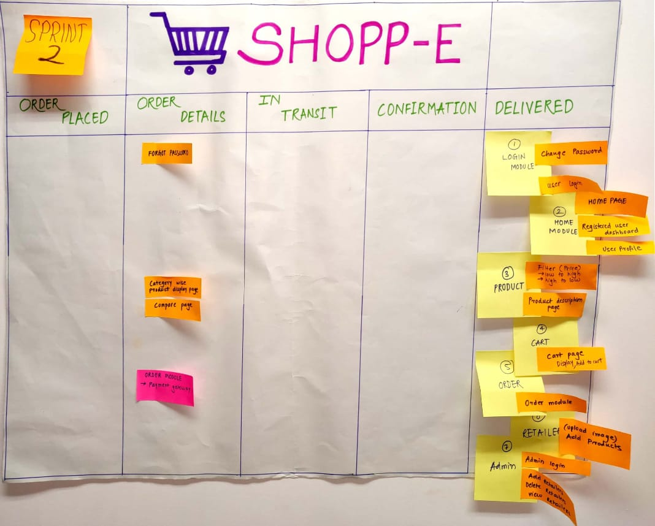
SPRINT-2

Slide 8
Technologies Used
Front End
HTML
CSS
jQuery (using AJAX)
Rest Web Services
BackEnd
Hibernate
Spring MVC

Slide 9
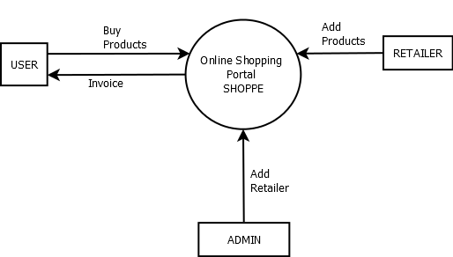
Architecture – Data Flow Diagram(Level 0)
Fig.1. Data Flow Diagram Level 0

Slide 10
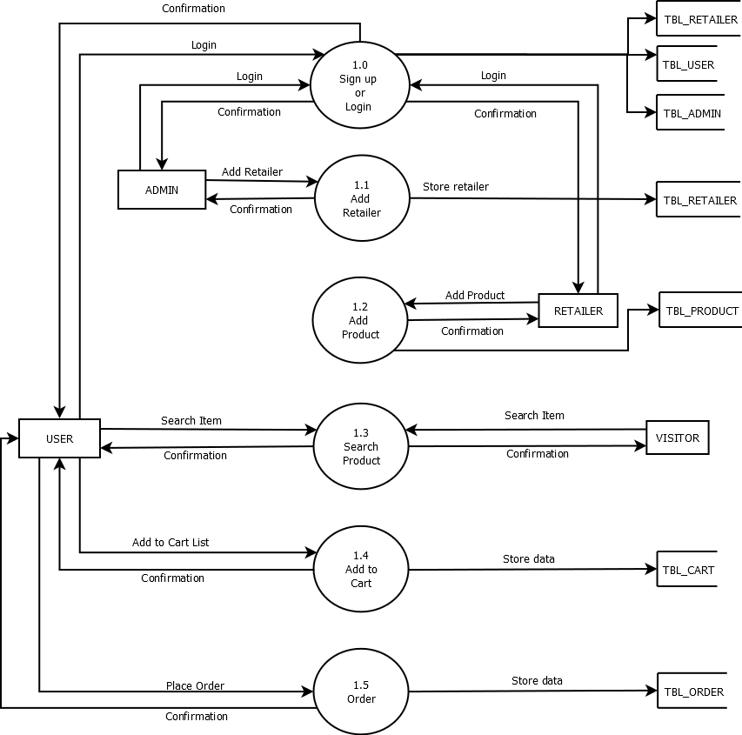
Architecture – Data Flow Diagram(Level 1)
Fig.1. Data Flow Diagram Level 1

Slide 11
SNAPSHOTS

Slide 12
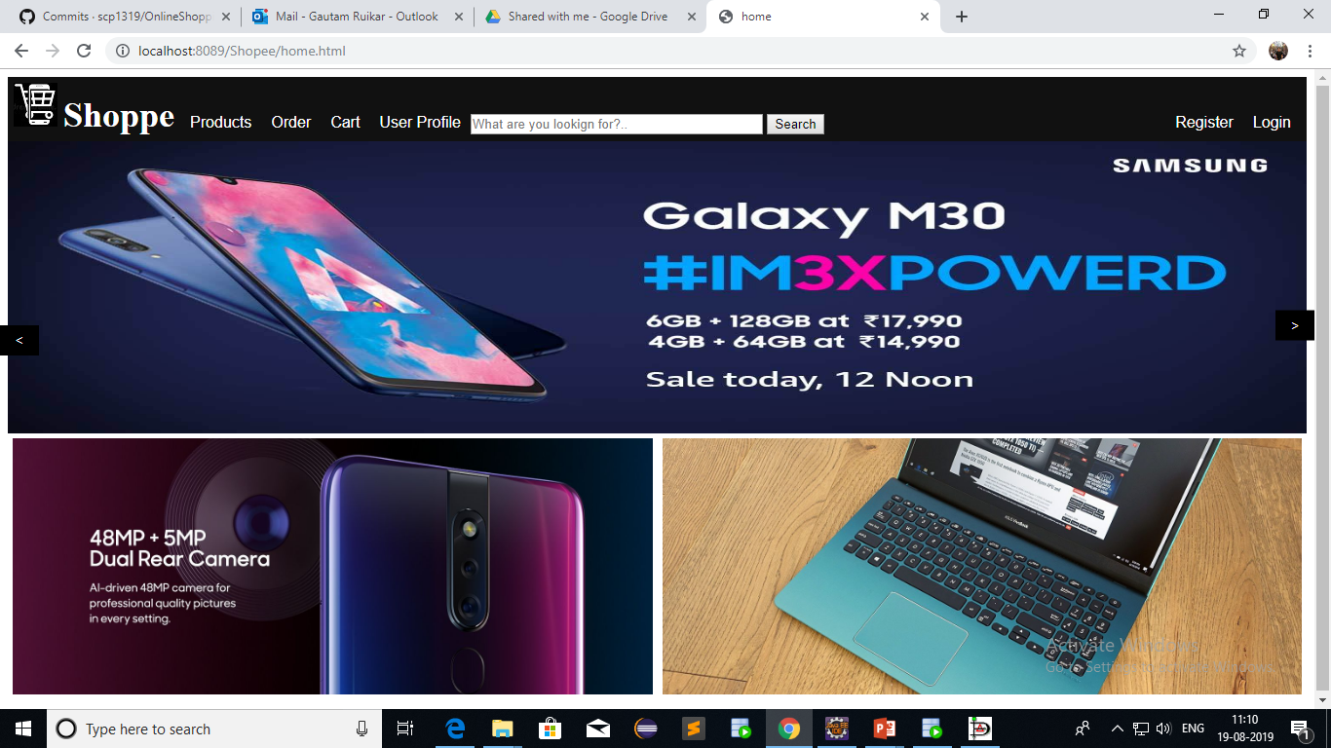
Home Page

Slide 13
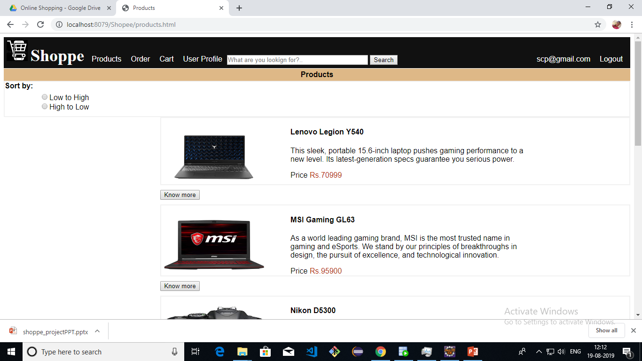
Products

Slide 14
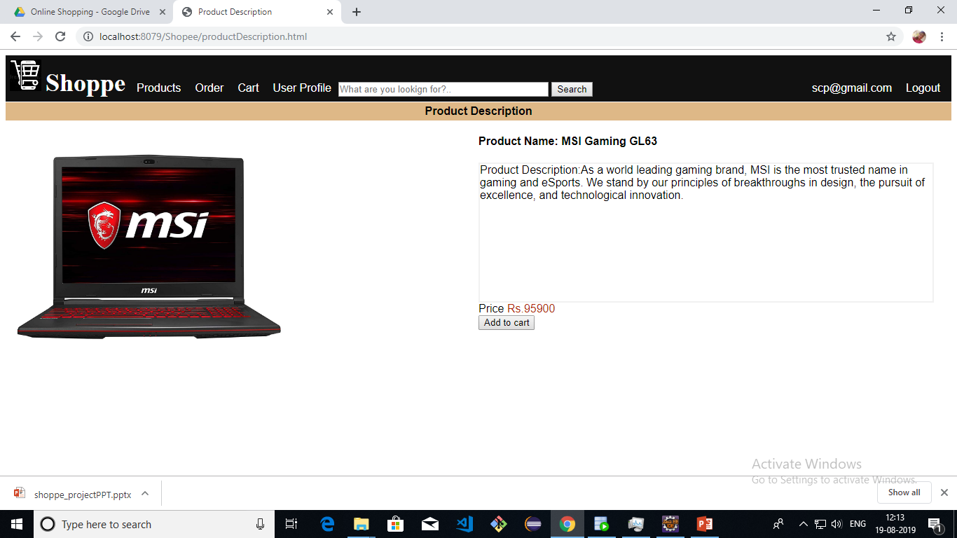
Product description

Slide 15
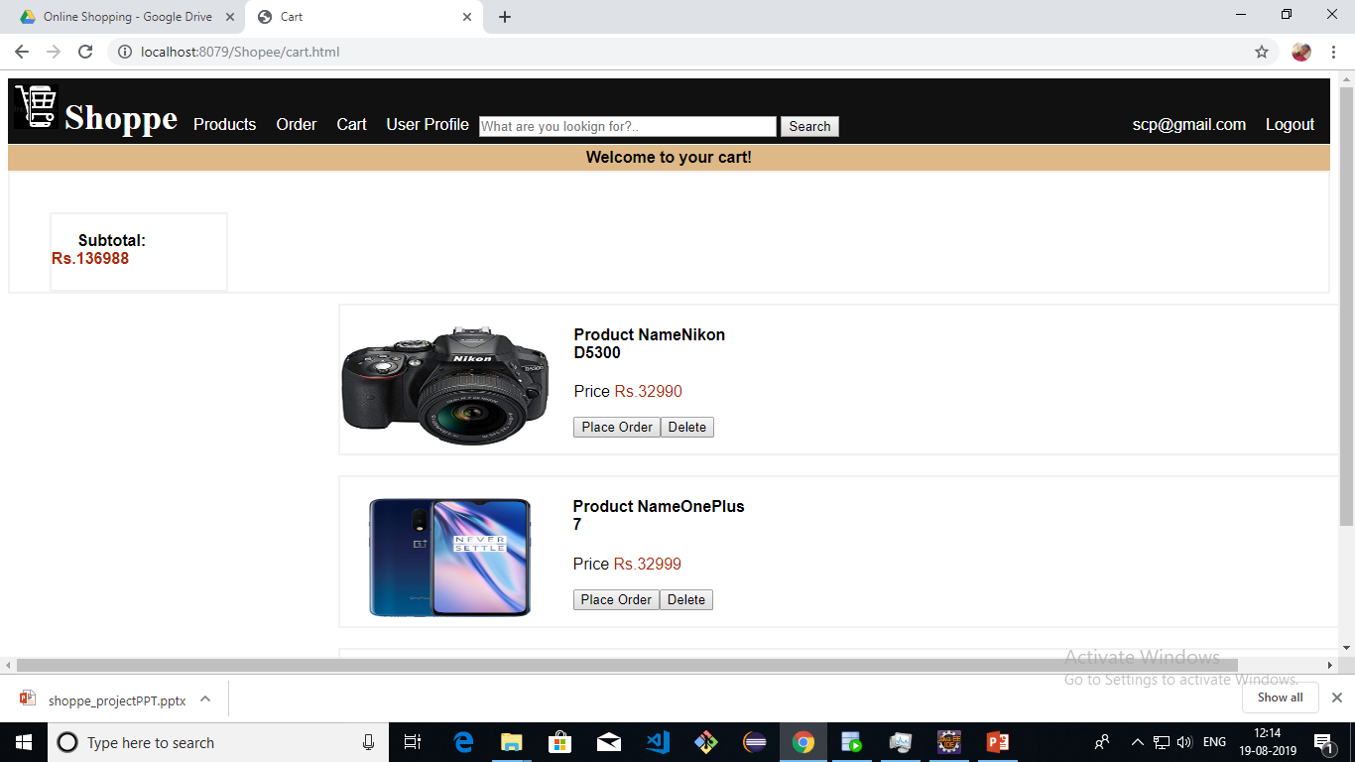
CART

Slide 16
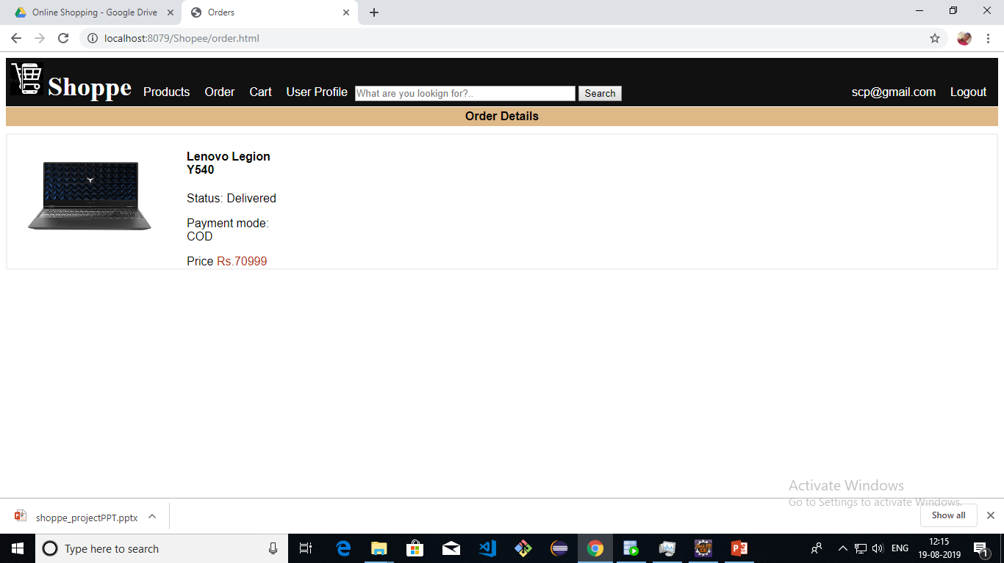
Order Details

Slide 17
DEMO

