Slide 1
Chapter 0-2 JDK & Eclipse Setup

Slide 2
What Is the Java™ Technology?
Java technology is:
A programming language
A development environment
An application environment
A deployment environment
It is similar in syntax to C++.
It is used for developing both applets and applications.

Slide 3
History
Interactive Television Project
James Gosling, Mike Sheridan, and Patrick Naughton initiated the Java language project in June 1991
Oak after an oak tree that stood outside Gosling's office
Later the project went by the name Green and was finally renamed Java

Slide 4
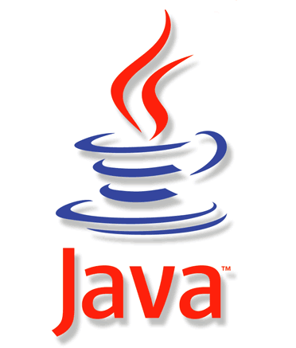
History
Java
Sun Microsystems released the first public implementation as Java 1.0 in 1995
It promised "Write Once, Run Anywhere"
released initially as J2SE 1.2 in December 1998 – 1999
new versions had multiple configurations built for different types of platforms

Slide 5
History
Different types of platforms
JAVA EE
J2EE included technologies and APIs for enterprise applications typically run in server environments
Java ME
J2ME featured APIs optimized for mobile applications
Java SE
The desktop version was renamed J2SE
Notes:
for marketing purposes, Sun renamed new J2 versions as Java EE, Java ME, and Java SE, respectively.

Slide 6
Principles
There were five primary goals in the creation of the Java language
It must be "simple, object-oriented and familiar"
It must be "robust and secure"
It must be "architecture-neutral and portable"
It must execute with "high performance"
It must be "interpreted, threaded, and dynamic"
Notes:
1.简单性：Java丢弃了C++中很少使用的，很难理解的，令人迷惑的特性，操作符重载，多继承，自动的强制类型转换，Java不使用指针，并提供自动的废料收集，使得程序员不必为内存管理而担忧
2.纯粹的面向对象：类，接口和继承
Java语言全面支持动态绑定，而c++语言只对虚函数使用动态绑定。
3.可移植性：
体系结构中立性，Java语言中严格规定了各个基本数据类型的长度；
Java系统本身具有很强的移植性，java编译器用Java实现的，Java的运行环境是用ANSI C实现的。
4.半编译半解释——Java程序在Java平台上先被编译， java编译器对字节码进行解释执行
5.具有多线程处理能力
6.具有较高的安全性
Java通常被用在网络环境中，Java提供了一个安全机制防止恶意代码的攻击
7.健壮性
Java有强类型机制，异常处理，废料的自动收集，Java的安全检查机制
8.可扩展性

Slide 7
Versions
Major release versions of Java
JDK 1.0 (January 21, 1996)
JDK 1.1 (February 19, 1997)
J2SE 1.2 (December 8, 1998)
J2SE 1.3 (May 8, 2000)
J2SE 1.4 (February 6, 2002)
J2SE 5.0 (September 30, 2004)
Java SE 6 (December 11, 2006)
Java SE 7 (July 28, 2011)
Java SE 8 (March 18, 2014)

Slide 8
Java platform
Compiled Language
C
通过编译器一次将源代码翻译成机器可以识别的目标代码，今后运行的都为目标代码

Slide 9

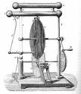
Java platform
Interpreted language
Basic、Perl
代码每次运行时由解释器将其翻译成目标代码，一边解释一边运行
Perl Program
write
You
Perl interpreter runs it – things happen
Notes:
This is usually less efficient…

Slide 10
Java platform
Cross-platform computing environment
programs written for the Java platform must run similarly on any combination of hardware and operating system with adequate runtime support
Semi-Compiled
converts Java source code into Java bytecode
Semi-Interpreted
a "virtual machine" that executes Java bytecode programs

Slide 11
Java platform
Java bytecode
analogous to machine code
be executed by a virtual machine
Machine code
architecture-specific

Slide 12
Java platform
Java Virtual Machine(JVM)
The heart of the Java platform
The JVM has the following major subsystems
Class loader
Execution Engine

Slide 13
Java platform
Class loader
Responsible for loading all classes necessary for the execution of a program into the data areas.
Execution Engine
Responsible for executing instructions from the data areas.
Bytecode interpreter
(JIT)just-in-time compiler

Slide 14
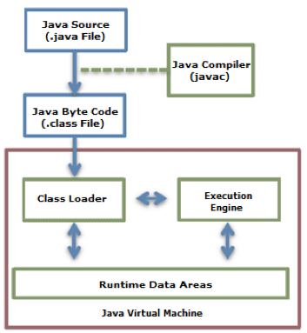
Java platform

Slide 15
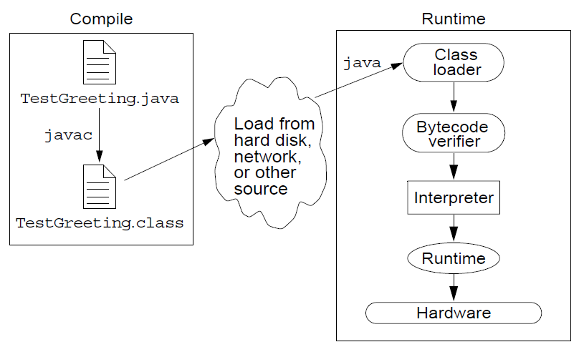
Java platform
The Java application environment performs as follows:

Slide 16
Java platform
Programs written in Java have a reputation for being slower and requiring more memory than those written in C++.
Java was designed to run based on a virtual machine separated from a physical machine for implementing WORA (Write Once Run Anywhere)

Slide 17
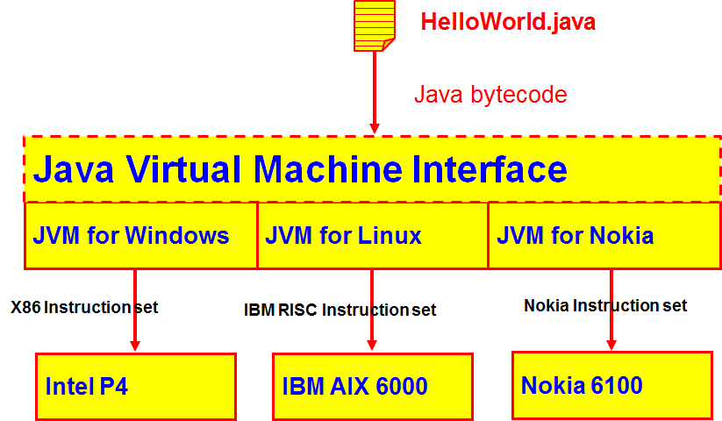
Java platform

Slide 18
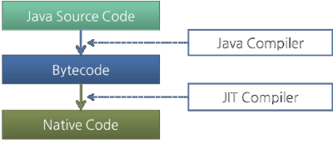
Java platform
JIT(Just In time) Complier
translates the Java bytecode into native processor instructions at run-time and caches the native code in memory during execution

Slide 19
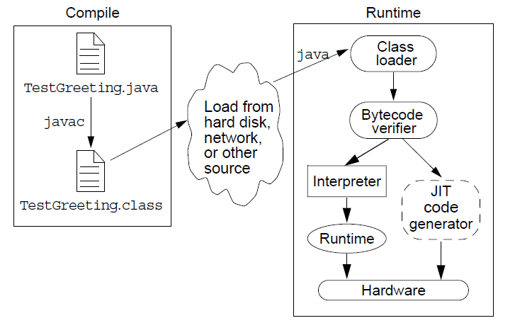
Java platform

Slide 20
JDK
Java Development Kit (JDK)
An implementation of either one of the Java SE, Java EE or Java ME platforms
a complete Java Runtime Environment(JRE)
a collection of programming tools
a wide selection of example programs demonstrating the use of almost all portions of the Java API

Slide 21
JRE
JRE(Java Runtime Environment)
consists of a Java Virtual Machine
all of the class libraries present in the production environment, as well as additional libraries only useful to developers

Slide 22
JDK Download
JDK Download
JDK install
JDK deployment
http://www.oracle.com/technetwork/java/javase/downloads/index-jsp-138363.html
jdk-8u31-windows-x64.exe(window 64 bit)
jdk-8u31-windows-i586.exe(window 32 bit)

Slide 23
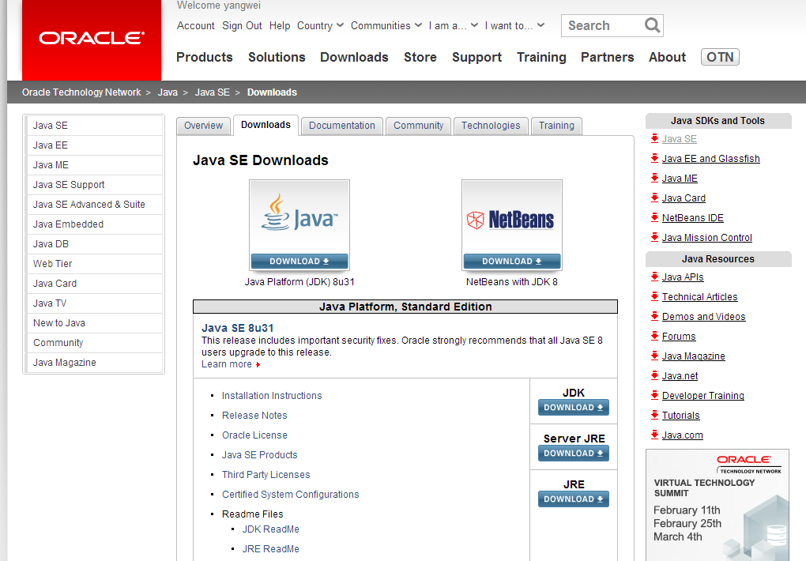
JDK Download

Slide 24
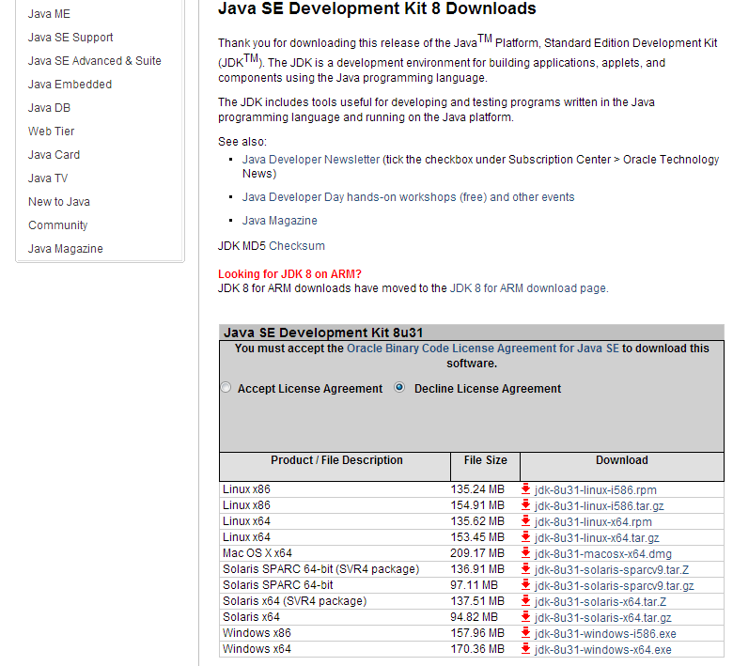

Slide 25
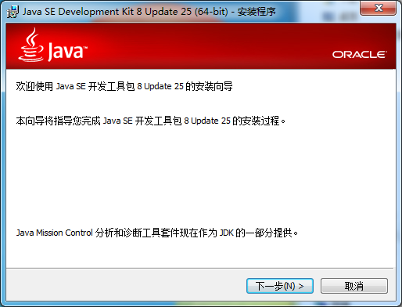
JDK Install
运行JDK安装程序，进入安装过程

Slide 26
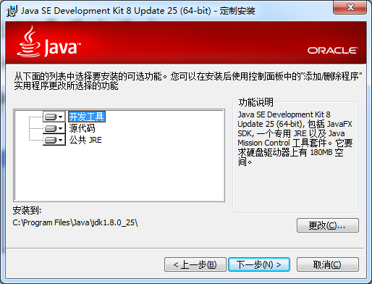
JDK Install
选择安装目录

Slide 27
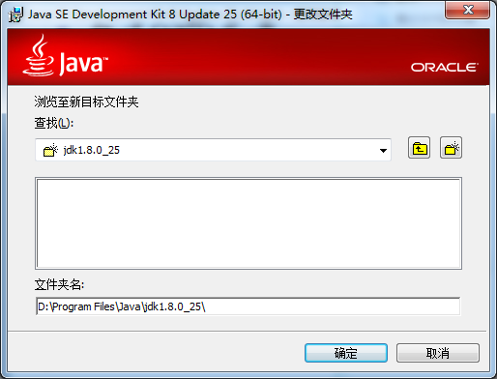
JDK Install
更改安装目录

Slide 28
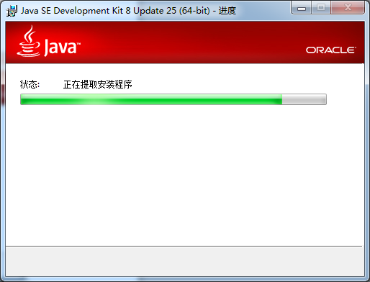
JDK Install
安装进行中

Slide 29
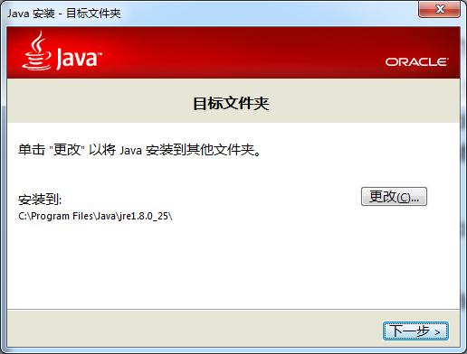
JDK Install
Install JRE

Slide 30
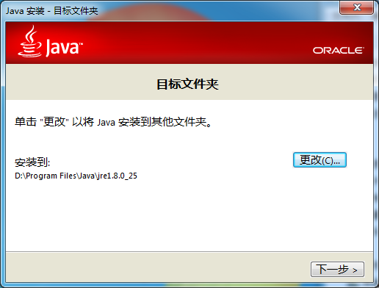
JDK Install
选择安装目录

Slide 31
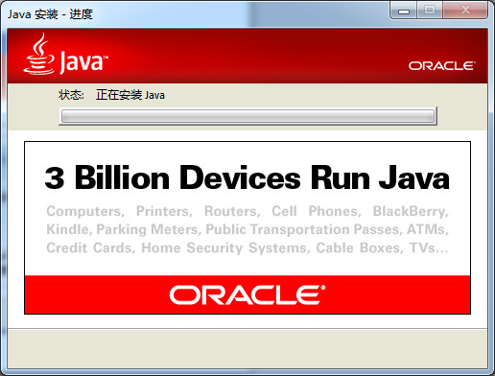
JDK Install
安装进行中

Slide 32
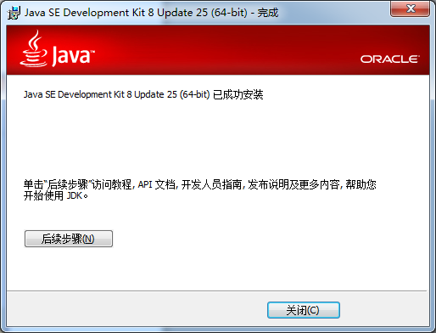
JDK Install
完成安装

Slide 33
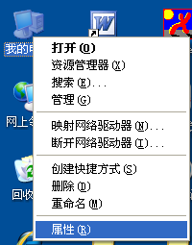
JDK Deployment
右键单击“我的电脑”，选择“属性”

Slide 34
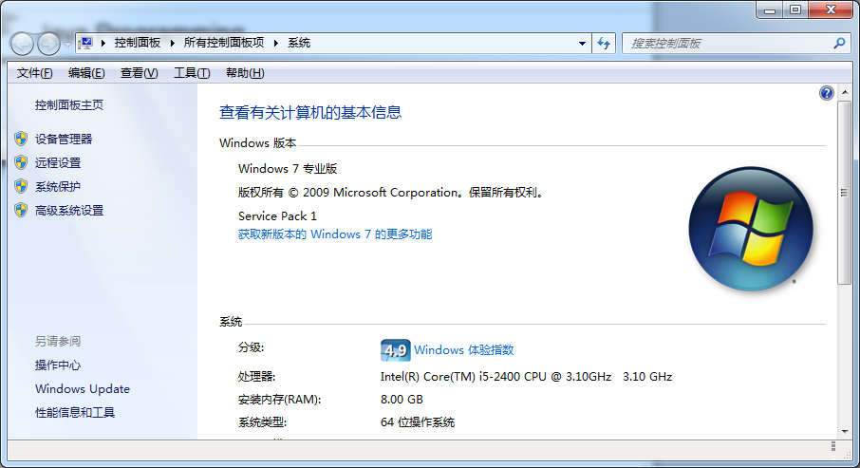

Slide 35
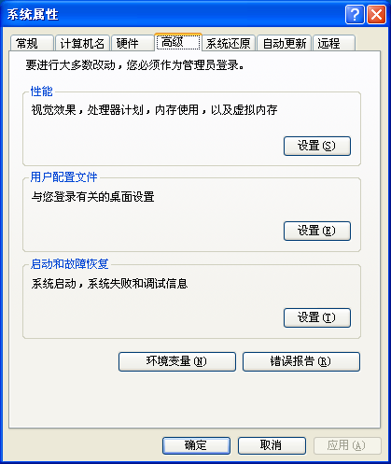
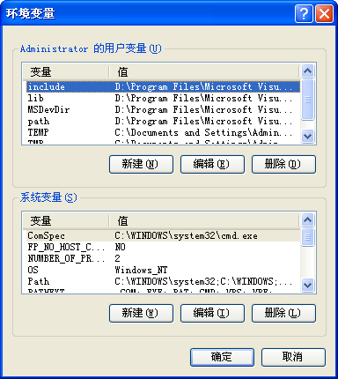
JDK Deployment
选择“高级”选项卡，单击“环境变量”按钮

Slide 36
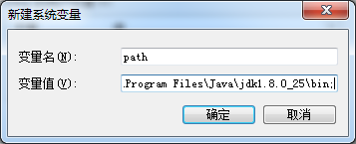
JDK Deployment
新建path变量
.; D:\Program Files\Java\jdk1.8.0_25\bin;
Notes:
D:\Program Files\Java\jdk1.8.0_25\

Slide 37
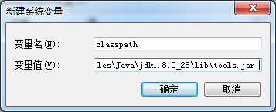
JDK Deployment
新建classpath变量
.; D:\Program Files\Java\jdk1.8.0_25\lib\tools.jar;

Slide 38
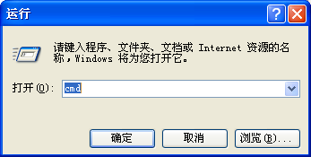
Environment Test
安装后，检测是否安装成功
【开始】→【运行】菜单
在运行框中输入cmd 并按下回车键

Slide 39
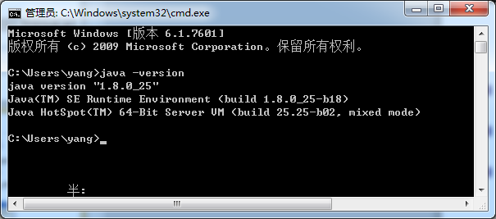
Environment Test
在打开的CMD窗口中输入命令
java -version

Slide 40
Your turn:
After class repeat what I just did and some more.

Slide 41
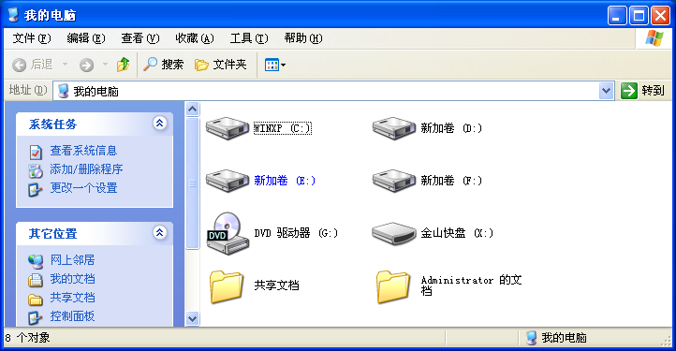
Prepared work

Slide 42
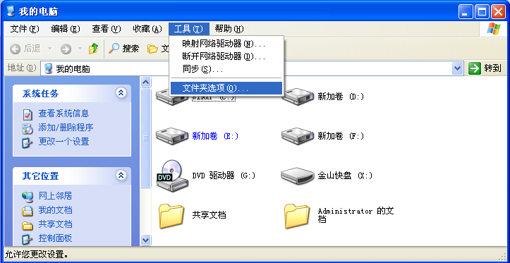
Prepared work

Slide 43
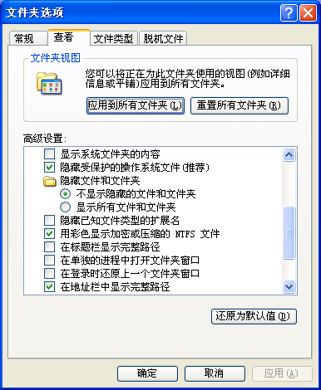
Prepared work

Slide 44
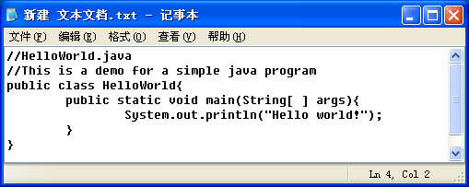
Your first Java program
Create a new file using notepad

Slide 45
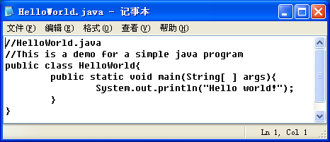
Your first Java program
Choose “file"→"save as"
Rename the file as HelloWorld.java

Slide 46
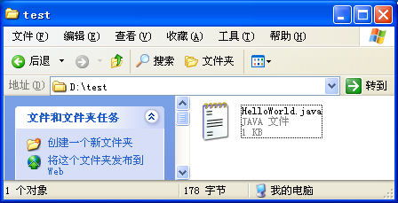
Your first Java program
The file name must be the class name followed by the “.java” file-name extension.

Slide 47
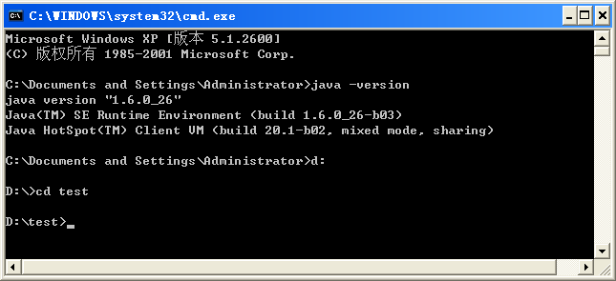
Compile and run Java source file

Slide 48
Compile and run Java source file
Compile Java Source code
打开命令行窗口，进入程序所在目录
输入命令进行编译
javac class_name.java

Slide 49
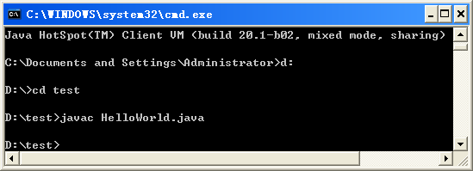
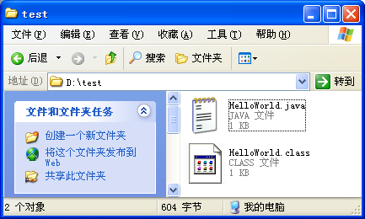
Compile and run Java source file
输入javac命令，将源文件进行编译

Slide 50
Compile and run Java source file
Java解释程序
java解释javac所编译的字节代码
运行(run)
输入命令运行程序
观察程序运行结果
java 类文件名(不带扩展名) 参数

Slide 51
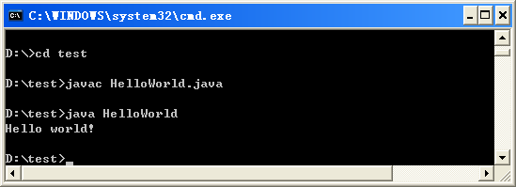
Compile and run Java source file
输入java命令，执行程序

Slide 52
Compile and run Java source file
操作很复杂
编写源代码
编译源代码 →javac命令
运行程序→java命令

Slide 53
Analysis the HelloWorld Program
//HelloWorld.java
//This is a demo for a simple java program
public class HelloWorld{
public static void main(String[ ] args){
System.out.println("Hello world!");
}
}

Slide 54
Declaring Java Technology Classes
//HelloWorld.java
//This is a demo for a simple java program
public class HelloWorld{
public static void main(String[ ] args){
System.out.println("Hello world!");
}
}

Slide 55
Declaring Java Technology Classes
Java is object-oriented
Everything is object.
Objects are the things in a program
Classes are BLUEPRINTS for designing these things
Declaring Java Technology Classes
Java的程序最少必须包含一个您所声明的类
public class <class name>

Slide 56
Declaring Java Technology Classes
a public Class Definition
类名称必须与源文件名称一致
public class name
public class HelloWorld{
……
}
HelloWorld.java

Slide 57
Code block
//HelloWorld.java
//This is a demo for a simple java program
public class HelloWorld{
public static void main(String[ ] args){
System.out.println("Hello world!");
}
}

Slide 58
The main Method
//HelloWorld.java
//This is a demo for a simple java program
public class HelloWorld{
public static void main(String[ ] args){
System.out.println("Hello world!");
}
}

Slide 59
The main Method
The main Method
it's the entry point for your application and will subsequently invoke all the other methods required by your program
public static void main(String[ ] args)
public static void main(String[ ] args){
}

Slide 60
Statements
//HelloWorld.java
//This is a demo for a simple java program
public class HelloWorld{
public static void main(String[ ] args){
System.out.println("Hello world!");
}
}

Slide 61
Statements
standard output
System.out.println();
System.out.print();

Slide 62
String
//HelloWorld.java
//This is a demo for a simple java program
public class HelloWorld{
public static void main(String[ ] args){
System.out.println("Hello world!");
}
}

Slide 63
String
//HelloWorld.java
//This is a demo for a simple java program
public class HelloWorld{
public static void main(String[ ] args){
System.out.println("Hello world!");
}
}
System.out.println("Hello"+" world!");

Slide 64
Source Code Comments
//HelloWorld.java
//This is a demo for a simple java program
public class HelloWorld {
public static void main(String[ ] args){
System.out.println("Hello world!");
}
}

Slide 65
statement
statement
以分号(;)结束的一行或多行代码
一条语句可以实现一个特定功能
System.out.println("Hello World!");
System.out.print ("Hello World!\n");

Slide 66
Eclipse World
Eclipse
为高度集成的工具开发提供一个全功能的、具有商业品质的工业平台
Eclipse项目
Eclispe工具开发
Eclispe技术项目

Slide 67
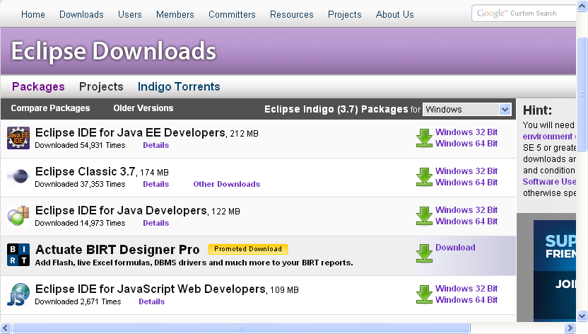
Download and install Eclipse
Download Eclipse
http://www.eclipse.org/downloads/

Slide 68
Download and install Eclipse
Download Compression package
Eclipse绿色的
无须执行安装程序，解压压缩文件就可以用
不过一定要先安装JDK
eclipse-java-indigo-win32.zip

Slide 69
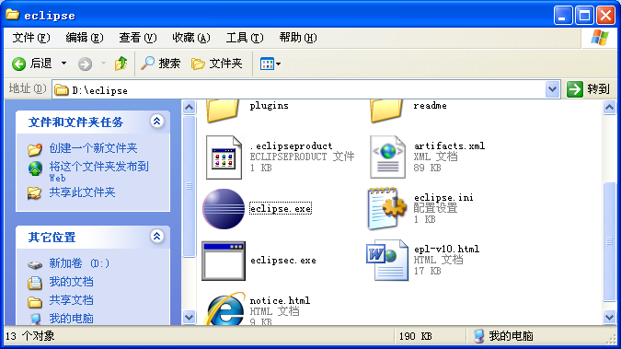
Run Eclipse

Slide 70

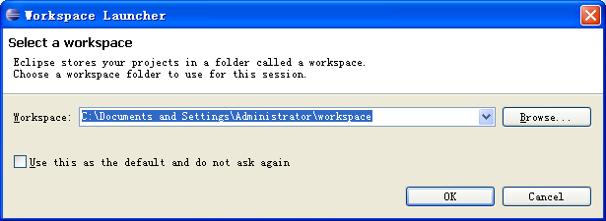
Run Eclipse

Slide 71
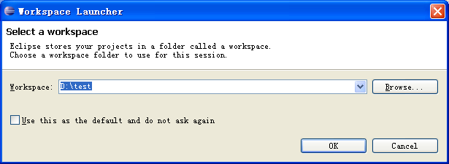
Run Eclipse
Select a workspace

Slide 72
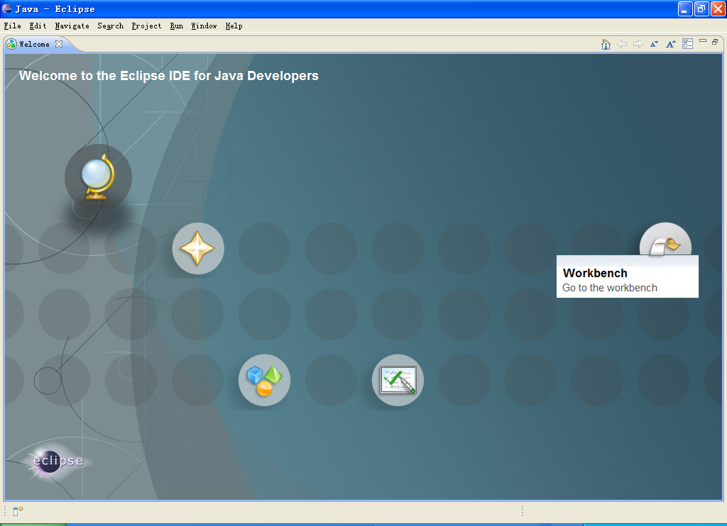
Run Eclipse

Slide 73
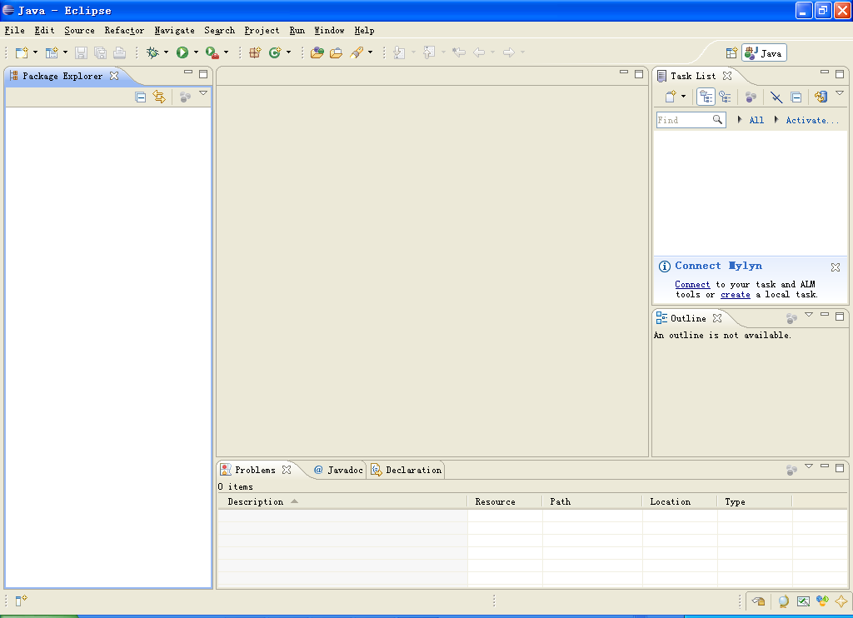
Run Eclipse

Slide 74
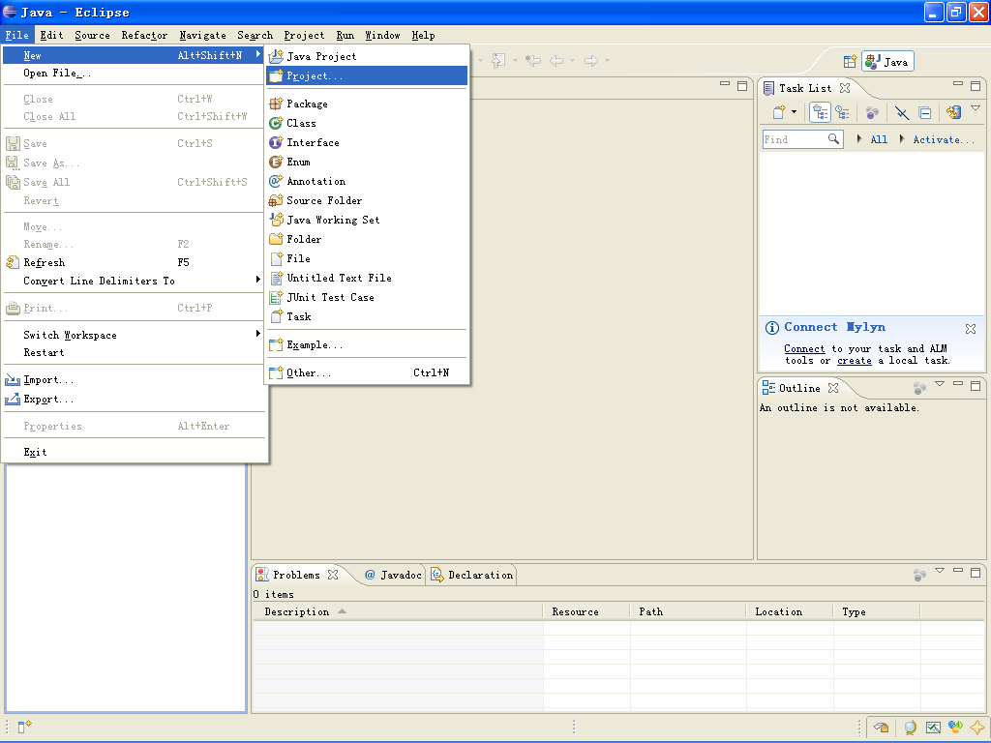
Run Eclipse
Create a new Project
单击"File"→"New" →"Project"

Slide 75
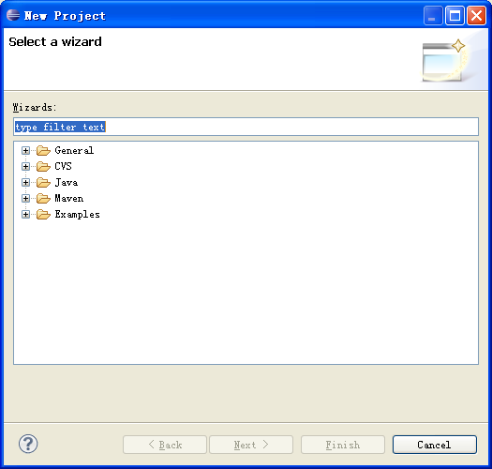
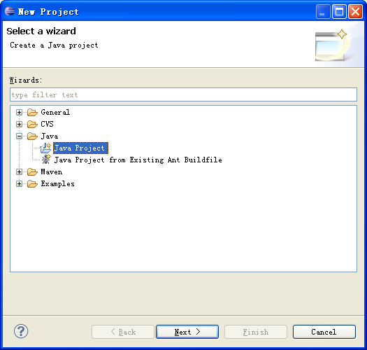
Run Eclipse

Slide 76
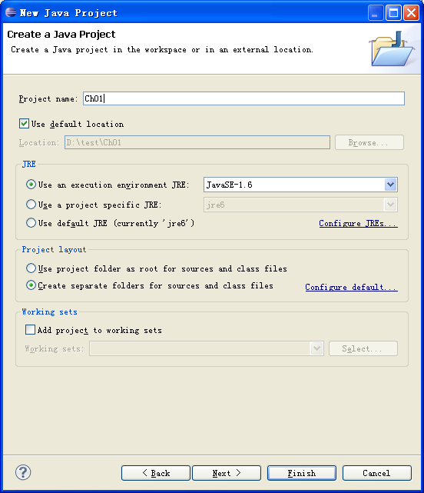
Run Eclipse
在“Project name”中输入项目名称，单击Finish

Slide 77
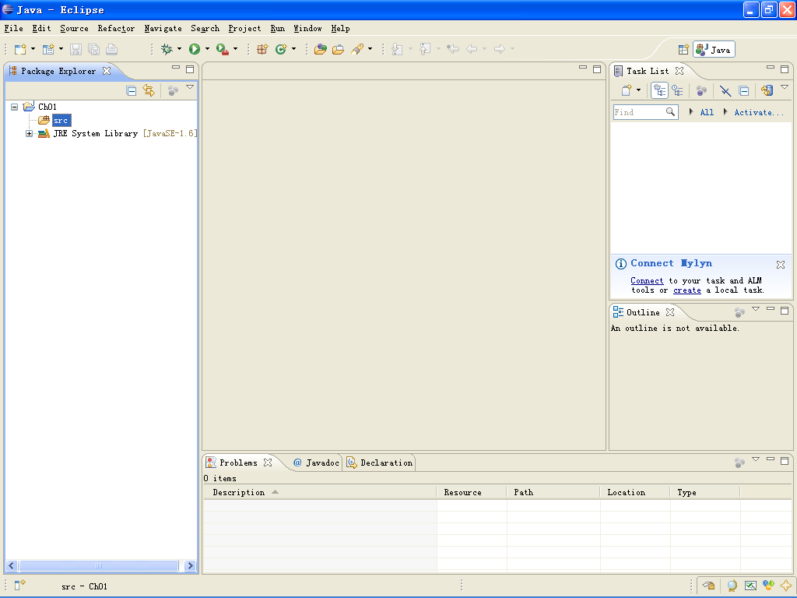
Run Eclipse

Slide 78
Run Eclipse
创建Java源文件
类
在Eclipse的左侧双击”ch01”项目，选择“src”选项，单击鼠标右键，在弹出的快捷菜单中选择“New”→”Class”命令

Slide 79
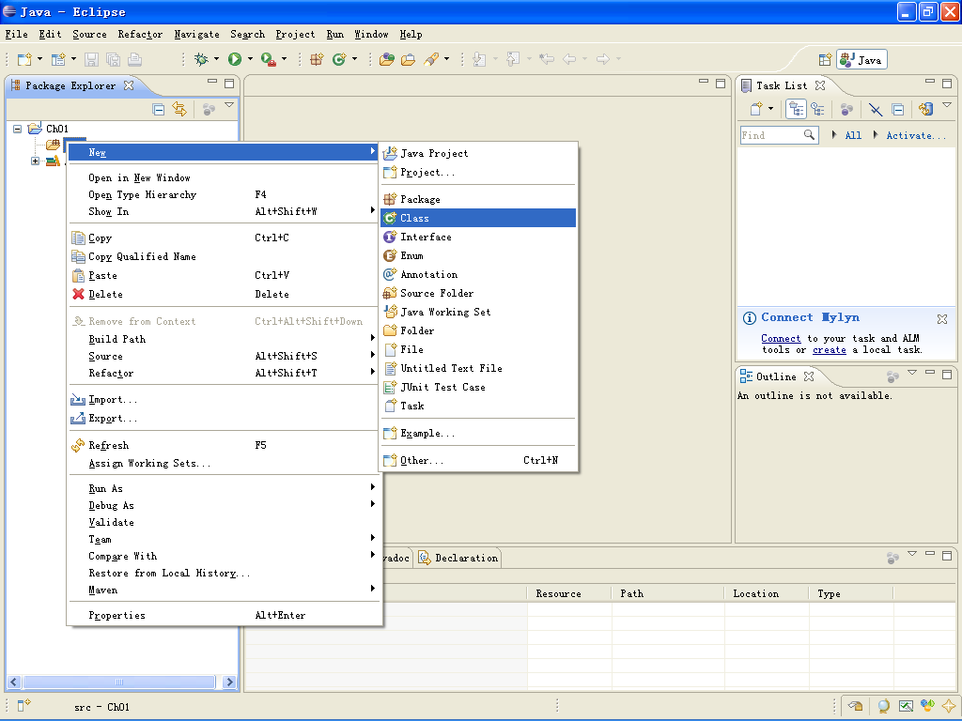
Run Eclipse

Slide 80
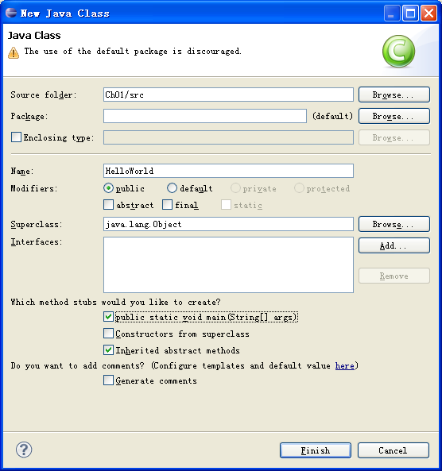
public class name

Slide 81
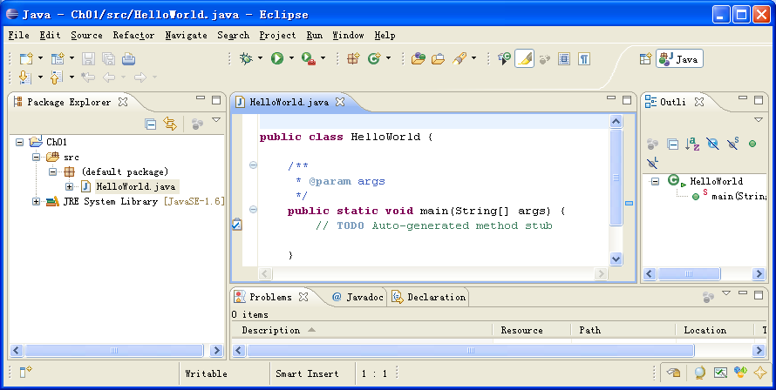
write HelloWorld program

Slide 82
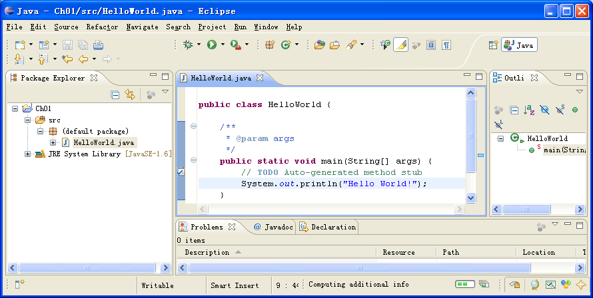
write HelloWorld program

Slide 83

Compile and run Java source file
Compile
Save the program
Run
Press the run button
ctrl+F11

Slide 84

Compile and run

Slide 85
The aims of this session
Write and run your first programs!
Use an integrated development environment (IDE) called Eclipse to help you do this…
I will talk a bit and then you have a go…
Demonstrators are here to help…
Work in pairs to help each other…

