Slide 1
Chapter 5 Class Design

Slide 2

Contents
Identifying Appropriate Classes
Determining Associations Between Classes
Identifying Attributes
Identifying Operations
Library System Class Diagram
Student Registry System Class Diagram
Object-Oriented Programming and Design

Slide 3
5.1 Identifying Appropriate Classes

Slide 4

Identifying Classes
List all the nouns in the specification.
Prune the list:
  Convert plural nouns to their singular form.
  Eliminate nouns that represent objects. Replace them with generic nouns. For example, use "client" instead of "John Smith."
  Eliminate vague nouns.
  Eliminate nouns that are class attributes.
Group the synonyms and then choose the best name for the class from the group. For example, "user" and "client" are synonyms. In a bank system, the best name is "client" because the system may have two types of users: the clients and the bank's employees.
Select the classes that are relevant to the system.
Object-Oriented Programming and Design

Slide 5
Identifying Classes
Look for more relevant classes. Search the application domain for:
  Physical things. For example, "person," "book," and "computer."
  Roles played by persons or organizations. For example, "employer" and "supplier."
  Objects that represents an occurrence or event. For example, "system crash," "flight," and "mouse click."
  Objects that represent a relationship between other objects in the model. For example, "purchase" (related to "buyer," "seller," and "merchandise") and "marriage" (related to "man" and "woman").
  People who carry out some function. For example, "student" and "clerk."
  Places. For example, "library," "classroom," and "bank."
  Collections of objects, people, resources, or facilities. For example, "catalog" and "group."
  Concepts or ideas that are intangible. For example, "money" and "bank account."
Object-Oriented Programming and Design

Slide 6
Identifying Classes
A client is a person that has one or more accounts.
Object-Oriented Programming and Design

Slide 7
Identifying Classes
Client
Person
Account
Object-Oriented Programming and Design

Slide 8
5.2 Determining Associations Between Classes

Slide 9
Determining Associations Between Classes
Create an n x n table where n is the number of classes. Label the rows and columns with the class names.
 | Client | Person | Account
Client
Person
Account
Object-Oriented Programming and Design

Slide 10
Determining Associations Between Classes
To identify the inheritance (specialization/generalization) relationships, for each cell in the row A and column B, ask the following questions:
  Is an instance of class A an instance of class B?
  Is an instance of class B an instance of class A?
If the answer to both questions is yes, then the class names might be synonyms.
If the answer to the first question is yes, then class A is a subclass(specialization) of class B. Mark the cell in the row A and column B with an S.
If the answer to the second question is yes, then class A is a superclass(generalization) of class B. Mark the cell in the row A and column B with a G.
Object-Oriented Programming and Design

Slide 11
Determining “is a”
 | Client | Person | Account
Client |  | S
Person | G
Account
Object-Oriented Programming and Design

Slide 12
Determining “has a”
If there is no association between class A and class B, mark the cell with an X.
If there are one or more associations between class A and class B, then insert the association attributes. For example, "pilot," "wife," "ownedAccounts," and "clients."
 | Client | Person | Account
Client | X | S | ownAccount
Person | G | X | X
Account | X | X | X
Object-Oriented Programming and Design

Slide 13
5.3 Identifying Attributes

Slide 14


Identifying Attributes
Attributes are the data that an object is responsible for knowing and maintaining. The steps for identifying the class attributes are the following:
  Look for adjectives and possessive phrases such as "the X of Y" and "Y's X" in the system specification. For example, "number of the account" and "client's name."
  Use your knowledge of the application domain to define the set of attributes needed for the system being developed.
Object-Oriented Programming and Design

Slide 15
Identifying Attributes
Person：name
Client：
Account：numOfAccout，password，balance
Object-Oriented Programming and Design

Slide 16
5.4 Identifying Methods

Slide 17
Identifying Methods
To identify behaviors, look for verbs. For example, the statement
  "the client deposits money into the account"
indicates that class Account should define a method deposit.
Use your knowledge of the application domain to define the set of methods needed for the system being developed. Look in the application domain for actions that:
  Create and initialize new instances.
  Set and get values of attributes.
  Load to and save from persistent storage.
  Destroy instances.
  Perform calculations using an object's values.
  Output or display a result.
If there are any collections held by the object, include the methods needed to add, remove, and access elements of these collections.
Object-Oriented Programming and Design

Slide 18
Identifying Methods
Person：
  getName()
  setName()
Client：
  getAccount()
  setAccount()
  addAccount()
  deleteAccount()
  findAccount()
Account：
  deposit()
  withdraw()
  getBalance()
Object-Oriented Programming and Design

Slide 19
5.5 Library System Class Diagram

Slide 20
Modeling the Library System
Specification of the Library System
Identifying Classes
Identifying Relationships
Identifying Attributes
Identifying Methods
Modeling Using UML
Object-Oriented Programming and Design

Slide 21
Specification of the Library System
The library system tracks the items checked out by borrowers.
The system contains a catalog of the items owned by the library. There are two kinds of catalog items: books and recordings. All catalog items are identified by a unique code. (If the library owns several copies of the same book or recording, each copy has a unique code.) The information for each item includes title, year, and availability. An item is available if it is not checked out.
In addition:
  The information for a book includes the author and number of pages.
  The information for a recording includes the performer and format (CD or tape).
The system contains a database of the borrowers. Each borrower has a unique identification code in addition to a name. The system maintains a list, for each borrower, of the catalog items checked out.
Object-Oriented Programming and Design

Slide 22
Specification of the Library System
In the library system, the user should be able to:
  Display the catalog by listing the code, title, and availability of each item.
  Display a catalog item.
  Display the borrowers by listing the identification code and name of each borrower.
  Display the catalog items checked out by a borrower.
  Check out a catalog item by adding the item to borrower's list of borrowed items.
  Check in a catalog item by removing the item from borrower's list of borrowed items.
Object-Oriented Programming and Design

Slide 23
List the nouns in the system specification
  library system
  Book
  CD
  Items
  Recording
  Tape
  Borrowers
  Copy
  Database
  System
  Information
  Borrower
  Catalog
  Item
  identification code
  Library
  Title
  Name
  Kinds
  Year
  List
  Catalog Items
  Availability
  User
  Books
  Author
  (borrower) code
  audio items
  number of pages
  list of borrowed items
  (item) code
  Performer
  Copies
  format
Object-Oriented Programming and Design

Slide 24
Prune the list by eliminating the following nouns
(item) code, title, year,availability | These nouns are attributes of a catalog item.
author, number of pages | These nouns are attributes of a book.
performer, format | These nouns are attributes of an audio item.
CD, tape | These nouns are values for the attribute format.
name, identification code, (borrower) code | These nouns are attributes of a borrower.
user | This noun is an element outside the library system.
information | This noun is a generic term for the class attributes.
kinds | This noun is not relevant to the system.
Object-Oriented Programming and Design

Slide 25
Group the synonyms
CatalogItem | items, catalog items, copies, copy, item
LibrarySystem | library system, system, library
Borrower | borrowers, borrower
Book | books, book
Recording | recordings, recording
BorrowerItems | list, list of borrowed items
Object-Oriented Programming and Design

Slide 26
Select the classes that are relevant to the system
LibrarySystem
Catalog
CatalogItem
Book
Recording
Borrower
BorrowedItems
BorrowerDatabase
Object-Oriented Programming and Design

Slide 27
Identifying Relationships
 | LibrarySystem | Catalog | CatalogItem | Book | Recording | Borrower | BorrowerItems | BorrowerDatabase
LibrarySystem
Catalog
CatalogItem
Book
Recording
Borrower
BorrowerItems
BorrowerDatabase
Object-Oriented Programming and Design

Slide 28
Identifying Relationships
 | LibrarySystem | Catalog | CatalogItem | Book | Recording | Borrower | BorrowerItems | BorrowerDatabase
LibrarySystem
Catalog
CatalogItem |  |  |  | G
Book
Recording
Borrower
BorrowerItems
BorrowerDatabase
Object-Oriented Programming and Design

Slide 29
Identifying Relationships
 | LibrarySystem | Catalog | CatalogItem | Book | Recording | Borrower | BorrowerItems | BorrowerDatabase
LibrarySystem
Catalog
CatalogItem |  |  |  | G | G
Book
Recording
Borrower
BorrowerItems
BorrowerDatabase
Object-Oriented Programming and Design

Slide 30
Identifying Relationships
 | LibrarySystem | Catalog | CatalogItem | Book | Recording | Borrower | BorrowerItems | BorrowerDatabase
LibrarySystem
Catalog
CatalogItem |  |  |  | G | G
Book |  |  | S
Recording
Borrower
BorrowerItems
BorrowerDatabase
Object-Oriented Programming and Design

Slide 31
Identifying Relationships
 | LibrarySystem | Catalog | CatalogItem | Book | Recording | Borrower | BorrowerItems | BorrowerDatabase
LibrarySystem
Catalog
CatalogItem |  |  |  | G | G
Book |  |  | S
Recording |  |  | S
Borrower
BorrowerItems
BorrowerDatabase
Object-Oriented Programming and Design

Slide 32
Identifying Relationships
 | LibrarySystem | Catalog | CatalogItem | Book | Recording | Borrower | BorrowerItems | BorrowerDatabase
LibrarySystem |  | catalog
Catalog
CatalogItem |  |  |  | G | G
Book |  |  | S
Recording |  |  | S
Borrower
BorrowerItems
BorrowerDatabase
Object-Oriented Programming and Design

Slide 33
Identifying Relationships
 | LibrarySystem | Catalog | CatalogItem | Book | Recording | Borrower | BorrowerItems | BorrowerDatabase
LibrarySystem |  | catalog |  |  |  |  |  | borrowerDB
Catalog
CatalogItem |  |  |  | G | G
Book |  |  | S
Recording |  |  | S
Borrower
BorrowerItems
BorrowerDatabase
Object-Oriented Programming and Design

Slide 34
Identifying Relationships
 | LibrarySystem | Catalog | CatalogItem | Book | Recording | Borrower | BorrowerItems | BorrowerDatabase
LibrarySystem |  | catalog |  |  |  |  |  | borrowerDB
Catalog |  |  | item
CatalogItem |  |  |  | G | G
Book |  |  | S
Recording |  |  | S
Borrower
BorrowerItems
BorrowerDatabase
Object-Oriented Programming and Design

Slide 35
Identifying Relationships
 | LibrarySystem | Catalog | CatalogItem | Book | Recording | Borrower | BorrowerItems | BorrowerDatabase
LibrarySystem |  | catalog |  |  |  |  |  | borrowerDB
Catalog |  |  | item
CatalogItem |  |  |  | G | G
Book |  |  | S
Recording |  |  | S
Borrower |  |  |  |  |  |  | borrowerItem
BorrowerItems
BorrowerDatabase
Object-Oriented Programming and Design

Slide 36
Identifying Relationships
 | LibrarySystem | Catalog | CatalogItem | Book | Recording | Borrower | BorrowerItems | BorrowerDatabase
LibrarySystem |  | catalog |  |  |  |  |  | borrowerDB
Catalog |  |  | item
CatalogItem |  |  |  | G | G
Book |  |  | S
Recording |  |  | S
Borrower |  |  |  |  |  |  | borrowerItem
BorrowerItems |  |  | items
BorrowerDatabase
Object-Oriented Programming and Design

Slide 37
Identifying Relationships
 | LibrarySystem | Catalog | CatalogItem | Book | Recording | Borrower | BorrowerItems | BorrowerDatabase
LibrarySystem |  | catalog |  |  |  |  |  | borrowerDB
Catalog |  |  | item
CatalogItem |  |  |  | G | G
Book |  |  | S
Recording |  |  | S
Borrower |  |  |  |  |  |  | borrowerItem
BorrowerItems |  |  | items
BorrowerDatabase |  |  |  |  |  | borrower
Object-Oriented Programming and Design

Slide 38
Identifying Attributes
LibrarySystem
catalog, borrowerDB
Catalog
items
CatalogItem
code, title, year, available
Book
author, numberOfPages
Recording
performer, format
Borrower
name, id, borrowedItems
BorrowerItems
items
BorrowerDatabase
borrowers
Object-Oriented Programming and Design

Slide 39
Identifying Methods
LibrarySystem | displayCatalog() displayCatalogItem() displayBorrowerDatabase() displayBorrower() checkIn() checkOut()
Object-Oriented Programming and Design

Slide 40
Identifying Methods
Catalog | addItem(item:CatalogItem) getItem(index:int):CatalogItem getNumberOfItems():int getItem(code:String):CatalogItem
Object-Oriented Programming and Design

Slide 41
Identifying Methods
CatalogItem | getCode():String getTitle():String getYear():int isAvailable():boolean setAvailable(value:boolean)
Object-Oriented Programming and Design

Slide 42
Identifying Methods
Book | getAuthor():String getNumberOfPages():int
Recording | getPerformer():String getFormat():String
Borrower | getId():String getName():String getBorrowedItems():BorrowedItems
Object-Oriented Programming and Design

Slide 43
Identifying Methods
BorrowerItems | addItem(item:CatalogItem) removeItem(item:CatalogItem) getItem(index:int):CatalogItem getItem(code:String):CatalogItem getNumberOfItems():int
Object-Oriented Programming and Design

Slide 44
Identifying Methods
BorrowerDatabase | addBorrower(borrower:Borrower) getBorrower(index:int):Borrower getNumberOfBorrowers():int getBorrower(id:String):Borrower
Object-Oriented Programming and Design

Slide 45
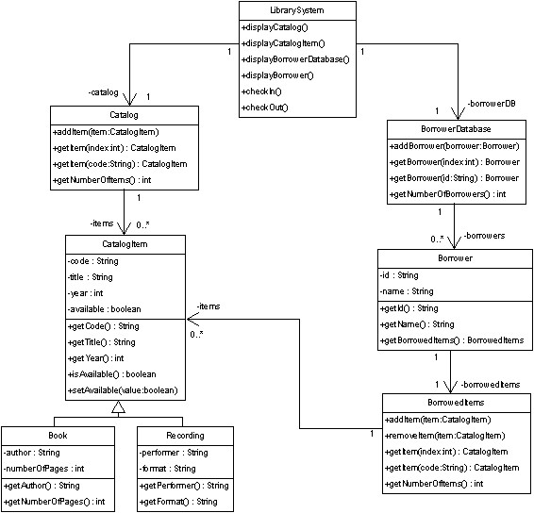
Modeling Using UML
Object-Oriented Programming and Design

Slide 46
5.6 Student Registry System Class Diagram

Slide 47
Modeling the Student Registry System
Specification of the Student Registry System
Identifying Classes
Identifying Relationships
Identifying Attributes
Identifying Methods
Modeling Using UML
Object-Oriented Programming and Design

Slide 48
Specification of SRS
We have been asked to develop an automated Student Registration System (SRS) for the university. This system will enable students to register online for courses each semester, as well as track their progress toward completion of their degree.
When a student first enrolls at the university, he/she uses the SRS to set forth a plan of study as to which courses he/she plans on taking to satisfy a particular degree program, and chooses a faculty advisor. The SRS will verify whether or not the proposed plan of study satisfies the requirements of the degree that the student is seeking.
Object-Oriented Programming and Design

Slide 49
Specification of SRS
Once a plan of study has been established, then, during the registration period preceding each semester, students are able to view the schedule of classes online, and choose whichever classes they wish to attend, indicating the preferred section (day of the week and time of day) if the class is offered by more than one professor. The SRS will verify whether or not the student has satisfied the necessary prerequisites for each requested course by referring to the student’s online transcript of courses completed and grades received (the student may review his/her transcript online at any time).
Assuming that (a) the prerequisites for the requested course(s) are satisfied, (b) the course(s) meet(s) one of the student’s plan of study requirements, and (c) there is room available in each of the class(es), the student is enrolled in the class(es).
Object-Oriented Programming and Design

Slide 50
Specification of SRS
If (a) and (b) are satisfied, but (c) is not, the student is placed on a first-come, first-served wait list. If a class/section that he/she was previously waitlisted for becomes available (either because some other student has dropped the class or because the seating capacity for the class has been increased), the student is automatically enrolled in the waitlisted class, and an email message to that effect is sent to the student. It is the student’s responsibility to drop the class if it is no longer desired; otherwise, he/she will be billed for the course.
Students may drop a class up to the end of the first week of the semester in which the class is being taught.
Object-Oriented Programming and Design

Slide 51
Classes of SRS
StudentRegistrySystem
Person
Student
Professor
Course
PlanOfStudy
Section
Transcript
TranscriptEntry
Falcuty
CourseCatalog
Object-Oriented Programming and Design

Slide 52
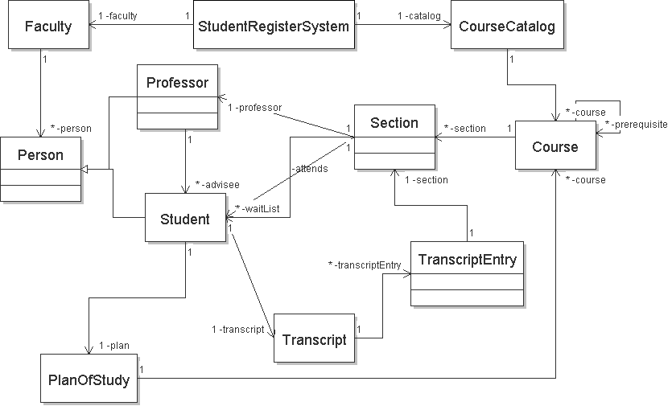
Class Relationships of SRS
Object-Oriented Programming and Design

Slide 53
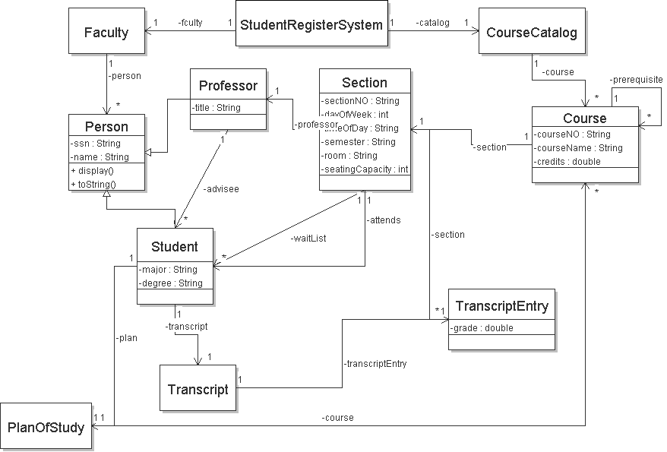
Class’s Attributes of SRS
Object-Oriented Programming and Design

Slide 54
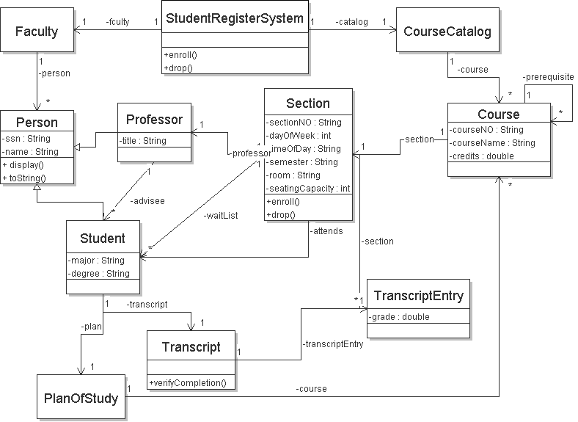
Class Digram of SRS
Object-Oriented Programming and Design

Slide 55
Exercise
Read textbook chapter 10.
Develop a class diagram for the PTS project, using UML notation. Reflect all significant attributes and relationships among classes, including the appropriate multiplicity. Ideally, you should use an object modeling software tool if you have one available to you.
Object-Oriented Programming and Design

