Slide 1

Chapter 6 Advanced Class Design
Polymorphism …
abstract classes …
interfaces …
static features ...

Slide 2

Contents
Polymorphism
Abstract Classes
Interfaces
Static Features
Design Pattern
Singleton Pattern
Strategy Pattern
Object-Oriented Programming and Design

Slide 3
6.1 Polymorphism

Slide 4


Polymorphism
The ability of two or more objects belonging to different classes to respond to exactly the same message in different class-specific ways
  A surgeon, a hair stylist, and an actor
Object-Oriented Programming and Design

Slide 5
Eg:
Container
+computeVolume() : double
Wagon
-width : double -height : double -length : double
+computeVolume() : double
Tank
-radius : double -length : double
+computeVolume() : double
Object-Oriented Programming and Design

Slide 6
Class Container
public class Container {
/**
* Computes the volume of this container.
*
* @return the volume of this container.
*/
public double computeVolume(){
System.out.println("This is in Container.");
return 0.0;
}
}
Object-Oriented Programming and Design

Slide 7
Wagon类
public class Wagon extends Container {
private double width;
private double height;
private double length;
public Wagon(double initialWidth,
double initialHeight,
double initialLength) {
width = initialWidth;
height = initialHeight;
length = initialLength;
}
public double computeVolume() {
return width * height * length;
}
}
Object-Oriented Programming and Design

Slide 8
Tank类
public class Tank extends Container {
private double radius;
private double length;
public Tank(double initialRadius,
double initialLength) {
radius = initialRadius;
length = initialLength;
}
public double computeVolume() {
return Math.PI * radius * radius * length;
}
}
Object-Oriented Programming and Design

Slide 9
import java.io.*;
public class ContainerDemo {
private static PrintWriter stdOut = new PrintWriter(System.out, true);
public static void main(String[] args) {
Container [ ]container = new Container[5];
container[0] = new Wagon(1, 1, 3);
container[1] = new Tank(1, 3);
container[2] = new Wagon(2, 3, 4);
container[3] = new Tank(2, 3);
container[4] = new Container();
for(int i = 0; i < 5; i++){
stdOut.println("Volume: " + container[i].computeVolume());
}
}
}
Object-Oriented Programming and Design

Slide 10
Output
Volume: 3.0
Volume: 9.42477796076938
Volume: 24.0
Volume: 37.69911184307752
This is in Container.
Volume: 0.0
Object-Oriented Programming and Design

Slide 11

Polymorphism, cont.
The term polymorphism is defined in Webster’s dictionary as:
  ‘The quality or state of being able to assume different forms’.
The line of code:
    container.computeVolume()
is said to be polymorphic because the method code performed in response to the message can take many different forms, depending on the class identity of the object.
Object-Oriented Programming and Design

Slide 12
Polymorphism, cont.
Polymorphism
  Inheritance
  Overriding
  Superclass object reference
Polymorphism doesn't happen automatically in C++
  Virtual functions
Object-Oriented Programming and Design

Slide 13
Polymorphism Simplifies Code Maintenance
To appreciate the power of polymorphism, let’s look at how we might have to approach the challenge of handling different objects in different type-specific ways with a non-OO programming language
  We'd typically handle all of the various scenarios having to do with different kinds of containers using a series of ‘if’ tests (see next page)
Object-Oriented Programming and Design

Slide 14
Simplified Maintenance, cont.
    for (int i = 0; i < 5; i++) {
    // Process the i^{th} container.
    Container c = (Container) container.elementAt(i);
    // (pseudocode)
    if (c is a wagon)
    computeWagonVolume(c);
    else if (c is a tank)
    computeTankVolume(c);
    else if ...
    }
As the number of cases grows, so too does the ‘spaghetti’ nature of the resultant code!
Object-Oriented Programming and Design

Slide 15
Simplified Maintenance, cont.
With a polymorphic language, we can invent as many subtypes after the fact as we like and the client code that manipulates these needn't change!
    // SAME CODE AS BEFORE!
    // Step through the array (collection) ...
    for(int i = 0; i < 5; i++){
stdOut.println("Volume: " + container[i].computeVolume());
}
Object-Oriented Programming and Design

Slide 16
6.2 Abstract Class

Slide 17
Find relationships between the classes
Fish
BlueWhale
Dog
Animal
Eagle
Shark
Mammal
GrayWhale
Bird
Whale
Object-Oriented Programming and Design

Slide 18
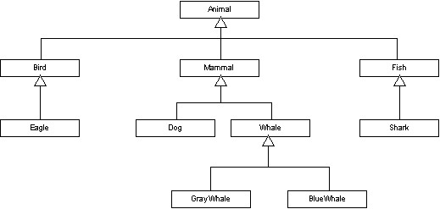
Object-Oriented Programming and Design

Slide 19


Abstract Class
Abstract class
  Can not be instantiated.
  Use abstract keyword.
Definition
  public abstract class className { . . . }
Object-Oriented Programming and Design

Slide 20
Eg:
Container
+computeVolume() : double
Wagon
-width : double -height : double -length : double
+computeVolume() : double
Tank
-radius : double -length : double
+computeVolume() : double
Object-Oriented Programming and Design

Slide 21
Container Class
public abstract class Container {
/**
* Computes the volume of this container.
* @return the volume of this container.
*/
public double computeVolume(){
return 0.0;
}
}
Object-Oriented Programming and Design

Slide 22
Abstract Methods
Abstract Method’s definition：
  No method bodies；
  Use abstract keyword；
Abstract methods’s declaration：
  public abstract void eat(int amount);
  public abstract void sleep(int hours);
Abstract methods must be defined in abstract class.
Object-Oriented Programming and Design

Slide 23
Eg:
Container
+computeVolume() : double
Wagon
-width : double -height : double -length : double
+computeVolume() : double
Tank
-radius : double -length : double
+computeVolume() : double
Object-Oriented Programming and Design

Slide 24
Container Class
public abstract class Container {
/**
* Computes the volume of this container.
* @return the volume of this container.
*/
public abstract double computeVolume();
}
Object-Oriented Programming and Design

Slide 25

Abstract Classes and Inheritance, cont.
If we fail to provide concrete method bodies for all of the abstract methods that we've inherited:
  They are inherited as abstract methods.
  The compiler will force us to declare the subclass as an abstract class.
Object-Oriented Programming and Design

Slide 26
Wagon类
public abstract class Wagon extends Container {
private double width;
private double height;
private double length;
public Wagon(double initialWidth,
double initialHeight,
double initialLength) {
width = initialWidth;
height = initialHeight;
length = initialLength;
}
public abstract double computeVolume();
}
Object-Oriented Programming and Design

Slide 27
Tank类
public class Tank extends Container {
private double radius;
private double length;
public Tank(double initialRadius,
double initialLength) {
radius = initialRadius;
length = initialLength;
}
public double computeVolume() {
return Math.PI * radius * radius * length;
}
}
Object-Oriented Programming and Design

Slide 28
Abstract Classes and Instantiation
We cannot instantiate an abstract class:
Container c = new Container(); // Impossible!
This makes intuitive sense, because there are service(s) that such an object could not perform
    c.computeVolume(); // Behavior undefined!
Object-Oriented Programming and Design

Slide 29
Abstract Classes and Variable Declaration
We are allowed to declare references belonging to an abstract class, however
  Container c; // Fine and dandy!
This enables us to take advantage of polymorphism, e.g., when iterating through a collection
  Vector container;
  for (int i = 0; i < container.size(); i++) {
  Container c = (Container)container.elementAt(i); c.computeVolume() // polymorphic
  }
Object-Oriented Programming and Design

Slide 30
Abstractness
Recall that a class, as an abstract data type, is an abstraction of a real world object
We can see that an abstract class is ‘more abstract’ than a ‘normal’ class because we’ve omitted the details for how one or more particular behaviors are to be performed
But, with an abstract class, we typically still specify the data structure (attributes)
What if we wanted to specify only abstract behaviors?
Object-Oriented Programming and Design

Slide 31
6.3 Interface

Slide 32
Interfaces
An interface is simply a named list of method declarations
  Does not implement methods, only declares them
  An interface is not a class, although it looks remarkably like an abstract class
Declared types in Java are either classes or interfaces
Interfaces represent a promise of support services to the objects which implement the interface – a “contract”
public interface File {
public void open(String name);
public void close();
}
Notes:
For example, a class that implements an interface MUST implement all its methods, which is not the case when extending abstract classes.

Slide 33
Protocols
An interface defines a protocol (a set of methods)
  If a class implements a given interface, then that class implements that protocol
An interface can impose a common protocol on a group of classes that are not related by inheritance
  In the chain of classes related by inheritance, the common protocol is imposed through subclassing
Comparable
compareTo()
Date
compareTo()
Integer
compareTo()
String
compareTo()
Notes:
Interfaces contain only method stubs - no functionality. Interfaces contain no variables.
Superclasses can contain methods, with functionality, as well as variables.

Slide 34
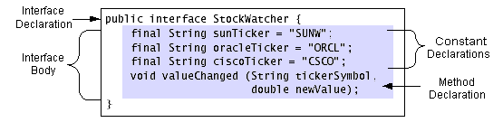
Declaring an Interface
Interface definition has two components
  Interface declaration
  Interface body
The interface declaration declares various attributes about the interface
  Name
  Whether it extends other interfaces

Slide 35
Implementing Interface Methods
Methods declared in an interface are implemented in the classes which support that interface
public class TextFile implements File {
public void open(String name) {
// implementation of open method
}
public void close() {
// implementation of close method
}
}

Slide 36
Syntax
In a class declaration, the naming of the superclass precedes any interfaces supported by the class:
public class Directory extends Secure
implements File {
...
}

Slide 37
Multiple Interfaces
If a class implements multiple interfaces, the interfaces are all listed, separated by commas:
public class Directory
implements File, Secure {
...
}

Slide 38
Implementing an Interface
A class which implements an interface must implement every method defined by that interface
If one or more methods is not implemented, Java will generate a compiler error
Subclasses automatically implement all interfaces that their superclass implements
Notes:
Note: the clone() method performs the actual bitwise duplication of an object
An "empty" interface is uncommon, but useful in this case.
The clone() method is part of the Object class, which ordinarily would mean that all classes would inherit it. However, a built-in safeguard, CloneNotSupportedException, prevents any object from being cloned if it is not an instance of a "cloneable" class.
Thus, Cloneable is a way of preventing just any and all objects from being cloned.

Slide 39
Cloneable Interface
Some interfaces, such as Cloneable, do not contain any methods
  In the case of Cloneable, it alerts the JVM that objects of the implementing class can be copied via the clone() method
  These act as a signal to Java that a class observes a certain protocol that may not be expressible as a specific set of methods
  Only the objects that implement the Cloneable interface can be copied, or cloned.

Slide 40
Typing and Interfaces
A variable's type can be an interface
Stipulations
  Only objects whose class implements that interface can be bound to that variable
  Only messages defined by the interface can be used
  Interfaces cannot appear in a new expression
File r = new File(); // Error
File f = new TextFile(); // OK!
Notes:
In this example, f does not “know” it is a TextFile, unless it is explicitly cast as one.

Slide 41
Subinterfaces
Interfaces can be extended
  Interface hierarchy is independent of the class hierarchy
  The interface which extends another interface inherits all of its method declarations
  interface File {
  public void open(String name);
  public void close();
  }
  interface ReadableFile extends File {
  public byte readByte();
  }
  interface WritableFile extends File {
  public void writeByte(byte b);
  }
  interface ReadWriteFile extends ReadableFile,
  WritableFile {
  public void seek(int position);
  }
Notes:
When subclassing, use the word extends with only one superclass.
With interfaces, extends can refer to multiple base interfaces when building a new interface.
In other words:
with classes, there is NO multiple inheritance in Java.
with interfaces, there CAN be multiple inheritance.

Slide 42
Using Interfaces
Using interfaces allows
  Cross-hierarchy polymorphism
  Access to methods in separate class trees
  Substitution of an object for another object which is not related via the class hierarchy
Classes that implement the same interface understand the same messages
  Regardless of their location in the class hierarchy
Notes:
One of the differences between interfaces and abstract classes is that the use of abstract classes cannot provide access to methods in separate class trees.

Slide 43
More Advantages of Using Interfaces
Allows more control over how objects are used
The programmer can define a method's parameters as interfaces
  This restricts the use of those parameters
  The programmer knows which message the objects will respond to
Improves reusability of code

Slide 44
Naming Conventions for Interfaces
Make "able" interfaces
  Cloneable, Serializable, ...
Name interfaces using proper nouns and provide "Impl" implementation of your interfaces
  Bank, BankImpl, BankAccount, BankAccountImpl
  With this convention, the interface typically contains a definition for all (or most) of the implementation class' public methods
Prefix interface names with "I" and use proper nouns for your classes
  IBank, Bank, IBankAccount
Notes:
These naming conventions are suggested, and not intended to be enforced simultaneously.

Slide 45
Interfaces
The preferred approach is to declare a Java interface, which is a set of (abstract) method signatures that collectively define what it means to assume a certain role (such as teaching)
  public interface Teacher {
  // Note: no "abstract" keyword required.
  public void agreeToTeach(Course c);
  public void designateTextbook(Book b, Course c);
  public Syllabus defineSyllabus(Course c);
  public boolean approveEnrollment(Student s, Course c);
  }
Object-Oriented Programming and Design
Notes:
接口把方法的特征和方法的实现分割开来。这种分割体现在接口常常代表一个角色，它包装与该角色相关的操作和属性，而实现这个接口的类便是扮演这个角色的演员。一个角色由不同的演员来演，而不同的演员之间除了扮演一个共同的角色之外，并不要求其它的共同之处。
java接口最大的用武之地，我觉得应该是从软件工程的角度来说的，也就是软件设计人员（或者说上层开发人员）可以先定义接口，然后再由底层开发人员来具体进行接口在类中的实现。这样，接口定义和具体类的开发就可以分离开来，这样大家就可以将关注点放在自己需要注重的地方（角色的分离成为可能）。至于抽象类，我还不是很懂。可能主要是应用在具体开发中子类父类之间的标准化要求吧。

Slide 46
Interfaces, cont.
We then indicate that a particular class performs these behaviors by implementing the interface and overriding the methods (just as we did with abstract classes):
public class Professor implements Teacher {
    public void agreeToTeach(Course c) {
    code body provided …
    }
  public void designateTextbook(Book b, Course c) {
    code body provided …
    }
    }
Object-Oriented Programming and Design

Slide 47
UML Diagram
<<interface>> Teacher
+agreeToTeach(c:Course) +designateTextbook(b:Book,c: Course) +defineSyllabus(c:Course): Syllabus +approveEnrollment(s:Student,c: Course):boolean
Professor
Student
Object-Oriented Programming and Design

Slide 48
Interfaces, cont.
In terms of the ‘abstractness spectrum’, an interface is even more abstract than an abstract class, which is in turn more abstract than a ‘regular’ class
A class may be instructed to implement as many interfaces as desired (by contrast, a class may extend only one parent class)
For example, if we were to invent a second interface called ‘Administrator’, which specified the following method signatures:
public boolean approveNewCourse(Course c);
public boolean hireProfessor(Professor p);
Object-Oriented Programming and Design

Slide 49
Interfaces, cont.
then we could instruct a class to implement both the Teacher and Administrator interfaces:
class Professor implements Teacher, Administrator { ... }
When a class implements more than one interface, it effectively assumes multiple identies or roles
  Its ‘handle’ can therefore be managed by various types of reference variables
Object-Oriented Programming and Design

Slide 50
UML Diagram
<<interface>> Teacher
<<interface>> Administrator
Professor
-name : String
+getName() : String
Object-Oriented Programming and Design

Slide 51
Interfaces, cont.
Professor p = new Professor();
Teacher t;
Administrator a;
t = p;
a = p;
Object-Oriented Programming and Design

Slide 52
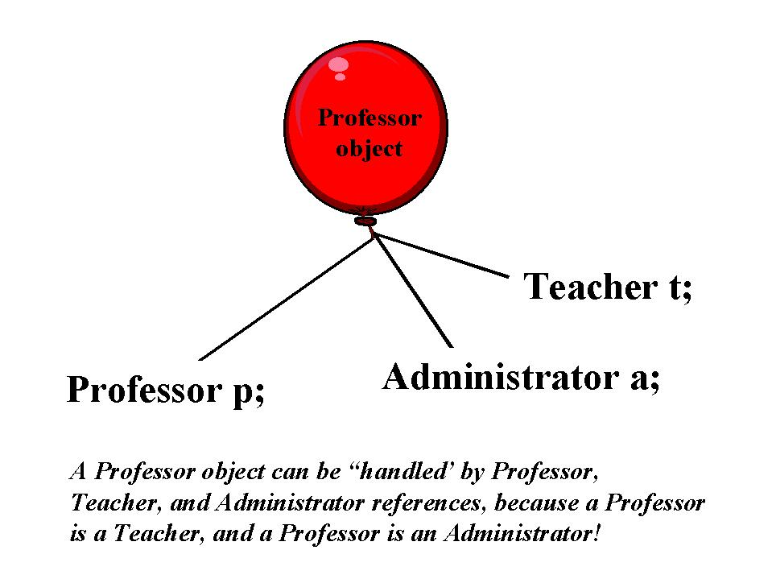
Interfaces, cont.
An interface is therefore another way of implementing the "is a" relationship!
Object-Oriented Programming and Design

Slide 53
Interfaces, cont.
We may then command the same object as either a Professor …
p.getName();
or as a Teacher …
t.agreeToTeach(c);
or as an Administrator …
a.approveNewCourse(c);
because it is all three!
Object-Oriented Programming and Design

Slide 54

Interfaces, cont.
We cannot do the following, however:
t.getName();
because even though, in our scenario, t is referring to a Professor object at runtime, the compiler will object: not all Teachers are Professors
Object-Oriented Programming and Design

Slide 55
Interfaces, cont.
If we also wish to enable Students to be teachers:
class Professor implements Teacher, Administrator { … }
class Student implements Teacher { … }
we may then use Student and Professor object references interchangeably wherever a Teacher object reference is required
Object-Oriented Programming and Design

Slide 56
Versatility of Interfaces
public class Course {
Teacher instructor; // This is a more versatile design.
public void setInstructor(Teacher t) {
instructor = t;
} // etc.
public static void main(String[] args) {
Student s = new Student();
Professor p = new Professor();
Course c = new Course();
c.setInstructor(p); -or- c.setInstructor(s);
Either will work just fine!
Object-Oriented Programming and Design

Slide 57
Interfaces, cont.
An interesting example of casting to consider:
Professor p = new Professor();
Student s = new Student();
Teacher t;
t = p;
p = t;
Object-Oriented Programming and Design

Slide 58
Interfaces, cont.
An interesting example of casting to consider:
Professor p = new Professor();
Student s = new Student();
Teacher t;
t = p; // This is fine.
p = (Professor) t; // Will compile and run fine now.
}
}
Object-Oriented Programming and Design

Slide 59
Interfaces, cont.
An interesting example of casting to consider:
// implements Teacher
Professor p = new Professor();
// implements Teacher
Student s = new Student();
Teacher t;
t = p; // This is fine.
//Will compile and will run fine.
p = (Professor) t;
// t now refers to our Student object.
t = s;
// Will this compile/run properly?
p = (Professor) t;
Object-Oriented Programming and Design

Slide 60
Interfaces, cont.
An interesting example of casting to consider:
Professor p = new Professor(); Student s = new Student();
Teacher t;
t = p;
p = (Professor) t;
t = s;
p = (Professor) t;
// Will compile, but will throw a runtime ClassCastException.
}}
Object-Oriented Programming and Design

Slide 61
Interfaces vs. Multiple Inheritance, cont.
There are object modeling techniques for making up for the lack of multiple inheritance in a language
  See Object-Oriented Modeling and Design by James Rumbaugh et al, Prentice Hall, 1991; Chapter 4, Section 4.4 "MULTIPLE INHERITANCE", section 4.4.3 "Workarounds"
Object-Oriented Programming and Design

Slide 62
Versatility of Interfaces
Whenever possible/feasible, design the public aspects of your classes:
  arguments to methods
  method return types
Using interface types instead of specific class types to allow for greater flexibility/utility of your methods
Object-Oriented Programming and Design

Slide 63
6.4 Static Features

Slide 64
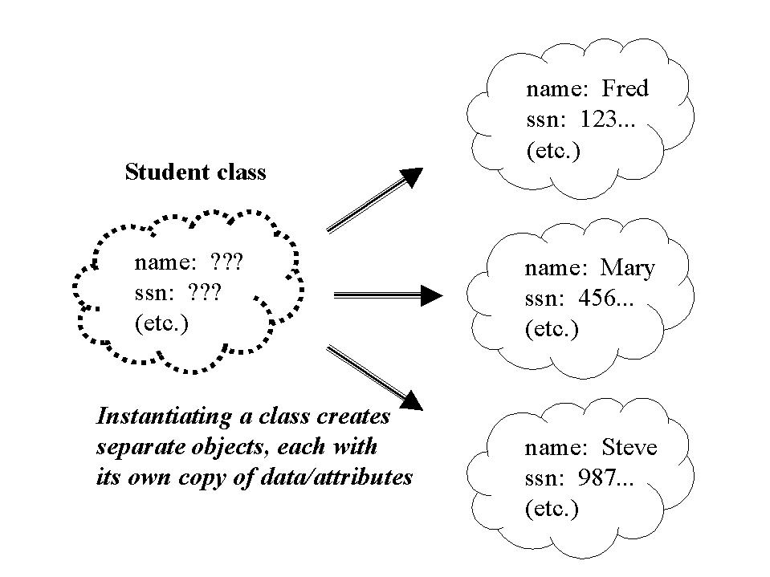
Static Attributes
When we create an object, we are creating an instance of the appropriate class ‘template’ which gets filled in with attribute values
Object-Oriented Programming and Design

Slide 65
Static Attributes, cont.
Suppose there were some piece of general information – say, the total student enrollment count at the university – that we wanted all Student objects to have shared access to
  We could implement this as a ‘standard’ attribute of the Student class -- say, int totalStudents …
  … but then we'd have to work hard to make sure that all of the different Student objects' values for totalStudents were in synch
Object-Oriented Programming and Design

Slide 66
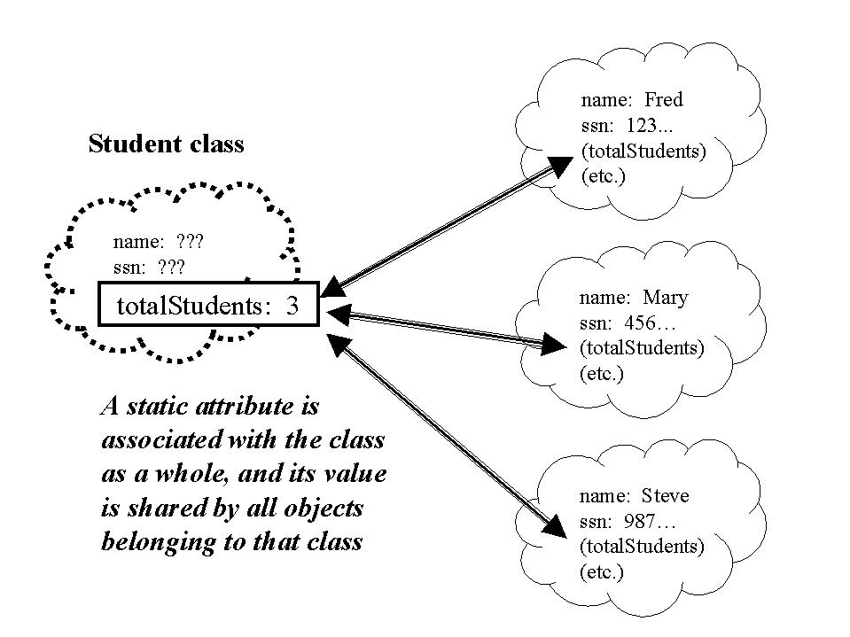
Static Attributes, cont.
A static attribute is one whose value is shared by all instances of that class
  It in essence belongs to the class as a whole
  "Global" to all instances of that class
Object-Oriented Programming and Design

Slide 67
Static Attributes, cont.
class Student {
private String name;
private static int totalStudents = 0;
public Student(String n) {
setName(n);
totalStudents++;
}
public static int getTotalStudents() {
return totalStudents;
}
}
Object-Oriented Programming and Design

Slide 68
Static Attributes, cont.
// Client code:
Student s1 = new Student("Fred");
Student s2 = new Student("Mary");
Student s3 = new Student("Steve");
s1.getTotalStudents();
s2.getTotalStudents();
s3.getTotalStudents();
Object-Oriented Programming and Design

Slide 69
Static Attributes, cont.
// Client code:
Student s1 = new Student("Fred");
Student s2 = new Student("Mary");
Student s3 = new Student("Steve");
s1.getTotalStudents();
s2.getTotalStudents();
s3.getTotalStudents();
// So will THIS!
Student.getTotalStudents();
Object-Oriented Programming and Design

Slide 70
Accessing Static Attributes
The latter of these messages illustrates what's known as a static method: i.e., one which can be invoked on the class as a whole
public class Student {
private String name;
  private static int totalStudents = 0;
  public static int getTotalStudents() {
  return totalStudents;
  }
  // etc.}
Object-Oriented Programming and Design

Slide 71
Static Methods
Important restriction on static methods: they may only access static attributes:
class Student {
  private String name; // NOT static
  private static int totalStudents;
  public static void print() {
  System.out.println(name + " is one of " + totalStudents + " students."); // ILLEGAL!
  }
  }
Object-Oriented Programming and Design
Notes:
Can't make a static reference to nonstatic variable name in class Student

Slide 72
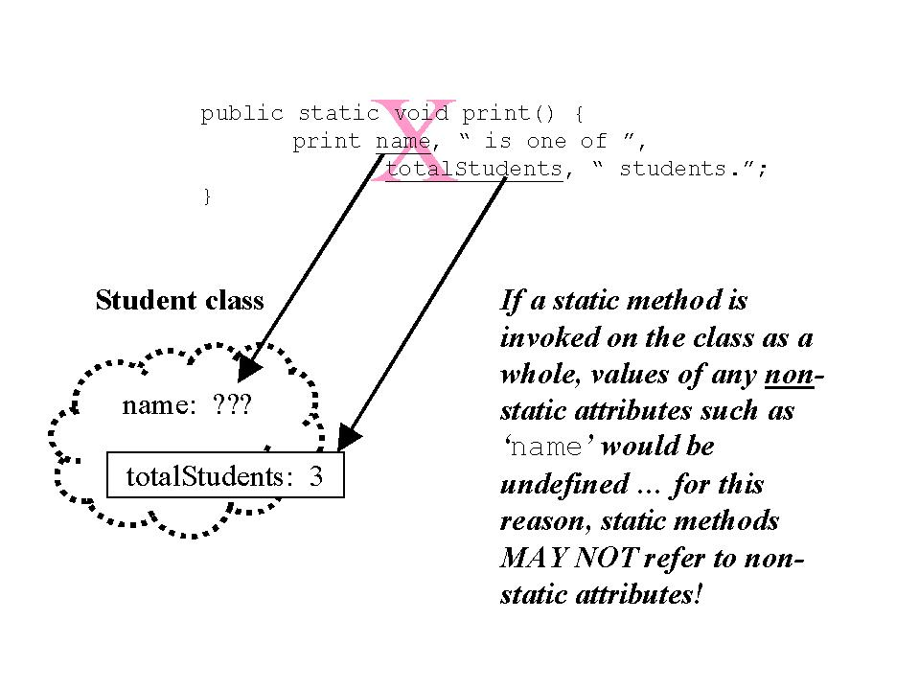
Static Methods, cont.
Why is this?
  Classes are for the most part empty templates
  If a static method is invoked on a class as a whole, and tries to access a non-static attribute, the value of that attribute would be undefined
Object-Oriented Programming and Design

Slide 73
The Static Nature of main()
Why must the main() method of an application be declared to be static?
public static void main(String[] args) { … }
To answer this question, let's review what happens when we first launch an application
  java MyApp
  the JVM is looking for a class file with the specified name, loading it into its memory, and looking for/running the main() method
Object-Oriented Programming and Design

Slide 74
The Nature of main(), cont.
java MyApp
Step 1: the JVM looks for a class file with the specified name
Step 2: if found, it is loaded into the JVM's memory
Step 3: the JVM inspects the class for the existence of a main() method with the appropriate signature
Step 4: if found, the main() method is executed
-- but, we haven't created have any objects yet, so we must look to the class to run this method => it must be a static method!
Object-Oriented Programming and Design

Slide 75
Utility Classes
Some classes consist predominantly/wholly of static methods (and sometimes public static final (constant) attributes), and are created as a convenient way of bundling utility functions
  Example: java.lang.Math
  Defines static methods for performing basic numeric operations along with elementary exponential, logarithm, square root, and trigonometric functions
  We never instantiate a Math object -- instead, we use the methods statically on the Math class as a whole, as a sort of math "library"
Object-Oriented Programming and Design

Slide 76
Math Class Example
public class MathExample {
  public static void main(String[] args) {
  // We never instantiate the Math class!
double d = -3.4;
double dabs = Math.abs(d); // absolute value
double radius = 3.7;
// A public static (constant) ATTRIBUTE!
  double circumference = 2.0 * Math.PI * radius;
  double area = Math.PI * Math.pow(radius, 2.0);
  double e = 7.92;
  // Compute the square root of d squared plus e squared.
  double answer = Math.sqrt(Math.pow(d, 2.0) +
  Math.pow(e, 2.0)); // nested
  // etc.
  }
}
Object-Oriented Programming and Design

Slide 77
Alternative Terminology
To differentiate between ‘normal’ (non-static) attributes and static attributes:
  ‘instance variable’ is often used for the former: namely, a ‘variable’ (attribute) that has value or meaning for an ‘instance’, or object
  ‘class variable’, then, is often used as a synonym for ‘static attribute’
Object-Oriented Programming and Design

Slide 78
6.5 Design Pattern

Slide 79
History of Pattern
Christopher Alexander, in the 1970’s, wrote books on architectural patterns. He thought that modern architecture was awful and that it ignored expertise that had existed for a long, long time.
Object-Oriented Programming and Design

Slide 80

Good Design during 1400-1500
Object-Oriented Programming and Design

Slide 81

The Worst Design in 1900
Object-Oriented Programming and Design

Slide 82



Alexander’s Patterns
Object-Oriented Programming and Design

Slide 83



Alexander’s Patterns
Object-Oriented Programming and Design

Slide 84



Alexander’s Patterns
Object-Oriented Programming and Design

Slide 85
Design Pattern
Design patterns describe practical solutions to common design problems that occur repeatedly in software development. A design pattern description consists of:
  A name that identifies the pattern
  A description of the problem that the pattern addresses
  A description of the solution that includes the class structures that solve the problem
  A discussion of the consequences of using the pattern
Design patterns document good design solutions that can be used for similar problems and form a shared vocabulary for problem-solving discussions .
Object-Oriented Programming and Design

Slide 86
Design Patterns
Design Patterns: Elements of Reusable Object-Oriented Software；
Authors：Erich Gamma, Richard Helm, Ralph Johnson, and John Vlissides；
Object-Oriented Programming and Design

Slide 87
设计模式的种类
Creational Patterns: | Abstract Factory, Builder, Factory Method, Prototype , Singleton
Structural Patterns: | Adapter, Bridge, Composite, Decorator , Façade, Flyweight, Proxy
Behavioral Patterns: | Chain of Responsibility, Command, Iterator, Mediator, Memento, Observer, State, Strategy, Visitor, Template Method, Interpreter
Object-Oriented Programming and Design

Slide 88
6.6 Singleton Pattern

Slide 89
Intent
The intent of the Singleton pattern is to ensure that a class has only one instance and to provide a global point of access to it.
Object-Oriented Programming and Design

Slide 90
Motivation
It's important for some classes to have exactly one instance.
  Many printers, but only one print spooler
  One file system
  One window manager
Object-Oriented Programming and Design

Slide 91





Example
Object-Oriented Programming and Design

Slide 92
Example
Print Spooler
Object-Oriented Programming and Design

Slide 93
public class PrintSpooler {
private String name;
private String address;
private Printer printer;
public PrintSpooler() {
name = “John";
address = “192.168.103.11";
printer = new Printer();
}
public void print(String out) {
printer.print(out);
}
}
Object-Oriented Programming and Design

Slide 94
public class User {
private String name;
private String address;
public User(String initialName,
String initialAddress) {
name = initialName;
address = initialAddress;
}
public void print(PrintSpooler spooler,
String content) {
spooler.print(content);
}
}
Object-Oriented Programming and Design

Slide 95
public class PrintSpoolerDemo {
public static void main(String[] args) {
PrintSpooler printSpooler =
new PrintSpooler();
User alice =
new User(“Alice”, “192.168.103.12”);
User ann =
new User(“Ann”, “192.168.103.13”);
User mike =
new User(“Mike”, “192.168.103.14”);
alice.print(printSpooler, “I am Alice.”);
ann.print(printSpooler, “I am Ann.”);
mike.print(printSpooler, “I am Mike.”); }}
Object-Oriented Programming and Design

Slide 96
public class PrintSpoolerDemo {
public static void main(String[] args) {
PrintSpooler printSpooler =
new PrintSpooler();
User alice =
new User(“Alice”, “192.168.103.12”);
User ann =
new User(“Ann”, “192.168.103.13”);
User mike =
new User(“Mike”, “192.168.103.14”);
}
}
PrintSpooler anotherPrintSpooler =
new PrintSpooler();
alice.print(anotherPrintSpooler, “I am Alice.”);
ann.print(printSpooler, “I am Ann.”);
mike.print(anotherPrintSpooler, “I am Mike.”);
Object-Oriented Programming and Design

Slide 97
Example
Object-Oriented Programming and Design

Slide 98
Singleton Structure
Structure：
Singleton
-singletonInstance: Singleton
-Singleton()
+getSingletonInstance() : Singleton
Notice that the static members of the class are underlined.
Object-Oriented Programming and Design

Slide 99
In this pattern
The constructor is defined as private so that other classes cannot create instances.
The static attribute instance contains the single instance of the class.
The static method getSingletonInstance returns the single instance of the class. The first time this method is called, it creates the single instance.
Object-Oriented Programming and Design

Slide 100
Example----PrintSpooler
PrintSpooler
-printSpoolerInstance: PrintSpooler
-PrintSpooler()
+getPrintSpoolerInstance()
: PrintSpooler
Object-Oriented Programming and Design

Slide 101
public class PrintSpooler {
private String name;
private String address;
private Printer printer;
public void print(String out) {
printer.print(out);
}
}
static private PrintSpooler printSpoolerInstance = null;
private PrintSpooler() {
name = “John";
address = “192.168.103.11";
printer = new Printer();
}
static public PrintSpooler getPrintSpoolerInstance(){
if(printSpoolerInstance == null){
printSpoolerInstance = new PrintSpooler();
}
return printSpoolerInstance;
}
Object-Oriented Programming and Design

Slide 102
public class PrintSpoolerDemo {
public static void main(String[] args) {
}
}
PrintSpooler printSpooler =
PrintSpooler.getPrintSpoolerInstance();
User alice =
new User(“Alice”, “192.168.103.12”);
User ann =
new User(“Ann”, “192.168.103.13”);
User mike =
new User(“Mike”, “192.168.103.14”);
PrintSpooler anotherPrintSpooler =
PrintSpooler.getPrintSpoolerInstance();
alice.print(anotherPrintSpooler, “I am Alice.”);
ann.print(printSpooler, “I am Ann.”);
mike.print(anotherPrintSpooler, “I am Mike.”);
Object-Oriented Programming and Design

Slide 103
Program run
In main method
PrintSpooler printSpooler =
PrintSpooler.getPrintSpoolerInstance();
printSpooler
printSpoolerInstance
(null)
Object-Oriented Programming and Design

Slide 104
Program run
In getPrintSpoolerInstance method.
if(printSpoolerInstance == null){
printSpoolerInstance = new PrintSpooler();
}
return printSpoolerInstance;
printSpooler
printSpoolerInstance
(null)
Object-Oriented Programming and Design

Slide 105
Program run
In getPrintSpoolerInstance method.
if(printSpoolerInstance == null){
printSpoolerInstance = new PrintSpooler();
}
return printSpoolerInstance;
PrintSpooler
printSpooler
printSpoolerInstance
Object-Oriented Programming and Design

Slide 106
Program run
In getPrintSpoolerInstance method.
if(printSpoolerInstance == null){
printSpoolerInstance = new PrintSpooler();
}
return printSpoolerInstance;
PrintSpooler
printSpooler
printSpoolerInstance
Object-Oriented Programming and Design

Slide 107
Program run
Back main method.
PrintSpooler printSpooler =
PrintSpooler.getPrintSpoolerInstance();
PrintSpooler
printSpooler
printSpoolerInstance
Object-Oriented Programming and Design

Slide 108
Program run
In main method.
PrintSpooler anotherPrintSpooler =
PrintSpooler.getPrintSpoolerInstance();
PrintSpooler
anotherPrintSpooler
printSpooler
printSpoolerInstance
Object-Oriented Programming and Design

Slide 109
Program run
In getPrintSpoolerInstance method.
if(printSpoolerInstance == null){
printSpoolerInstance = new PrintSpooler();
}
return printSpoolerInstance;
PrintSpooler
anotherPrintSpooler
printSpooler
printSpoolerInstance
Object-Oriented Programming and Design

Slide 110
Program run
In getPrintSpoolerInstance method.
if(printSpoolerInstance == null){
printSpoolerInstance = new PrintSpooler();
}
return printSpoolerInstance;
PrintSpooler
anotherPrintSpooler
printSpooler
printSpoolerInstance
Object-Oriented Programming and Design

Slide 111
Program run
Back main method.
PrintSpooler anotherPrintSpooler =
PrintSpooler.getPrintSpoolerInstance();
PrintSpooler
anotherPrintSpooler
printSpooler
printSpoolerInstance
Object-Oriented Programming and Design

Slide 112
public class PrintSpoolerDemo {
public static void main(String[] args) {
}
}
PrintSpooler printSpooler =
PrintSpooler.getPrintSpoolerInstance();
User alice =
new User(“Alice”, “192.168.103.12”);
User ann =
new User(“Ann”, “192.168.103.13”);
User mike =
new User(“Mike”, “192.168.103.14”);
PrintSpooler anotherPrintSpooler =
PrintSpooler.getPrintSpoolerInstance();
alice.print(anotherPrintSpooler, “I am Alice.”);
ann.print(printSpooler, “I am Ann.”);
mike.print(anotherPrintSpooler, “I am Mike.”);
Object-Oriented Programming and Design

Slide 113
Singleton Pattern
The singleton pattern ensures that only one instance of a class is created and provides a method to access that one instance.
Every object that uses an instance of a singleton class uses the same instance.
Object-Oriented Programming and Design

Slide 114
Key of Singleton Pattern
Constructors must be private. Notice that all constructors must be private.
Must provide a public static method to issue and keep track of instances.
Object-Oriented Programming and Design

Slide 115
Benefits
A singleton class can control how and when client code accesses the single instance.
A singleton class can be easily modified if requirements change and the application needs to limit the number of instances to a number other than one.
Object-Oriented Programming and Design

Slide 116
6.7 Strategy Pattern

Slide 117
For example: sales-tax calculation
Consider an e-commerce system that supports sales in the United States, Mexico, and Canada. In the near future, the customer base may expand to include countries in South America. The system must know how to calculate the sales tax for customers in three countries, each of which has its own rules for calculating sales tax. The design of the code for sales-tax calculation should be flexible so it will be easy to add other countries. One solution is a monolithic method called calculateTax that calculates the sales taxes for every country.
Object-Oriented Programming and Design

Slide 118
sales-tax calculation (cont.)
public class Order {
private double calculateTax(String country, double amount) {
double tax
if (country.equals("United States")) {
tax = ... ;
} else if (country.equals("Canada")) {
tax = ... ;
} else if (country.equals("Mexico")) {
tax = ... ;
}
...
return tax;
}
}
Object-Oriented Programming and Design

Slide 119
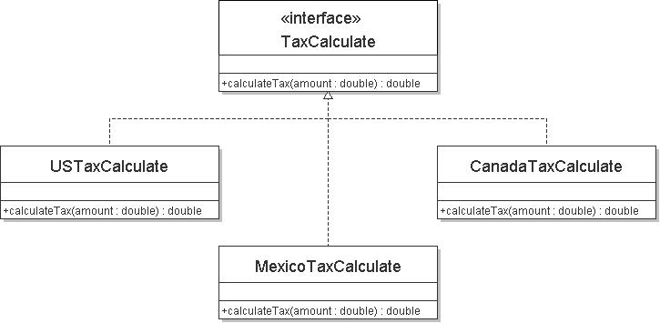
类图
Object-Oriented Programming and Design

Slide 120
public class TestTaxCaculate {
public static void main(String[] args){
TaxCalculate taxCalculate;
taxCalculate = new USTaxCalculate();
taxCalculate.calculateTax(1000000);
taxCalculate = new MexicoTaxCalculate();
taxCalculate.calculateTax(1000000);
taxculate = new CanadaTaxCalculate();
taxCalculate.calculateTax(10000000);
}
}
Object-Oriented Programming and Design

Slide 121
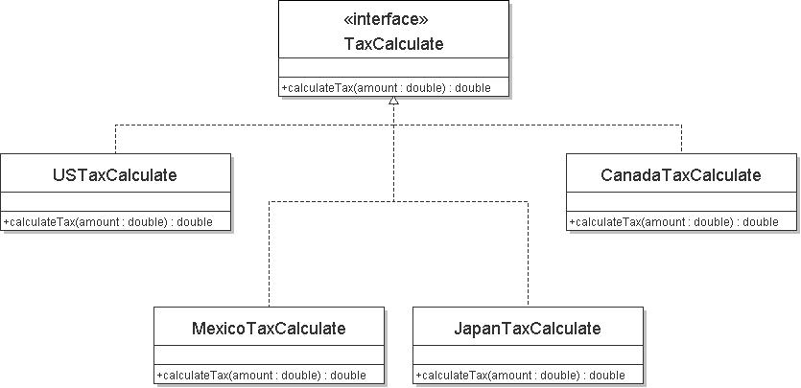
税费计算图
Object-Oriented Programming and Design

Slide 122
测试税费计算
public class TestTaxCaculate {
public static void main(String[] args){
TaxCalculate taxCalculate;
taxCalculate = new USTaxCalculate();
taxCalculate.calculateTax(1000000);
taxCalculate = new MexicoTaxCalculate();
taxCalculate.calculateTax(1000000);
taxculate = new CanadaTaxCalculate();
taxCalculate.calculateTax(10000000);
taxculate = new JapanTaxCalculate();
taxCalculate.calculateTax(10000000);
}
}
Object-Oriented Programming and Design

Slide 123
strategy pattern
Define a family of algorithms, encapsulate each one, and make them interchangeable. Strategy lets the algorithm vary independently from the clients that use it.
  each algorithm is encapsulated in its own class.
  An interface that declares a method for executing an algorithm is created, and all the algorithm classes implement the interface .
Applications where the strategy pattern may prove useful include:
  An application for compressing files that allows the user to select the type of compression
  An application where the nature of the data to be sorted determines the sorting algorithm
Object-Oriented Programming and Design

Slide 124
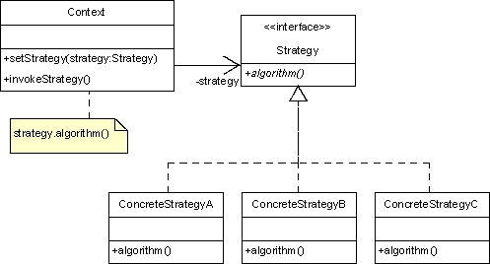
strategy pattern- UML Class Diagram
Object-Oriented Programming and Design

Slide 125
library system
This enhancement makes it possible to format the information in the borrower database in one of three ways:
  plain text,
  HTML
  XML
Object-Oriented Programming and Design

Slide 126
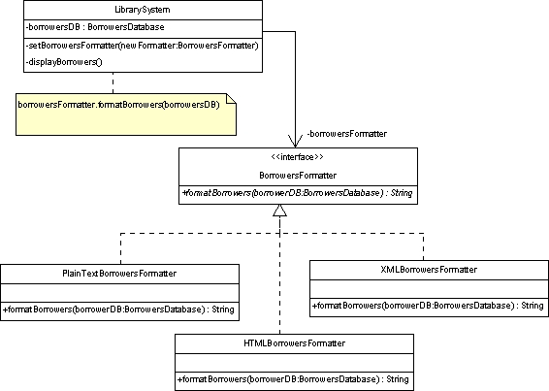
图书馆系统类图
Object-Oriented Programming and Design

Slide 127
Exercises
Read textbook, chapter 7.
Give an example to use singleton and strategy pattern.
To study a new pattern of iterator and give an example to use iterator.
Object-Oriented Programming and Design

