Slide 1
Chapter 8 File I/O

Slide 2

Contents
Introduction
A Sample Read from and Write to file
Text and Binary Formats
Random Access & Sequential Access
Using File I/O in Library System
Object-Oriented Programming and Design

Slide 3
8.1 Introduction

Slide 4
Basic
（串）并行设备
驱动器
（串）并行
设备
应用程序A
视频设备
驱动程序
视频设备
一般设备
独立I/O服务
应用程序A
音频设备
驱动程序
音频设备
游戏设备驱动器
游戏设备
应用程序A
IDE设备驱动器
IDE设备
应用程序 操作系统 设备驱动程序 物理设备
Object-Oriented Programming and Design

Slide 5


Why do we need files?
Files stored on secondary storage devices
  Magnetic disks
  Optical disks
  Magnetic tapes
Files provide long-term storage of large amounts of data.
  Data in a file can persist after termination of program.
As we are using objects in OO, we need to:
  Read object data from a file
  Saving object data to a file

Slide 6
How to use a file
Open a Connection
Use a Class provided by the underlying system to
  Write to a new file
  Over write data in a file
  Append to the end of a file
  Read data from a file
Close Connection
This Process is common to most languages
In Java,
java.io package provides several classes to deal with files.

Slide 7
Using Files in Java
You must import classes from the java.io package
Then, link to input or output file in code
  Files can then be read from or written to
Any file handling operations must be enclosed within a try…catch structure to handle any exceptions
import java.io.*;
try
{
in.close();
}
catch (IOException ioe)
{
System.out.println("ERROR: "+ ioe.getMessage());
}

Slide 8
Using Files in Java
You must import classes from the java.io package
Then, link to input or output file in code
  Files can then be read from or written to
Any file handling operations must be enclosed within a try…catch structure to handle any exceptions
At end of processing, all files should be closed.
import java.io.*;

Slide 9

Java readers, writers, streams
Classes provided by java.io package falls into 2 main categories:
  Classes to deal with text files
  Classes to deal with binary files
Java classes provided to process text files:
  FileReader for character-based input from a file
  FileWriter for character-based output to a file

Slide 10
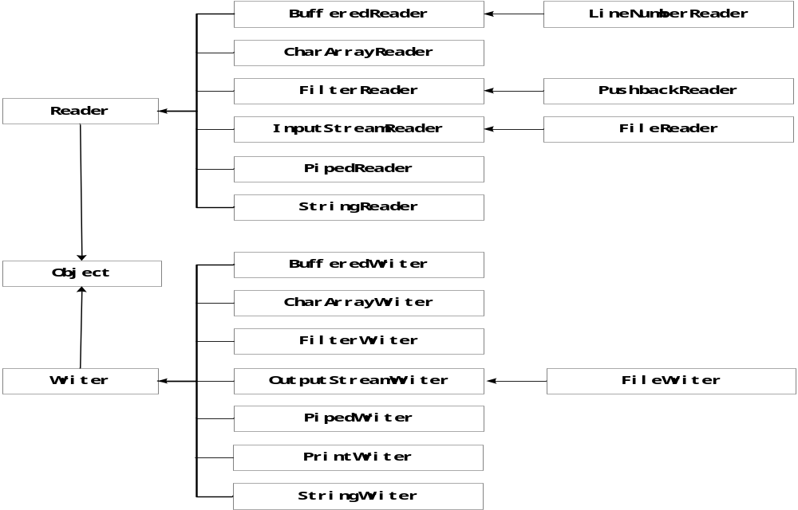
java.io

Slide 11
Java readers, writers, streams
Classes provided by java.io package falls into 2 main categories:
  Classes to deal with text files
  Classes to deal with binary files
Java classes provided to process text files:
  FileReader for character-based input from a file
  FileWriter for character-based output to a file
Java classes provided to process binary files:
  FileInputStream for byte-based input from a file
  FileOutputStream for byte-based output to a file

Slide 12
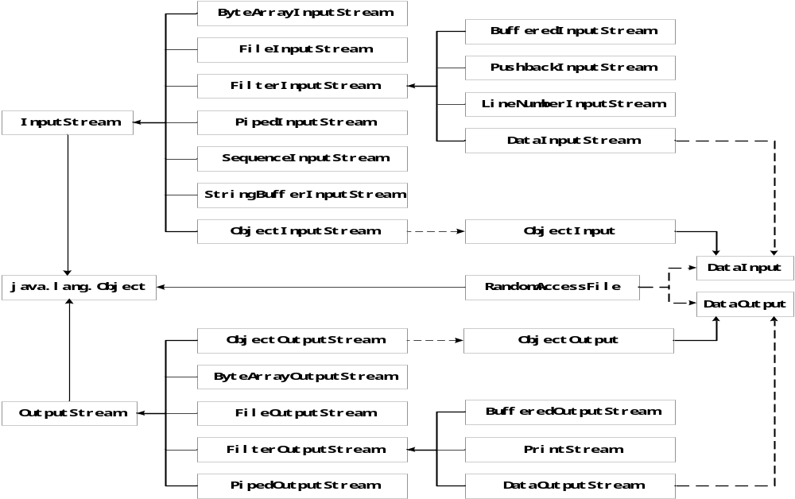
java.io

Slide 13
8.2 A Sample Read from and Write to a File

Slide 14

Reading Text Files
Simplest way to read text: use Scanner class
To read from a disk file, construct a FileReader
Then, use the FileReader to construct a Scanner object
Use the Scanner methods to read data from file
  next, nextLine, nextInt, and nextDouble
FileReader reader = new FileReader("input.txt");
Scanner in = new Scanner(reader);
String line = in.nextLine();
int i = in.nextInt();
Object-Oriented Programming and Design

Slide 15
Writing Text Files
To write to a file, construct a PrintWriter object
If file already exists, it is emptied before the new data are written into it
If file doesn't exist, an empty file is created
PrintWriter out = new PrintWriter("output.txt");
Object-Oriented Programming and Design
Continued…

Slide 16
Writing Text Files
Use print and println to write into a PrintWriter:
You must close a file when you are done processing it:
Otherwise, not all of the output may be written to the disk file
out.println(29.95);
out.println(new Rectangle(5, 10, 15, 25));
out.println("Hello, World!");
out.close();
Object-Oriented Programming and Design

Slide 17
A Sample Program
Reads all lines of a file and sends them to the output file, preceded by line numbers
Sample input file:
Mary had a little lamb
Whose fleece was white as snow.
And everywhere that Mary went,
The lamb was sure to go!
Object-Oriented Programming and Design
Continued…

Slide 18

A Sample Program
Program produces the output file:
Program can be used for numbering Java source files
/* 1 */ Mary had a little lamb
/* 2 */ Whose fleece was white as snow.
/* 3 */ And everywhere that Mary went,
/* 4 */ The lamb was sure to go!
Object-Oriented Programming and Design

Slide 19
File LineNumberer.java
01: import java.io.FileReader;
02: import java.io.IOException;
03: import java.io.PrintWriter;
04: import java.util.Scanner;
05:
06: public class LineNumberer
07: {
08: public static void main(String[] args)
09: {
10: Scanner console = new Scanner(System.in);
11: System.out.print("Input file: ");
12: String inputFileName = console.next();
13: System.out.print("Output file: ");
14: String outputFileName = console.next();
15:
16: try
17: {
Object-Oriented Programming and Design
Continued…

Slide 20
File LineNumberer.java
18: FileReader reader = new FileReader(inputFileName);
19: Scanner in = new Scanner(reader);
20: PrintWriter out = new PrintWriter(outputFileName);
21: int lineNumber = 1;
22:
23: while (in.hasNextLine())
24: {
25: String line = in.nextLine();
26: out.println("/* " + lineNumber + " */ " + line);
27: lineNumber++;
28: }
29:
30: out.close();
31: }
32: catch (IOException exception)
33: {
Continued…
Object-Oriented Programming and Design

Slide 21
File LineNumberer.java
34: System.out.println("Error processing file:"
+ exception);
35: }
36: }
37: }
Object-Oriented Programming and Design

Slide 22
Self Check
What happens when you supply the same name for the input and output files to the LineNumberer program?
What happens when you supply the name of a nonexistent input file to the LineNumberer program?
Object-Oriented Programming and Design

Slide 23
Answers
When the PrintWriter object is created, the output file is emptied. Sadly, that is the same file as the input file. The input file is now empty and the while loop exits immediately.
The program catches a FileNotFoundException, prints an error message, and terminates.
Object-Oriented Programming and Design

Slide 24
8.3 Text and Binary Formats

Slide 25

Text and Binary Formats
Two ways to store data:
  Text format
  Binary format
Object-Oriented Programming and Design

Slide 26

Text Format
Human-readable form
Sequence of characters
  Integer 12,345 stored as characters '1' '2' '3' '4' '5'
Use Reader and Writer and their subclasses to process input and output
To read:
To write
FileReader reader = new FileReader("input.txt");
FileWriter writer = new FileWriter("output.txt");
Object-Oriented Programming and Design

Slide 27
Binary Format
Data items are represented in bytes
Integer 12,345 stored as a sequence of four bytes 00 00 30 39
Use InputStream and OutputStream and their subclasses
More compact and more efficient
Object-Oriented Programming and Design
Continued…

Slide 28
Binary Format
To read:
To write
FileInputStream inputStream =
new FileInputStream("input.bin");
FileOutputStream outputStream =
new FileOutputStream("output.bin");
Object-Oriented Programming and Design

Slide 29

Reading a Single Character from a File in Binary Format
Use read method of InputStream class to read a single byte
  returns the next byte as an int
  or the integer -1 at end of file
InputStream in = . . .;
int next = in.read();
byte b;
if (next != -1)
b = (byte) next;
Object-Oriented Programming and Design

Slide 30
Reading a Single Character from a File in Text Format
Use read method of Reader class to read a single character
  returns the next character as an int
  or the integer -1 at end of file
Reader reader = . . .;
int next = reader.read();
char c;
if (next != -1)
c = (char) next;
Object-Oriented Programming and Design

Slide 31
Text and Binary Format
Use write method to write a single character or byte
read and write are the only input and output methods provided by the file input and output classes
Java stream package principle: each class should have a very focused responsibility
Object-Oriented Programming and Design
Continued…

Slide 32
Self Check
Suppose you need to read an image file that contains color values for each pixel in the image. Will you use a Reader or an InputStream?
Why do the read methods of the Reader and InputStream classes return an int and not a char or byte?
Object-Oriented Programming and Design

Slide 33
Answers
Image data is stored in a binary format–try loading an image file into a text editor, and you won't see much text. Therefore, you should use an InputStream.
They return a special value of -1 to indicate that no more input is available. If the return type had been char or byte, no special value would have been available that is distinguished from a legal data value.
Object-Oriented Programming and Design

Slide 34
An Encryption Program
File encryption
  To scramble it so that it is readable only to those who know the encryption method and secret keyword
To use Caesar cipher
  Choose an encryption key–a number between 1 and 25
  Example: If the key is 3, replace A with D, B with E, . . .
Object-Oriented Programming and Design

Slide 35
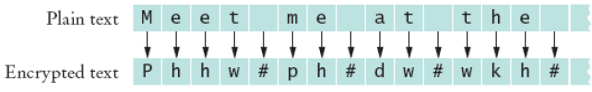
An Encryption Program
To decrypt, use the negative of the encryption key
Object-Oriented Programming and Design

Slide 36
To Encrypt Binary Data
int next = in.read();
if (next == -1) done = true;
else
{
//call the method to encrypt the byte
byte b = (byte) next;
byte c = encrypt(b);
out.write(c);
}
Object-Oriented Programming and Design

Slide 37
File Encryptor.java
01: import java.io.File;
02: import java.io.FileInputStream;
03: import java.io.FileOutputStream;
04: import java.io.InputStream;
05: import java.io.OutputStream;
06: import java.io.IOException;
07:
08: /**
09: An encryptor encrypts files using the Caesar cipher.
10: For decryption, use an encryptor whose key is the
11: negative of the encryption key.
12: */
13: public class Encryptor
14: {
15: /**
16: Constructs an encryptor.
17: @param aKey the encryption key
18: */
Object-Oriented Programming and Design
Continued…

Slide 38
File Encryptor.java
19: public Encryptor(int aKey)
20: {
21: key = aKey;
22: }
23:
24: /**
25: Encrypts the contents of a file.
26: @param inFile the input file
27: @param outFile the output file
28: */
29: public void encryptFile(String inFile, String outFile)
30: throws IOException
31: {
32: InputStream in = null;
33: OutputStream out = null;
34:
35: try
36: {
Object-Oriented Programming and Design
Continued…

Slide 39
File Encryptor.java
37: in = new FileInputStream(inFile);
38: out = new FileOutputStream(outFile);
39: encryptStream(in, out);
40: }
41: finally
42: {
43: if (in != null) in.close();
44: if (out != null) out.close();
45: }
46: }
47:
48: /**
49: Encrypts the contents of a stream.
50: @param in the input stream
51: @param out the output stream
52: */
Continued…
Object-Oriented Programming and Design

Slide 40
File Encryptor.java
53: public void encryptStream(InputStream in, OutputStream out)
54: throws IOException
55: {
56: boolean done = false;
57: while (!done)
58: {
59: int next = in.read();
60: if (next == -1) done = true;
61: else
62: {
63: byte b = (byte) next;
64: byte c = encrypt(b);
65: out.write(c);
66: }
67: }
68: }
69:
Object-Oriented Programming and Design
Continued…

Slide 41
File Encryptor.java
70: /**
71: Encrypts a byte.
72: @param b the byte to encrypt
73: @return the encrypted byte
74: */
75: public byte encrypt(byte b)
76: {
77: return (byte) (b + key);
78: }
79:
80: private int key;
81: }
Object-Oriented Programming and Design

Slide 42
File EncryptorTester.java
01: import java.io.IOException;
02: import java.util.Scanner;
03:
04: /**
05: A program to test the Caesar cipher encryptor.
06: */
07: public class EncryptorTester
08: {
09: public static void main(String[] args)
10: {
11: Scanner in = new Scanner(System.in);
12: try
13: {
14: System.out.print("Input file: ");
15: String inFile = in.next();
16: System.out.print("Output file: ");
17: String outFile = in.next();
Object-Oriented Programming and Design
Continued…

Slide 43
File EncryptorTester.java
18: System.out.print("Encryption key: ");
19: int key = in.nextInt();
20: Encryptor crypt = new Encryptor(key);
21: crypt.encryptFile(inFile, outFile);
22: }
23: catch (IOException exception)
24: {
25: System.out.println("Error processing file: "
+ exception);
26: }
27: }
28: }
29:
30:
Object-Oriented Programming and Design

Slide 44
Self Test
Decrypt the following message: Khoor/#Zruog$.
Can you use this program to encrypt a binary file, for example, an image file?
Object-Oriented Programming and Design

Slide 45
Answers
It is "Hello, World!", encrypted with a key of 3.
Yes–the program uses streams and encrypts each byte.
Object-Oriented Programming and Design

Slide 46
8.4 Random Access & Sequential Access

Slide 47


Random Access vs. Sequential Access
Sequential access
  A file is processed a byte at a time
  It can be inefficient
Random access
  Allows access at arbitrary locations in the file
  Only disk files support random access
    System.in and System.out do not
  Each disk file has a special file pointer position
    You can read or write at the position where the pointer is
Object-Oriented Programming and Design
Continued…

Slide 48
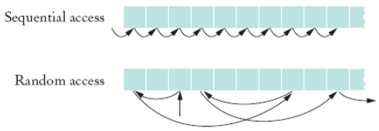
Random Access vs. Sequential Access
Each disk file has a special file pointer position
  You can read or write at the position where the pointer is
Object-Oriented Programming and Design

Slide 49
RandomAccessFile
You can open a file either for
  Reading only ("r")
  Reading and writing ("rw")
To move the file pointer to a specific byte
RandomAccessFile f = new
RandomAcessFile("bank.dat","rw");
f.seek(n);
Object-Oriented Programming and Design
Continued…

Slide 50
RandomAccessFile
To get the current position of the file pointer.
To find the number of bytes in a file long
long n = f.getFilePointer();
//of type "long" because files can be very large
fileLength = f.length();
Object-Oriented Programming and Design

Slide 51
A Sample Program
Use a random access file to store a set of bank accounts
Program lets you pick an account and deposit money into it
To manipulate a data set in a file, pay special attention to data formatting
  Suppose we store the data as text
  Say account 1001 has a balance of $900, and account 1015 has a balance of 0
Object-Oriented Programming and Design

Slide 52


A Sample Program
We want to deposit $100 into account 1001
If we now simply write out the new value, the result is
Object-Oriented Programming and Design

Slide 53
A Sample Program
Better way to manipulate a data set in a file:
  Give each value a fixed size that is sufficiently large
  Every record has the same size
  Easy to skip quickly to a given record
  To store numbers, it is easier to store them in binary format
Object-Oriented Programming and Design

Slide 54
A Sample Program
RandomAccessFile class stores binary data
readInt and writeInt read/write integers as four-byte quantities
readDouble and writeDouble use 8 bytes
double x = f.readDouble();
f.writeDouble(x);
Continued…
Object-Oriented Programming and Design

Slide 55
A Sample Program
To find out how many bank accounts are in the file
public int size() throws IOException
{
return (int) (file.length() / RECORD_SIZE);
// RECORD_SIZE is 12 bytes:
// 4 bytes for the account number and
// 8 bytes for the balance
}
Object-Oriented Programming and Design

Slide 56
A Sample Program
To read the nth account in the file
public BankAccount read(int n)
throws IOException
{
file.seek(n * RECORD_SIZE);
int accountNumber = file.readInt();
double balance = file.readDouble();
return new BankAccount(
accountNumber, balance);
}
Object-Oriented Programming and Design

Slide 57
A Sample Program
To write the nth account in the file
public void write(int n, BankAccount account)
throws IOException
{
file.seek(n * RECORD_SIZE);
file.writeInt(account.getAccountNumber());
file.writeDouble(account.getBalance());
}
Object-Oriented Programming and Design

Slide 58
File BankDatatester.java
01: import java.io.IOException;
02: import java.io.RandomAccessFile;
03: import java.util.Scanner;
04:
05: /**
06: This program tests random access. You can access existing
07: accounts and deposit money, or create new accounts. The
08: accounts are saved in a random access file.
09: */
10: public class BankDataTester
11: {
12: public static void main(String[] args)
13: throws IOException
14: {
15: Scanner in = new Scanner(System.in);
16: BankData data = new BankData();
17: try
Object-Oriented Programming and Design
Continued…

Slide 59
File BankDatatester.java
18: {
19: data.open("bank.dat");
20:
21: boolean done = false;
22: while (!done)
23: {
24: System.out.print("Account number: ");
25: int accountNumber = in.nextInt();
26: System.out.print("Amount to deposit: ");
27: double amount = in.nextDouble();
28:
29: int position = data.find(accountNumber);
30: BankAccount account;
31: if (position >= 0)
32: {
33: account = data.read(position);
34: account.deposit(amount);
Continued…
Object-Oriented Programming and Design

Slide 60
File BankDatatester.java
35: System.out.println("new balance="
36: + account.getBalance());
37: }
38: else // Add account
39: {
40: account = new BankAccount(accountNumber,
41: amount);
42: position = data.size();
43: System.out.println("adding new account");
44: }
45: data.write(position, account);
46:
47: System.out.print("Done? (Y/N) ");
48: String input = in.next();
49: if (input.equalsIgnoreCase("Y")) done = true;
50: }
51: }
Continued…
Object-Oriented Programming and Design

Slide 61
File BankDatatester.java
52: finally
53: {
54: data.close();
55: }
56: }
57: }
58:
59:
60:
61:
62:
63:
64:
65:
66:
67:
68:
69:
Object-Oriented Programming and Design

Slide 62
File BankData.java
001: import java.io.IOException;
002: import java.io.RandomAccessFile;
003:
004: /**
005: This class is a conduit to a random access file
006: containing savings account data.
007: */
008: public class BankData
009: {
010: /**
011: Constructs a BankData object that is not associated
012: with a file.
013: */
014: public BankData()
015: {
016: file = null;
017: }
Object-Oriented Programming and Design
Continued…

Slide 63
File BankData.java
018:
019: /**
020: Opens the data file.
021: @param filename the name of the file containing savings
022: account information
023: */
024: public void open(String filename)
025: throws IOException
026: {
027: if (file != null) file.close();
028: file = new RandomAccessFile(filename, "rw");
029: }
030:
031: /**
032: Gets the number of accounts in the file.
033: @return the number of accounts
034: */
Object-Oriented Programming and Design
Continued…

Slide 64
File BankData.java
035: public int size()
036: throws IOException
037: {
038: return (int) (file.length() / RECORD_SIZE);
039: }
040:
041: /**
042: Closes the data file.
043: */
044: public void close()
045: throws IOException
046: {
047: if (file != null) file.close();
048: file = null;
049: }
050:
Object-Oriented Programming and Design
Continued…

Slide 65
File BankData.java
051: /**
052: Reads a savings account record.
053: @param n the index of the account in the data file
054: @return a savings account object initialized with
// the file data
055: */
056: public BankAccount read(int n)
057: throws IOException
058: {
059: file.seek(n * RECORD_SIZE);
060: int accountNumber = file.readInt();
061: double balance = file.readDouble();
062: return new BankAccount(accountNumber, balance);
063: }
064:
065: /**
066: Finds the position of a bank account with a given
// number
Continued…
Object-Oriented Programming and Design

Slide 66
File BankData.java
067: @param accountNumber the number to find
068: @return the position of the account with the given
// number,
069: or -1 if there is no such account
070: */
071: public int find(int accountNumber)
072: throws IOException
073: {
074: for (int i = 0; i < size(); i++)
075: {
076: file.seek(i * RECORD_SIZE);
077: int a = file.readInt();
078: if (a == accountNumber) // Found a match
079: return i;
080: }
081: return -1; // No match in the entire file
082: }
Object-Oriented Programming and Design
Continued…

Slide 67
File BankData.java
083:
084: /**
085: Writes a savings account record to the data file
086: @param n the index of the account in the data file
087: @param account the account to write
088: */
089: public void write(int n, BankAccount account)
090: throws IOException
091: {
092: file.seek(n * RECORD_SIZE);
093: file.writeInt(account.getAccountNumber());
094: file.writeDouble(account.getBalance());
095: }
096:
097: private RandomAccessFile file;
098:
Object-Oriented Programming and Design
Continued…

Slide 68
File BankData.java
099: public static final int INT_SIZE = 4;
100: public static final int DOUBLE_SIZE = 8;
101: public static final int RECORD_SIZE
102: = INT_SIZE + DOUBLE_SIZE;
103: }
Object-Oriented Programming and Design

Slide 69
Output
Account number: 1001
Amount to deposit: 100
adding new account
Done? (Y/N) N
Account number: 1018
Amount to deposit: 200
adding new account
Done? (Y/N) N
Account number: 1001
Amount to deposit: 1000
new balance=1100.0
Done? (Y/N) Y
Object-Oriented Programming and Design

Slide 70
Self Check
Why doesn't System.out support random access?
What is the advantage of the binary format for storing numbers? What is the disadvantage?
Object-Oriented Programming and Design

Slide 71
Answers
Suppose you print something, and then you call seek(0), and print again to the same location. It would be difficult to reflect that behavior in the console window.
Advantage: The numbers use a fixed amount of storage space, making it possible to change their values without affecting surrounding data. Disadvantage: You cannot read a binary file with a text editor.
Object-Oriented Programming and Design

Slide 72
8.5 Using File I/O in Library System

Slide 73
Using File in the Library System
The catalog will be stored in a data file and the library system will load the catalog from that file.
  Book_code_title_year_author_numberOfPages
  Recording_code_title_year_performer_format
The user will be able to save the borrower data to a file in one of three formats: Plain text, HTML and XML.
Object-Oriented Programming and Design

Slide 74
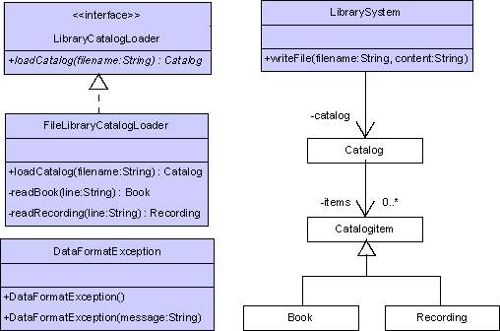
Object-Oriented Programming and Design

Slide 75
Exercise
Reading chapter 15 in textbook.
Object-Oriented Programming and Design

