Slide 1

Chapter 1 Java Language Overview
Ch1. Language Basics (2)
杨巍
yangwei@mail.neu.edu.cn

Slide 2
Variables
declaring a local variable
All variables must first be declared before they can be used
Data-types variable-name;
int num;
int num,num1,num2;

Slide 3
Naming
Always begin your variable names with a letter, not "$" or "_“
Subsequent characters may be letters, digits, dollar signs, or underscore characters.
Variable names are case-sensitive.
Avoid using keywords

Slide 4
Key words
abstract | default | if | protected | throws
assert | do | implements | public | transient
boolean | double | import | return | try
break | else | instanceof | short | void
byte | extends | int | static | volatile
case | enum | interface | synchronized | while
catch | final | long | super
char | fianlly | native | strictfp
class | float | new | switch
continue | for | package | this
const | goto | private | throw

Slide 5
Naming
If the name you choose consists of only one word, spell that word in all lowercase letters.
If it consists of more than one word, capitalize the first letter of each subsequent word.
int year;
int currentGear;

Slide 6
Initializing declaration
Initializing declaration
Declaration that also assigns an initial value
Data-types variable-name;
variable-name=initial-value;
int num;
num=9;
int num=9;

Slide 7
Data type
A variable's data type determines the values it may contain, plus the operations that may be performed on it.
Data type
primitive types
Integral number
floating point number
char
boolean
reference types

Slide 8
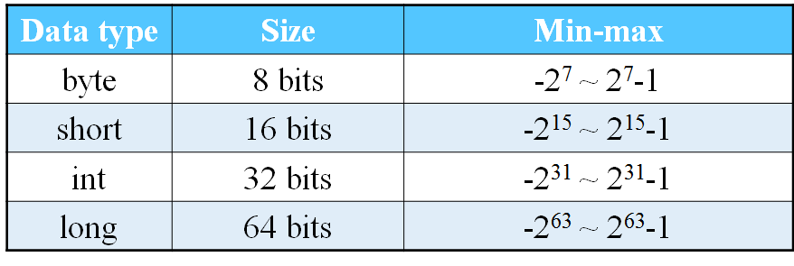
Primitive types
Integral number

Slide 9
Integer Literals
Integer Literals
An integer literal is of type long if it ends with the letter L or l;
otherwise it is of type int.
Values of the integral types byte, short, int, and long can be created from int literals.
Values of type long that exceed the range of int can be created from long literals.

Slide 10
Integer Literals
Integer literals can be expressed by these number systems
Decimal
Base 10
Hexadecimal
Base 16
Binary
Base 2

Slide 11
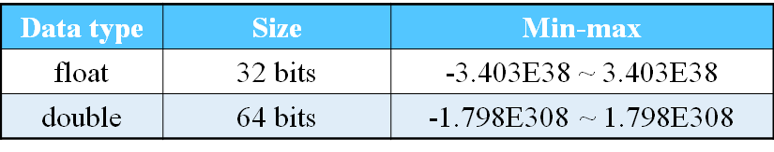
Primitive types
Floating point number

Slide 12
Floating-Point Literals
Floating-Point Literals
A floating-point literal is of type float if it ends with the letter F or f;
otherwise its type is double and it can optionally end with the letter D or d.

Slide 13
Floating-Point Literals
Floating-Point Literals
For scientific notation
The floating point types (float and double) can also be expressed using E or e
public class DataDemo{
public static void main(String[ ] args){
double d1 = 123.4;
double d2=1.234e2;
}
}

Slide 14
boolean
The boolean data type has only two possible values
true and false
Use this data type for simple flags that track true/false conditions.

Slide 15
char
char
The char data type is a single 16-bit Unicode character.
Java采用Unicode字符码系统
Unicode为每个字符制订了一个唯一的数值
Always use 'single quotes' for char literals

Slide 16
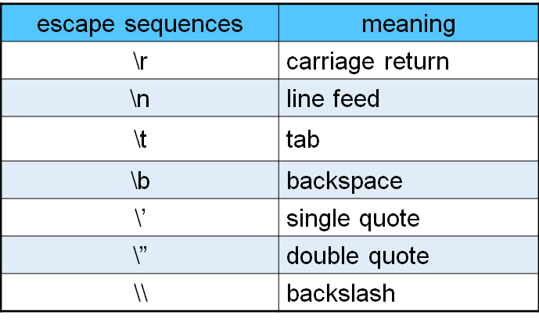
char
Unicode escape sequences

Slide 17
Summary of Variables
The eight primitive data types are
byte, short, int, long
float, double
boolean, and char.
A literal is the source code representation of a fixed value.

Slide 18
Operators
Java was inherited from C++, most of these operators will be familiar to C and C++ programmers.
Java has also added some improvements and simplifications.
An operator takes one or more arguments and produces a new value.

Slide 19
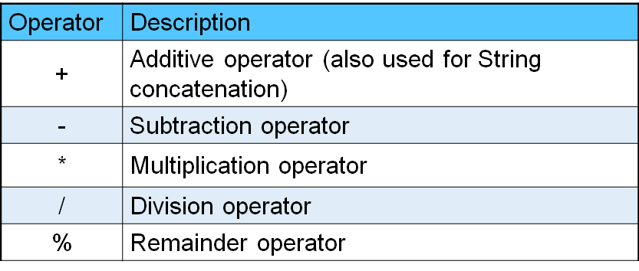
Operators
Assignment Operator
=
The Arithmetic Operators

Slide 20
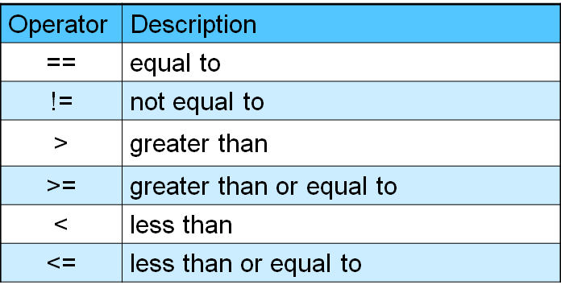
Operators
The Equality and Relational Operators
Notes:
Now that you've learned how to declare and initialize variables, you probably want to know how to do something with them.

Slide 21
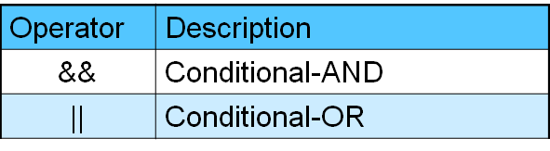
Operators
The Conditional Operators
These operators exhibit "short-circuiting" behavior, which means that the second operand is evaluated only if needed

Slide 22
Operators
Bitwise and Bit Shift Operators
perform bitwise and bit shift operations on integral types
The operators discussed in this section are less commonly used.
The intent is to simply make you aware that these operators exist.

Slide 23
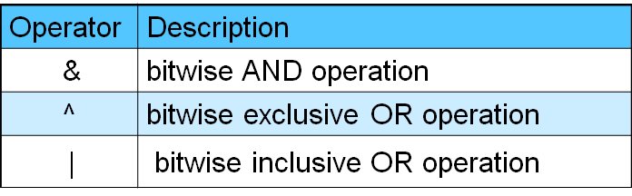
Operators
Bitwise and Bit Shift Operators

Slide 24
Operators
Type conversion
Numbers are automatically promoted to a more inclusive type if no information is lost.

Slide 25
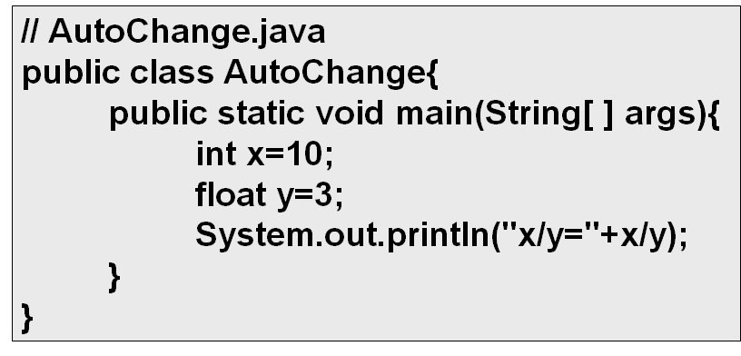
Operators

Slide 26
Operators
Casting operator
Casting allows you to make this type conversion explicit, or to force it when it wouldn’t normally happen.
Cast should be used sparingly and with care.
(converted-type)variable;

Slide 27
Operators
//Casting.java
public class Casting{
public static void main(String[ ] args){
int x=10;
int y=3;
System.out.println("x/y="+ (float)x/y );
}
}

Slide 28
Operators
Casting operator
Java allows you to cast any primitive type to any other primitive type, except for boolean, which doesn’t allow any casting at all.
Class types do not allow casting.

Slide 29
Operators
Precedence
defines how an expression evaluates when several operators are present.
Java has specific rules that determine the order of evaluation.
multiplication and division happen before addition and subtraction
use parentheses to make the order of evaluation explicit

Slide 30
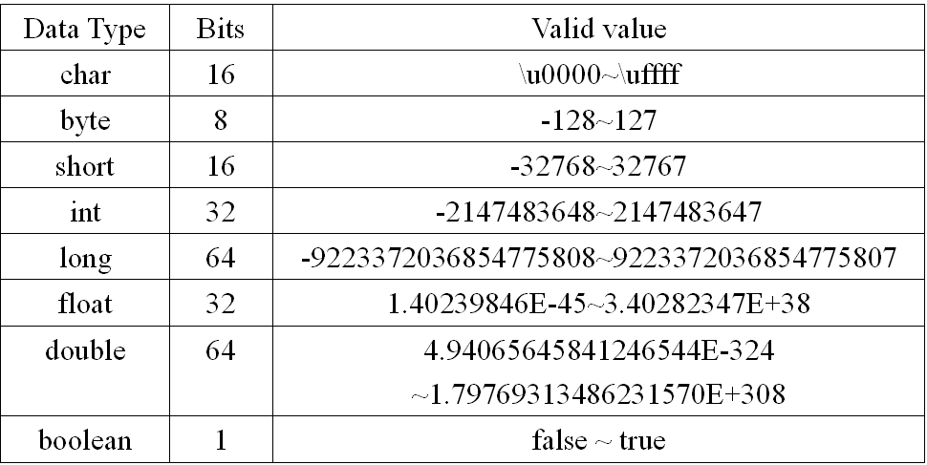
Summary

Slide 31
Summary
Promotion
Automatic
Casting operator

Slide 32
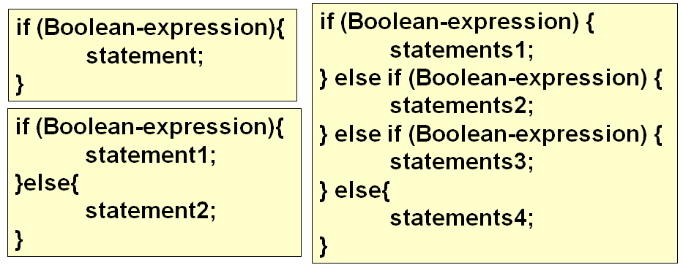
if Statements
Note that Java doesn’t allow you to use a number as a boolean.

Slide 33
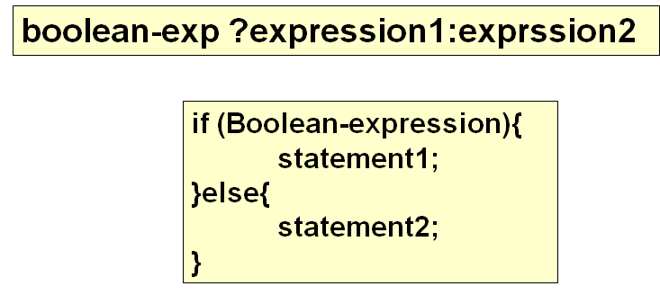
if Statements
Ternary if-else operator
Notes:
conditional operator

Slide 34
switch Statements
switch Statements
selection statement
have a number of possible execution paths.
Switch语句中选择值只能是字符或整形常量
each case ends with a break
But the break is optional

Slide 35
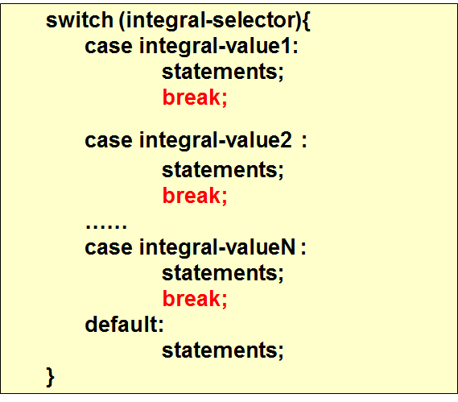
switch Statements

Slide 36
switch Statements
Using Strings in switch Statements
In Java SE 7 and later, you can use a String object in the switch statement's expression.

Slide 37
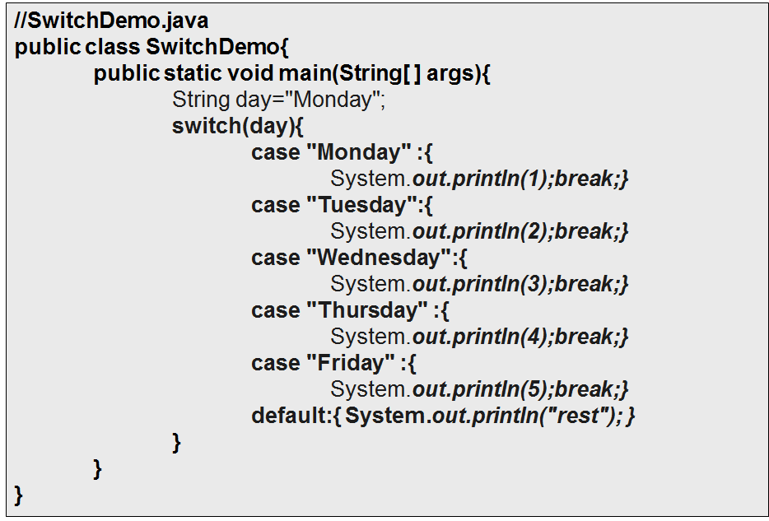

Slide 38
while Statements
事先不知道循环该执行多少次
While语句先判断，后执行
while (Boolean-expression){
statements;
increment/decrement counter;
}

Slide 39
while (Boolean-expression){
statements;
increment/decrement counter;
}
initialize
Boolean
expression
F
T
statement or block
Increment/decrement
Notes:
break语句
使用break语句使得循环从For或while中跳出;
continue语句
continue使得跳过循环内剩余的语句而进入下一次循环；

Slide 40
do…while Statements
do…while
The sole difference between while and do-while is that the statement of the do-while always executes at least once, even if the expression evaluates to false the first time
do {
statements;
increment/decrement counter;
} while (Boolean-expression);

Slide 41
do {
statements;
increment/decrement counter;
} while (Boolean-expression);
initialize
statement or block
Increment/decrement
T
Boolean
expression
F

Slide 42
for Statements
for(Expression1;Expression2;Expression3) {
statements;
}
for (initialize; Boolean-expression; increment/decrement) {
statements;
}
Expression1;
while( Expression2 ) {
Block;
Expression3
};

Slide 43
for Statements
initialize
Boolean
expression
F
T
statement or block
Increment/decrement

Slide 44
Break and continue
Break statement
Immediately exits the loops
Continue statement
Immediately begins the next iteration of the loop

Slide 45
Scoping
Scoping
Determines both the visibility and lifetime of the names defined within that scope.
In C, C++, and Java, scope is determined by the placement of curly braces {}
Determination comes entirely from the location in which the variable is declared — which is between the opening and closing braces of a method.

Slide 46
Scoping
{
int x = 12;
{
int x = 96; // Illegal
}
}
The compiler will announce that the variable x has already been defined.
Notes:
尽管在C和C++中是合法的，但是在Java中却不能像下面这样做：

Slide 47
Comments
Comments
Comments are ignored by the compiler but are useful to other programmers.
The Java programming language supports three kinds of comments
Comments on one line
Comments on one or more lines
Documentation comments

Slide 48
Comments
Comments on one line
The compiler ignores everything from // to the end of the line.
// This is comment on one line
int num = 10; // declare a variable named num

Slide 49
Comments
Comments on one or more lines
The compiler ignores everything from /* to */.
/*
int = 10; //
int x=5;
*/

Slide 50
Comments
Documentation comments
以/**开头，以*/结尾，中间可以加入特殊的指令
文档注释放在类、变量和方法之前，说明其作用
/**
* Title: test
* @author yw
* @version 1.0
*/

Slide 51
Comments
Documentation comments(doc comment)
The compiler ignores this kind of comment, just like it ignores comments that use /* and */.
The javadoc tool uses doc comments when preparing automatically generated documentation.
javadoc 类文件(带扩展名)

Slide 52
The aims of this session
Java basic
Variable
Datatype
Operators
Control structure
Comments

