Slide 1
Part 7 Exception Handling
Object-Oriented Programming and Design
Software College of NEU

Slide 2
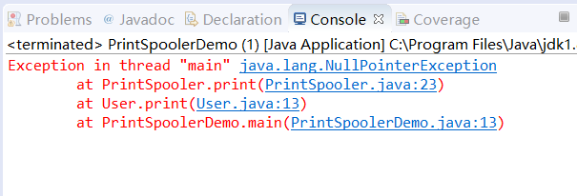


A Common Exception
java.lang.NullPointerException

Slide 3
Contents
What is an Exception
Generating an Exception (throw/throws)
Dealing with Exceptions (try/catch/finally)
Checked vs Unchecked Exceptions
How to write your own Exception

Slide 4
1. What is an Exception

Slide 5
Common Programmer faults
Incorrect implementation of program specification
Variables that have not been assigned an object
Variables with incorrectly assigned values
Index out of bound
Inconsistent or inappropriate object state
Path or file not found
Infinite loops
Divide by zero errors…. & …….. the list is endless
Programmers may get it right, but faults still occur!

Slide 6

Common Programmer faults
Incorrect implementation of program specification
Variables that have not been assigned an object
Variables with incorrectly assigned values
Index out of bound
Inconsistent or inappropriate object state
Path or file not found
Infinite loops
Divide by zero errors…. & …….. the list is endless
Abnormal events often arise from the environment:
  Incorrect URL entered
  Network interruption
File processing is particularly error-prone:
  Missing files
  Lack of appropriate permissions
Programmers may get it right, but faults still occur!

Slide 7
What should we do to provide strong applications?
Anticipating Errors
  Where are errors likely to occur
  What is the nature of those errors
Error handling
  Can we detect the error
  What should we do if the error occurs
Error reporting
  Who should we tell, what should we say, and how should we log the error?

Slide 8
What can we do until now?
Ignore
  Possible program crash, corrupted state, corrupted data
Write a message to the screen & continue on
  Not practical sometimes, who reads the message still have a corrupted state
Block the request that caused the problem, write error to log and shut down program
  Would this be satisfactory for a software product?
Exceptions Provide a structured approach to deal with abnormal events that occur in a program.

Slide 9

Exceptions
When a code block encounters an abnormal condition (an exception condition) that it can’t handle itself...
  An Exception is created
  The exception is thrown
  Normal program flow-of-control stops
  The program searches for code that will catch the exception (deal with the exception)
    Abandons each method on the stack until a handler is found
  After the exception is dealt with normal program flow starts again

Slide 10
Definition of Exception
An exception is an abnormal event that occurs during the execution of a program that disrupts the normal flow of instructions.
Throwing an exception:
  When an abnormal event occurs the code creates an exception object and hands it off to the runtime system.
  The exception object contains information about the exception, including its type and the state of the program when the error occurred.
Catching an exception:
  It happens when the exception object bubbles up through the call stack until an appropriate exception handler is found. The handler catches the exception.

Slide 11
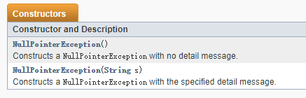
Javadoc for java.lang.NullPointerException
public class NullPointerException extends RuntimeException
NullPointerException objects may be constructed by the virtual machine as if suppression were disabled and/or the stack trace was not writable.
https://docs.oracle.com/javase/7/docs/api/java/lang/NullPointerException.html

Slide 12
Javadoc for java.lang.NullPointerException
Thrown when an application attempts to use null in a case where an object is required. These include:
  Calling the instance method of a null object.
  Accessing or modifying the field of a null object.
  Taking the length of null as if it were an array.
  Accessing or modifying the slots of null as if it were an array.
  Throwing null as if it were a Throwable value.
Applications should throw instances of this class to indicate other illegal uses of the null object.
https://docs.oracle.com/javase/7/docs/api/java/lang/NullPointerException.html

Slide 13
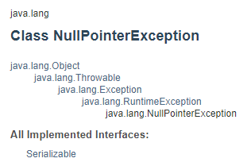
Javadoc for java.lang.NullPointerException
https://docs.oracle.com/javase/7/docs/api/java/lang/NullPointerException.html

Slide 14
A portion of class Throwable inheritance hierarchy
Throwable
Exception
Error
RuntimeException
IOException
AWTError
ThreadDeath
VirtualMachineError
ClassCastException
NullPointerException
ArithmeticExcetion
IndexOutOfBoundException
NoSuchElementException
ArrayIndexOutOfBoundException
InputMismatchException

Slide 15
2. Generating an Exception
throw/throws

Slide 16
Throwing an exception
Throwable serves as the base class for an entire family of exception classes, declared in java.lang package, that your program can instantiate and throw.
To throw an exception, you must simply,
  Construct an exception object
  Then, use the keyword throw and throw the object
You can’t throw just any object as an exception, however—only those objects whose classes descend from Throwable.
throw new SomeThrowableExceptionType();

Slide 17
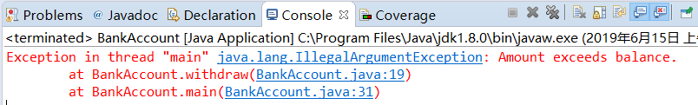
Throwing an exception
public class BankAccount
{
public void withdraw(double amount)
{
if (amount > balance)
{
IllegalArgumentException exception
= new IllegalArgumentException("Amount
exceeds balance");
throw exception;
}
balance = balance - amount;
}
. . .
}

Slide 18
Throwing an exception
No need to store exception object in a variable:
public class BankAccount
{
public void withdraw(double amount)
{
if (amount > balance)
{
IllegalArgumentException exception
= new IllegalArgumentException("Amount
exceeds balance");
throw exception;
}
balance = balance - amount;
}
. . .
}
throw new IllegalArgumentException(
"Amount exceeds balance");

Slide 19
Exception Specification
throws keyword is used when a method contains code that may throw an exception. Then the throws clause can be used to declare it.
It is also used if a method does not handle a checked exception. Then the method must throw it using the throws keyword.
The throws keyword appears at the end of a method header.
public void withdraw(double amount)
throws IllegalArgumentException

Slide 20
Exception Specification
Throw an exception and transfer control to a handler for this exception type.
public class BankAccount
{
public void withdraw(double amount)
throws IllegalArgumentException
{
if (amount > balance)
{
throw new IllegalArgumentException("Amount
exceeds balance");
}
balance = balance - amount;
}
. . .
}

Slide 21
Exception Specification
A method can throw more than one exception:
public class className
{
public void withdraw(double amount) throws
IOException, NullPointerException
{
// Method implementation
}
//Remainder of class definition
}

Slide 22
3. Dealing with Exceptions
try/catch/finally

Slide 23
The try/catch block
To catch an exception in java ,we have to write a try block with one or more catch clauses.
  The try block places a fence around a bit of code that is under the watchful eye of the associated catchers.
  Each catch clause specifies one exception type that it is prepared to handle.
try
{
//Java Statements that might create an exception
}
catch (ExceptionType variablename)
{
//Java Statements to handle exception
}

Slide 24
The try/catch block
Clients catching an exception must protect the call with a try statement:
Code that might create an exception
Code that generates an exception must be in enclosed within a try block
try
{
//Protect one or more statements here.
}
catch(Exception e)
{
//Report and recover from the exception here.
}
...
Catch the exception here
Write recovery code here
After recovery continue normal flow-of-control here

Slide 25
The try/catch block
If a code delimited by a try block throws an exception
  The associated catch blocks of that try block will be examined by the JVM
  If the JVM finds a catch clause that is prepared to handle the thrown exception, the program continues execution starting with the first statement of that catch clause.

Slide 26
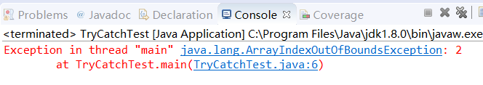
Example: Catching an exception
Observe the following code…
public class ExcepTest{
public static void main(String args[]){
int a[] = new int[2];
System.out.println("Access element three :" + a[2]);
}
}
The above is an array declared with 2 elements. Then the code tries to access the 3rd element of the array which throws an exception.

Slide 27
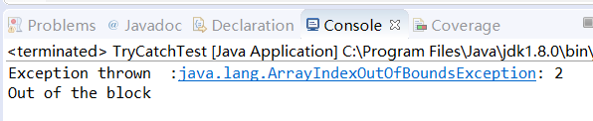
Example: Catching an exception
Solution:
  public class ExcepTest{
  public static void main(String args[]){
  try{
  int a[] = new int[2];
  System.out.println("Access element three :" + a[2]);
  }
  catch(ArrayIndexOutOfBoundsException e){
  System.out.println("Exception thrown :" + e);
  }
  System.out.println("Out of the block");
  }
  }

Slide 28
Multiple catch blocks
A try block can be followed by multiple catch blocks. The syntax for multiple catch blocks looks like the following:
try
{
//Protected code
}
catch(ExceptionType1 e1)
{
//Catch block 1
}
catch(ExceptionType2 e2)
{
//Catch block 2
}
If an exception occurs and it matches one of the catch clauses, execute the first one that matches.
If no exception occurs, or an
exception is thrown that doesn't match any catch clause, then skip the catch clauses.
Notes:
The previous statements demonstrate three catch blocks, but you can have any number of them after a single try. If an exception occurs in the protected code, the exception is thrown to the first catch block in the list. If the data type of the exception thrown matches ExceptionType1, it gets caught there. If not, the exception passes down to the second catch statement. This continues until the exception either is caught or falls through all catches, in which case the current method stops execution and the exception is thrown down to the previous method on the call stack.
A Bayley

Slide 29
Example: Catching multiple exceptions
try
{
String filename = . . .;
FileReader reader = new FileReader(filename);
Scanner in = new Scanner(reader);
String input = in.next();
int value = Integer.parseInt(input);
}
catch (IOException exception)
{
exception.printStackTrace();
}
catch (NumberFormatException exception)
{
System.out.println("Input was not a number");
}
Notes:
Signals that an end of file or end of stream has been reached unexpectedly during input. EOFException is a subclass of IOException. It will be thrown if you attempt to read from the stream and there is no more data to be read
A Bayley

Slide 30
Catching Exceptions
catch (IOException exception) block
  exception contains reference to the exception object that was thrown
  catch clause can analyze object to find out more details
  exception.printStackTrace(): printout of chain of method calls that lead to exception

Slide 31
The finally clause
The finally keyword is used to create a block of code that follows a try block.
try
{
//Protect one or more statements here.
}
catch(Exception e)
{
//Report and recover from the exception here.
}
finally {
//Perform any actions here whether or
//not an exception is thrown.
}

Slide 32
The finally clause
The finally keyword is used to create a block of code that follows a try block.
A finally block of code always executes, whether or not an exception has occurred.
Using a finally block allows you to run any cleanup (housekeeping) type of statements that you want to execute, no matter what happens in the protected code.

Slide 33
The finally clause
Exception terminates current method, which is danger as it may skip over essential code.
Example
  Must execute reader.close() even if exception happens
Use finally clause for code that must be executed "no matter what".
reader = new FileReader(filename);
Scanner in = new Scanner(reader);
readData(in);
reader.close(); // May never get here

Slide 34
The finally clause
FileReader reader = new FileReader(filename);
try
{
Scanner in = new Scanner(reader);
readData(in);
}
finally
{
reader.close(); // if an exception occurs, finally
// clause is also executed before
// exception is passed to its handler
}

Slide 35
The finally clause
Executed when try block is exited in any of three ways:
  After last statement of try block
  After last statement of catch clause, if this try block caught an exception
  When an exception was thrown in try block and not caught
Recommendation: don't mix catch and finally clauses in same try block

Slide 36
4. Checked vs UnChecked Exceptions

Slide 37
Exception categories
Unchecked exceptions (不受检查的异常)
  All exceptions under RuntimeException and Error classes
  Use for failures that is not checked by the compiler.
  Where recovery is difficult.
Checked exceptions (检查异常)
  All other Exceptions under the Throwable class
  Use for anticipated failures.
  Where recovery is possible in most cases.

Slide 38
Checked Exceptions
Checked exceptions are checked at compile-time
The compiler ensures that their use is tightly controlled.
  A code block throwing a checked exception, should handle the exception using try-catch block or declare it using the throws exception clause. If not the code block will give a compile-time error.
If used properly, failures may be recoverable.

Slide 39
Checked Exception Example –
Text input from file
try {
BufferedReader reader =
new BufferedReader(new FileReader("filename"));
String line = reader.readLine();
while(line != null) {
do something with line
line = reader.readLine();
}
reader.close();
}
catch(FileNotFoundException e) {
the specified file could not be found
}
catch(IOException e) {
something went wrong with reading or closing
}

Slide 40
Unchecked Exceptions
These exceptions are not checked by the compiler.
Cause program termination if not caught.
  We need not catch Unchecked Exceptions if we expect the result of such a exception to be program termination
  However, if there is a need to catch an Unchecked Exception, then an exception handler can be written for it, just like a Checked Exception
IllegalArgumentException is a typical example.

Slide 41
Unchecked Exception Example
/**
* Look up a name or phone number and return the
* corresponding contact details.
* @param key The name or number to be looked up.
* @return The details corresponding to the key,
* or null if there are none matching.
* @throws IllegalArgumentException if the key is null or empty
*/
public ContactDetails getDetails(String key)
{
if(key == null) {
throw new IllegalArgumentException("null key in getDetails");
}
if(key.trim().length() == 0) {
throw new IllegalArgumentException("Empty key passed to getDetails");
return book.get(key);
}

Slide 42
5. How to write your own Exceptios

Slide 43
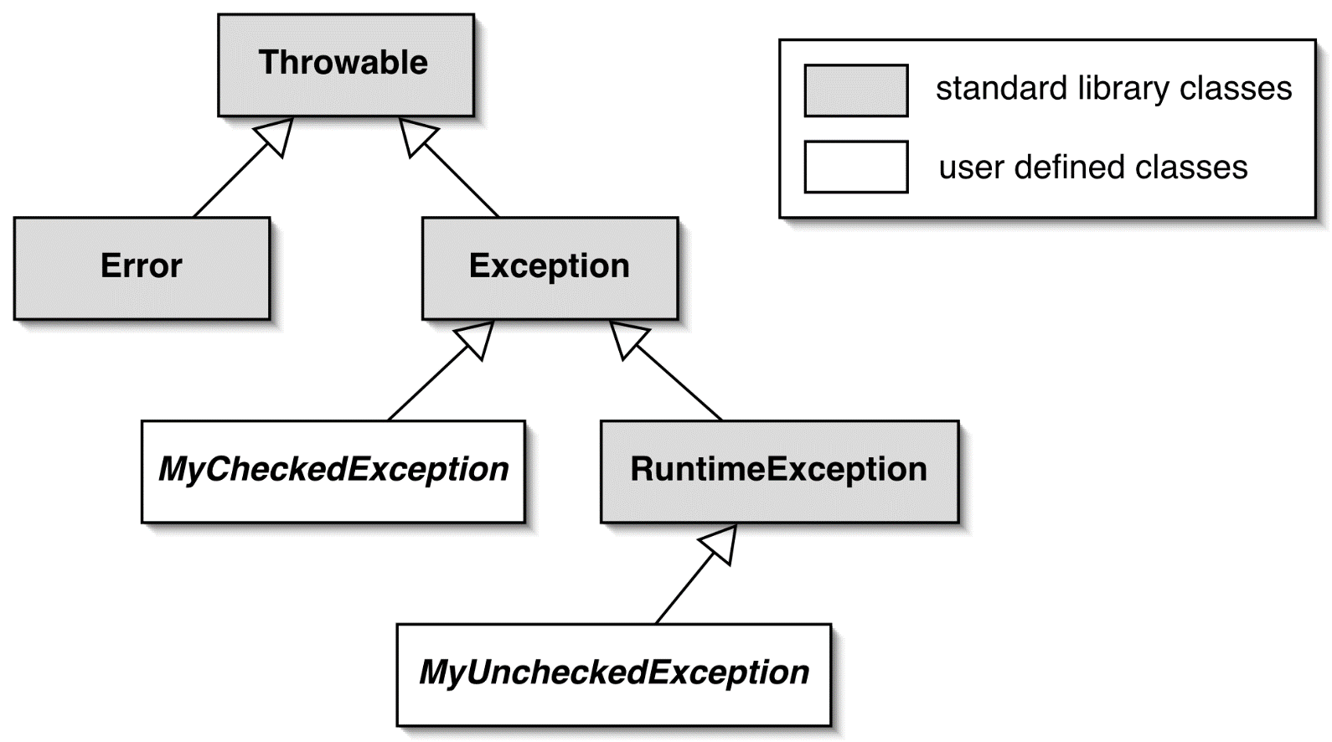
Designing Your Own Execution Types
You can design your own exception types–subclasses of Exception or RuntimeException
The ones you write
Difficult to recover, fewer rules
Can recover, rules enforced by compiler

Slide 44
Designing Your Own Execution Types
Keep the following points in mind when writing your own exception classes:
  All exceptions must be a child of Throwable.
  If you want to write a checked exception that is automatically enforced by the Handle or Declare Rule, you need to extend the Exception class.
  If you want to write an unchecked exception, you need to extend the RuntimeException class.

Slide 45

Example
public class InsufficientFundsException
extends RuntimeException{
public InsufficientFundsException() {}
public InsufficientFundsException(String message){
super(message);
}
}
public class BankAccount {
public void withdraw(double amount){
if (amount > balance){
throw new InsufficientFundsException(
"withdrawal of " + amount
+ " exceeds balance of " + balance);
}
balance = balance - amount;
}
. . .
}

Slide 46
Homework
Add necessary exception handling program to your Gourmet coffee or library system.

Slide 47
Part 7 Exception Handling
Object-Oriented Programming and Design
Software College of NEU

