Slide 1
The DESIGN ethos OF GERMANY
韩宁 李敏 王智翔 张嘉欣

Slide 2
Rational
Practical
Social Responsible
Function-related

Slide 3
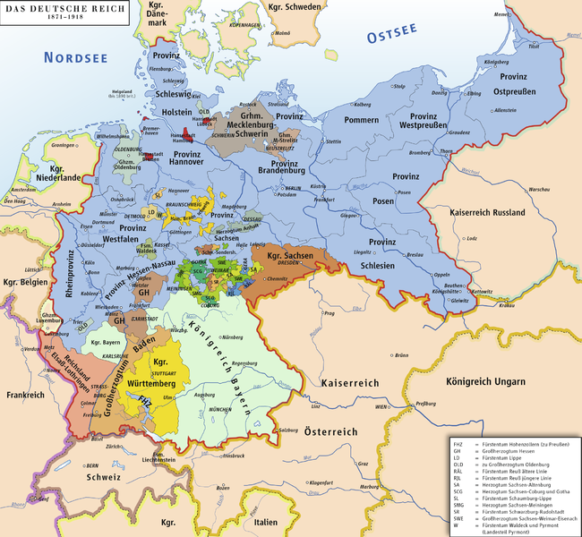
Give its geographical location center. Germany has always been a country that has been open to and indeed adopted influence from outside.
It was never a global political force like England, France, Spain or and Portugal.
Because the more or less autonomous small individual states prevented it from being so.

Slide 4


The widespread preconception that in 1920s Germany, modern design only took place in the Bauhaus must be refuted.
Modernism begins with the Thonet chair. That is correct inasmuch as Chair №14 made in 1859 was the first semi-industrially mass-produced article that no longer reflected on historical design templates and appeared to anticipate the dictum ‘Form follows function ’that Louis Sullivan devised in 1896 when referring to the challenge presented by now office building in the US

Slide 5

Immanuel Kant in his 1790 Critique of Judgement introduced the term ‘free’and ‘applied’beauty, thereby establishing an idealistic term for beauty which, however, accorded everyday objects, as well as architecture, a lower standing in the arts, as they could not necessary, was regarded as the real architectural aspect. And John Ruskin still differentiated between ‘architecture’ and ‘building’.

Slide 6
Vienna around 1900
Mathildenhohe in Darmstadt
Peter Behrens and AEG
Deutscher Werkbund
Werkbund dispute in 1914
Constructivism from Russia
De Stiji from the Netherlands
Japan
‘Modern architecture is: Japanese culture plus European tradition’,Adolf Loos wrote in 1927 in Vienna

Slide 7
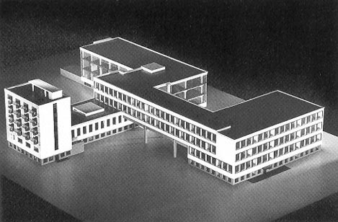
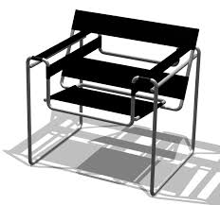

The Bauhaus
The ‘New Frankfurt’
Design under the Swastika
Design from the United States
Good Design
HfG (ULM)

