Slide 1
Paper cutting
石辰琪

Slide 2
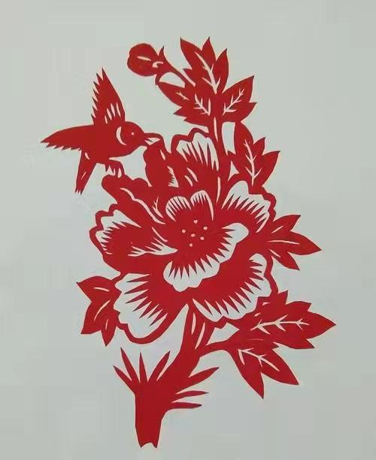
Paper cutting is one of the most ancient folk arts in China

Slide 3
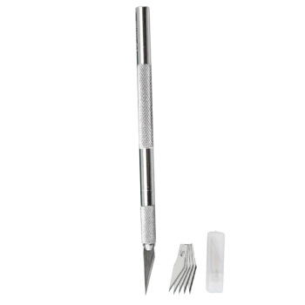
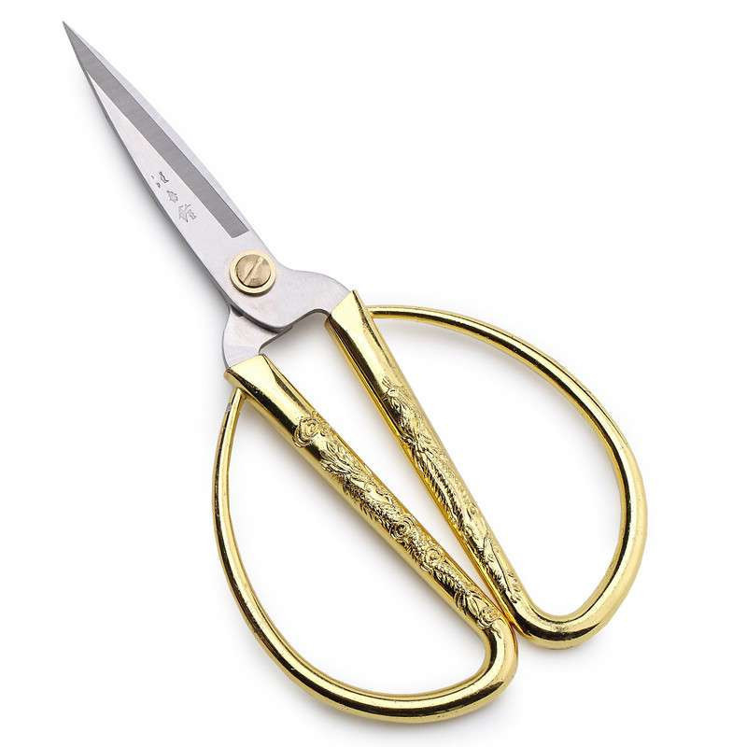
````````````
Scissor
Carving knife

Slide 4
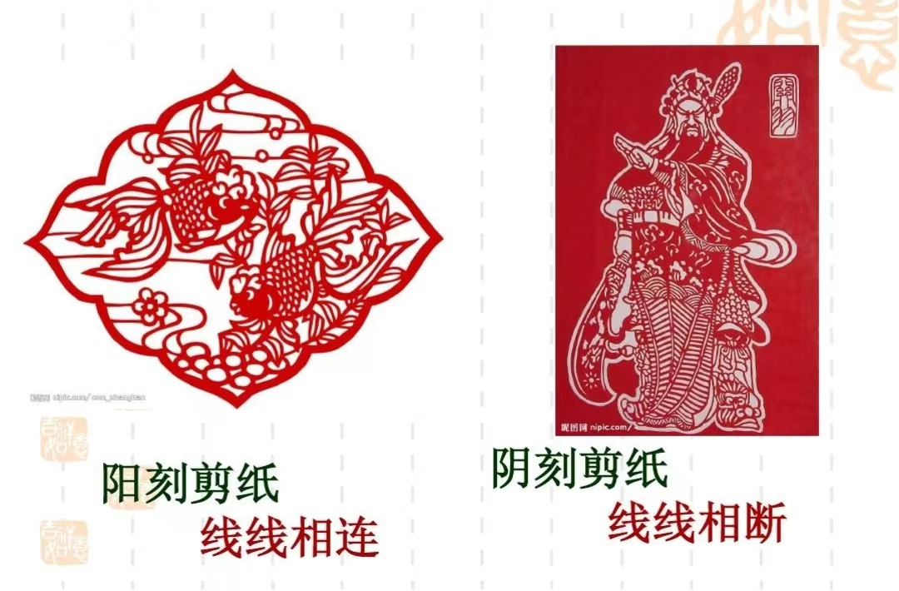
阳刻hollows out the parts other than the pattern, retains the original dots, lines and surfaces of the pattern. 阴刻hollows out the pattern itself, and shows the pattern with the background color.

Slide 5
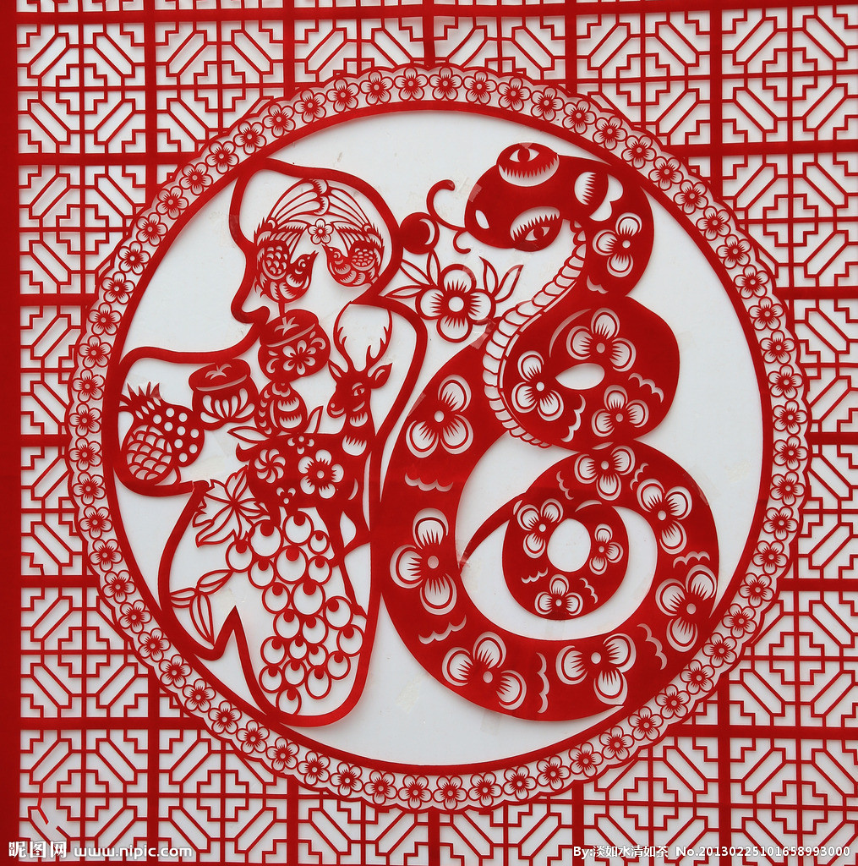
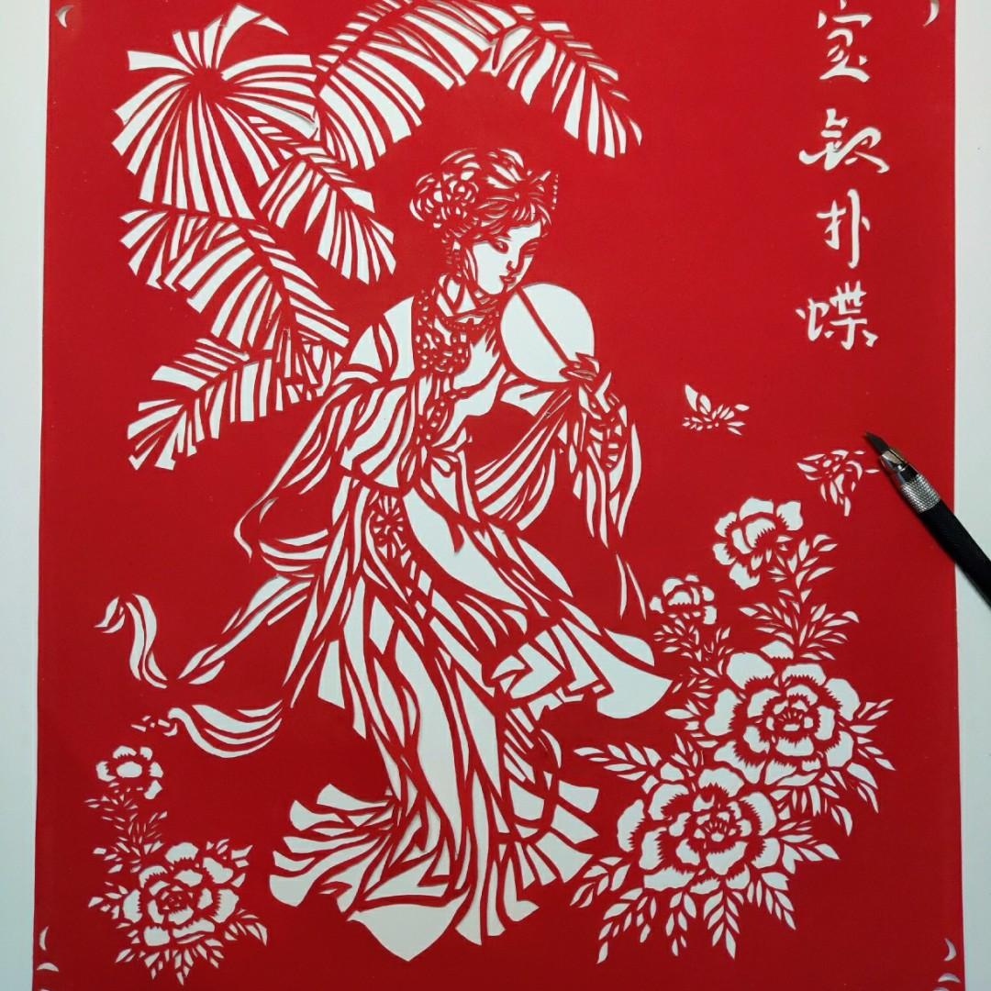
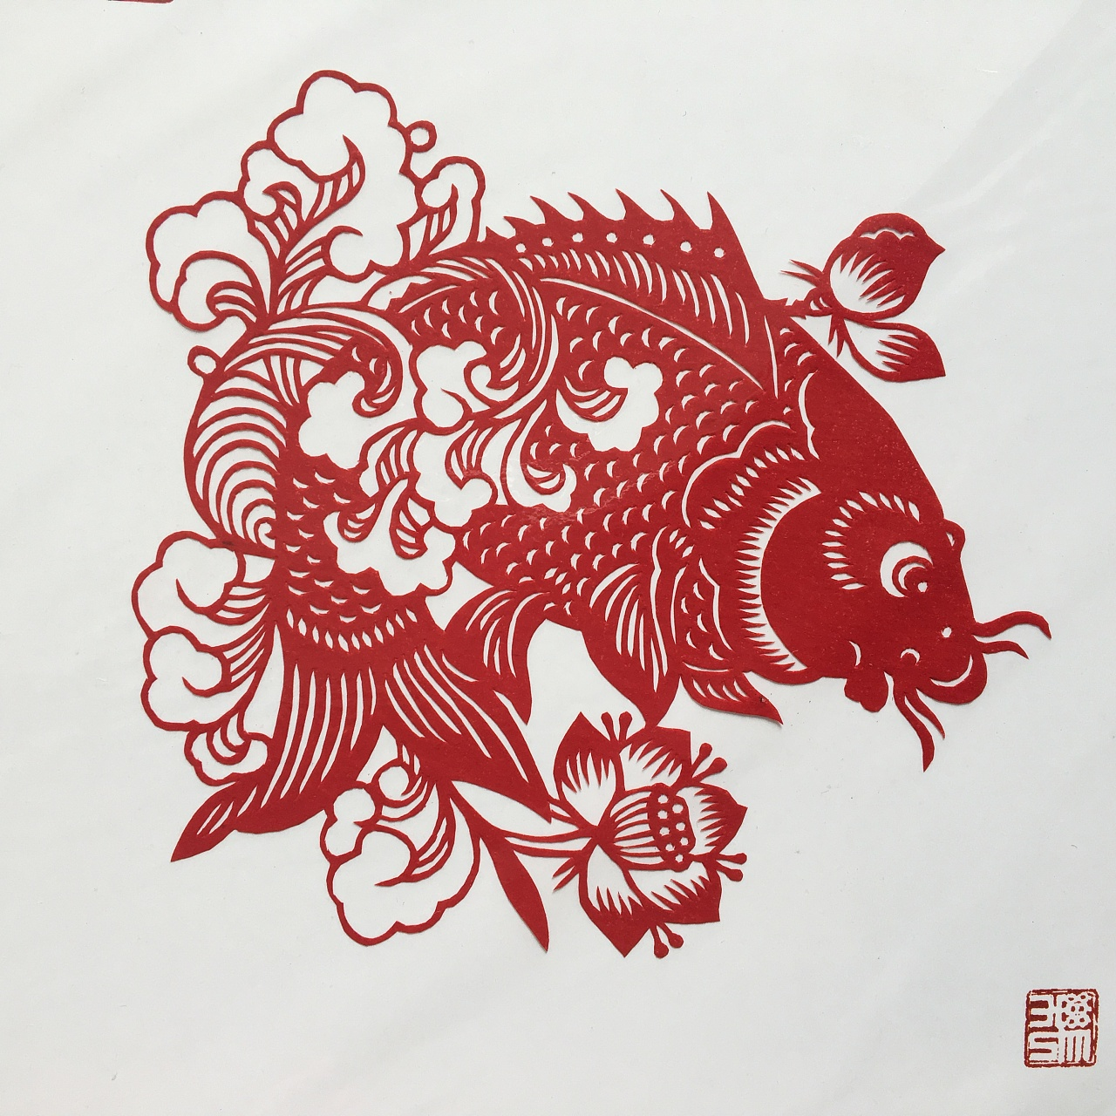

Slide 6
THANKS

