Slide 1
EXPLOLATORY DATA ANALYSIS

Slide 2
Content :
Introduction to EDA
Importance of EDA
Data types
Python Packages for EDA
Lists of Graphs
Practical EDA

Slide 3
1. INTRODUCTION TO EDA
Exploratory Data Analysis refers to the critical process of performing initial
investigations on data so as to discover patterns, to spot anomalies, to test
hypothesis and to check assumptions with the help of summary statistics
and graphical representations .
It is a good practice to understand the data first and try to gather as many
insights from it.

Slide 4
2. IMPORTANCE OF EDA
Identifying the most important variables/features in your dataset.
Testing a hypothesis or checking assumptions related to the dataset.
To check the quality of data for further processing and cleaning.
Deliver data driven insights to business stakeholders.
Verify expected relationships actually exists in the data .
To find unexpected structure or insights in the data.

Slide 5
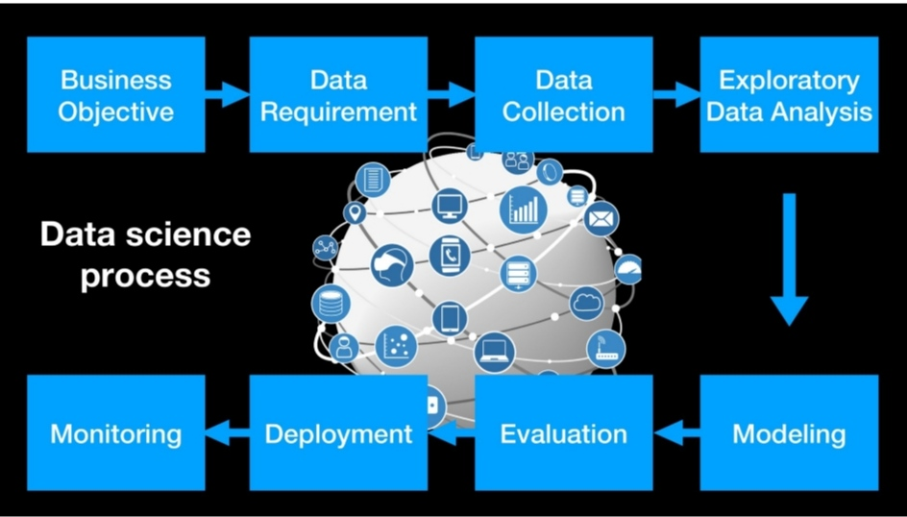
Data Science Modeling Process

Slide 6
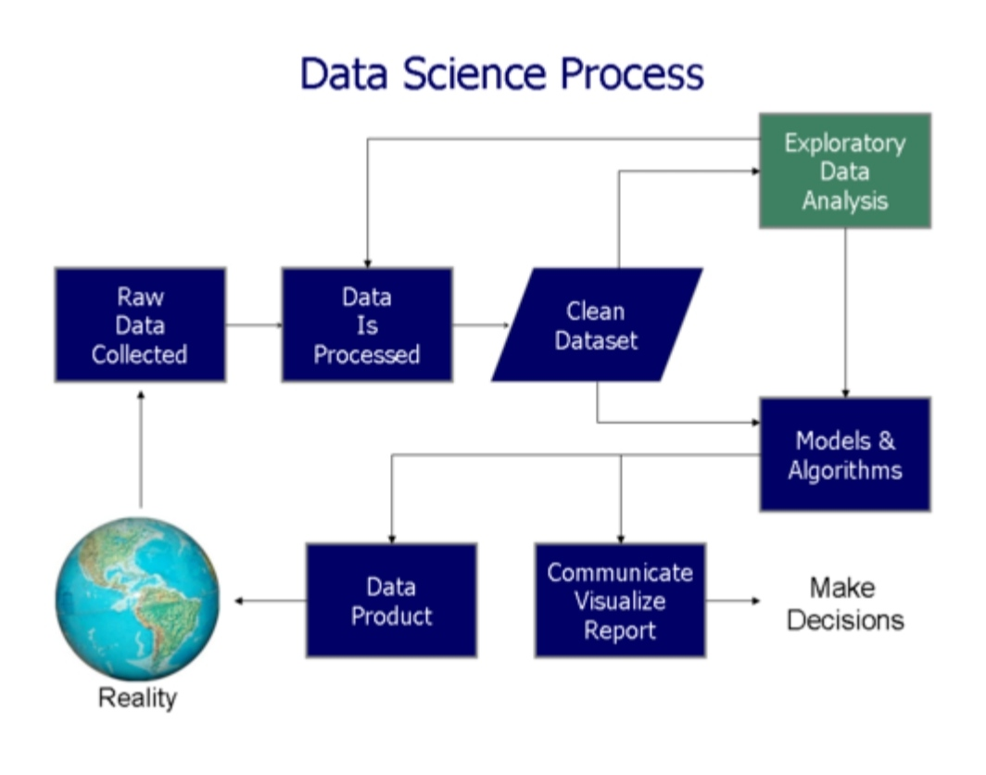
Data Science Process

Slide 7
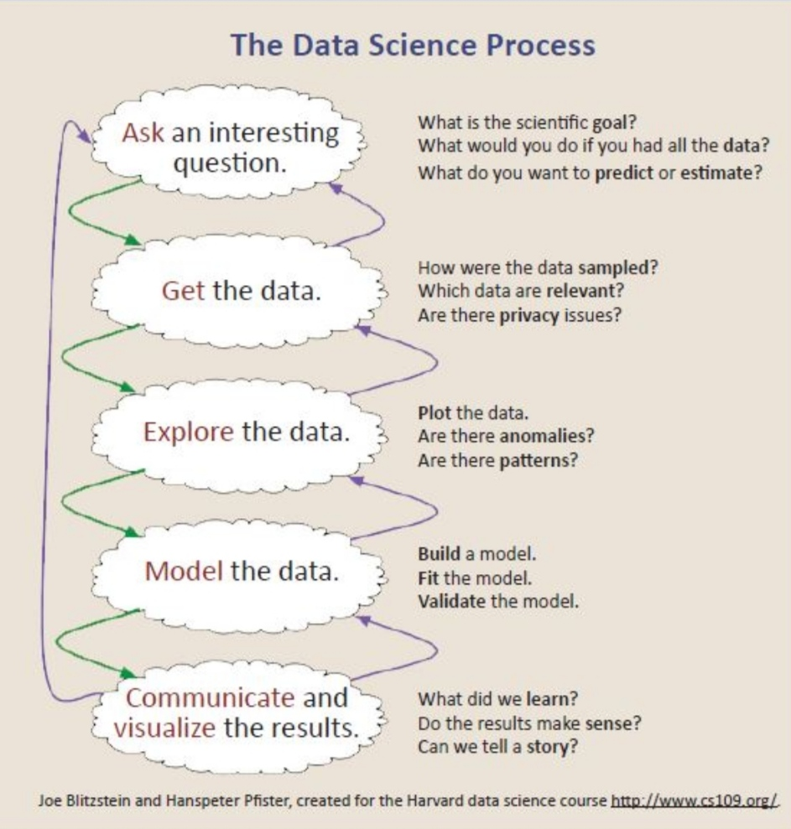

Slide 8
Two categories of Data
Structured Data types
example : CSV file , Excel file , Database file
Unstructured Data types
example : Images , videos , audio

Slide 9
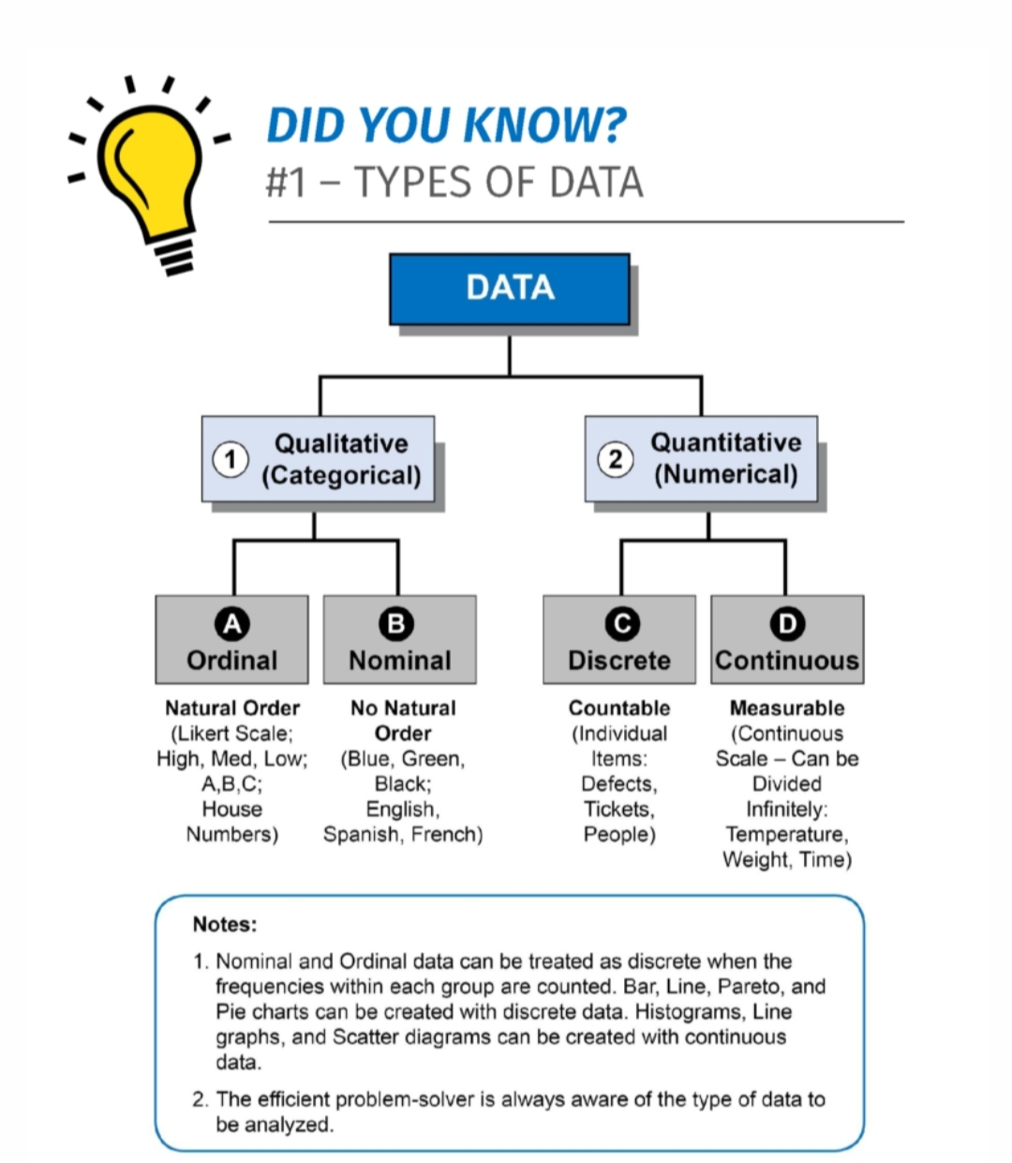
Data Types

Slide 10
Structured Data Types
Categorial – This is any data that is not a number .
Ordinal – have a set of order eg. Rating happiness on a scale of 1-10 .
Binary – have only two values eg. Male or female
Nominal – no set of order eg . Countries
Numerical - Data inform of numbers
Continious - numbers that don’t have a logical end to them eg. Heights
Discrete - have a logical end to them eg. Days in the Month

Slide 11

Python Packages for EDA

Slide 12
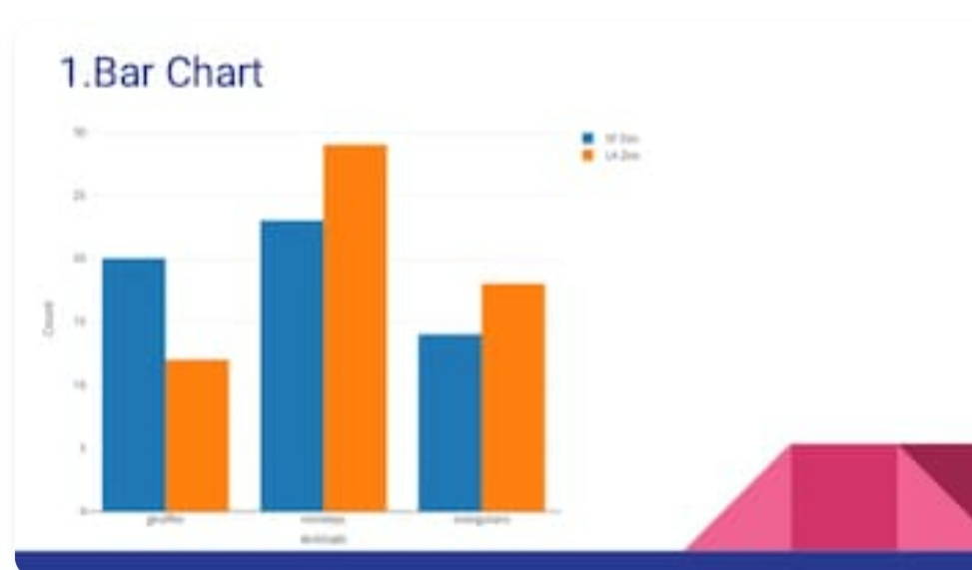
1. Bar Chart

Slide 13


Slide 14
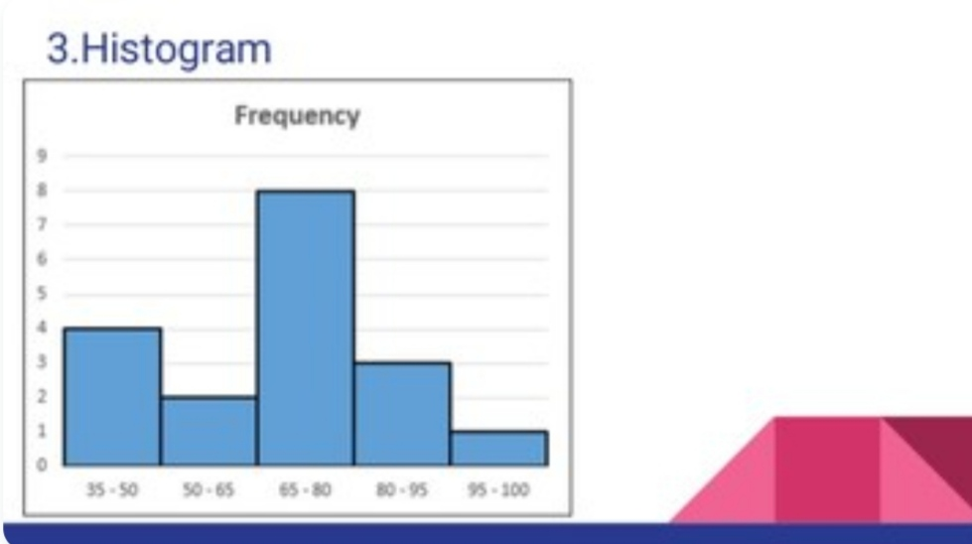

Slide 15
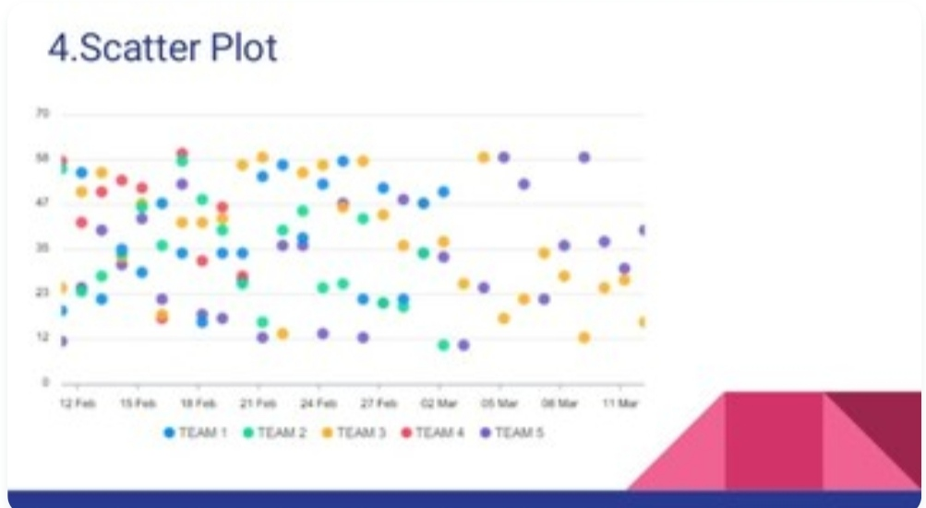

Slide 16


Slide 17
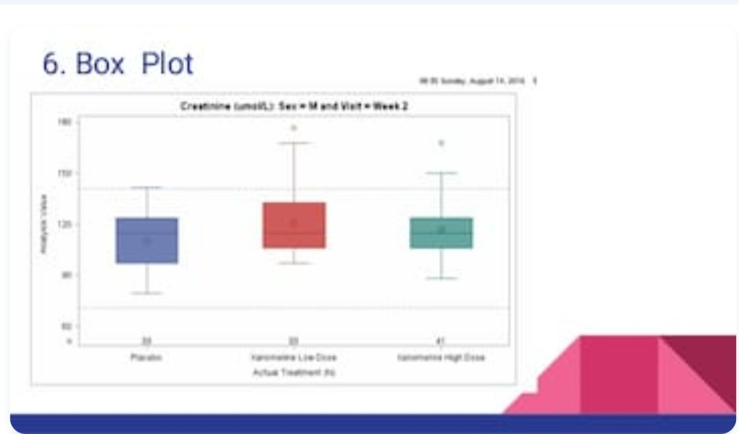

Slide 18


Slide 19
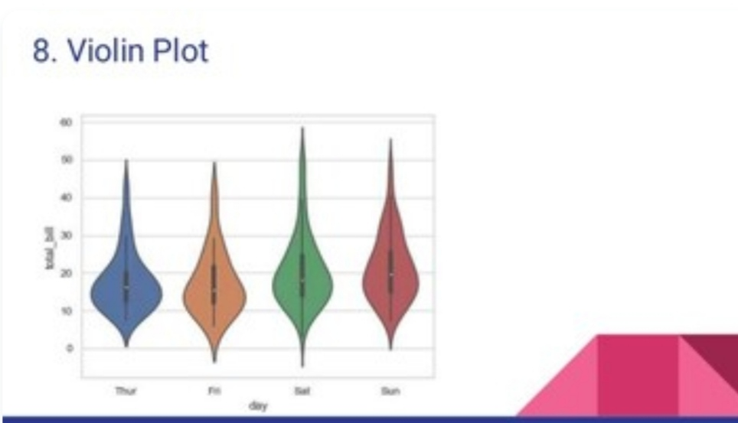

Slide 20
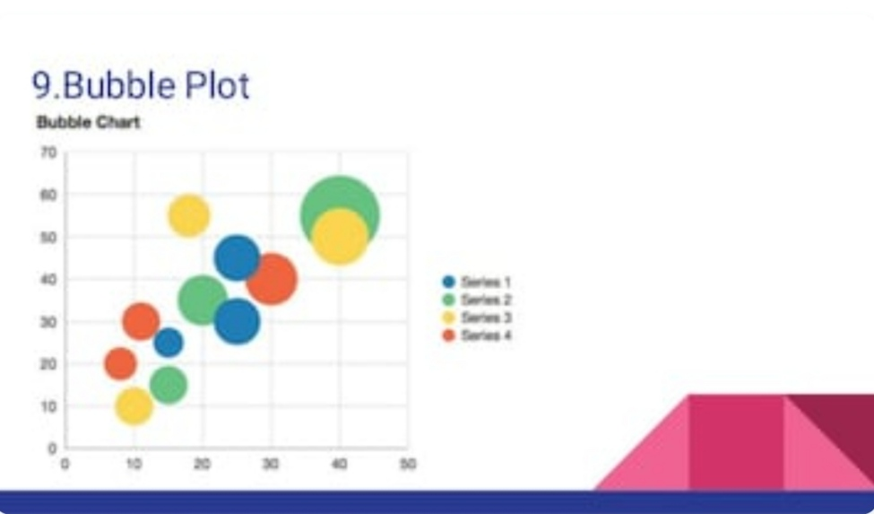

Slide 21
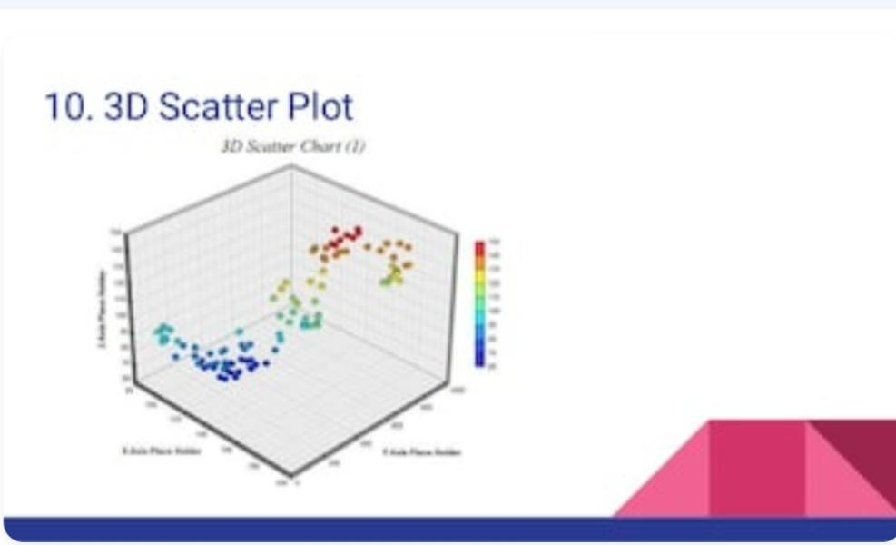

Slide 22
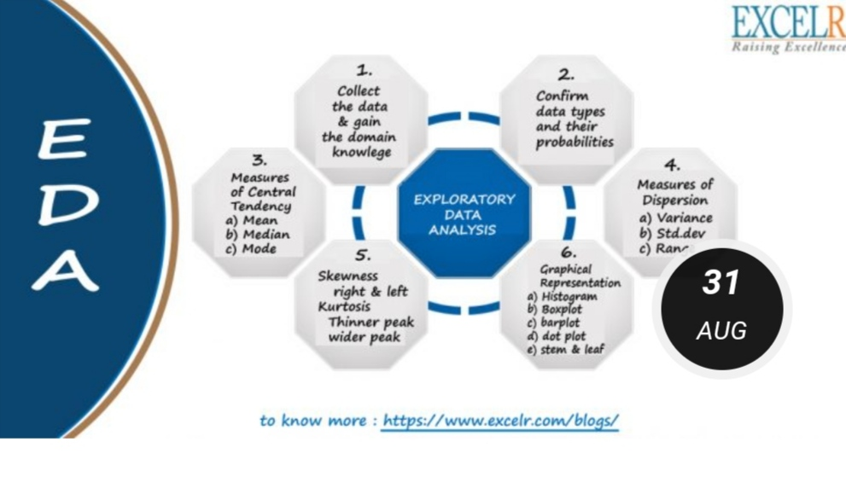
EDA steps and Visualization

Slide 23
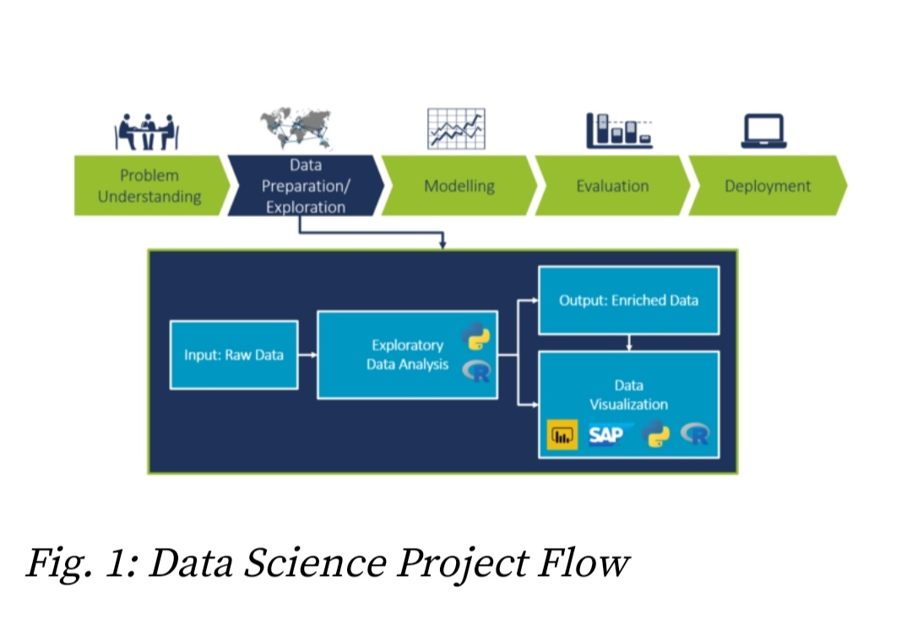
EDA steps and Assumptions

Slide 24
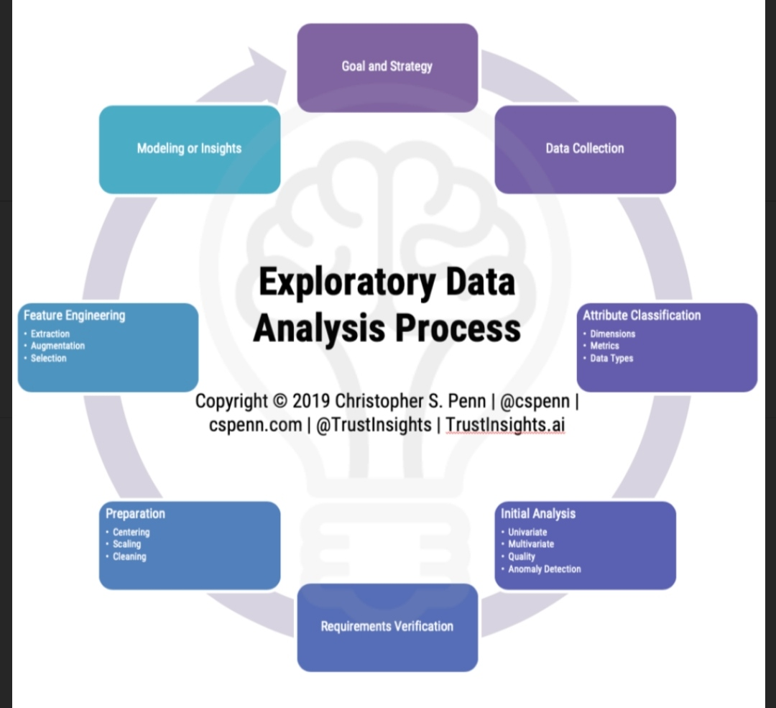
EDA Analysis Process

Slide 25
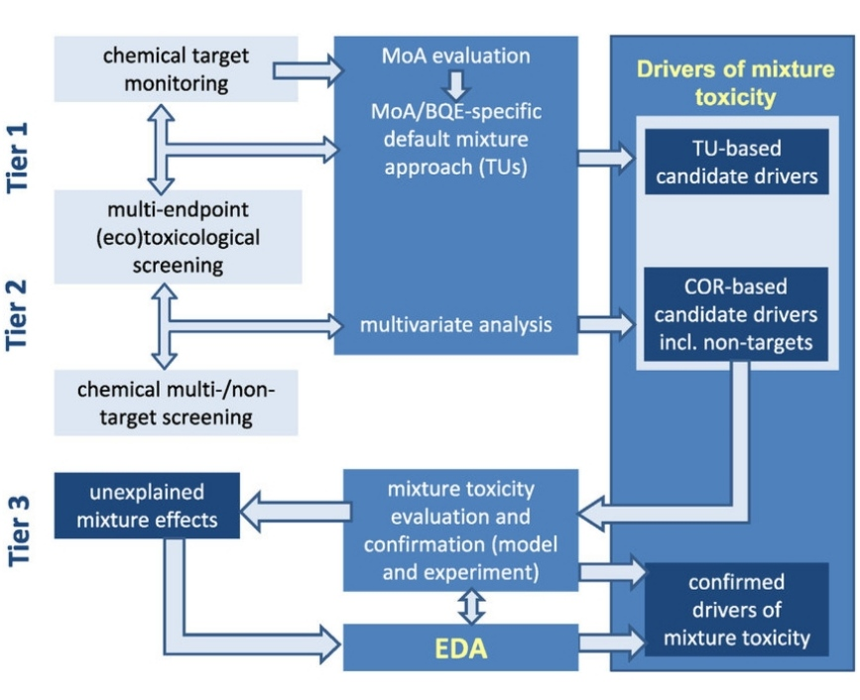
EDA Concept

Slide 26
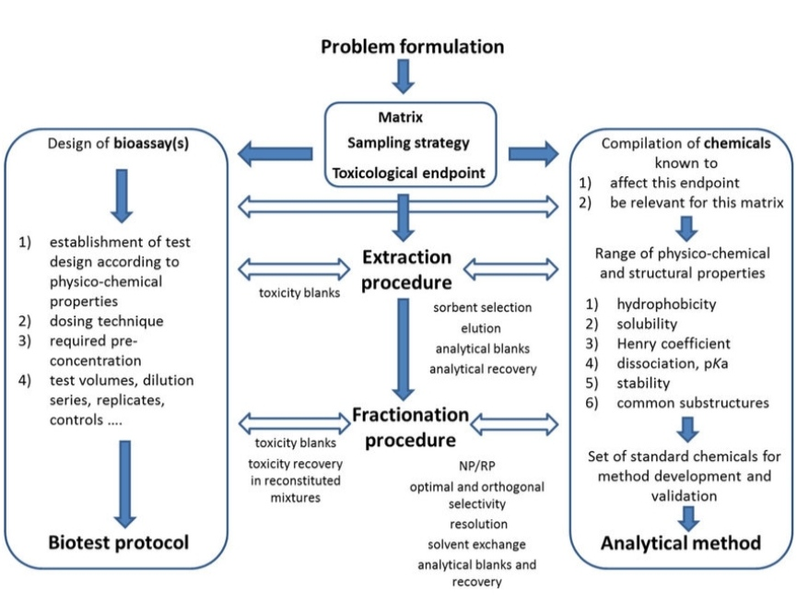
EDA Method

Slide 27

EDA Conclusion

Slide 28


