Slide 1

Analyzing and predicting hospital readmissions
Anna Dyar, Jackie Cheng, Janice Mathew, Jenny Nguyen

Slide 2



Introduction
Hospital readmissions have been shown to:
increase mortality rates
increase length of stay
increase adverse health outcomes
By accurately predicting readmission risk, hospitals and health systems can devote additional resources to prevent readmissions in populations most at risk.
Notes:
Readmission= readmitting to the hospital within 30 days after discharge for the same condition.
Under some value-based care models and health plans, including medicare, hospitals with high readmission rates for specific conditions are not paid for the readmission stay, further incentivizing thorough care and discharge planning during hospital stays.

Slide 3


About the data
CMS Medicare dataset containing:
Demographic
Spending
Utilization
Quality indicators
Standardized costs
State and county geographic level
Notes:
This dataset contains demographic, spending, use, and quality indicators at the state level (including the District of Columbia, Puerto Rico, and the Virgin Islands) and the county level.
Spending is standardized to remove geographic differences in payment rates for individual services as a source of variation.
In general, total standardized per capita costs are less than actual per capita costs because the extra payments Medicare made to hospitals were removed, such as payments for medical education (both direct and indirect) and payments to hospitals that serve a disproportionate share of low-income patients. Standardization does not adjust for differences in beneficiaries’ health status.

Slide 4

Analyzing features & Applying Machine Learning
Data preparation
Best features
Notes:
We had a lot of cleaning and preparation to do prior to machine learning- We worked to determine necessary/relevant columns, got rid of null values, decided on standardized costs (vs actual), and determined which years to analyze for the project. The dataset had a lot of numeric data, so we had a lot to work with for machine learning applications.
We were left with 82 columns of data following prep, and one of the first things we did was find the best features most correlated with hospital readmission. This pointed us in the right direction for further analysis and machine learning.

Slide 5
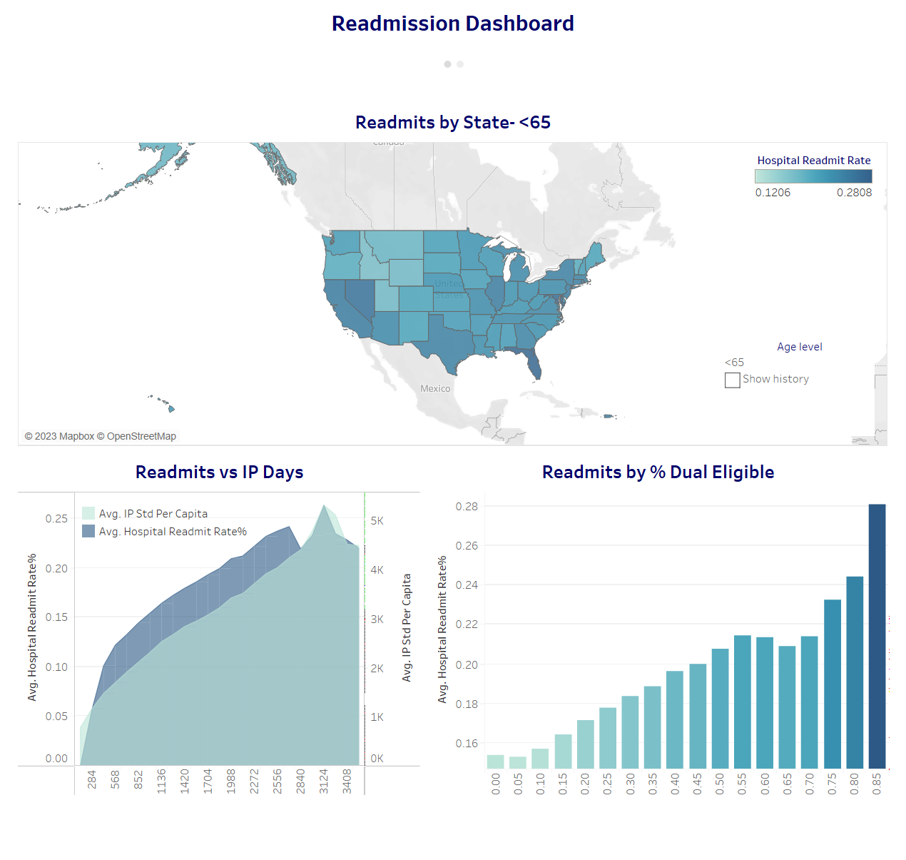
Readmission dashboard

Slide 6
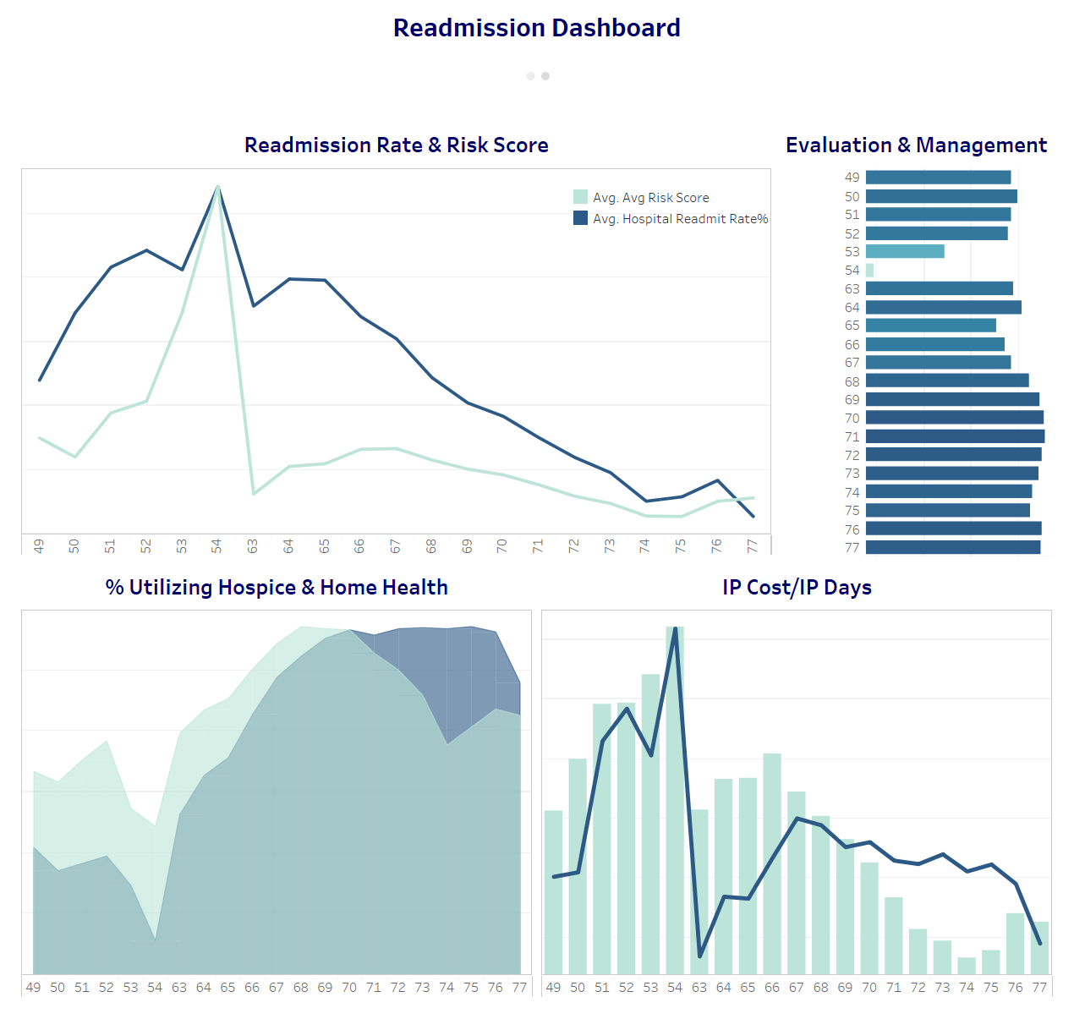

Slide 7
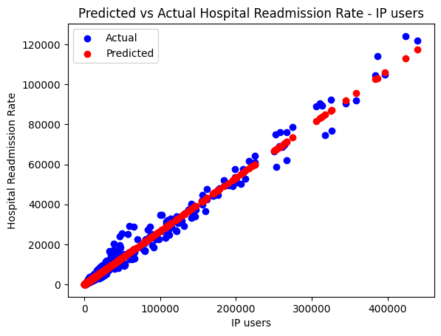
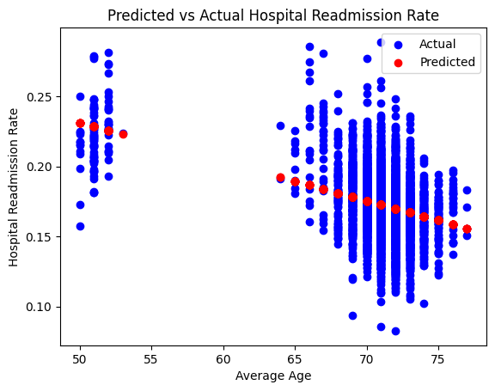
Readmission rates by IP USERS AND AVERAGE age
Notes:
Janice

Slide 8
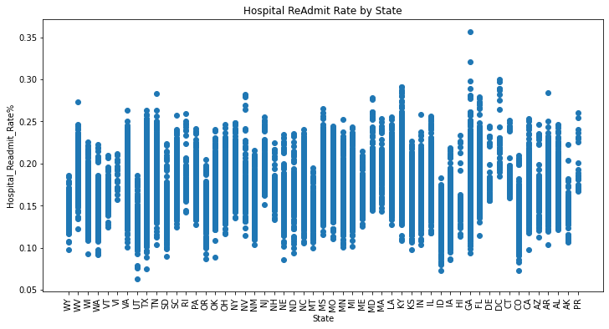
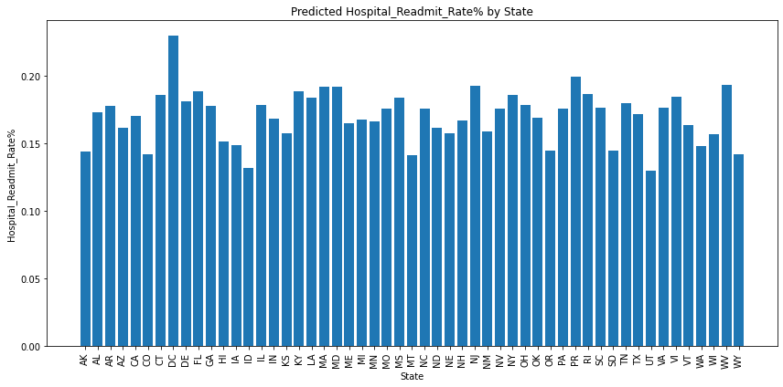
Readmission rates by state
Notes:
Jenny

Slide 9
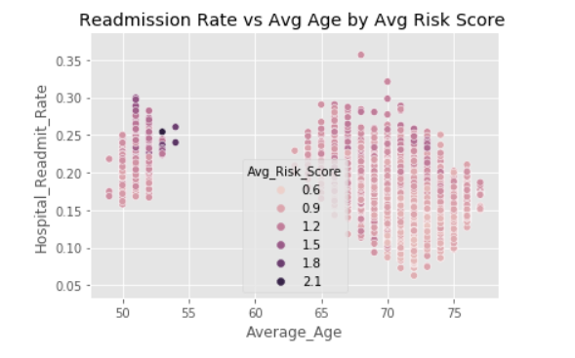
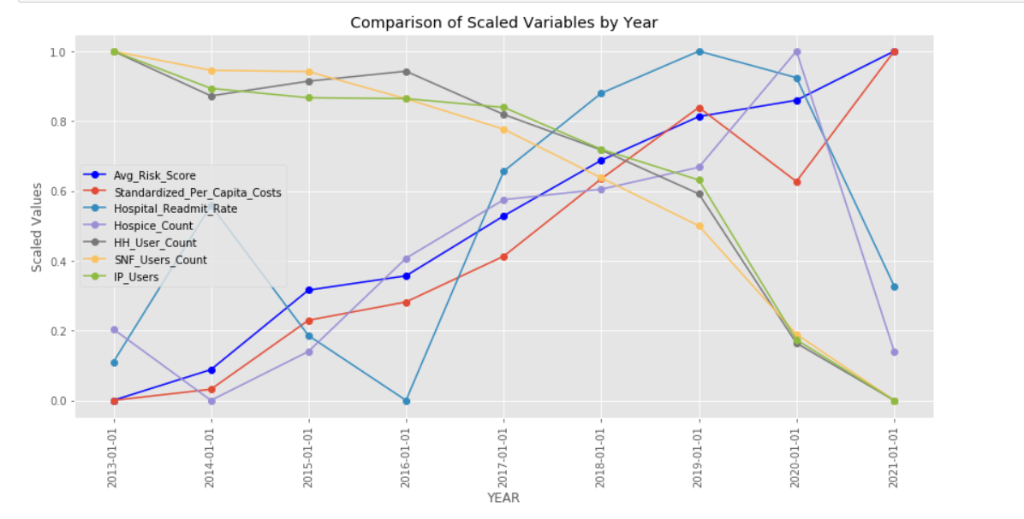
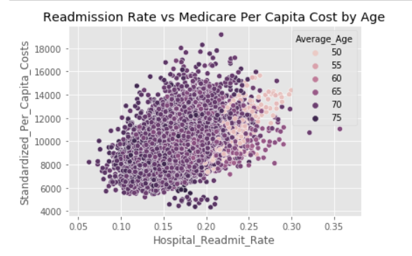
Notes:
Jackie :)

Slide 10
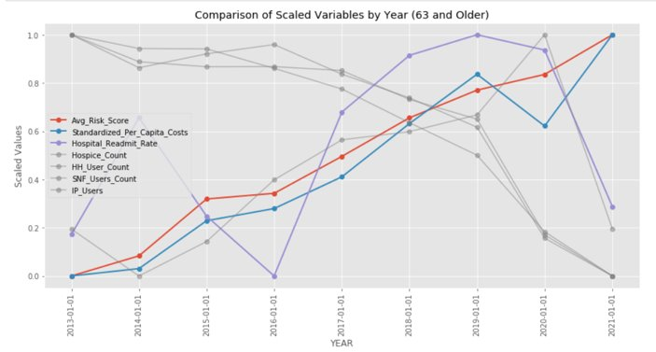
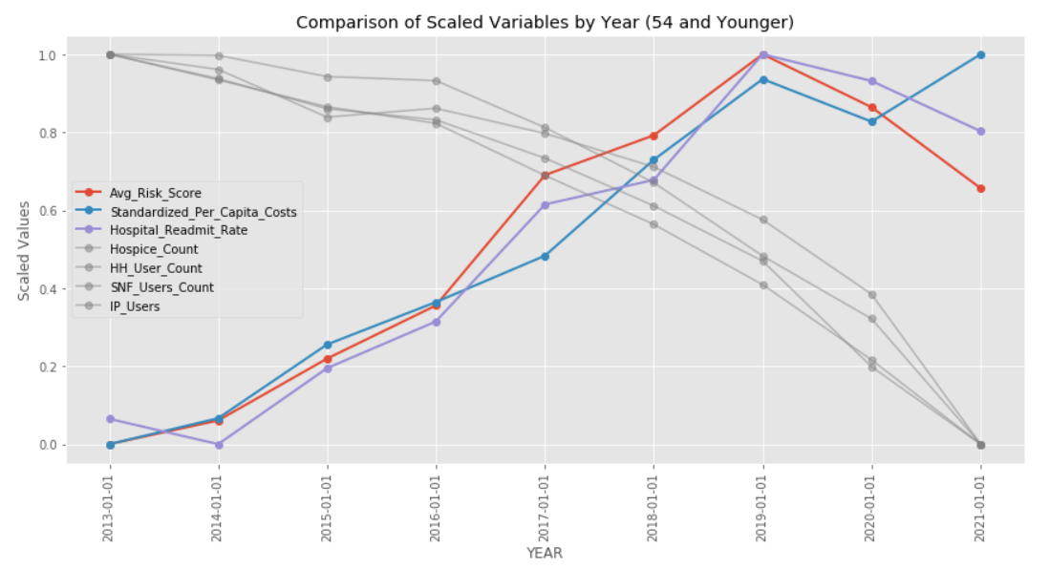







Hospital Readmissions Reduction Program (2012)
Penalty/Reduction:
2012 – up to 1%
2013 – up to 2%
2014 – up to 3%
21st Century Cures Act (2016)
account for patient backgrounds when it calculates reductions in its payments to hospitals
adjust penalties based on the proportion of a hospital's patients
Covid (2019)
Ease of Penalty (Ignored 1st half of 2020)
Younger Age Group
No big changes after 2016
Higher Risk Group -> Less of a dip in readmission during covid
Older Age Group
Steep upward trend after 2016 (Ease in penalty)
Steep downward trend during covid
Further exploration:
Diagnosis for readmissions
Morality Rate when readmission rates are low/dip dramatically
Demographics + Location
Hospital procedures for admissions comparisons (Care Coordination)

Slide 11

Limitations & Further exploration
Some states collected data inconsistently, especially demographic data
Many states paused collection on quality indicator data during 2020-21
Separate analysis for <65 and >65
Application of machine learning in real-time

Slide 12

Thank you

