Slide 1


PROJECT PRESENTATION
MOBILE APPLICATION DEVELOPMENT
TRAINHUB
A connected gym experience for members and professionals
Teacher
Academic Year
Students
Prof. Barbara Rita Barricelli
2025/2026
Davide Leone — 723335 Andrea Bariselli — 737436

Slide 2
PRESENTATION OUTLINE
The path from problem to working product
01
Introduction
02
Competitor analysis
Domain, initial scope and target users.
Existing ecosystems, fragmented alternatives and market gap.
03
User research
04
Application design
Questionnaire evidence, affinity mapping, personas and scenarios.
Navigation, paper prototype, Figma screens and design decisions.
05
Implementation
06
Conclusions
Architecture, offline behaviour, security and device features.
Project outcome and the most realistic future developments.
TRAINHUB
MOBILE APPLICATION DEVELOPMENT
02

Slide 3
CHAPTER 1 · INTRODUCTION
A single gym journey is split across unrelated tools
The user experiences one activity; the digital ecosystem treats it as several separate problems.
• Workout notes are often kept on paper, in phone notes or in a specialized tracking application.
• Nutrition plans frequently arrive as PDFs and are disconnected from appointments, progress and feedback.
• Members and professionals use generic messaging to exchange updates that quickly become difficult to retrieve.
• Facility access, bookings and subscription information usually belong to yet another closed gym system.
The consequence
More switching, duplicated information and less continuity between a workout and the professional response.
TRAINHUB
MOBILE APPLICATION DEVELOPMENT
03

Slide 4
CHAPTER 1 · INTRODUCTION
TrainHub Connects Every Part of the Fitness Journey
The preliminary scope focused on actions that link members directly to their facility and professionals.
01
Workout
Members follow or create plans and record individual sets during a live training run.
GYM MEMBERS
Need fast input, clear daily information and direct access to their assigned professional.
02
Nutrition
Qualified professionals create plans; members consult the meals assigned to each weekday.
Appointments
Members request sessions and consultations while professionals manage availability and status.
GYM PROFESSIONALS
03
Need a client-centered view for planning, monitoring, communication and scheduling.
04
Access
A rotating QR badge replaces the physical membership card and records validated check-ins.
TRAINHUB
MOBILE APPLICATION DEVELOPMENT
04

Slide 5
CHAPTER 2 · COMPETITOR ANALYSIS
TrainHub Stands Out in a Fragmented Fitness Market
Applications were downloaded and tested, then compared by market dimensions and available features.
Direct competitors
Indirect competitors
Products tied to a gym or designed to manage the member–professional relationship.
Specialized or generic tools that solve only one part of the same journey.
• Virgin Active
• Workout trackers
• EvolutionFit
• Nutrition trackers
• Technogym
• Wearable and health platforms
• Virtuagym
• Notes, spreadsheets, PDFs and messaging
TRAINHUB
MOBILE APPLICATION DEVELOPMENT
05

Slide 6
CHAPTER 2 · COMPETITOR ANALYSIS
Direct competitors demonstrate demand, but with different trade-offs
All cover workout and booking; nutrition, direct communication and staff tooling are less consistent.
Feature | Virgin | EvolutionFit | Technogym | Virtuagym
Workout tracking | YES | YES | YES | YES
Nutrition management | — | YES | — | YES
Booking | YES | YES | YES | YES
Facility access | YES | YES | YES | YES
Direct professional chat | — | YES | — | YES
Staff dashboard | — | YES | YES | YES
• Virgin Active offers a polished experience, but only within its own gym network.
• EvolutionFit offers many gym-focused features, but the experience varies between facilities.
• Technogym excels in training content, devices and wellness integration.
• Virtuagym offers a complete set of features but can be more complex to use.
Market validation
The feature set is credible; the opportunity lies in a clearer and lighter integration.
TRAINHUB
MOBILE APPLICATION DEVELOPMENT
06

Slide 7
CHAPTER 2 · COMPETITOR ANALYSIS
Indirect competitors solve one need, but fragment the journey
Each category is effective on its own; none connects the full member–professional relationship.
01
Workout tracking
02
Nutrition tracking
03
Cardio & health
04
Everyday tools
Hevy · GymLife Bodymatica
MyFitnessPal · Yazio
Garmin Connect · Strava Polar Flow · Suunto
WhatsApp · email · notes spreadsheets · PDFs
DOES WELL
DOES WELL
DOES WELL
DOES WELL
Routines and lifting progress.
Calories and macro tracking.
Wearable and outdoor activity data.
Familiar and flexible sharing.
WHAT IS MISSING
WHAT IS MISSING
WHAT IS MISSING
WHAT IS MISSING
No direct PT, booking or gym-access connection.
Diet data stays separate from workouts and gym services.
Not designed around gym management or PT context.
Scattered files and conversations break continuity.
TRAINHUB OPPORTUNITY
Connect these separate activities around the same member, gym and professional.
TRAINHUB
MOBILE APPLICATION DEVELOPMENT
INDIRECT COMPETITORS

Slide 8
CHAPTER 2 · COMPETITOR ANALYSIS
The market gap is continuity, not feature count
TrainHub combines the essential flows while keeping the member experience mobile-first.
• Specialized applications are often excellent at one task, but require users to reconstruct the overall picture themselves.
• Large B2B platforms cover many business processes, yet can introduce complexity unrelated to the everyday gym journey.
• TrainHub places workout management at the center and connects nutrition, appointments, chat and facility access around it.
• The same product serves both roles, so a member action can immediately become useful professional context.
POSITIONING
Integrated enough to replace fragmentation.
Focused enough to remain understandable.
TRAINHUB
MOBILE APPLICATION DEVELOPMENT
07

Slide 9
CHAPTER 3 · USER RESEARCH
A branched questionnaire tested the initial assumptions
The questions changed according to role and combined quantitative answers with open-ended feedback.
• Members described training frequency, tracking habits, application switching and their relationship with professionals.
• Professionals described client volume, monitoring tools, communication practices and recurring management difficulties.
• Open questions captured application names and problems that predefined answer lists might have missed.
• Early feedback was used to clarify ambiguous questions while data collection was still in progress.
81
74
7
VALID RESPONSES
GYM MEMBERS
PROFESSIONALS
The sample represents the two sides of the ecosystem, but professional percentages are interpreted cautiously because only seven professionals responded.
TRAINHUB
MOBILE APPLICATION DEVELOPMENT
08

Slide 10
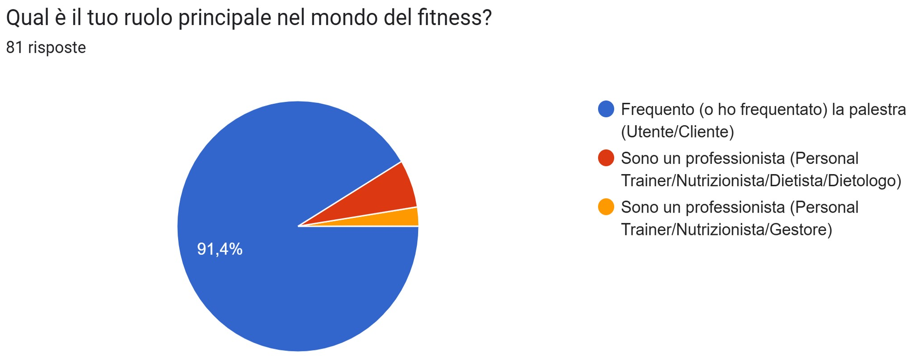
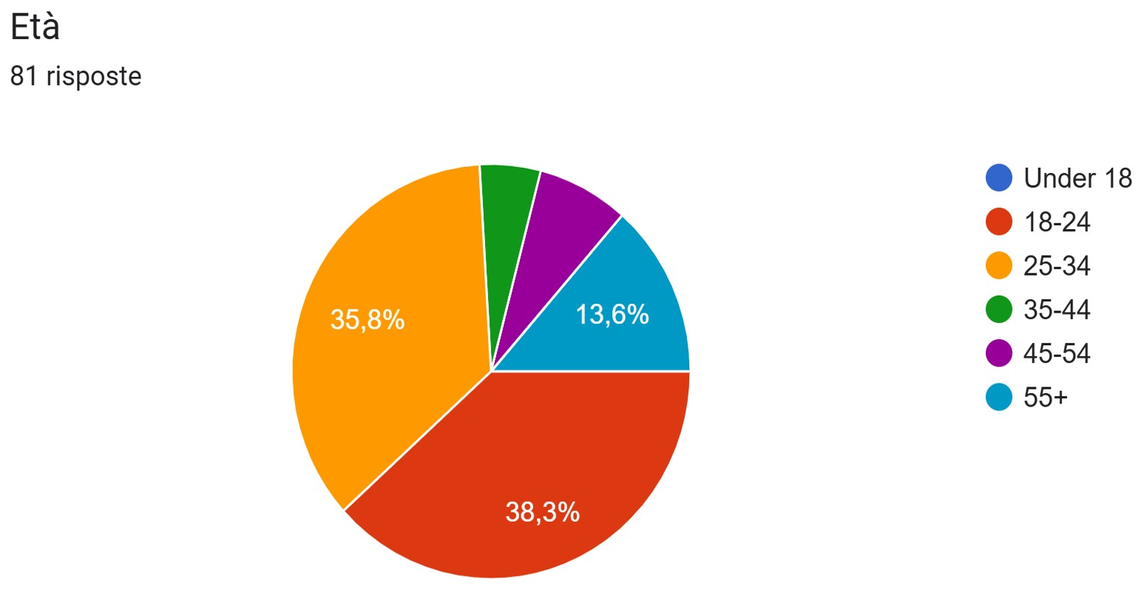
CHAPTER 3 · USER RESEARCH
The sample is young, active and predominantly member-side
Demographic results help define the main audience without excluding less digitally confident users.
• Gym members account for 91% of responses, while professionals represent the operational minority expected in a physical facility.
• Most respondents fall within the 18–34 age range and are already accustomed to frequent smartphone use.
TRAINHUB
MOBILE APPLICATION DEVELOPMENT
09

Slide 11
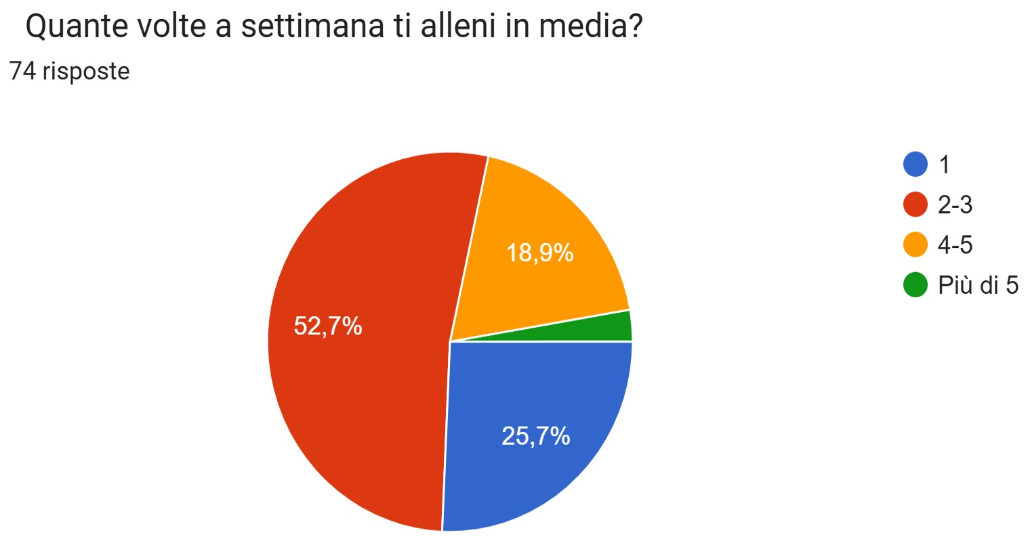
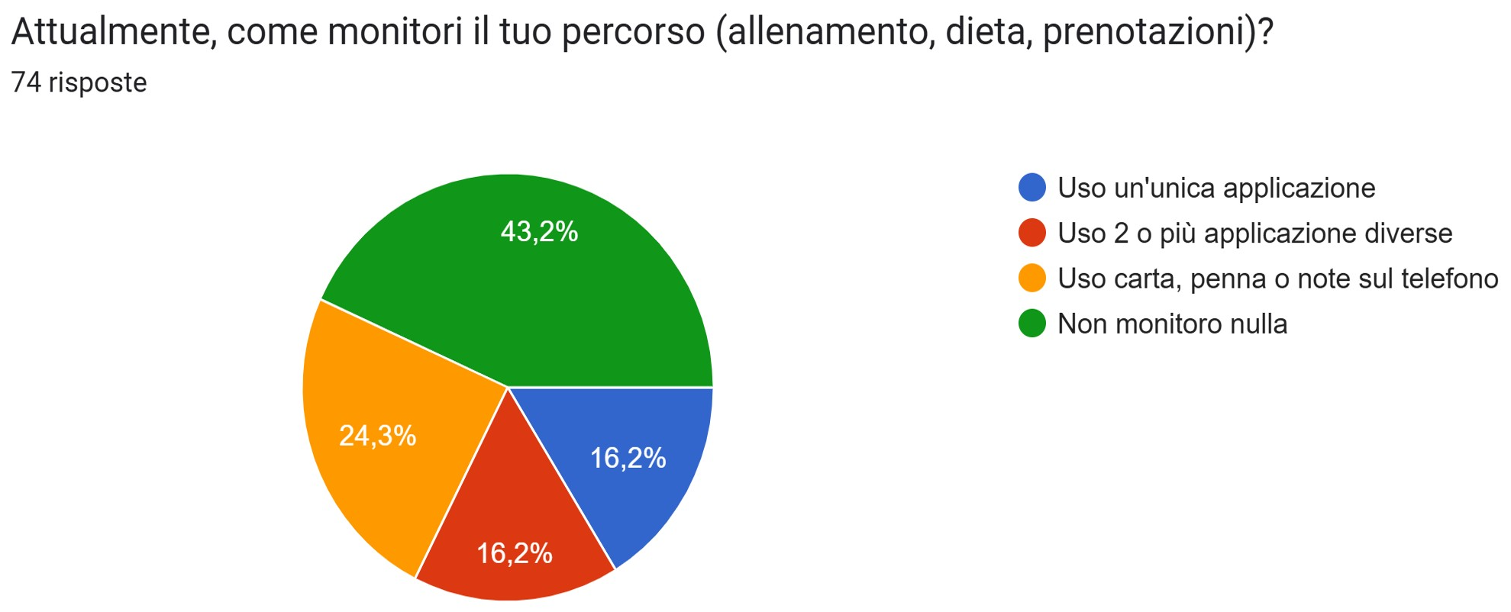
CHAPTER 3 · USER RESEARCH
Members train frequently, but tracking remains inconsistent
Activity level does not automatically translate into a structured digital routine.
• Most respondents train between two and five times per week, so speed and repeatability are everyday requirements.
• Paper, phone notes and generic tools remain common; some users do not maintain a structured record at all.
• Switching among multiple applications creates friction precisely during the moments that should require the least attention.
• A direct digital connection with the trusted professional was considered especially valuable for plans and feedback.
TRAINHUB
MOBILE APPLICATION DEVELOPMENT
10

Slide 12
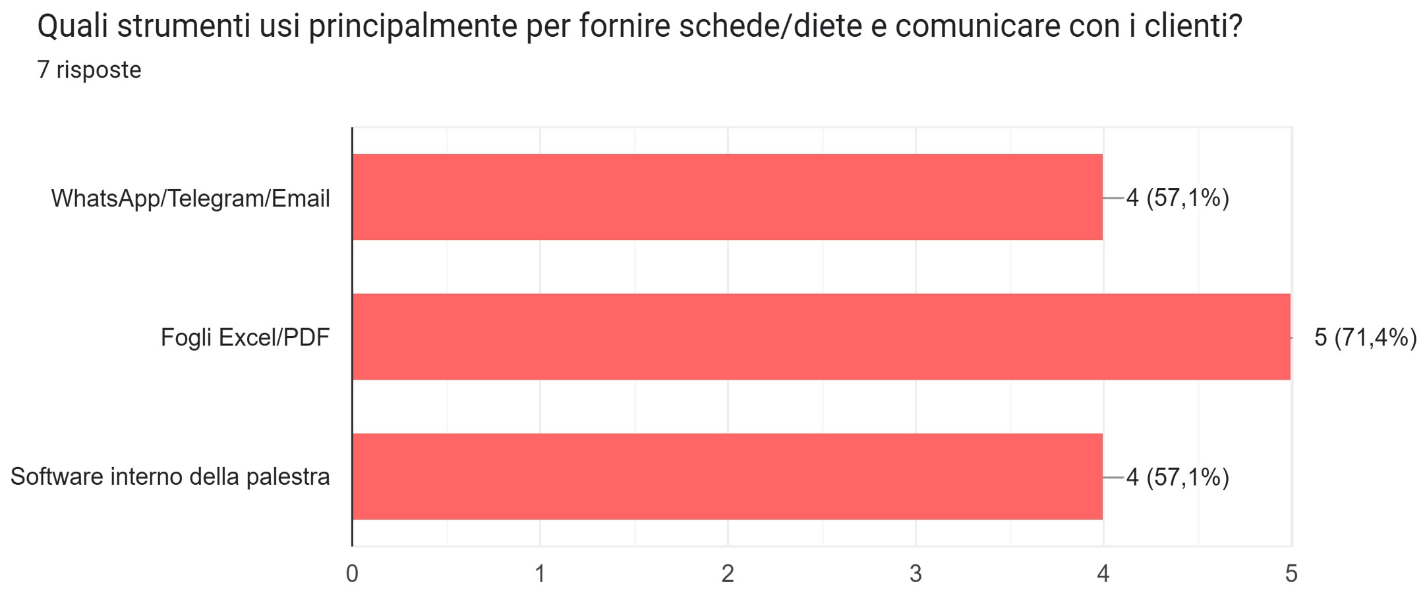
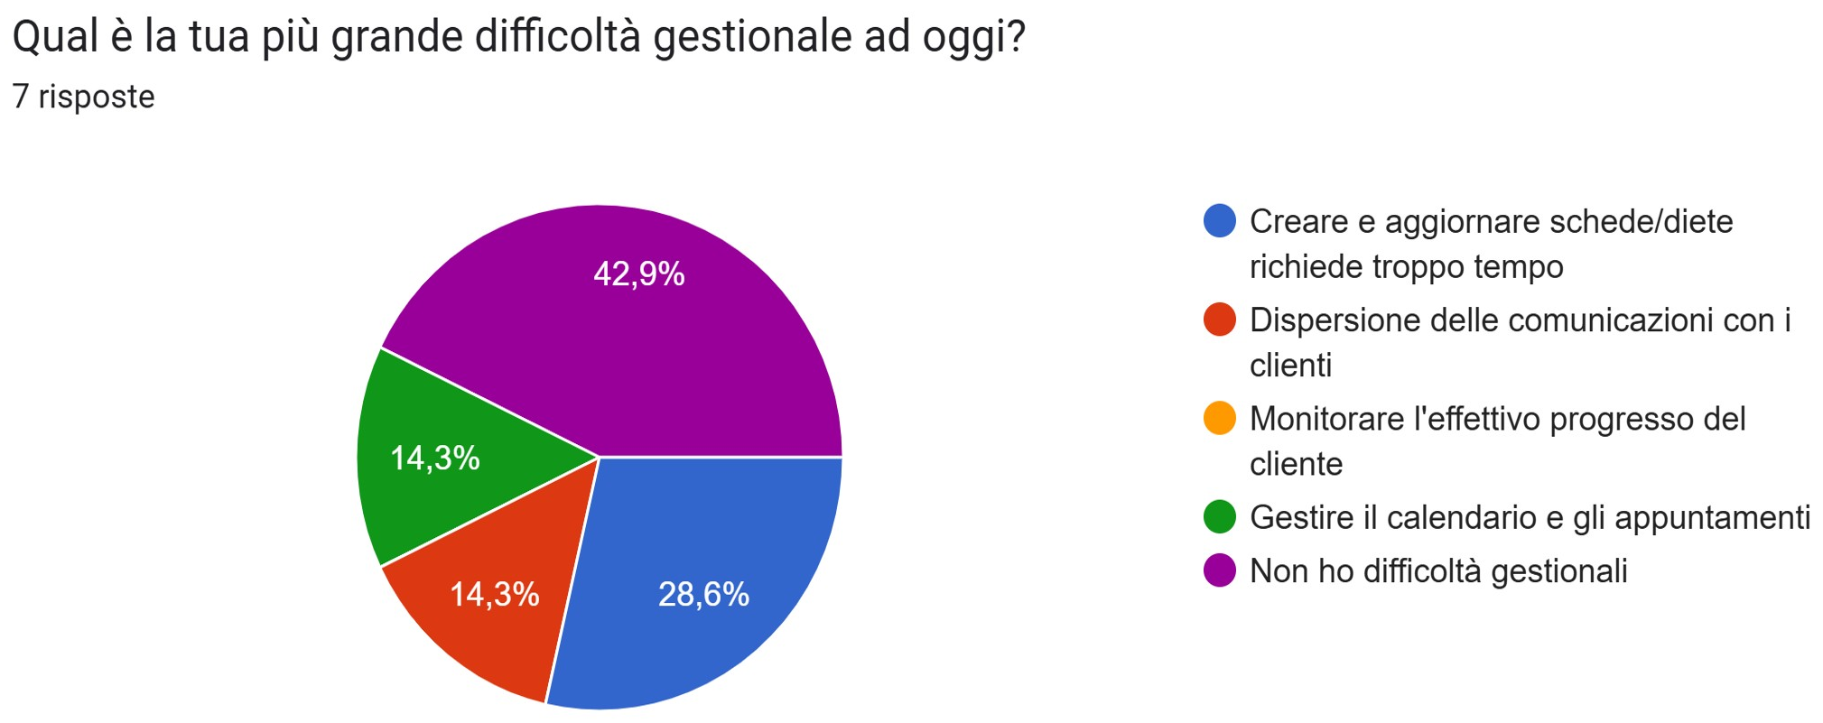
CHAPTER 3 · USER RESEARCH
Professionals still assemble client management from generic tools
The results are directional, but they reveal the same fragmentation from the operational side.
• Spreadsheets and PDFs are used by 71% of respondents; messaging and internal gym software are each used by 57%.
• The most frequent concrete difficulty is the time required to create and update workout or nutrition plans.
• Communication dispersion and appointment management also appear, although each percentage represents very few people.
TRAINHUB
MOBILE APPLICATION DEVELOPMENT
11

Slide 13
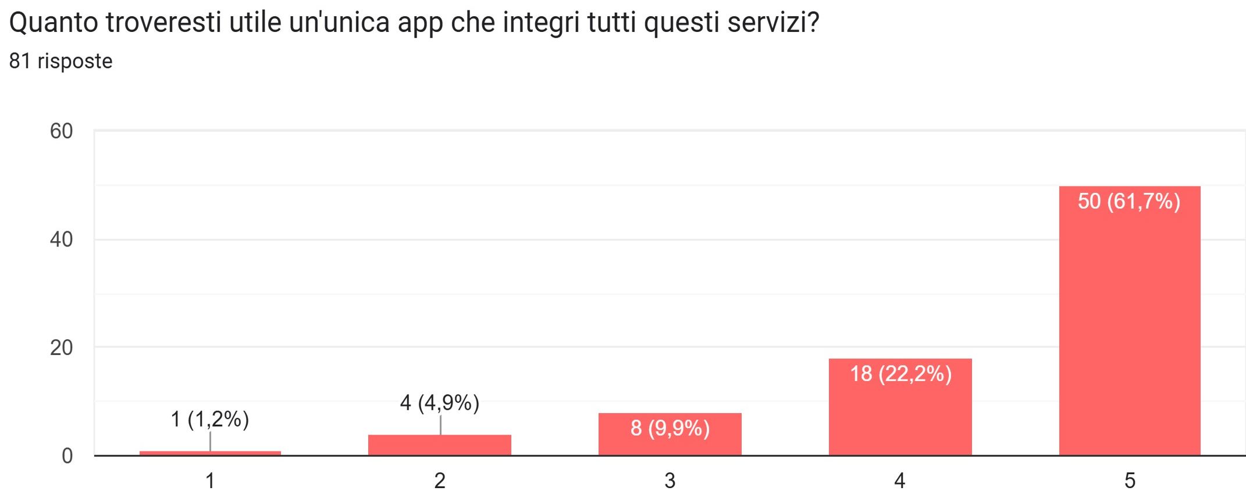
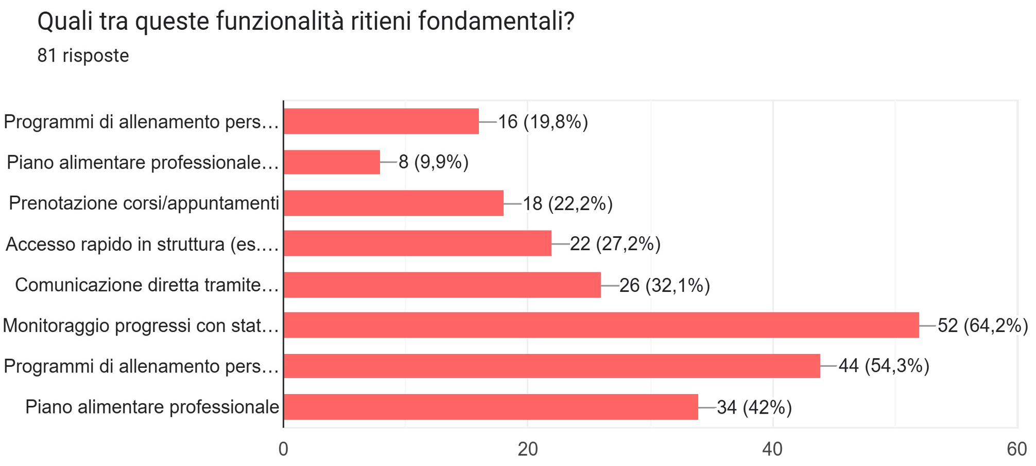
CHAPTER 3 · USER RESEARCH
The expected value is integration around three core capabilities
Respondents confirmed the central scope while also suggesting secondary services.
54%
personalized workout tracking
64%
progress monitoring and statistics
42%
professional diet management
TRAINHUB
MOBILE APPLICATION DEVELOPMENT
12

Slide 14
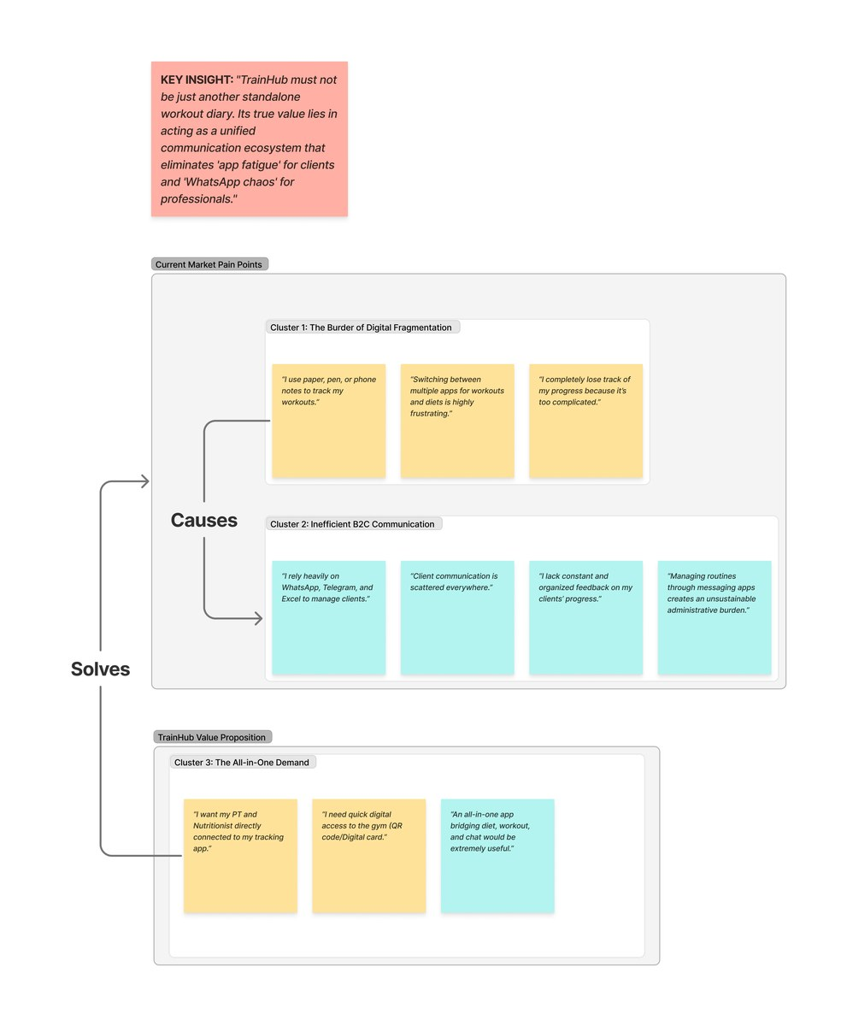
CHAPTER 3 · USER RESEARCH
Affinity mapping turned scattered answers into design direction
Notes were clustered, labelled and linked before personas and scenarios were finalized.
01
Digital fragmentation
Users reconstruct one journey from notes, specialized apps and files.
02
Inefficient communication
Important plans and feedback become difficult to locate in generic chats.
03
All-in-one demand
The desired solution is not another tracker, but a shared operational context.
TRAINHUB
MOBILE APPLICATION DEVELOPMENT
13

Slide 15
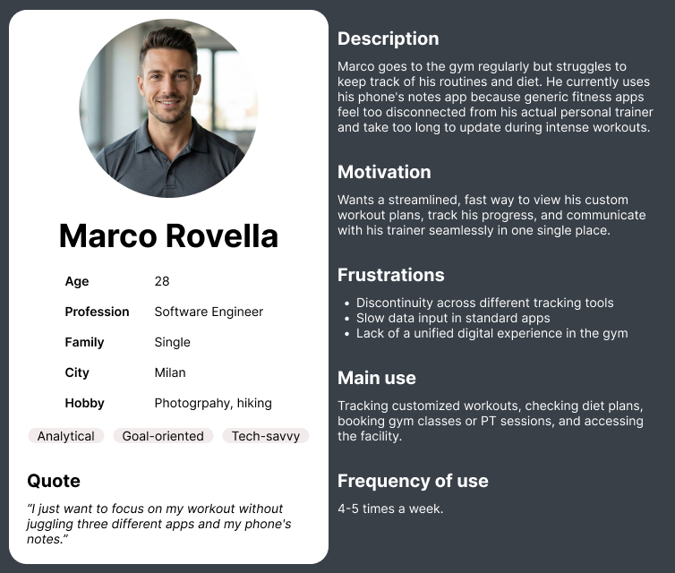
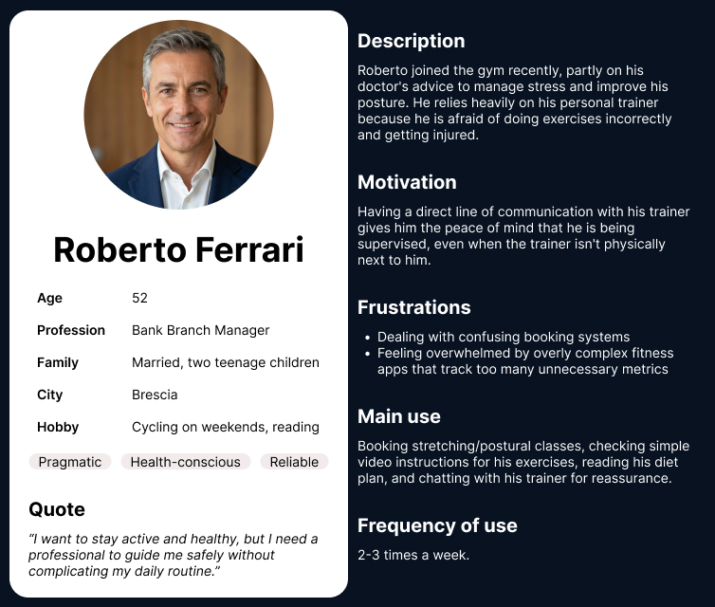
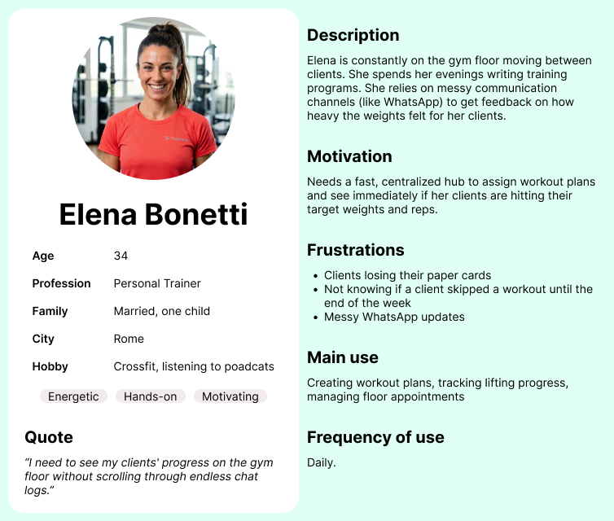
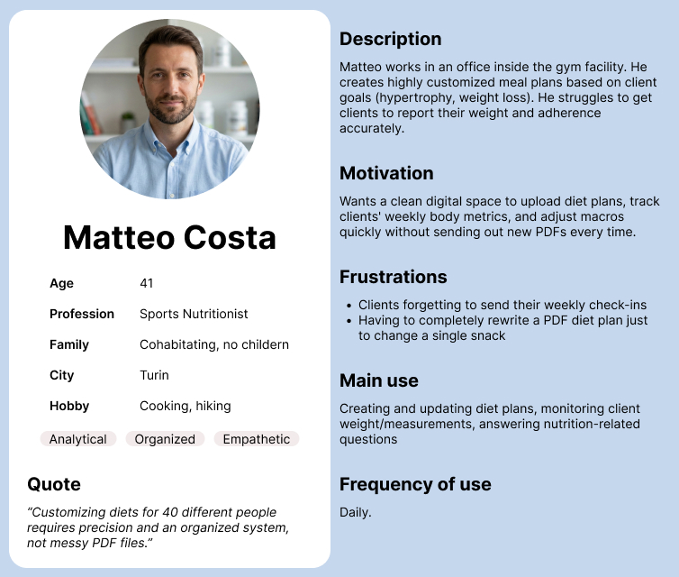
CHAPTER 3 · USER RESEARCH
Personas represent different abilities, contexts and responsibilities
They provide concrete reference points for interaction choices rather than abstract role labels.
Marco
Roberto
Elena
Matteo
YOUNG MEMBER
SENIOR MEMBER
PERSONAL TRAINER
NUTRITIONIST
Wants immediate set logging during a time-constrained workout.
Needs readable guidance and reassurance before training independently.
Reviews several clients and adjusts plans during short breaks.
Checks measurements and updates meal plans from a larger screen.
TRAINHUB
MOBILE APPLICATION DEVELOPMENT
14

Slide 16
CHAPTER 3 · USER RESEARCH
Scenarios translated personas into interaction requirements
Each scenario combines a real context, a user goal and an observable design response.
CONTEXT
GOAL
DESIGN RESPONSE
Marco · gym floor
Log prescribed weight without interrupting concentration.
Prefilled values, fast set controls and persistent live run.
Roberto · at home
Understand tomorrow's workout and ask for reassurance.
Readable session details and direct access to the assigned trainer.
Elena · short break
Review progress and adjust a routine in a few minutes.
Client-centered progress and versioned plan creation.
Matteo · office
Use measurements to update nutrition before the weekend.
Nutrition editor organized by day types, meals and macros.
TRAINHUB
MOBILE APPLICATION DEVELOPMENT
15

Slide 17
CHAPTER 4 · APPLICATION DESIGN
Research priorities became explicit interface principles
The design phase established hierarchy and navigation before visual details were refined.
01
Speed during training
02
Client-centered professional work
Frequent workout actions remain visible, large and close to the current exercise.
Plans, progress and communication stay connected around the selected client.
03
One product, distinct roles
04
Context before confirmation
Shared services stay consistent while navigation and permissions reflect different responsibilities.
Booking and plan editing preserve the selected day, professional or client until the final action.
TRAINHUB
MOBILE APPLICATION DEVELOPMENT
16

Slide 18
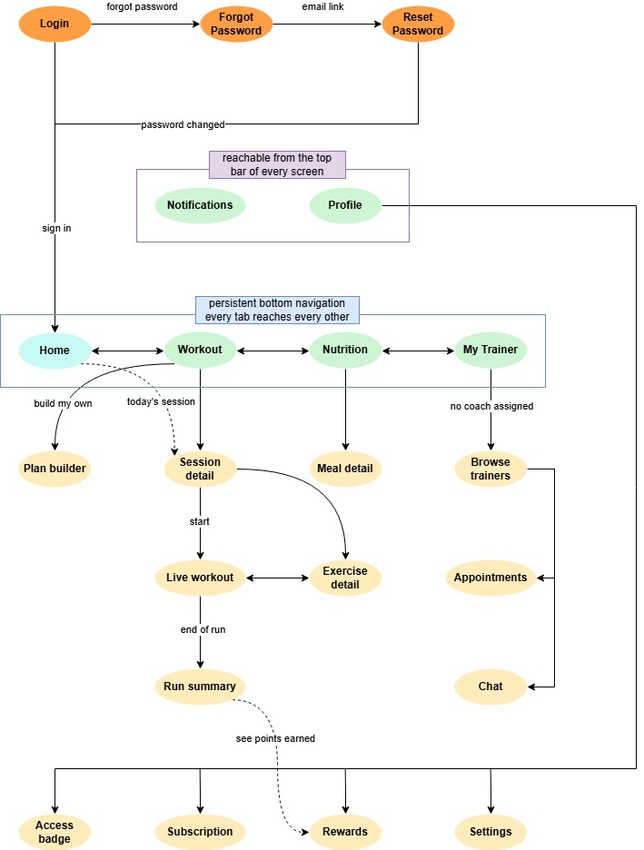
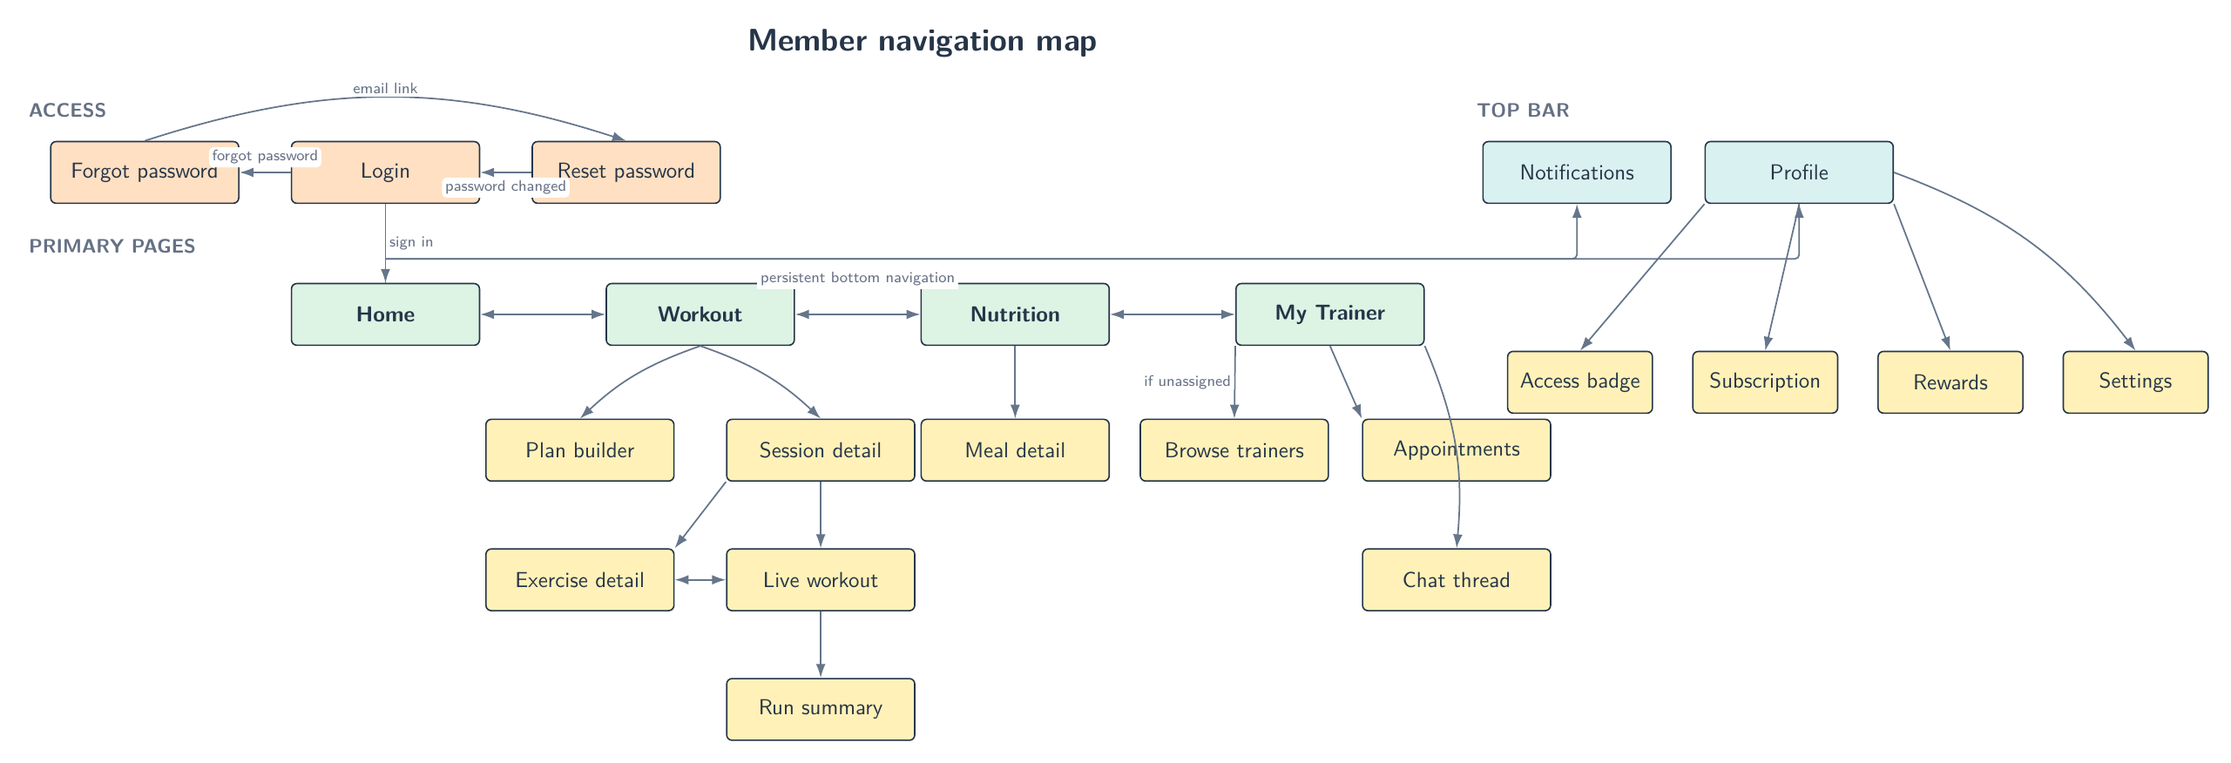
CHAPTER 4 · APPLICATION DESIGN
Member navigation prioritizes daily activities
The bottom bar exposes four frequent destinations; the header contains global account actions.
• Home summarizes the current day, next appointments and workout context.
• Workout leads from the active plan to sessions, exercises and live runs.
• Nutrition presents the meals assigned to the selected weekday.
• My Trainer connects professional discovery, appointments and chat.
• Profile groups badge, subscription, rewards and settings outside the daily path.
TRAINHUB
MOBILE APPLICATION DEVELOPMENT
17

Slide 19
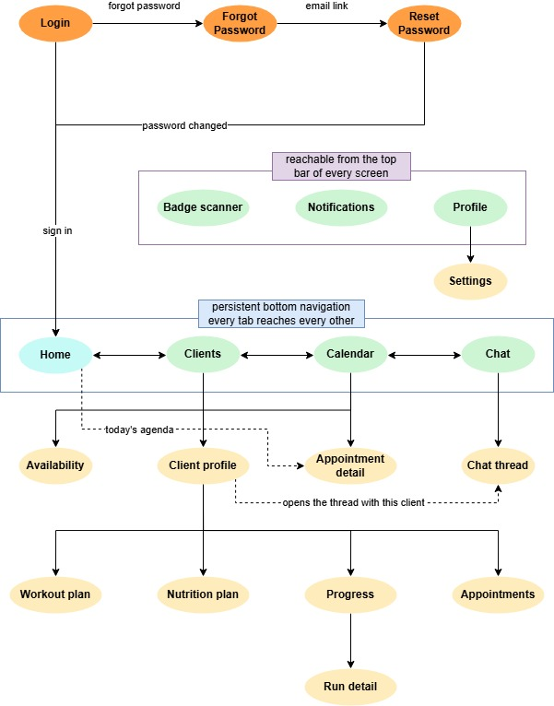
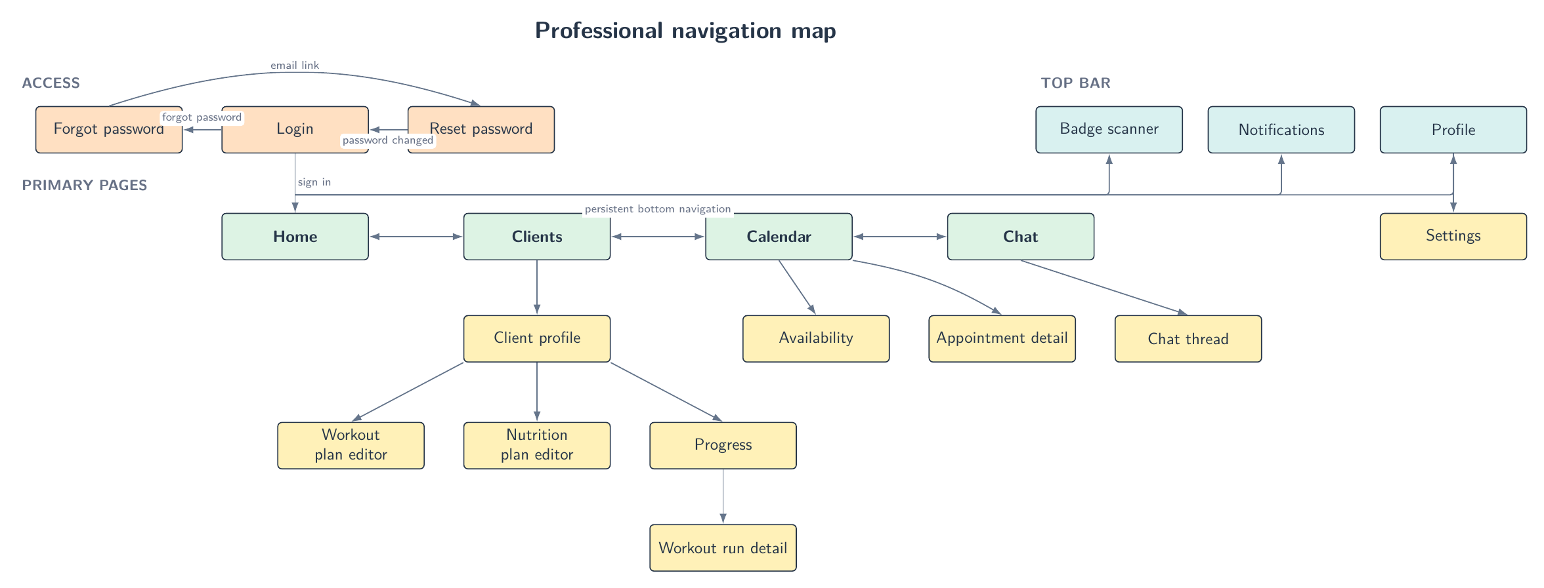
CHAPTER 4 · APPLICATION DESIGN
Professional navigation is organized around clients and time
Client profiles and appointments are managed separately, while chat and notifications connect both areas.
• Home focuses on the daily agenda and actions requiring attention.
• Clients opens each person's plans, progress, chat and membership state.
• Calendar combines appointments, status updates and recurring availability.
• Chat provides direct access to ongoing member conversations.
• Header actions expose profile, notifications and the professional QR scanner.
TRAINHUB
MOBILE APPLICATION DEVELOPMENT
18

Slide 20
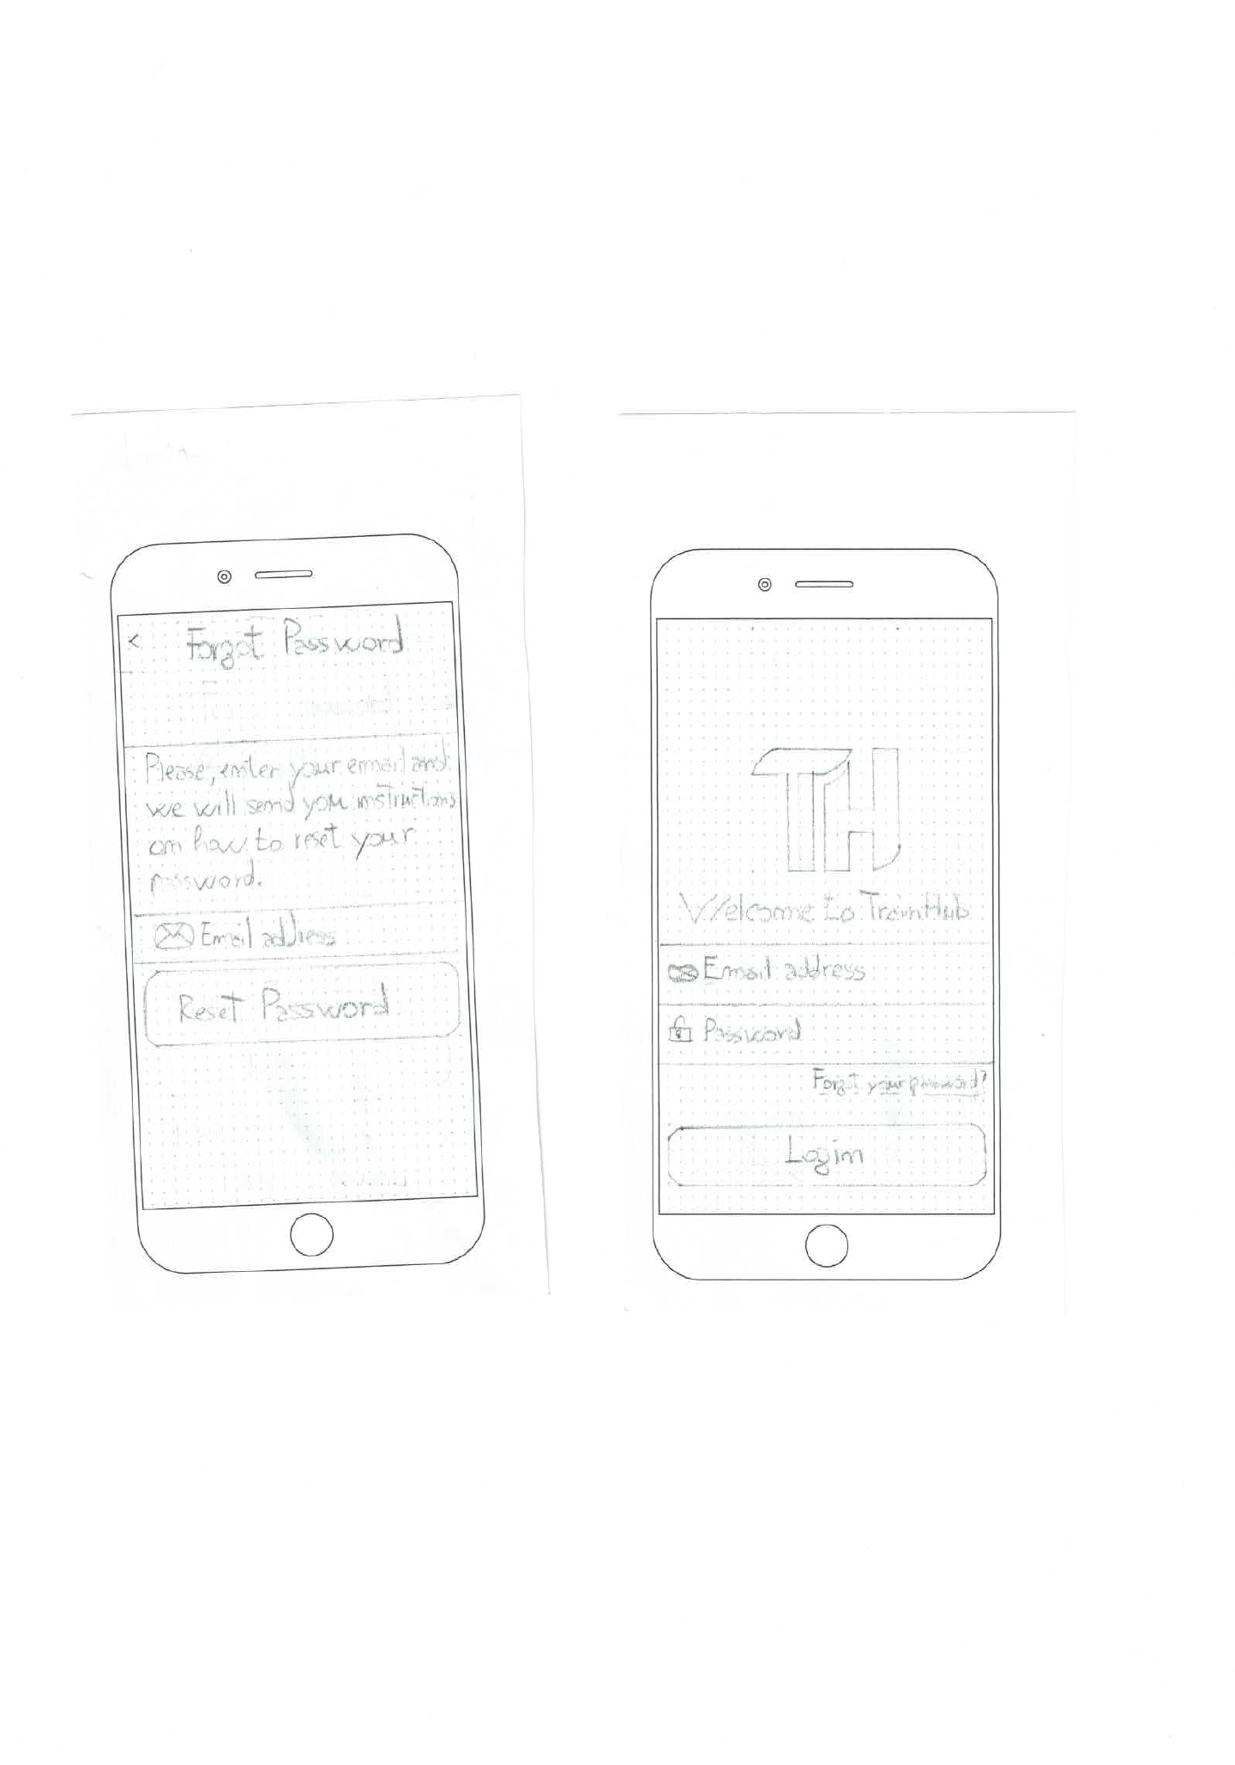
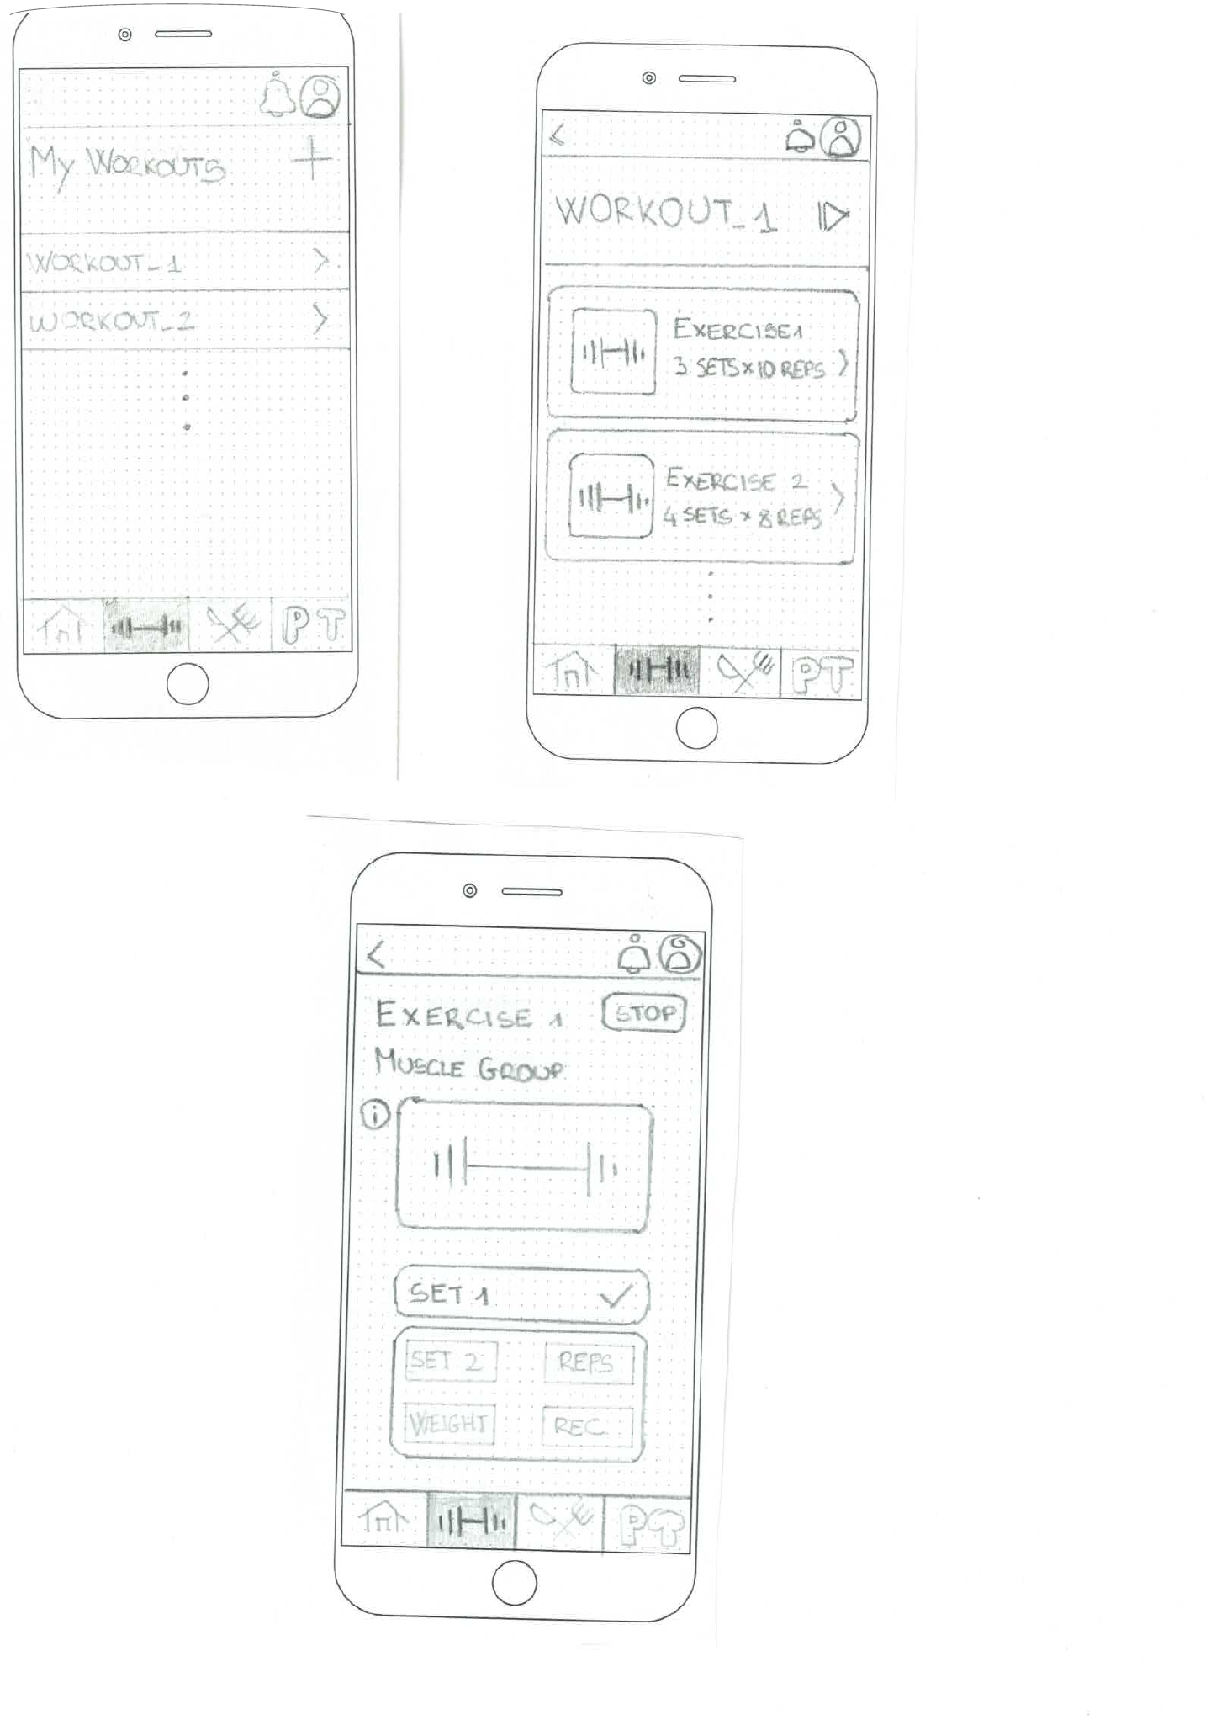
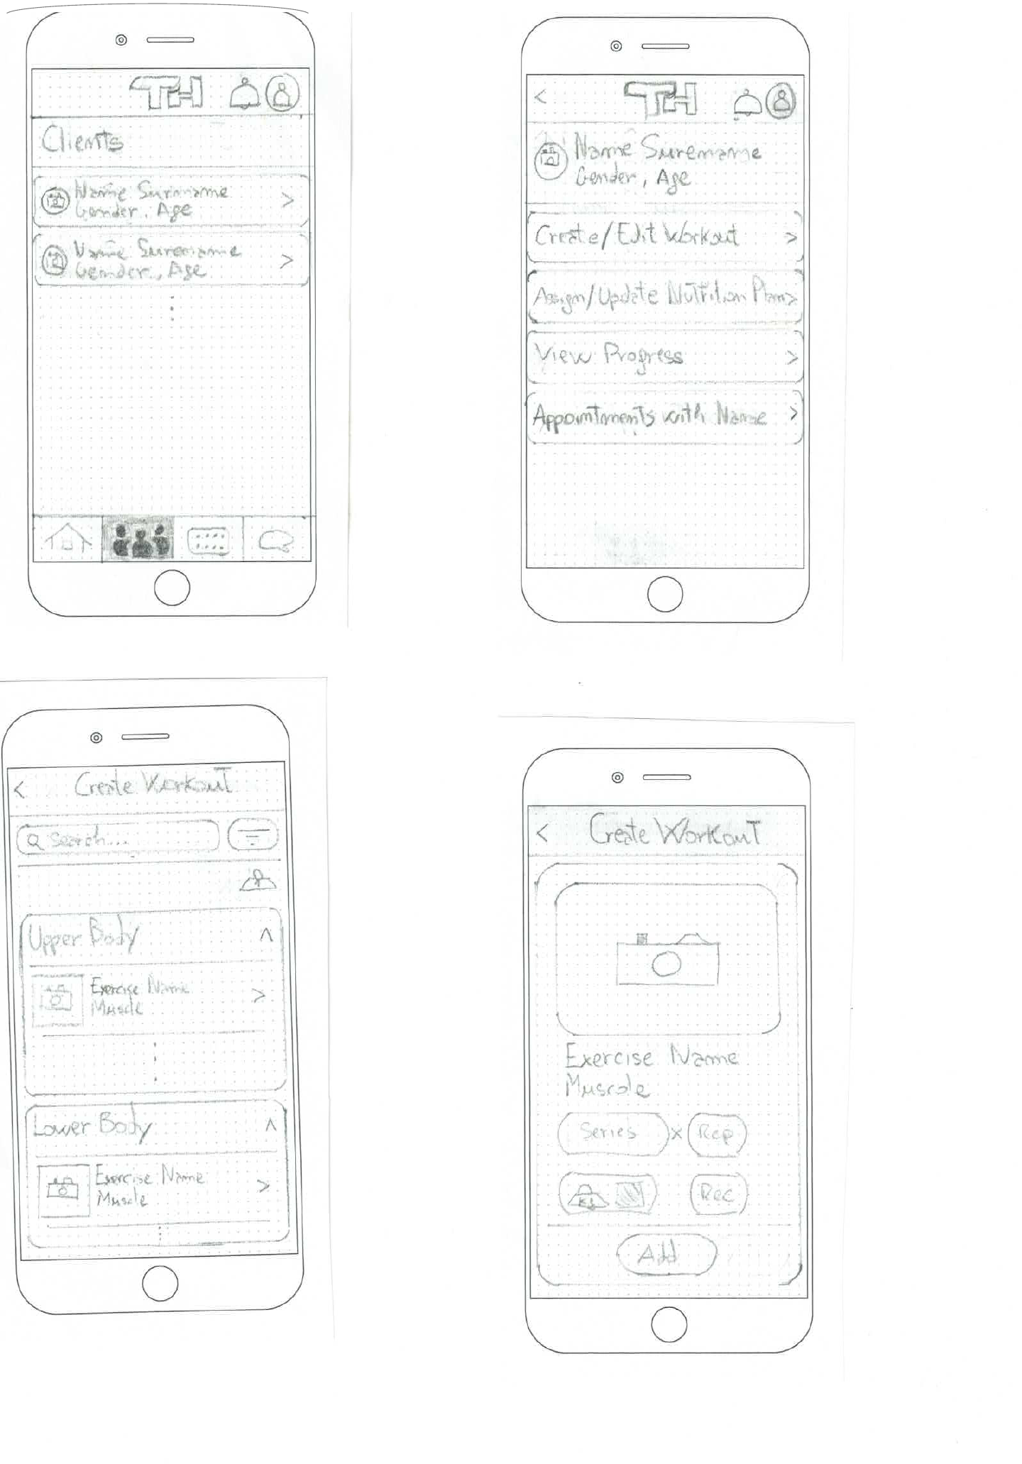
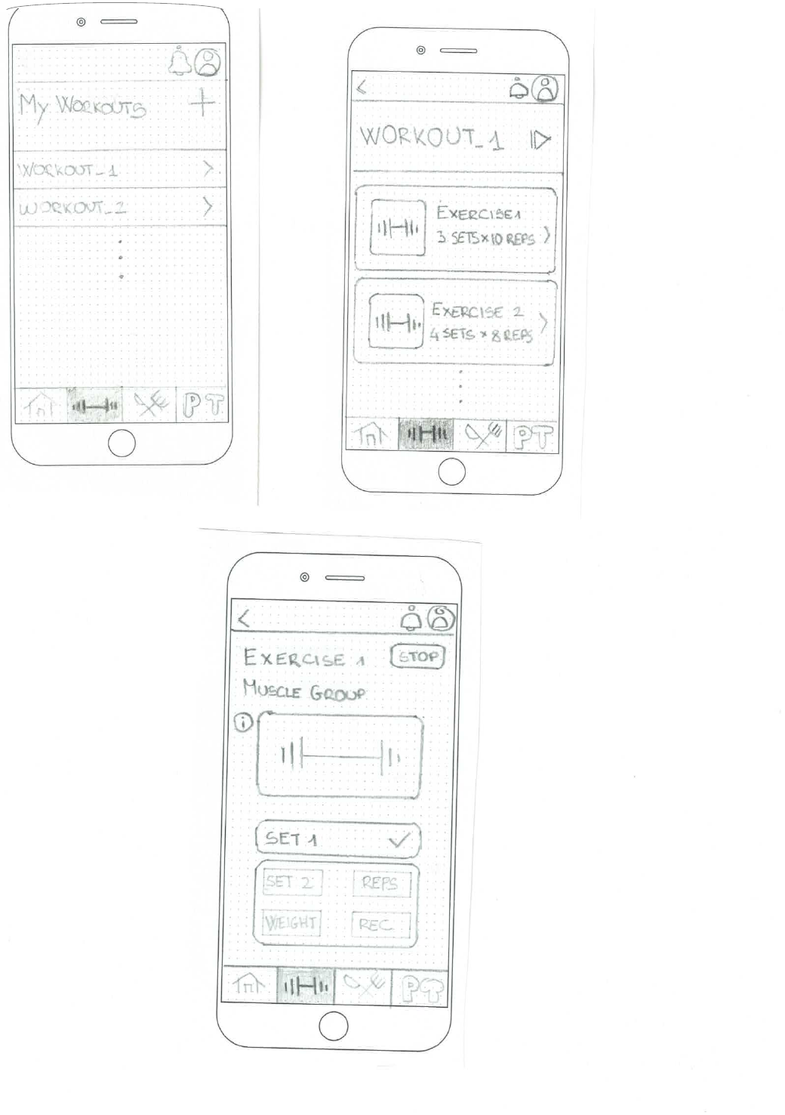
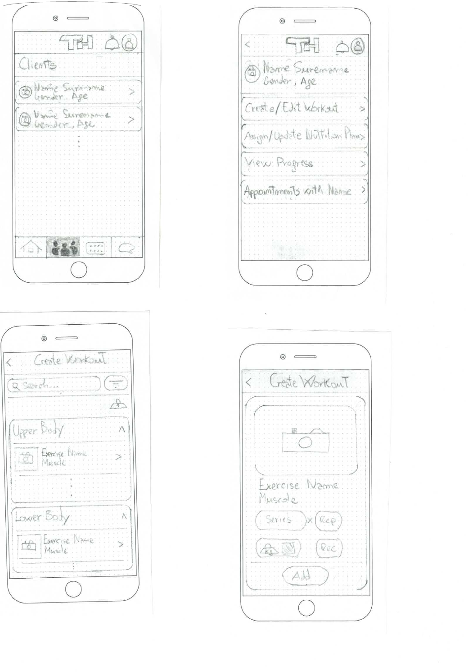
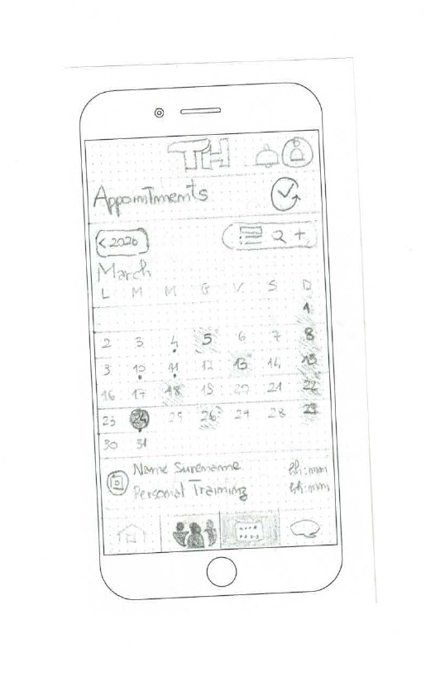
CHAPTER 4 · APPLICATION DESIGN
Paper prototypes checked flow depth before visual styling
Small sketches made structural mistakes cheap to identify and correct.
Shared authentication
Member workout flow
Professional client flow
• Shared sketches established authentication and the two role-specific entry points.
• Member sketches checked plan exploration, exercise details and set recording.
• Professional sketches made the selected client the starting point for plans and progress.
TRAINHUB
MOBILE APPLICATION DEVELOPMENT
19

Slide 21
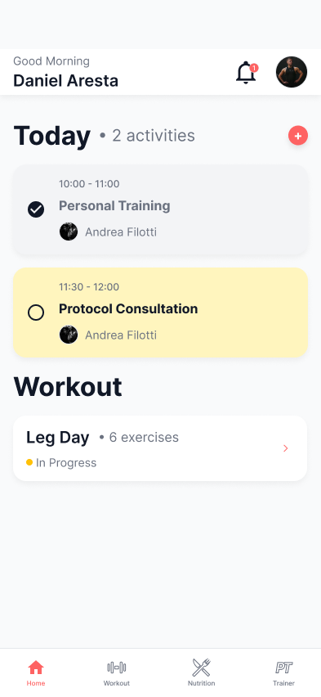
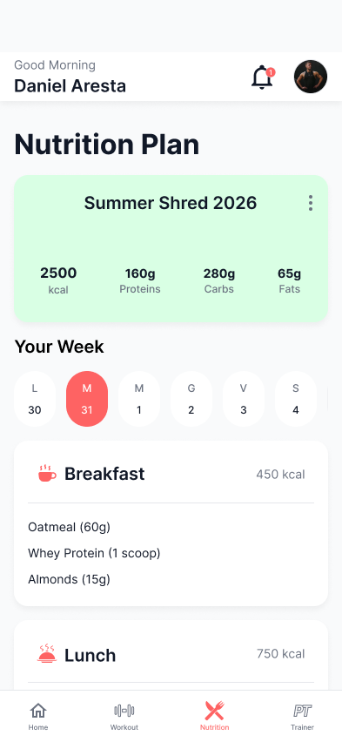
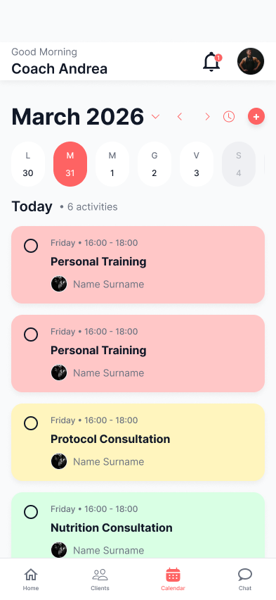
CHAPTER 4 · APPLICATION DESIGN
The visual system supports fast reading and consistent states
Figma color tokens are imported directly into the Material UI theme and reused across the application.
Visual rules
• Inter establishes a clear hierarchy between page titles, section headings, body text and secondary labels.
• Rounded cards and pill-shaped actions create a soft, consistent visual identity.
• Semantic tokens distinguish success, warning, danger, appointment types and suspended memberships.
• Key states also use labels, icons or numbers, so color is not the only signal.
Brand
Text
Success
Warning
Danger
Suspended
Member Home
Nutrition
Calendar
TRAINHUB
MOBILE APPLICATION DEVELOPMENT
20

Slide 22
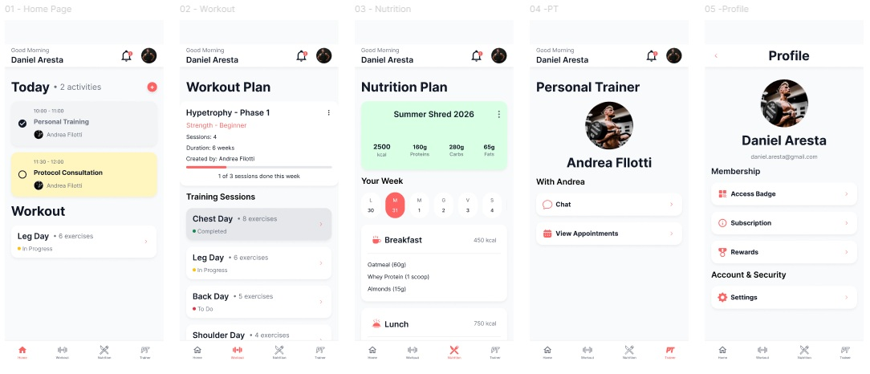
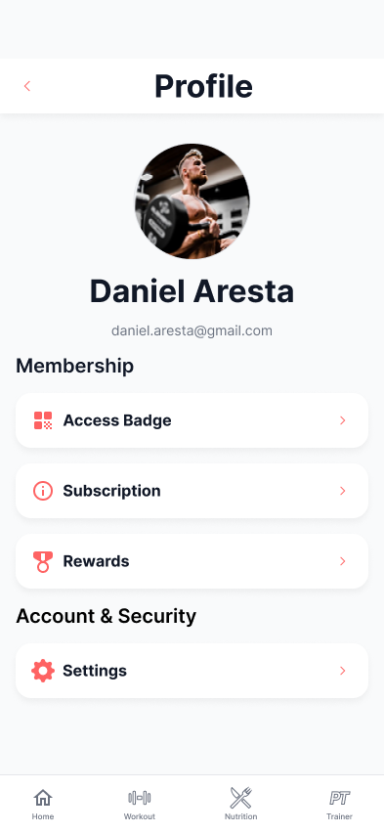
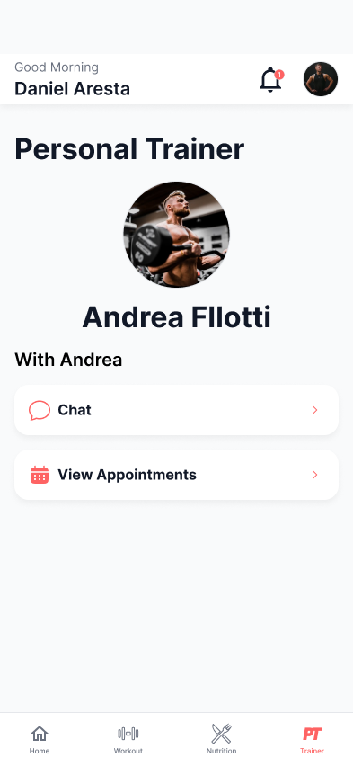
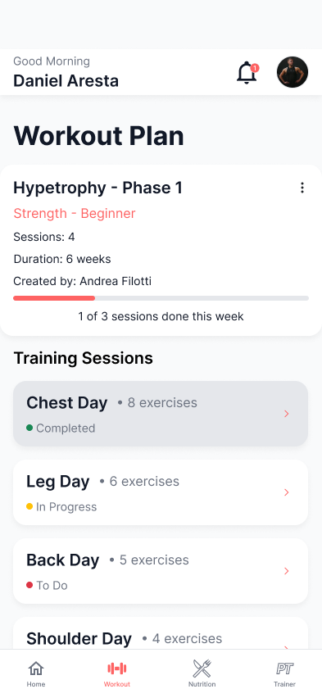
CHAPTER 4 · APPLICATION DESIGN
The member prototype presents overview first, detail on demand
Five representative screens show how the daily experience remains coherent across domains.
Final Figma flow: Home, Workout, Nutrition, My Trainer and Profile
TRAINHUB
MOBILE APPLICATION DEVELOPMENT
21

Slide 23
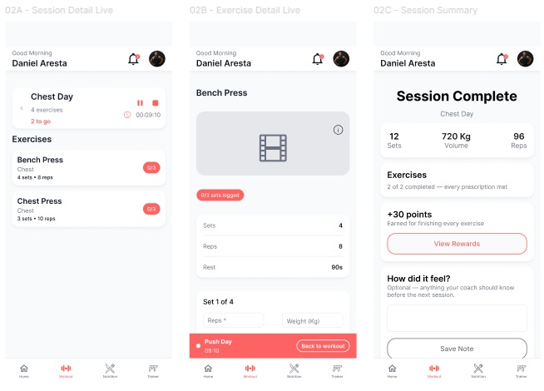
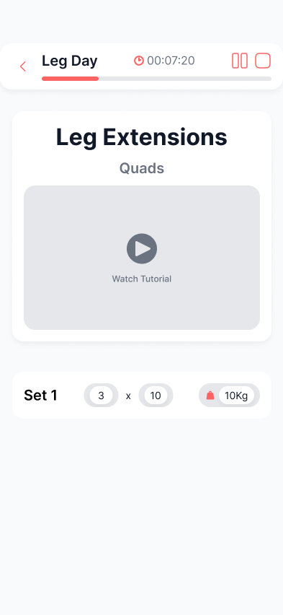
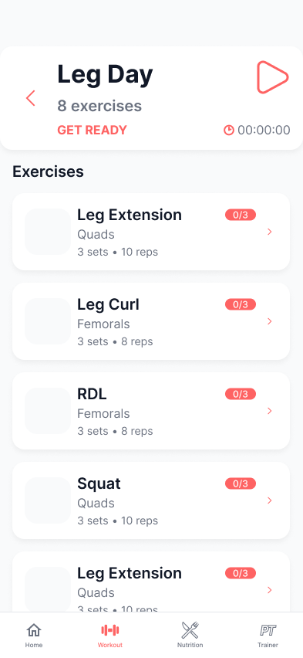
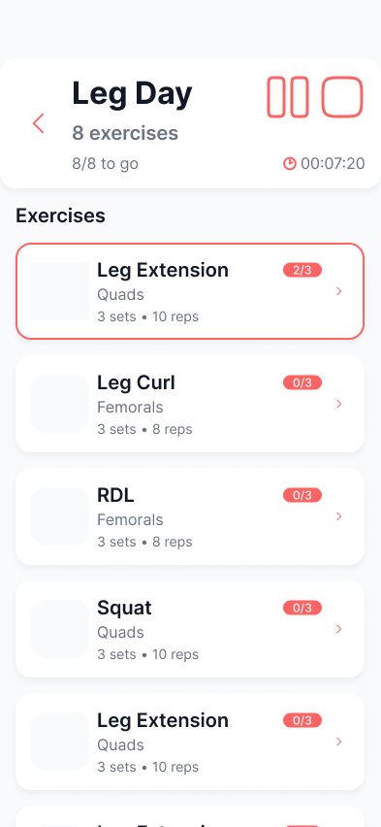
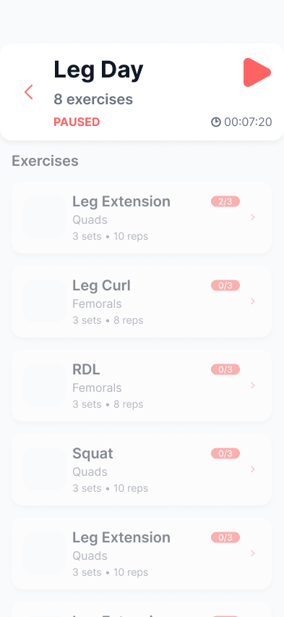
CHAPTER 4 · APPLICATION DESIGN
Live workout is the central interaction flow
The interface keeps the current run available while progress is derived from completed sets.
Run summary
• The timer counts active workout time and excludes pauses.
• Progress counts prescribed sets that were actually logged.
• The database closes the run as completed, partial or abandoned.
• Reward points require an active membership.
• The member can leave a note that appears in professional progress.
Live session → set logging → run summary
TRAINHUB
MOBILE APPLICATION DEVELOPMENT
22

Slide 24

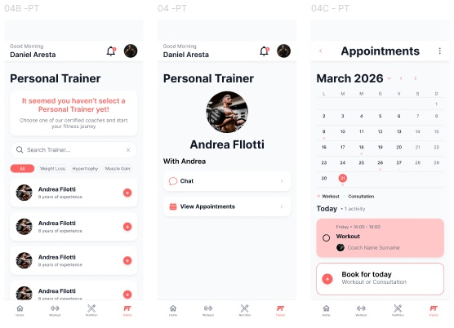
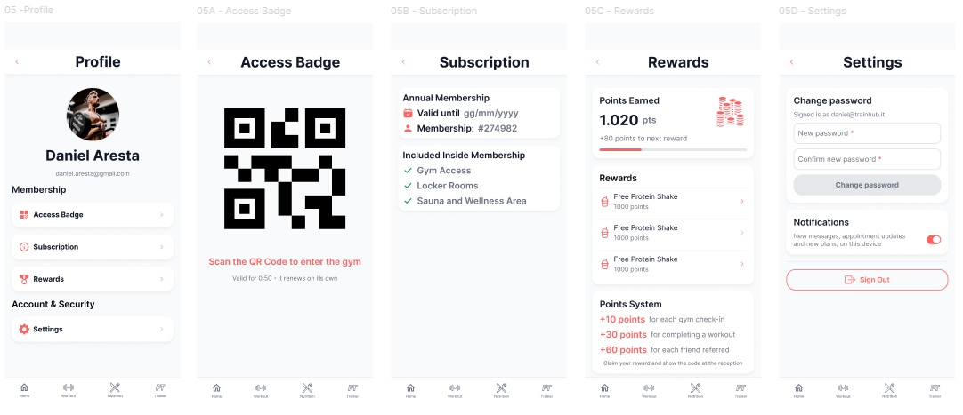
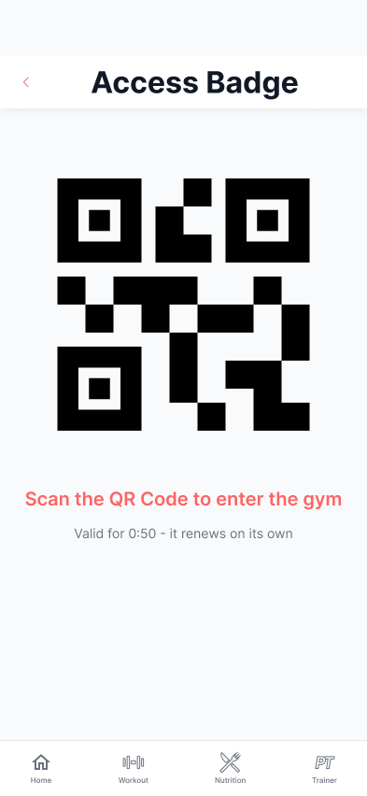
CHAPTER 4 · APPLICATION DESIGN
Secondary member services remain connected to the same context
Nutrition, booking and access support the workout journey without competing with it.
Nutrition by weekday
Trainer, appointments and booking
Profile, badge, subscription, rewards and settings
• The nutrition plan changes with the selected weekday and shows the meals assigned to that day.
• Members can browse available professionals and select their personal trainer.
• The trainer profile leads to appointments, where the member chooses the date and session.
• The profile area groups the QR access badge, membership details, rewards and account settings.
TRAINHUB
MOBILE APPLICATION DEVELOPMENT
23

Slide 25
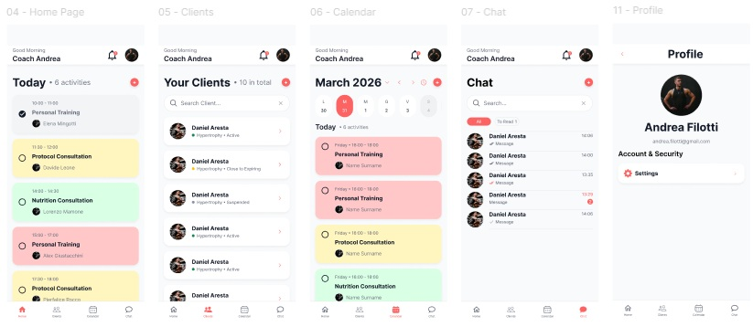
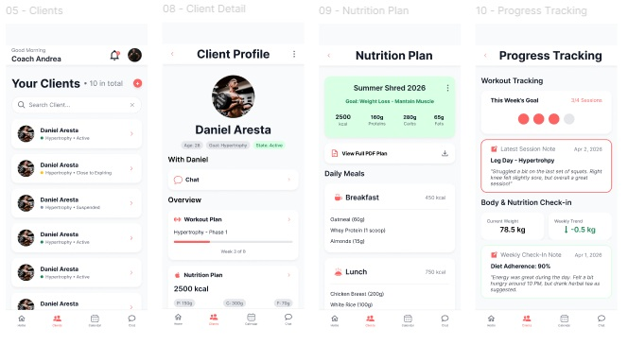
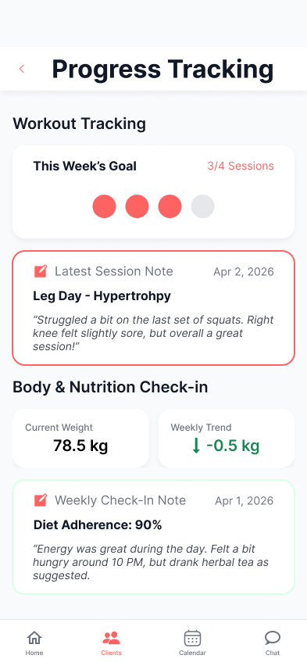
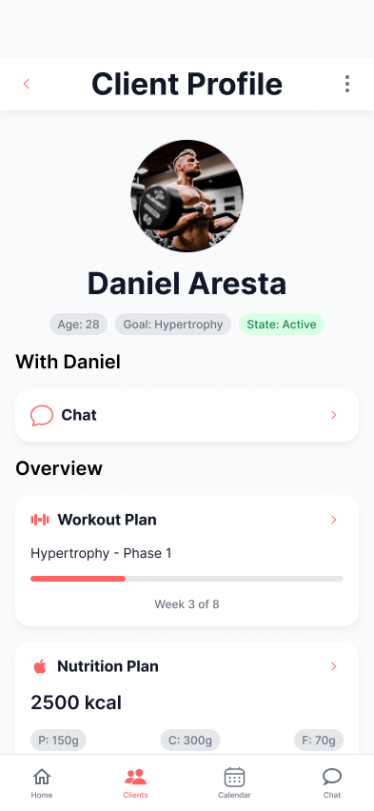
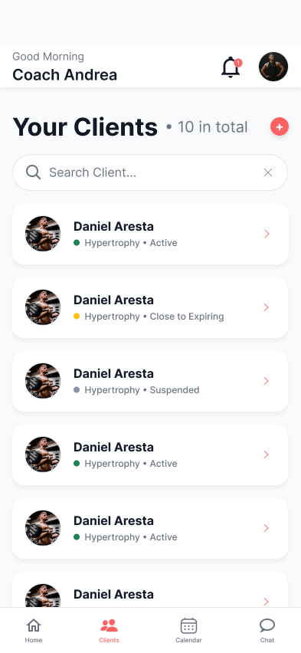
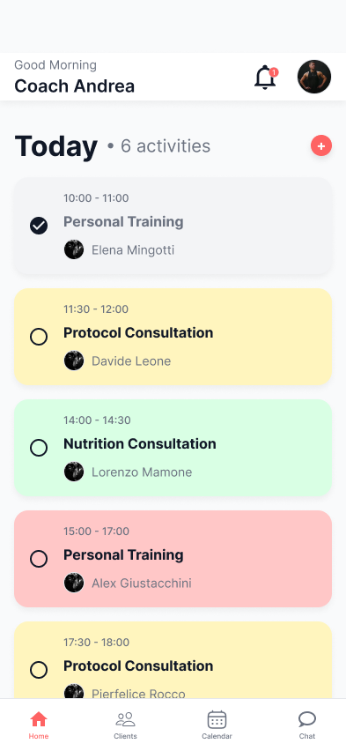
CHAPTER 4 · APPLICATION DESIGN
The professional interface moves from agenda to individual evidence
The selected client remains identifiable while the professional changes plans or reviews progress.
Agenda and global professional navigation
Client list, client hub, nutrition plan and recorded progress
• Home summarizes the daily agenda; Clients, Calendar and Chat remain available from the bottom navigation.
• The header keeps notifications, profile and the QR scanner available.
• From the selected client's profile, the professional can open chat, workout and nutrition plans, membership controls and progress.
• Workout results and session notes give the professional a clear view of the client's recent activity.
TRAINHUB
MOBILE APPLICATION DEVELOPMENT
24

Slide 26
CHAPTER 5 · IMPLEMENTATION AND ARCHITECTURE
The stack separates presentation, remote state and trusted rules
Each technology has one clear responsibility in the application.
01
React + Vite + MUI
JavaScript and JSX screens, production bundling, reusable components and shared styling.
Layering principle
Screens handle user actions. Data functions communicate with Supabase. The database enforces shared rules.
02
React Router
Public routes and protected member/professional application trees.
03
TanStack Query
Remote-state cache, invalidation, mutation defaults and persistence.
04
Supabase
Authentication, PostgreSQL, Realtime and Edge Functions.
This keeps filters, date handling and security rules out of individual screens.
05
PWA tools + Web APIs
Installable delivery, offline startup, push, camera, QR and device behaviour.
TRAINHUB
MOBILE APPLICATION DEVELOPMENT
26

Slide 27
CHAPTER 5 · IMPLEMENTATION AND ARCHITECTURE
Application structure keeps domain logic reusable
Routes and layouts organize access; shared modules keep data and rules reusable.
Source organization
Remote-state strategy
routes + layouts
Role-specific routes and the shared signed-in application shell.
• Shared query keys identify the domain and the relevant user or record.
• Valid cached data remains visible even when the latest refresh fails.
• Mutation functions are registered before persisted operations are restored.
• Ordered scopes preserve dependent writes; time-sensitive actions are never queued.
src/features
Screens grouped by workout, nutrition, chat, calendar, clients and other domains.
src/components
Reusable navigation, feedback, status and card components.
src/data
Plain asynchronous functions that read data or call protected operations.
lib + theme
Query keys, cache, dates, Supabase setup and visual tokens imported from Figma.
TRAINHUB
MOBILE APPLICATION DEVELOPMENT
27

Slide 28
CHAPTER 5 · IMPLEMENTATION AND ARCHITECTURE
The relational model preserves history and ownership
Plans define what should happen; workout runs record what actually happened.
Data model
Security model
• Twenty-one relational tables connect accounts, plans, runs, chat, appointments and access.
• Workout and nutrition edits create replacement versions instead of rewriting history.
• A session prescribes the work; each run stores one attempt, its pauses, sets, result and note.
• Foods stay as JSON inside a meal because they are always read and written with that meal.
• The public project key identifies Supabase; table privileges and Row Level Security grant access.
• Members see their own data; professionals see assigned-client data. Badge redemption is the front-desk exception.
• Protected database functions validate coordinated writes and complete them as one transaction.
• Stable identifiers and version checks make retries safe and stop unnoticed overwrites.
The interface can hide a button; only the database can make the rule unavoidable.
TRAINHUB
MOBILE APPLICATION DEVELOPMENT
28

Slide 29
CHAPTER 5 · IMPLEMENTATION AND ARCHITECTURE
Offline support is selective and explicit
TrainHub can open and show recent data offline, while live server decisions remain online-only.
What remains available
What requires a connection
• A hand-written service worker precaches the app shell, route chunks, styles, icons and Latin font files.
• Supabase data never enters that cache; useful query results stay in IndexedDB for at most one week.
• Recoverable writes keep their original identifier and time, then resume in scope order.
• An incompatible queued write is discarded with a one-time explanation to the user.
• New sign-in, badge validation and push registration need a current server decision.
• A fixed HTTPS origin keeps installation, push subscriptions and recovery links valid.
• The service worker is tested from a production build, not from the development server.
• Banners and action-level messages explain the unavailable function instead of failing silently.
TRAINHUB
MOBILE APPLICATION DEVELOPMENT
29

Slide 30
CHAPTER 5 · IMPLEMENTATION AND ARCHITECTURE
Realtime and device features use clear fallbacks
Only the capability that needs the missing network or permission becomes unavailable.
01
02
03
Chat and Realtime
Persistent and Web Push
QR, camera and timer
Realtime updates messages and read receipts. Duplicate identifiers are ignored, so optimistic messages appear only once.
The database stores the notification first, then calls the Edge Function. The service worker reuses an open TrainHub window.
QR frames are decoded locally. Elapsed time comes from timestamps, and the rest chime is unlocked by the member's tap.
Fallback
Refresh
Fallback
In-app history
Fallback
Manual code + text
TRAINHUB
MOBILE APPLICATION DEVELOPMENT
30

Slide 31
CHAPTER 5 · IMPLEMENTATION AND ARCHITECTURE
The workout flow connects every application layer
The flow connects routing, cached data, local-time rules, secure writes and both role views.
1
Load the active plan and current-week runs using local day boundaries and the persisted query cache.
2
Create one secure run after checking ownership; a unique database rule prevents a second open run.
3
Record each set against both the run and prescribed exercise, with ordered replay after disconnection.
4
Derive elapsed time from timestamps and accumulated pauses, even after background timers are frozen.
5
Close the run by recomputing percentage, outcome and eligible points from the set rows in the database.
6
Refresh the member summary; the professional opens the same stored run and reads its closing note.
Verification
17 direct Node assertion scripts · lint + production build · schema, privilege and RLS checks · anonymous and authenticated probes · real-device PWA, camera and push tests
TRAINHUB
MOBILE APPLICATION DEVELOPMENT
31

Slide 32
CHAPTER 6 · CONCLUSIONS
The result is a connected working relationship, not a collection of screens
Member autonomy and professional context now reinforce each other inside the same product.
Project outcome
Known limits and next steps
•
Members use a rotating QR badge, follow or create workout plans, record live sessions, consult nutrition, book and chat.
•
Badge scans check the professional role, not client assignment; add relationship checks or a front-desk role.
•
Membership expiry is evaluated when needed, not rewritten; gym integration should connect billing, opening hours and staff availability.
•
Professionals prepare plans, review progress, organize appointments, manage clients and scan access badges.
•
Member progress and preserved plan history are not yet visible; add dedicated views.
•
One codebase and one database connect both role-specific routes; repeating weekly runs make workout plans reusable.
•
Exercise media are placeholders; replace them with one licensed and consistent library.
•
The fixed HTTPS tunnel serves a local production build, not a hosted release; deploy with repeatable builds, monitoring and accessibility and performance audits.
TRAINHUB
MOBILE APPLICATION DEVELOPMENT
32

Slide 33
THANK YOU
Questions and discussion
Davide Leone · Andrea Bariselli

