Slide 1
Eploy
Connecting Talent to Opportunity with Intelligent Job Matching

Slide 2
1. Recruiters’ Struggle with Candidate Mismatch
Problem: Recruiters often face the challenge of sifting through large volumes of applications, many of which do not match the job requirements. This results in significant time and effort wasted on screening unqualified candidates.
2. Candidates’ Frustration with Lack of Unified Job Listings
Problem: Candidates often miss out on job opportunities because they struggle to find a unified platform that aggregates job listings from various sources. This fragmentation leads to missed chances and a more challenging job search process.

Slide 3
Eploy revolutionizes recruitment by aggregating job data, facilitating easy applications, and using AI-driven match scoring to connect the right candidates with the right opportunities, all in one streamlined platform.
Smart Job Matching:
AI matches candidates to jobs, giving HR professionals a simple match score for easy shortlisting.
Unified Job Listings:
The platform gathers job posts from various sources into one place, offering a wide range of opportunities for both recruiters and candidates.
Easy Applications:
Candidates can quickly apply to jobs with just a few clicks, while recruiters benefit from a hassle-free job posting process.
Boosted Hiring Efficiency:
By cutting down on manual work, Eploy helps companies hire faster and make better decisions, saving both time and money.

Slide 4
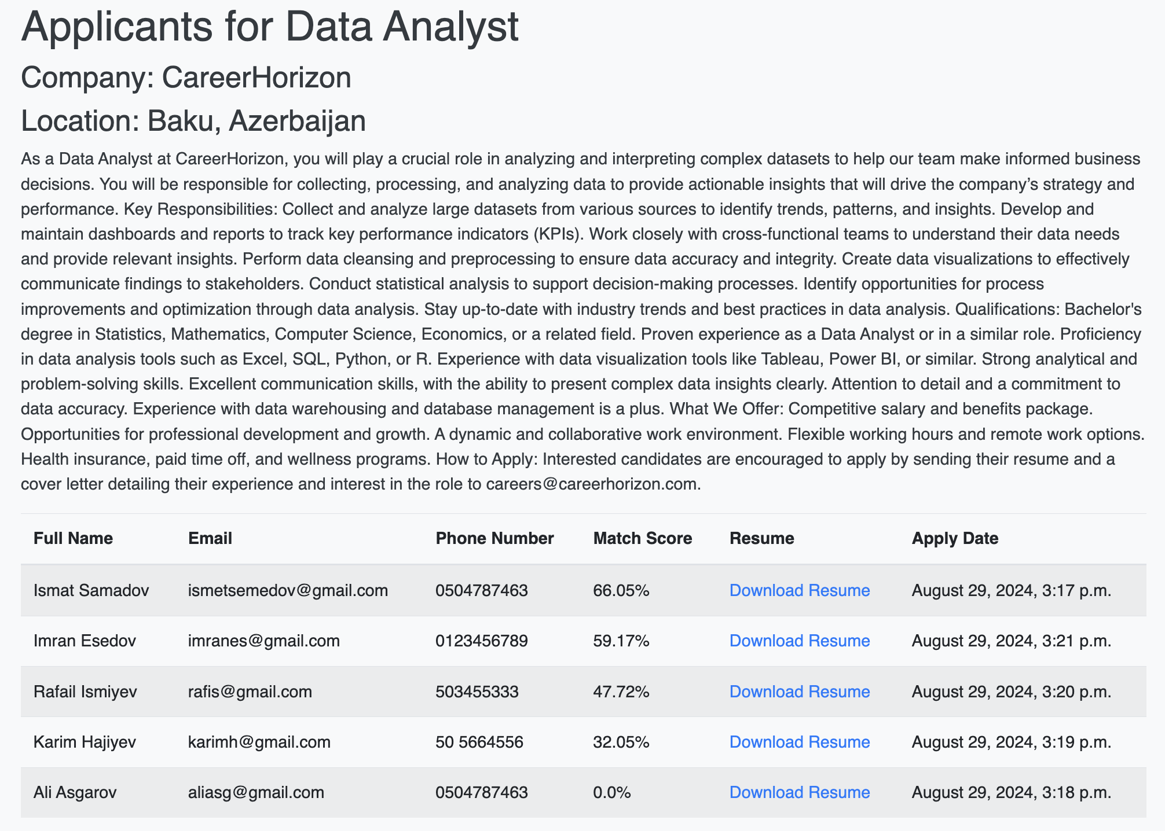

Slide 5
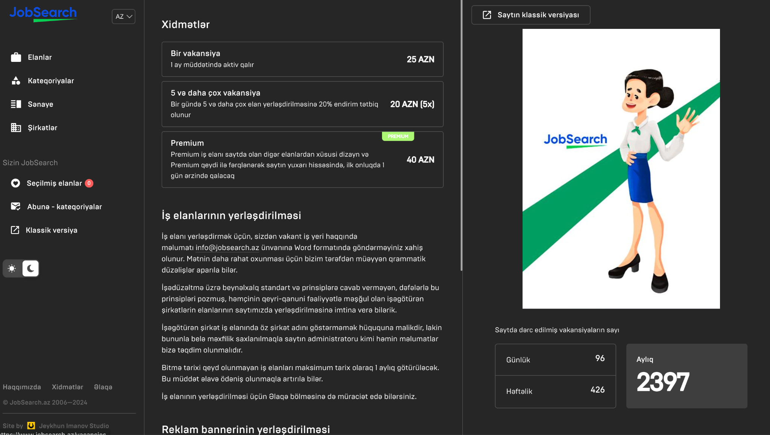

Slide 6
Standard Job Posting:
Cost: 15 AZN per job posting.
Duration: Keeps the job active on the website for 15 days.
Target Users: Recruiters and employers looking for a cost-effective way to post jobs and attract candidates over a longer period.
Premium Job Posting:
Cost: 20 AZN per job posting.
Duration: Keeps the job in the top 10 active listings for 1 day.
Target Users: Recruiters and employers who want to maximize visibility and attract more applicants quickly, ensuring their job posting gets prioritized at the top of the listings.
Job Posting Package:
Cost: 50 AZN for 5 job postings.
Duration: Each job posting in the package follows the standard posting rules (15 days active).
Target Users: Recruiters and employers who need to post multiple jobs and are looking for a cost-effective bundle option.

Slide 7
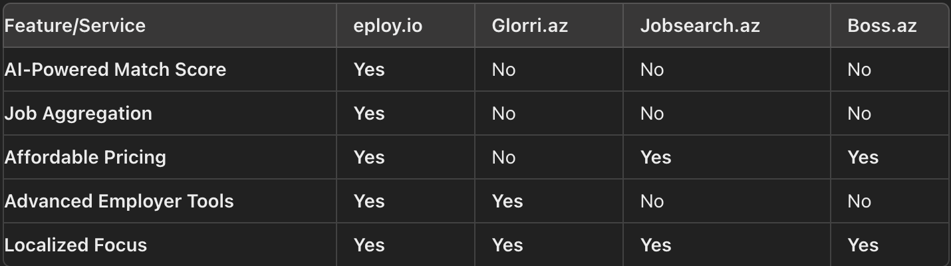

Slide 8
Achievements So Far
Platform Development: Core features built, basic AI match score implemented, initial web scraping integrated.
Market Research & Pricing: Competitor analysis, pricing model established, target market identified.
Beta Testing: Early users onboarded, feedback collected for improvement.
Month 1 Goals
Enhance Platform Features: Refine AI match score, expand job aggregation, improve UI.
Marketing & Outreach: Launch initial marketing campaign, start partnership discussions.
Beta Test Expansion: Onboard more beta users, collect and analyze feedback.
Evaluation Criteria:
20% improvement in match accuracy, 3-5 new job sources, positive UI feedback.
Month 2 Goals
Feature Finalization: Fix bugs, finalize core and advanced features.
Scale Marketing: Broaden campaigns, initiate PR efforts.
Onboard Early Adopters: Convert beta users to paid customers, engage early adopters.
Evaluation Criteria:
Bug-free platform, 30% traffic increase, 50% beta-to-paid conversion.
Month 3 Goals
Soft Launch: Begin soft launch, monitor platform performance.
Partnership Integration: Complete and launch key integrations.
Monitor & Iterate: Track KPIs, make data-driven improvements.
Evaluation Criteria:
500 job posting monthly, one major partnership, positive KPI trends.

Slide 9
Amount: 30,000 AZN to initiate operations in Azerbaijan.
Purpose of Funding:
1. Product Development (50% - 15,000 AZN):
AI Customization: Tailor the AI match score algorithm for the Azerbaijan job market.
Job Aggregation Expansion: Integrate major Azerbaijani job boards and sources.
Localization: Ensure the platform is fully functional and optimized for local users.
2. Marketing Expenses (50% - 15,000 AZN):
Initial Marketing Campaign: Raise awareness among Azerbaijani recruiters and job seekers.
Local Presence: Utilize digital marketing, social media, and partnerships with local influencers.
User Engagement: Engage early adopters and collect feedback for platform refinement.
Runway and Milestones:
Runway: 6 months of operations with clear milestones.
Months 1-3:
Complete product localization and development.
Launch the first marketing campaign targeting key industries in Azerbaijan.
Onboard at least 50 job post per month, focusing on early adopters from local businesses.
Months 4-6:
Refine the platform based on user feedback.
Expand marketing efforts to a broader audience.
Grow to 500 active users and secure at least one major partnership with a local job board or HR provider.

Slide 10




Tural Allahverdiyev
Bank of America
Data Analyst
4 years experience
Azar Ahmadov
Unibank CB
Scrum Master
5 years experience
Vusal Shukurov
Kapital Bank
Business Analyst
3 years experience
Kamal Khalilov
Leobank
Product Owner
4 years experience

