Slide 1
Netflix+IMDB+ Database
Soren Rasmussen, University of Oregon

Slide 2
Motivation
2016 Movie Revenue
Netflix: $6.8 billion
Hulu: $1.5 billion
Global Box Office: $38 Billion
Netflix Infamous “Netflix Prize”
$1,000,000 to winning team

Slide 3
3 V’s

Slide 4
Data Fusion: sources
Netflix Challenge User Ratings
17,000 Movies
100,000,000+ Ratings
480,000 Users
The Internet Movie Database
359,683 Film Ratings
iCheckMovies.com
180 Movie Lists
2193 entries

Slide 5
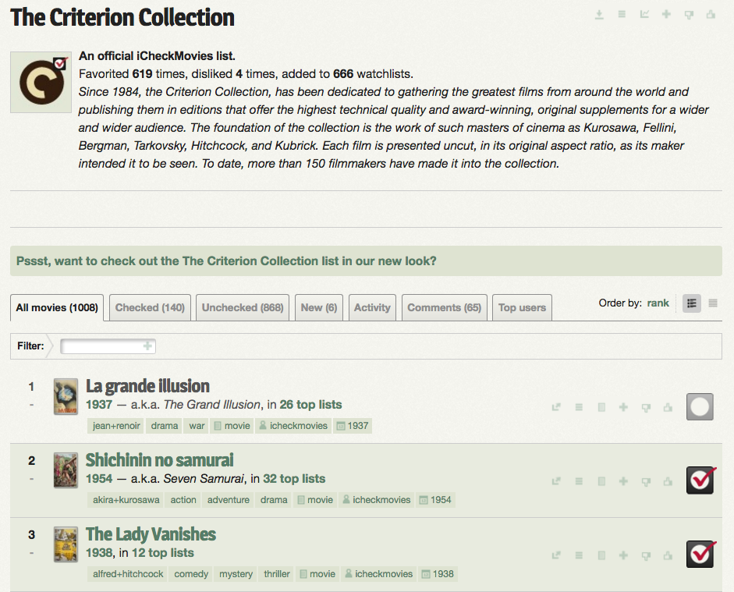
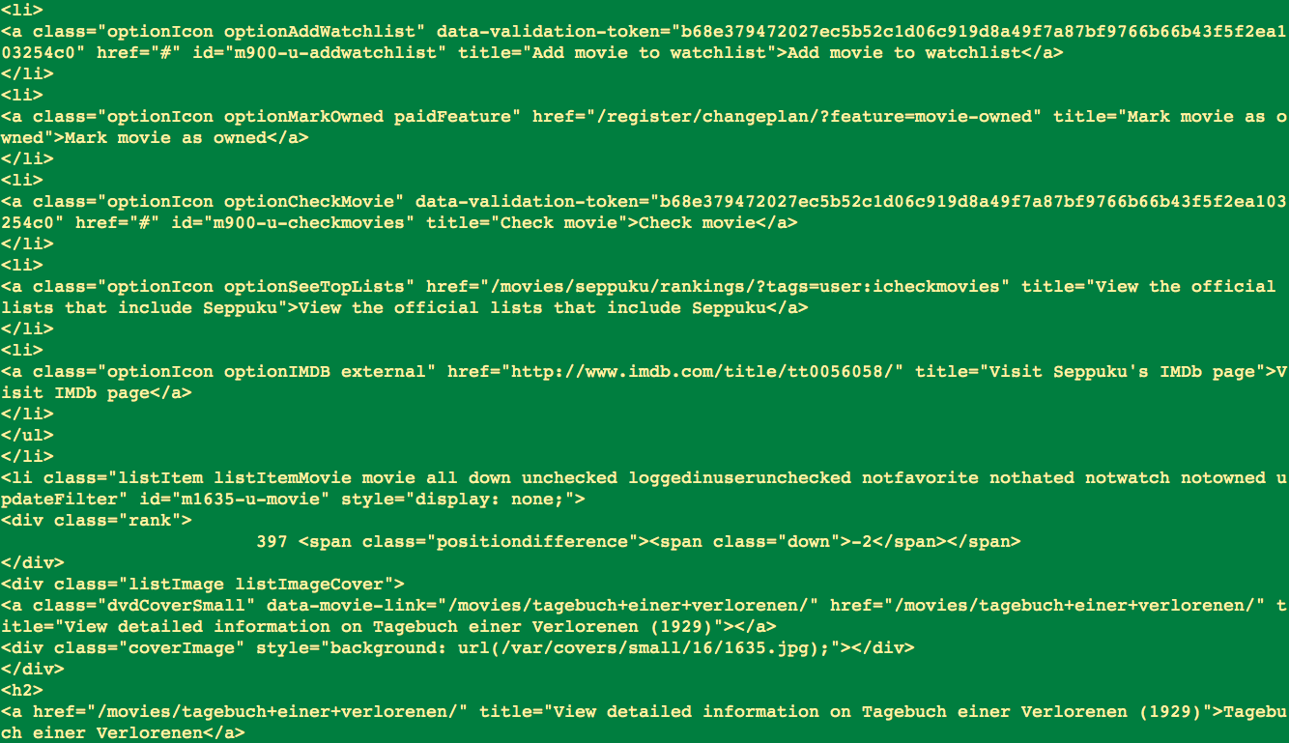
Web Scraping: iCheckMovies
Created Python Tool
Used Beautiful Soup
Challenges
Grapping English Titles
Largest Bottleneck
Slow: 23+ Minutes

Slide 6
Schemas
Netflix
Movies(ID, Year, Title)
In mv_*ID*.txt: Ratings(User, Rating, Date)
IMDB
Ratings(Distribution, Votes, Rank, Title, Year)
iCheckMovies
List(NumOfLists, Year, Title)

Slide 7


Distributed Databases
Lack of Resources
Laptop lacked memory & R
“Frankenstein” lacked Python packages
Web Scraping: iCheckMovies DB
Slow: 23 Minutes
Netflix + IMDB: big datasets
DB Cleaning in R and Python
Netflix: getting avgs ~8 min
Netflix: cleaning titles ~2 min
IMDB: cleaning titles ~1.5 min
Merge All Data in R:
Quick
Neural Network Processing in Python

Slide 8
Future Research
Add data sources
Add movies that are in theaters
Add Amazon ratings
Hulu? Private though

Slide 9
Thanks to

