Slide 1
Netflix+IMDB+… Database
Soren Rasmussen, University of Oregon

Slide 2
Motivation
2016 Movie Revenue
Netflix: $6.8 billion
Hulu: $1.5 billion
Global Box Office: ***$$38 Billion$$***
Netflix Infamous “Netflix Prize”
$1,000,000 to winning team

Slide 3
3 V’s
Velocity: Netflix databases constantly changing
Volume: Netflix has 81.5+ million users, see next slide
Variety:
Web scraping
Public databases
Private databases: user’s ratings
Movie theater listings

Slide 4
Data Fusion: sources
Netflix Challenge User Ratings
17,000 Movies
100,000,000+ Ratings
480,000 Users
The Internet Movie Database
359,683 Film Ratings
iCheckMovies.com
180 Movie Lists
2193 entries

Slide 5
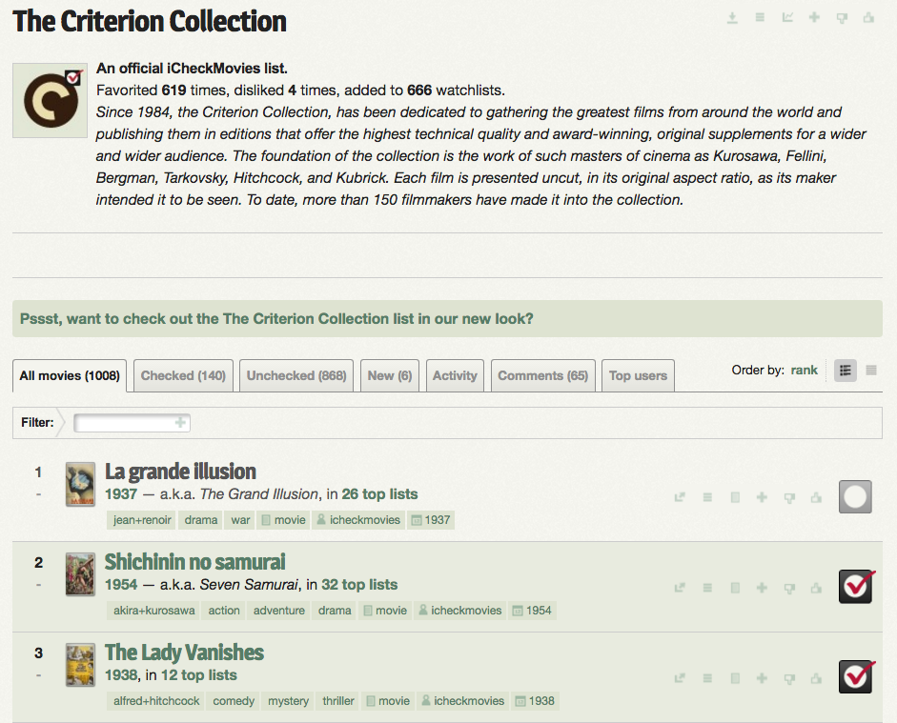
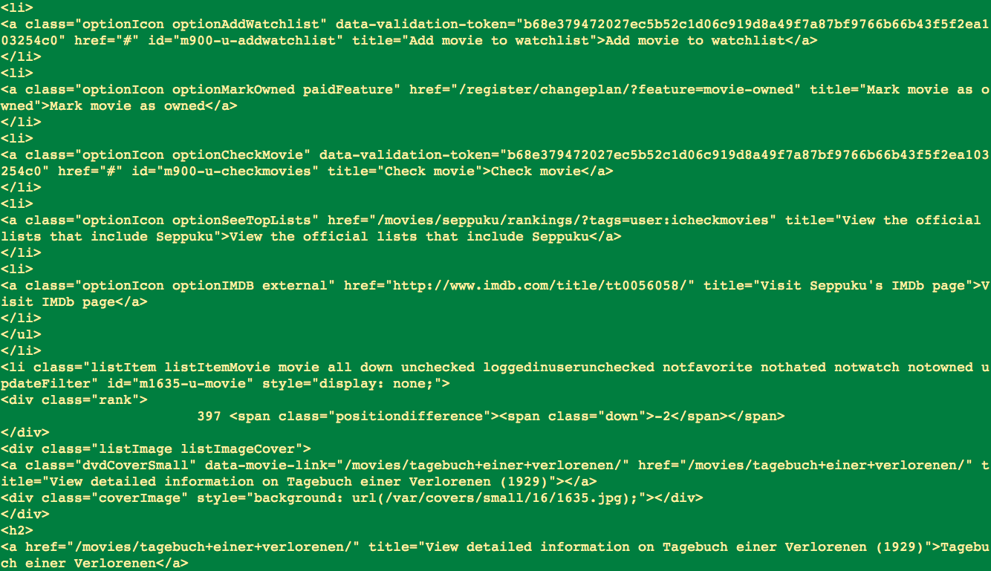
Web Scraping: iCheckMovies
Created Python Tool
Used Beautiful Soup
Challenges
Grapping English Titles
Largest Bottleneck
Slow: 23+ Minutes
Hidden Data

Slide 6
Schemas
Netflix
Movies(ID, Year, Title)
In mv_*ID*.txt: Ratings(User, Rating, Date)
IMDB
Ratings(Distribution, Votes, Rank, Title, Year)
iCheckMovies
List(NumOfLists, Year, Title)

Slide 7


Distributed Databases
Lack of Resources
Laptop lacked space & R
“Frankenstein” lacked Python packages
Web Scraping: iCheckMovies DB
Slow: 23 Minutes
Netflix + IMDB: big datasets
DB Cleaning in R and Python
Netflix: getting avgs ~8 min
Netflix: cleaning titles ~2 min
IMDB: cleaning titles ~1.5 min
Merge All Data in R:
Quick
Neural Network Processing in Python

Slide 8
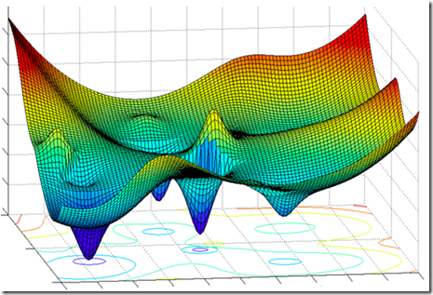
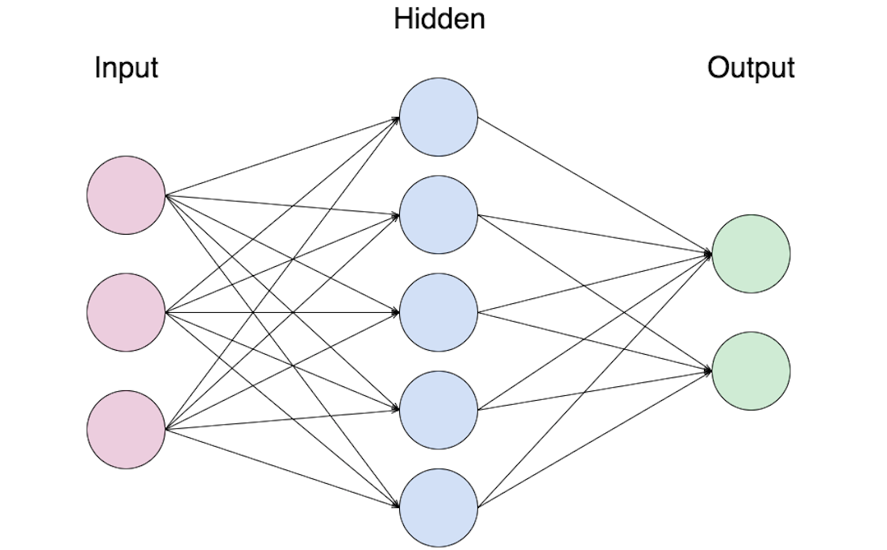
Neural Networks
Used Python’s scikit-neuralnetwork
Root Mean Square Deviation: 0.00037144

Slide 9
Future Research
Add data sources
Add movies that are in theaters
Add Amazon ratings
Hulu? Private though… like most data D:

Slide 10
Thanks to
u

