Slide 1
Netflix+IMDB Database
Soren Rasmussen, University of Oregon

Slide 2
Motivation
2016 Movie Revenue
Netflix: $6.8 billion
Hulu: $1.5 billion
Global Box Office: $38 Billion
Netflix Infamous “Netflix Prize”
$1,000,000 to winning team

Slide 3
Data Fusion: sources
Netflix Challenge User Ratings
17,000 Movies
100,000,000+ Ratings
480,000 Users
The Internet Movie Database
359,683 Film Ratings
iCheckMovies.com
180 Movie Lists
2193 entries

Slide 4
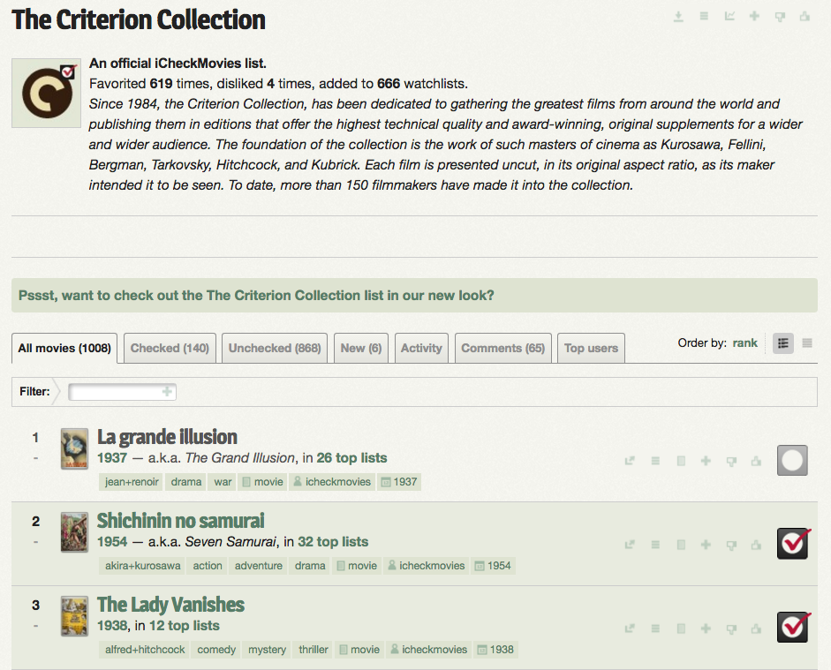
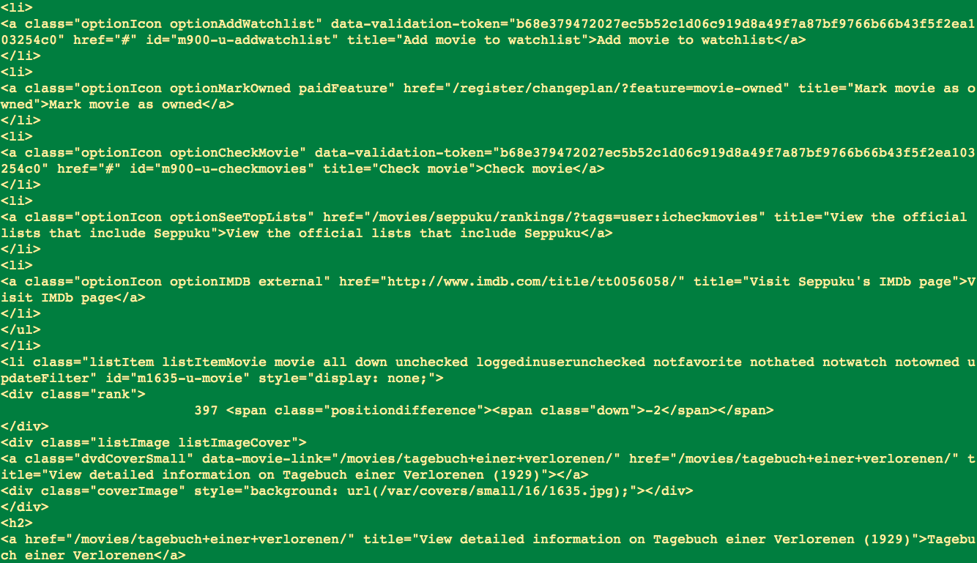
Web Scraping: iCheckMovies
Created Python Tool
Used Beautiful Soup

Slide 5
Schemas
Netflix
IMDB
iCheckMovies

Slide 6
Timing
Graph of schemas and transition

Slide 7
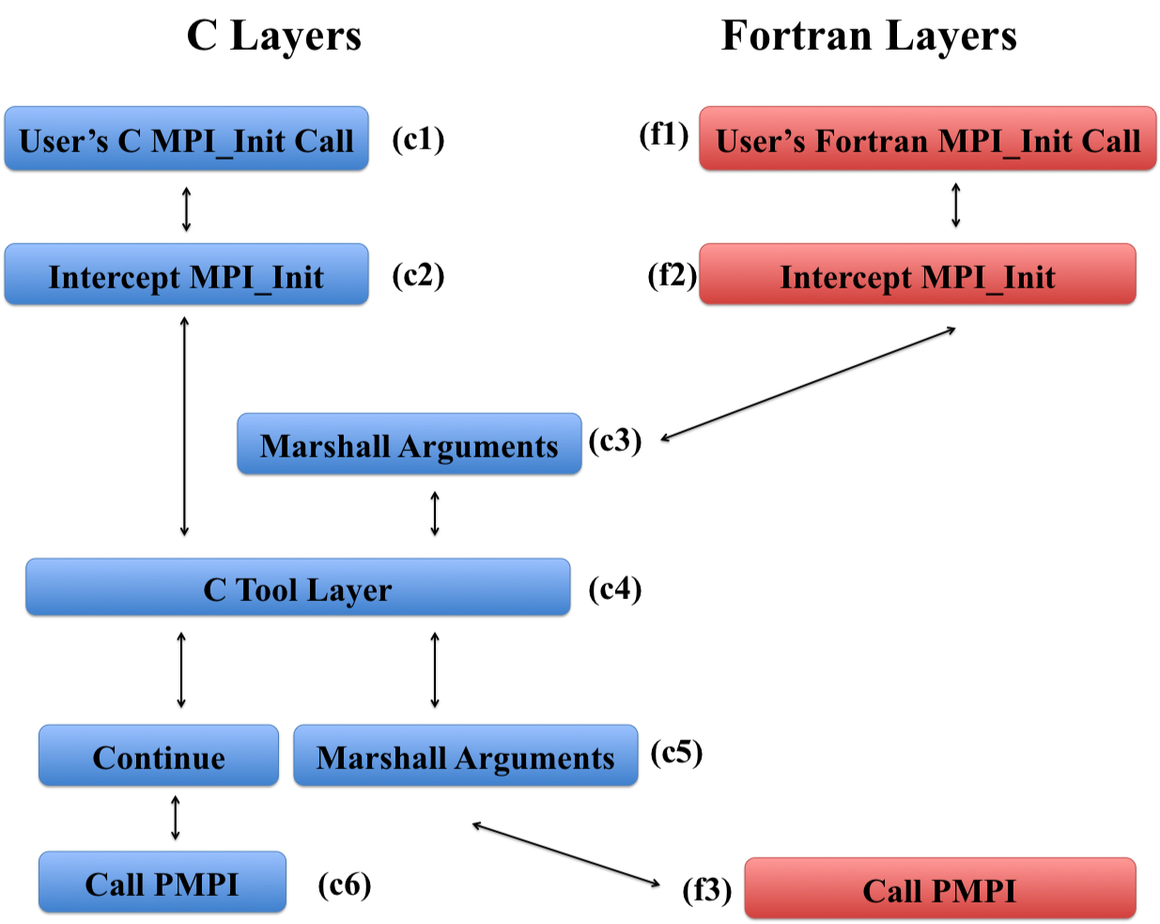
Wrapper Architecture

Slide 8
Future Research
Add data sources
Add movies that are in theaters
Add Amazon ratings
Hulu? Private though

Slide 9
Thanks to

