Slide 1
Getting Started
Before we get too deep into our coding, lets take a step back to talk about computers in general.
Computers are represented by many different things, besides just the normal laptop or desktop. Cell phones are computers, smartTVs are computers, video game systems, and more.
Keeping it simple, ALL computers are made of two things: Hardware and Software.

Slide 2
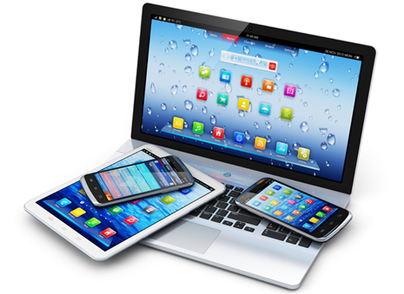
Hardware
The hardware of a computer is anything that you can feel and touch. The physical parts of a computer. The metal and pieces that make up the devices that we use.
These pieces include keyboards, mouse, monitor, Playstation, cell, wires, and more.

Slide 3
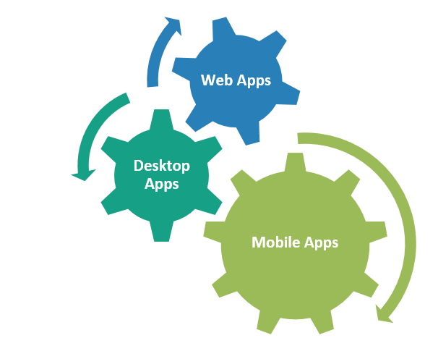
Software
If hardware is the parts and pieces of a computer, then Software is the brains of the computer.
Software tells the hardware on the computer exactly what to do and how to do it. You can’t touch or feel software, but without it, the computer would just be a pile of metals and screws.

Slide 4
Software
The software tells the computer what to show on the screen, what happens when you send a text, and how many points you’ll score when playing the Michael Jackson Experience on Wii.
Software can be the video games that we play, the apps on our phones, the desktop applications like Microsoft Word, and even social media platforms such as Facebook and Twitter.

