Slide 1
Mixed Effects Models
Jamil Bhanji
April 2024

Slide 2
Goals today
extend repeated measures ANOVA to cover a mixed design (1 or more between subjects factors, 1 or more within subjects factors) (easy)
understand the concept and advantages of multilevel models

Slide 3
What is a mixed effects model?
Often refers to a design that includes both between-subject factors and within-subject factors
e.g., Raio et al 2013 “Cognitive emotion regulation fails the stress test”
Acute Stress manipulation between subjects
Cognitive emotion regulation manipulation within subjects
this is just our repeated measure ANOVA model with an additional between subjects factor

Slide 4
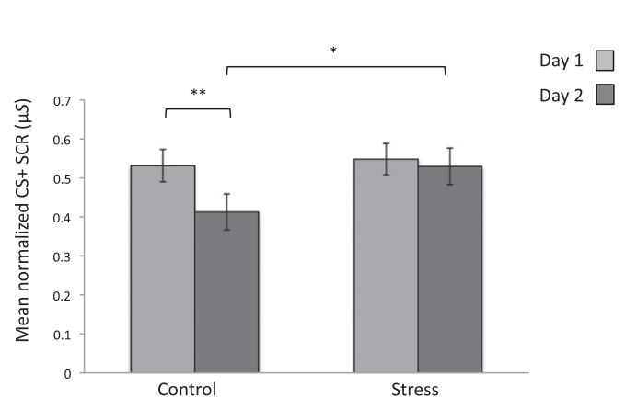
Mixed design example – Raio et al 2013
within-subjects
2 groups (Control, Stress), each participant has two measures
Day1=no regulation
Day2=cognitive regulation
DV = skin conductance response to CS+
repeated measures ANOVA with added between-subjects factor
repeated measures is required because within-subjects measures violate the independence assumption
between-subjects

Slide 5
Mixed design example
2 groups (Control, Stress), each participant has two measures
Day1=no regulation
Day2=cognitive regulation
repeated measures ANOVA with a between-subjects factor
repeated measures is required because within-subjects measures violate the independence assumption
in SPSS use General Linear Model->Repeated Measures
interpretation of output is exactly the same as before – interactions of within and between factors appear in “Within-Subjects” table
Greenhouse-Geisser correction for non-sphericity in within-subjects effects where there are more than two levels

Slide 6
Mixed design example – Raio et al 2013
Use same methods (planned contrasts, pairwise comparisons) to interpret an interaction effect
“We conducted a repeated-measures ANOVA using condition (stress, control) as a between-subject factor and session (day 1, day 2) as a within-subject factor. We observed a main effect of session [F(1, 78) = 8.45, P = 0.005], no effect of condition [F(1, 78) = 1.32, P = 0.25], and a significant session X condition interaction [F(1, 78) = 4.55, P = 0.03]. Paired samples t-tests confirmed that the control group showed a significant decrease in SCR to the CS+ across sessions [t(43) = 3.65, P = 0.001], whereas the stress group showed no such reduction [t(35) = 0.546, P = 0.59]. Mean SCR to the CS+ did not differ between groups on day 1 [t(78) = −0.28, P = 0.78, one-tailed]; however, on day 2 stressed participants showed significantly stronger SCR to the CS+ than did the control group, despite both groups undergoing the regulation training [t(78) = −1.76, P = 0.04, one-tailed].”

Slide 7
Mixed ANOVA in SPSS: Speed-dating example
Dating strategies:
If someone is committed to pursuing a relationship with a person who plays hard to get, they will find that person more desirable but less likeable (Dai, Dong, and Jia, 2014)
Field (2017) fictitious study to look at the interplay between looks, personality and dating strategies on evaluations of a date
Design
[within] IV 1 (attractiveness): Attractive, Average, Ugly
[within] IV 2 (charisma): High Charisma, Some Charisma, Dullard
[between] IV 3 (strategy): normal or playing hard to get
Outcome: P’s rating of the date
100% = ‘I’d pay a large sum of money for their phone number’
0% = ‘I’d pay a large sum of money for a plane ticket to get me as far away from them as possible’

Slide 8
Charisma | High Charisma |  |  | Some Charisma |  |  | Dullard
Looks | Attractive | Average | Unattractive | Attractive | Average | Unattractive | Attractive | Average | Unattractive
Strategy
Hard to get | 86 | 84 | 67 | 88 | 69 | 50 | 97 | 48 | 47
 | 91 | 83 | 53 | 83 | 74 | 48 | 86 | 50 | 46
 | 89 | 88 | 48 | 99 | 70 | 48 | 90 | 45 | 48
 | 89 | 69 | 58 | 86 | 77 | 40 | 87 | 47 | 53
 | 80 | 81 | 57 | 88 | 71 | 50 | 82 | 50 | 45
 | 80 | 84 | 51 | 96 | 63 | 42 | 92 | 48 | 43
 | 89 | 85 | 61 | 87 | 79 | 44 | 86 | 50 | 45
 | 100 | 94 | 56 | 86 | 71 | 54 | 84 | 54 | 47
 | 90 | 74 | 54 | 92 | 71 | 58 | 78 | 38 | 45
 | 89 | 86 | 63 | 80 | 73 | 49 | 91 | 48 | 39
Normal | 89 | 91 | 93 | 88 | 65 | 54 | 55 | 48 | 52
 | 84 | 90 | 85 | 95 | 70 | 60 | 50 | 44 | 45
 | 99 | 100 | 89 | 80 | 79 | 53 | 51 | 48 | 44
 | 86 | 89 | 83 | 86 | 74 | 58 | 52 | 48 | 47
 | 89 | 87 | 80 | 83 | 74 | 43 | 58 | 50 | 48
 | 80 | 81 | 79 | 86 | 59 | 47 | 51 | 47 | 40
 | 82 | 92 | 85 | 81 | 66 | 47 | 50 | 45 | 47
 | 97 | 69 | 87 | 95 | 72 | 51 | 45 | 48 | 46
 | 95 | 92 | 90 | 98 | 64 | 53 | 54 | 53 | 45
 | 95 | 93 | 96 | 79 | 66 | 46 | 52 | 39 | 47

Slide 9
Effects
Main effects
We will get an F-ratio for the main effect of each independent variable:
Attractiveness
Charisma
Strategy
Two-way interactions
We will get F-ratios for all possible interactions between pairs of variables:
Attractiveness × Charisma
Attractiveness × Strategy
Charisma × Strategy
Three-way Interaction
We will get an F-ratio for the interaction between all three variables
Attractiveness × Charisma × Strategy

Slide 10
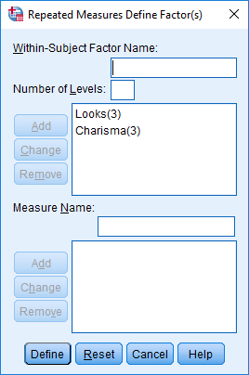
Define the repeated-measures variables

Slide 11
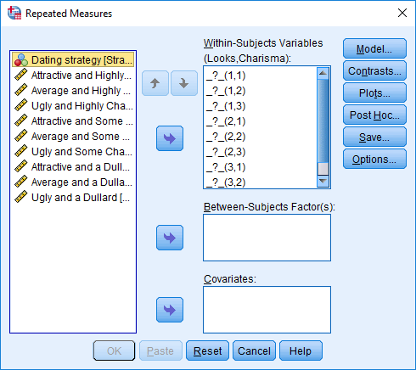
Define levels of the repeated-measures variables

Slide 12
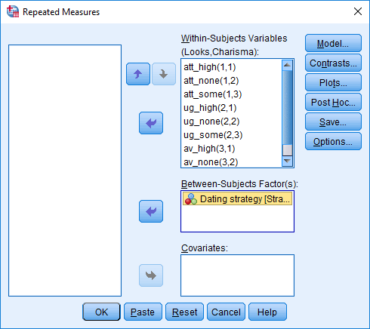
Define levels of the repeated-measures variables and select the between-group variable

Slide 13
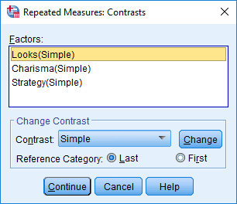
Define Contrasts

Slide 14
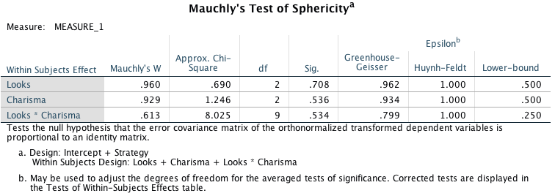
Output: sphericity

Slide 15
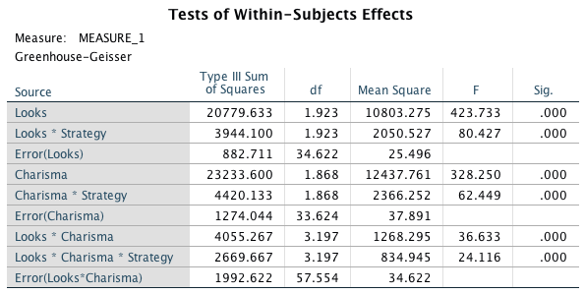
Repeated-measures effects
Notes:
Note that I’ve collapsed the table across sphericity corrections so that you can actually read it

Slide 16
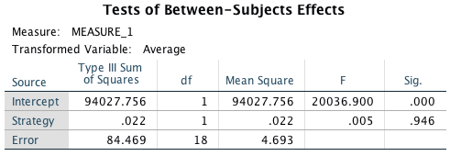
Between-subjects effect

Slide 17
Main effect of strategy

Slide 18
Main effect of looks

Slide 19
Main effect of charisma

Slide 20
The strategy × looks interaction

Slide 21
The strategy× charisma interaction

Slide 22
The looks × charisma interaction

Slide 23
The strategy × looks × charisma interaction

Slide 24
What is a mixed effects model?
Often refers to a design that includes both between-subject factors and within-subject factors
e.g., Raio et al 2013 “Cognitive emotion regulation fails the stress test”
Acute Stress manipulation between subjects
Cognitive emotion regulation manipulation within subjects
More generally, “linear mixed effects models” refer to linear models that incorporate both fixed and random effects
fixed effects = population level (average) effects that persist across experiments. i.e. effects of systematic variables (levels cover a defined range, not randomly sampled)
random effects = variation across clusters of dependent data points (e.g. observations from the same subject, from the same stimulus/item, from the same classroom)- the clusters are defined by a variable that is not systematically varied (it is sampled)
Notes:
Fixed effects represent population-level (i.e., average) effects that should persist across experiments. Condition effects are typically fixed effects because they are expected to operate in predictable ways across various samples of participants and items

Slide 25
More on random effects
think of “random effects” as “cluster-level effects”, or “cluster-varying effects”
Designs can have crossed random effects or nested random effects structures
crossed random effects: levels of one variable occur across levels other variables – e.g., each participant (random var1) sees each stimulus (random var2)
nested random effects: levels of one variable occur within levels of other variables – e.g., each classroom (random var1) contains a different set of students (random var2) – students are nested within classrooms
our activity today is an example of crossed random effects

Slide 26
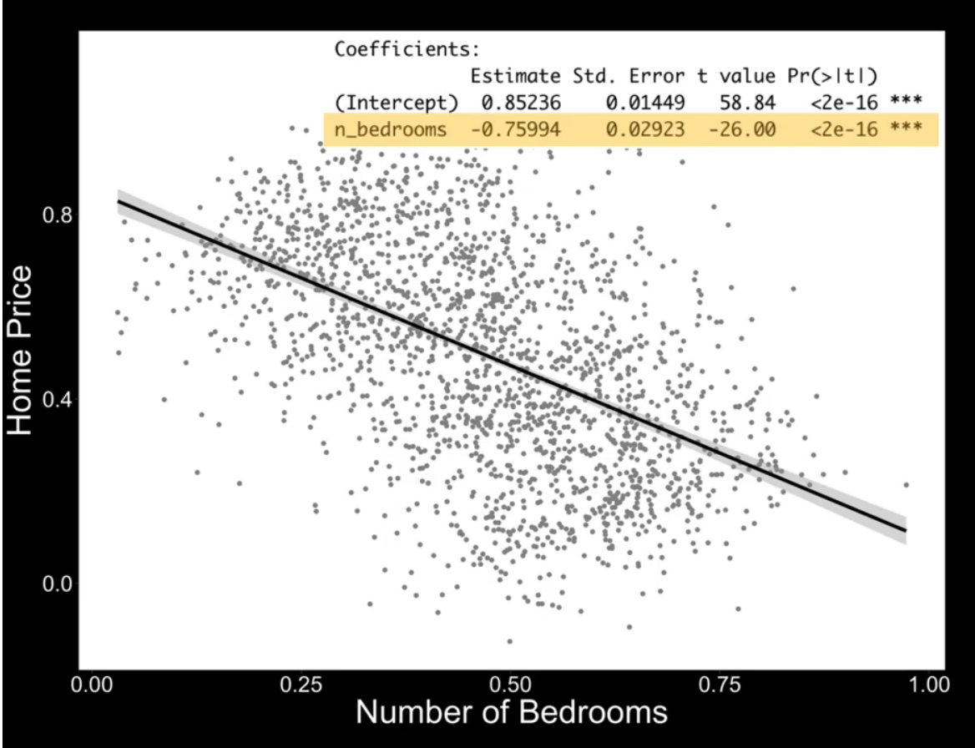
Complete pooling and partial pooling Example: home price by #bedrooms
complete pooling shows negative relationship: homes with more bedrooms cost less!
independence assumption is violated
sometimes referred to as ”complete pooling” (one size fits all)
example and screenshot from Violet Brown’s video: https://www.youtube.com/watch?v=3OFXxh4yORU

Slide 27
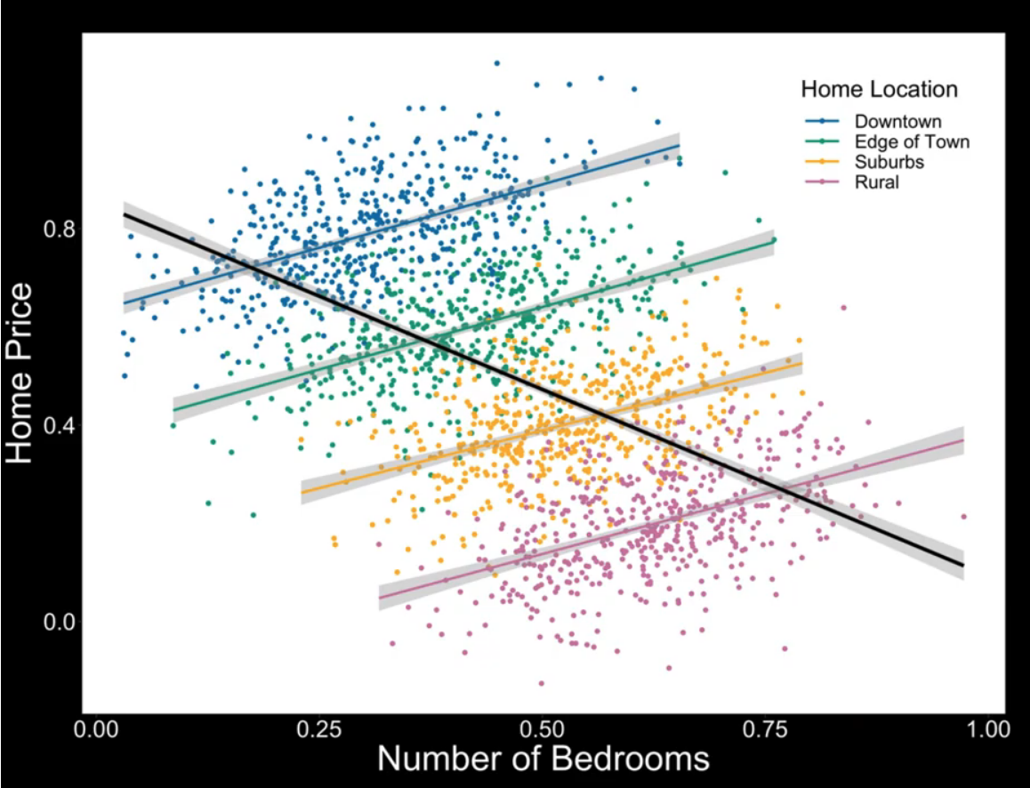
Example: home price by #bedrooms
there was information not considered: neighborhood
what do we do with that info?
“no pooling” – run separate regressions in each neighborhood
example and screenshot from Violet Brown’s video: https://www.youtube.com/watch?v=3OFXxh4yORU

Slide 28
Example: home price by #bedrooms
there was information not considered: neighborhood
what do we do with that info?
“no pooling” – run separate regressions in each neighborhood
“partial pooling” – include random effects (clustering) information in the model this is the linear mixed model (multilevel) approach
example and screenshot from Violet Brown’s video: https://www.youtube.com/watch?v=3OFXxh4yORU

Slide 29
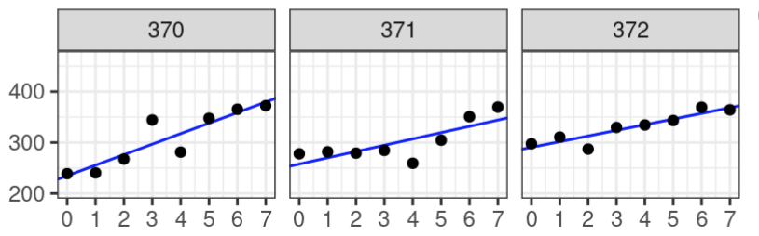
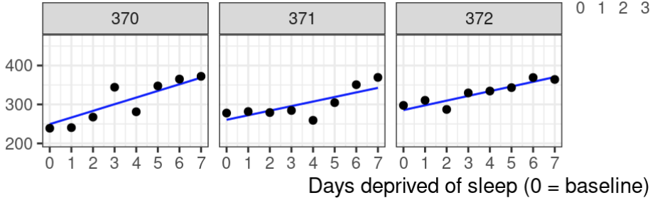
“No pooling” v “Partial pooling”: what is the difference?
No pooling (individual regression lines uninfluenced by each other)
imbalances are handled differently (i.e., not handled in the ”no pooling approach”)
random effects are influenced by each other: shrinkage
the model estimates values for the population, and pulls (shrinks) the estimates for individual subjects toward those values
Partial pooling (mixed effects/multilevel modeling approach)

Slide 30
Advantages of linear mixed models
captures variance (e.g. trial-to-trial) that may be important for accurately estimating effects of interest
allows modeling of multiple random variables (e.g., participants and stimuli), whereas ANOVA approaches allow only one random variable
participants are a sample from larger population
usually stimuli are also sampled from a larger population
in ANOVA you must choose to model only one random effect (usually participant effect, ignoring stimulus effect – Judd, Westfall & Kenny, 2012)

Slide 31
Advantages of linear mixed models (cont.)
handles unbalanced designs (and missing data)
e.g., effect of feedback choice on memory performance (different numbers of feedback and no feedback trials)
handles categorical or continuous predictors, coefficients give magnitude and direction of effects (as opposed to ANOVA approach)
extends to other types of outcome variables (e.g., binary) – referred to as generalized mixed models in this case (e.g., see glmer function in the lme4 R package)
e.g. Raio, C.M., Konova, A.B. & Otto, A.R. Trait impulsivity and acute stress interact to influence choice and decision speed during multi-stage decision-making. Sci Rep 10, 7754 (2020). https://doi.org/10.1038/

Slide 32
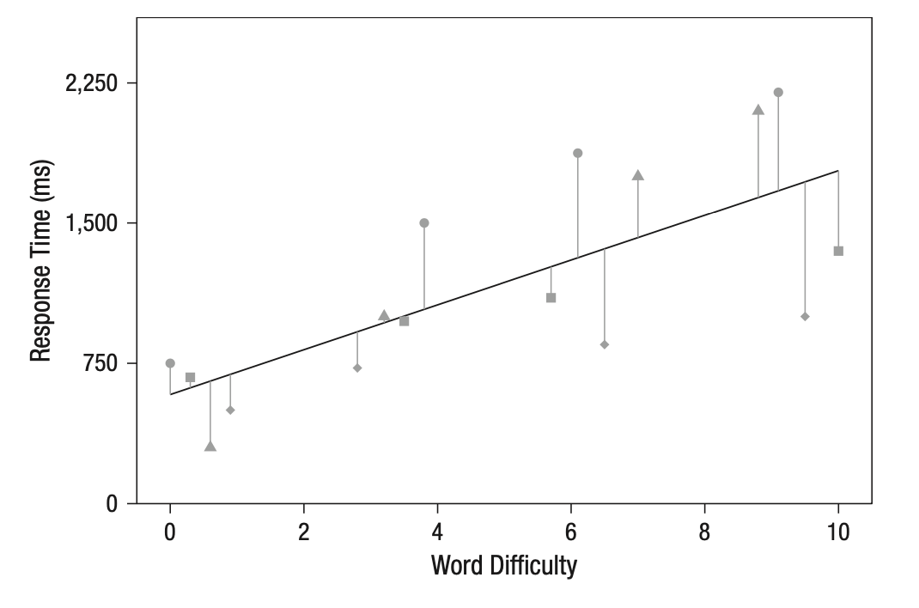
Example – DV=response time, IV=word difficulty
fixed effects only
does not capture subject or item variance
R:
RT ~ difficulty
SPSS:
/FIXED=difficulty
different shapes indicate an individual subject (this information is not accounted for by the fixed effects only model)

Slide 33
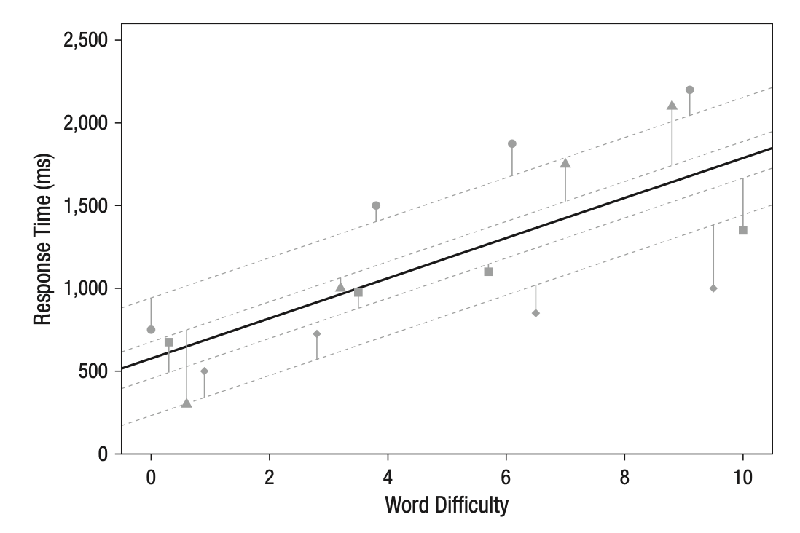
Random intercepts by participant
random intercepts by participant capture variance in the height of the outcome by participant
e.g. some participants tend to respond overall slower/faster
terminology in formula specification:
(1|participantID)
R:
RT ~ difficulty + (1|participantID)
SPSS:
/RANDOM=INTERCEPT | SUBJECT(participantID)

Slide 34
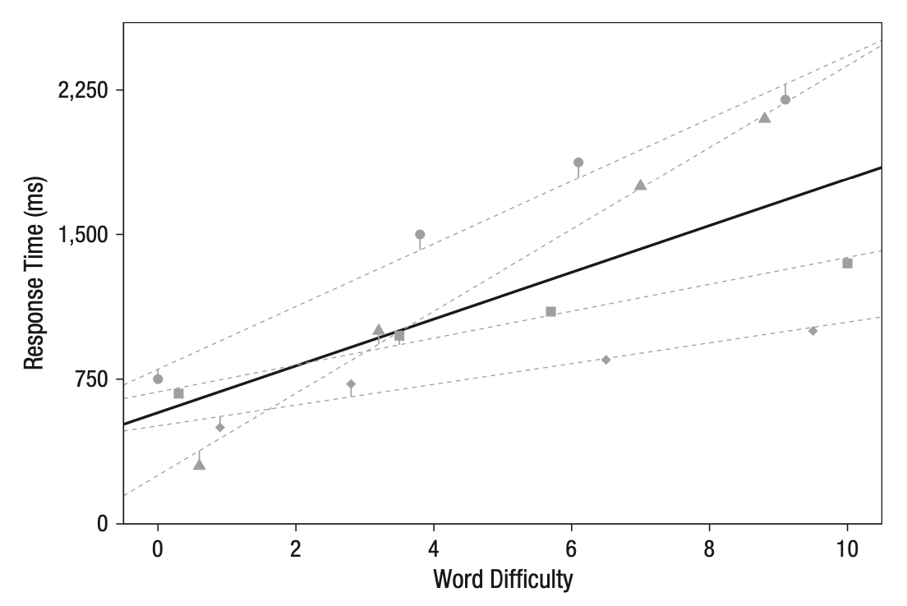
Random intercepts and slopes by participant
random slopes by participant capture variance in the magnitude of the effect across participants
e.g. some participants are more influenced by word difficulty
intercept and slope are often correlated (e.g. slower participants are less affected by word difficulty) – you can estimate this correlation with the mixed model
terminology in formula specification:
R: (1 + difficulty|participantID)
SPSS
/RANDOM=INTERCEPT difficulty | SUBJECT(participantID)

