Slide 1
Reading t-test output and some R tips for function output and different file types
October 27, 2022

Slide 2
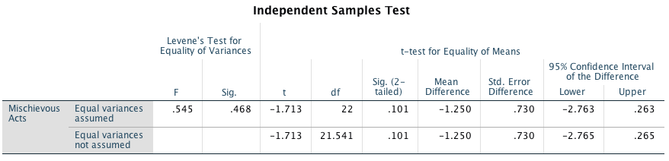
Independent Samples t-test
SPSS Output
t is Mean difference divided by standard error of the difference
sign of t is determined by which group is designated as Group 1 (Group 1 – Group 2)
2-tailed p gives probability of a t at least this far from 0 if the null hypothesis is true
some SPSS versions give 1-sided and 2-sided Sig (1-sided is half of 2-sided if the difference is in the expected direction, otherwise 1 minus half the 2-sided value)

Slide 3
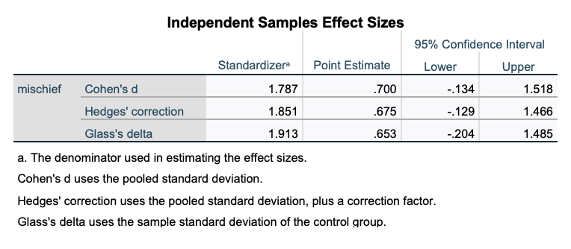
Independent Samples t-test
SPSS Output
“Point Estimate” is the effect size, confidence interval is around the point estimate
“Standardizer” specifies the denominator ( mean difference / {some measure of variance} )

Slide 4
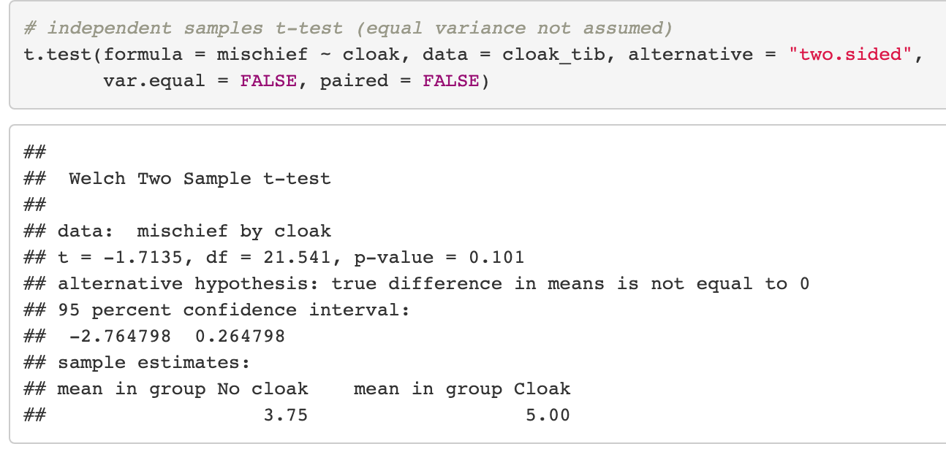
Independent Samples t-test
R Output
t is Mean difference divided by standard error of the difference
sign is determined by 1st group in the data (unless you specified level order)
alternative = “two.sided” specifies two-tailed p-value (other options are “less” or “greater”)
Standard error of the difference is not shown in default output but is accessible from the field $stderr (explained on the next slides)

Slide 5
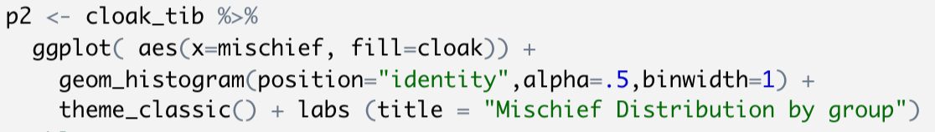
Function output in R
In the solution examples you often see:
first the output of the function (in this case a plot object) is stored in a variable, then the variable contents are sent to the screen
different functions have different output types (sometimes very complex)
you can examine the output in the Environment window pane
this allows us to re-use the plot in code later on (e.g. to add layers to it, or save the plot as an image file)
1
2

Slide 6
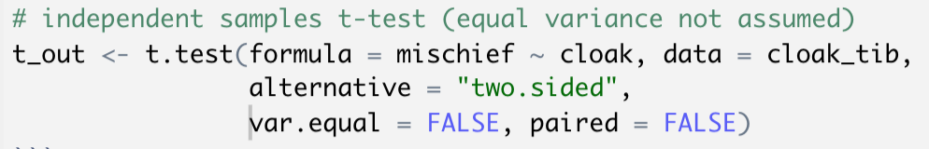
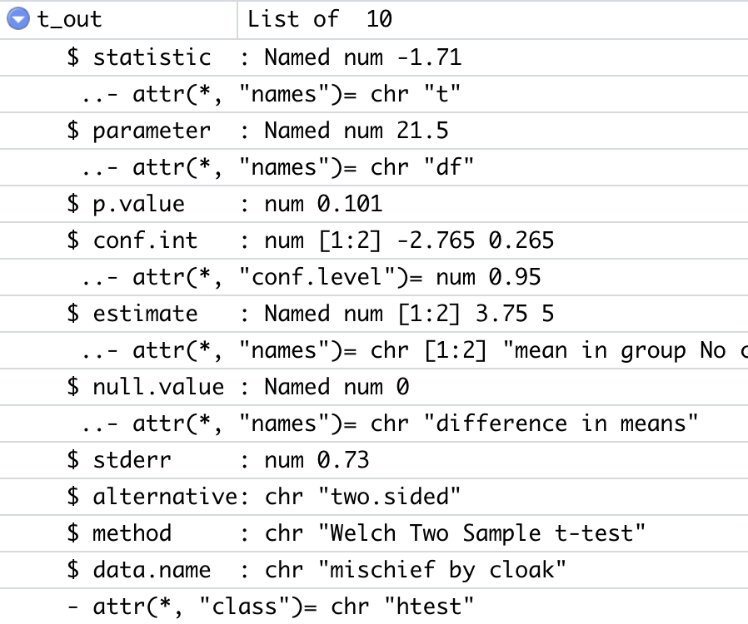
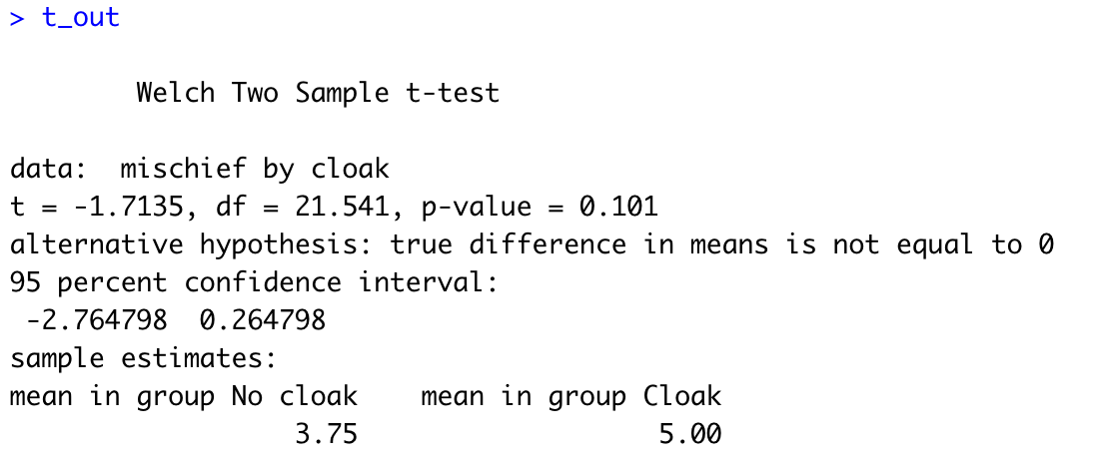
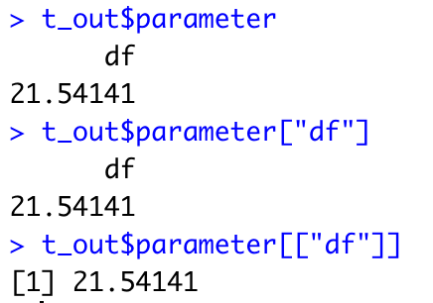
Storing function output in R
Different functions have different output:
Environment window pane:

Slide 7
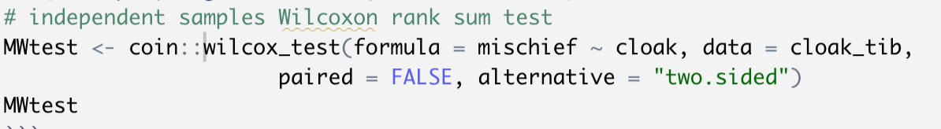
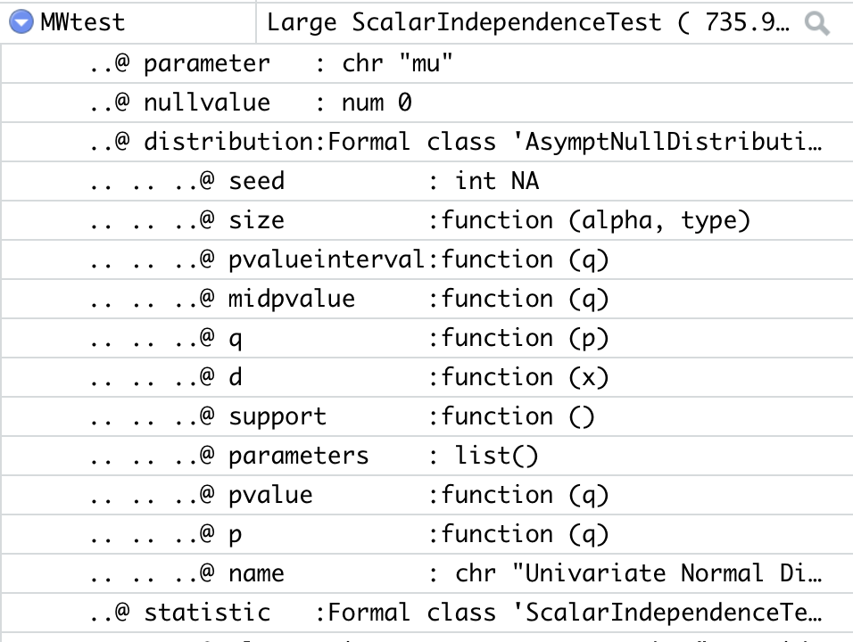
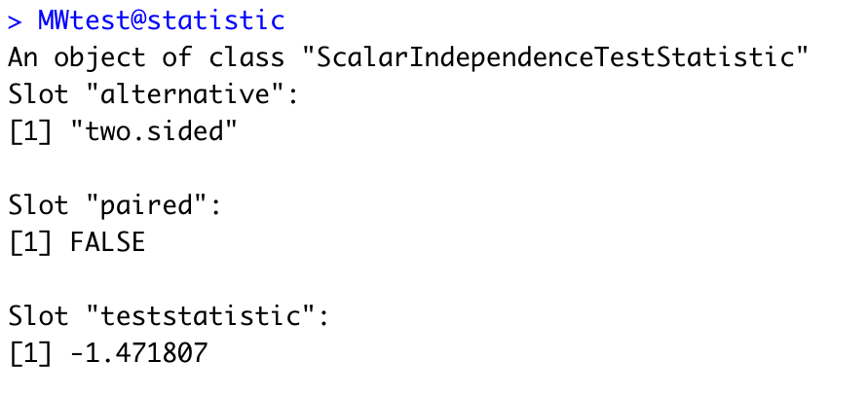
Storing function output in R
Some functions use a different variable class (S4) to store output:
use “@” to access fields of S4 variables:
Environment window pane:
See http://adv-r.had.co.nz/S4.html for more

Slide 8
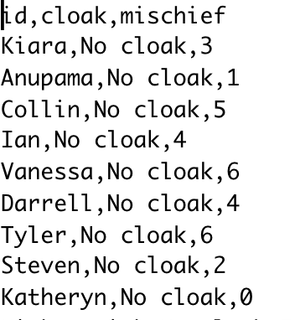
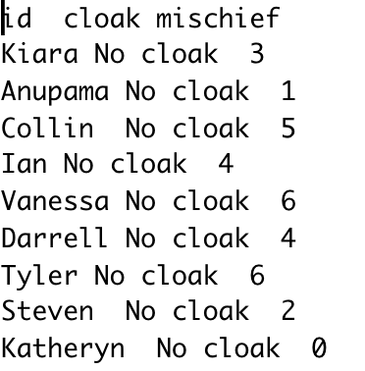
different file types
we have always used csv (comma separated values) files in class
use readr::read_csv(“filename”) to import in R
but we often see tab-delimited as well
use readr::read_delim(”filename”, delim = “\t”)

Slide 9
different file types
why the different file types?
CSV very common, but sometimes actual commas in the data values complicate export and import
TSV can also be complicated by actual tabs in the data values (e.g., free response input fields), but that is less common

Slide 10
Using pivot_wider

