Slide 1
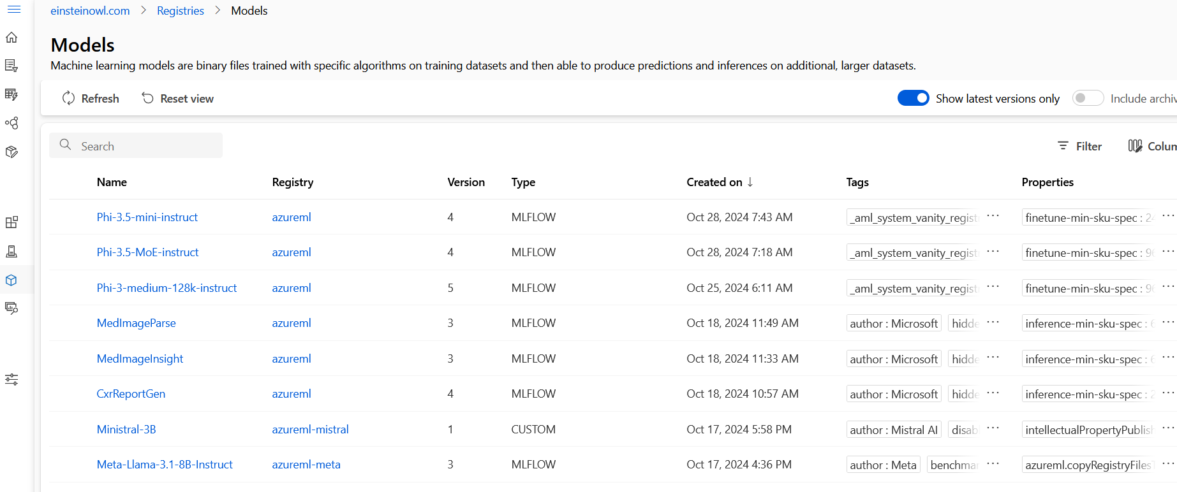
The process
start off running some experiments in Azureml using both regression and time sequence to predict surplus food surplus and discover which alternatives

Slide 2
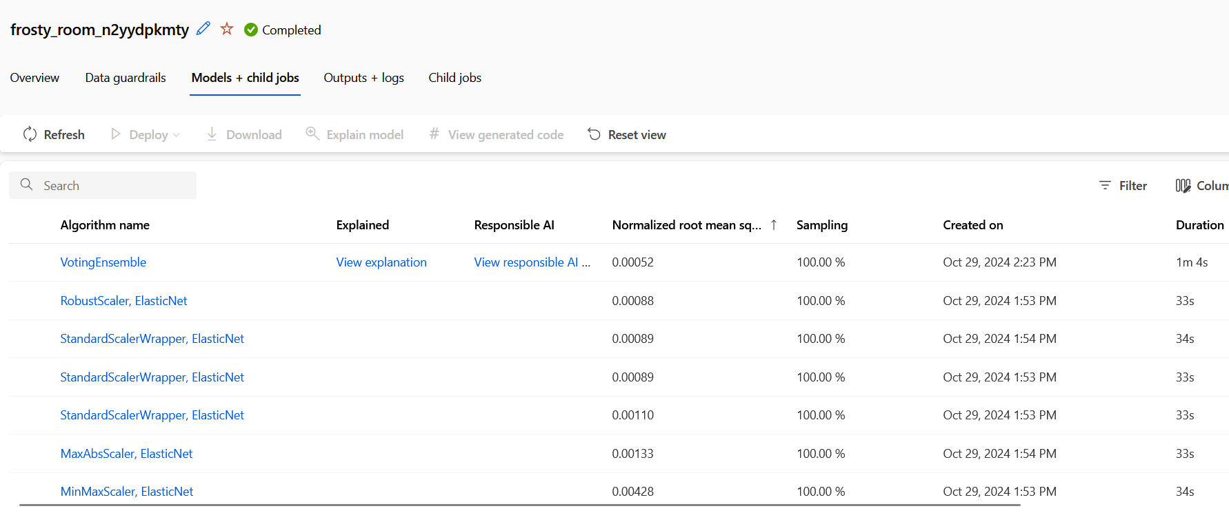

Slide 3
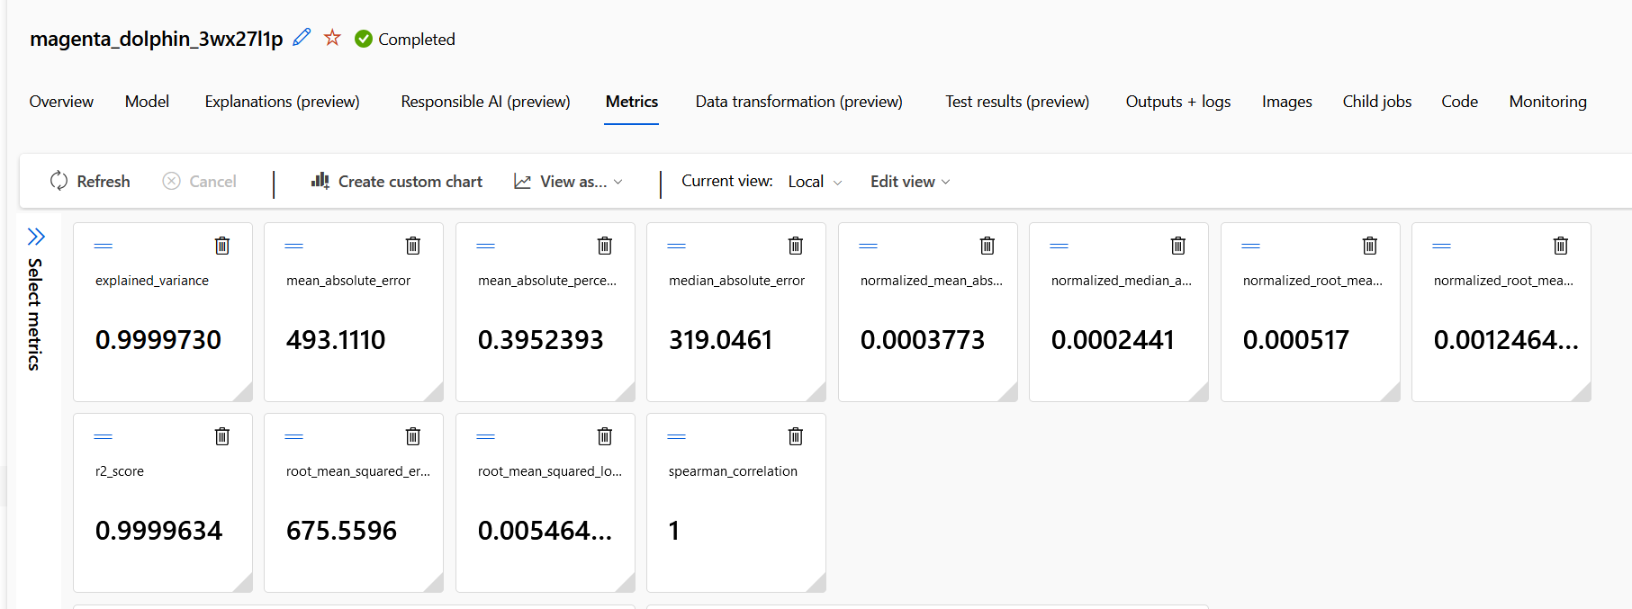

Slide 4
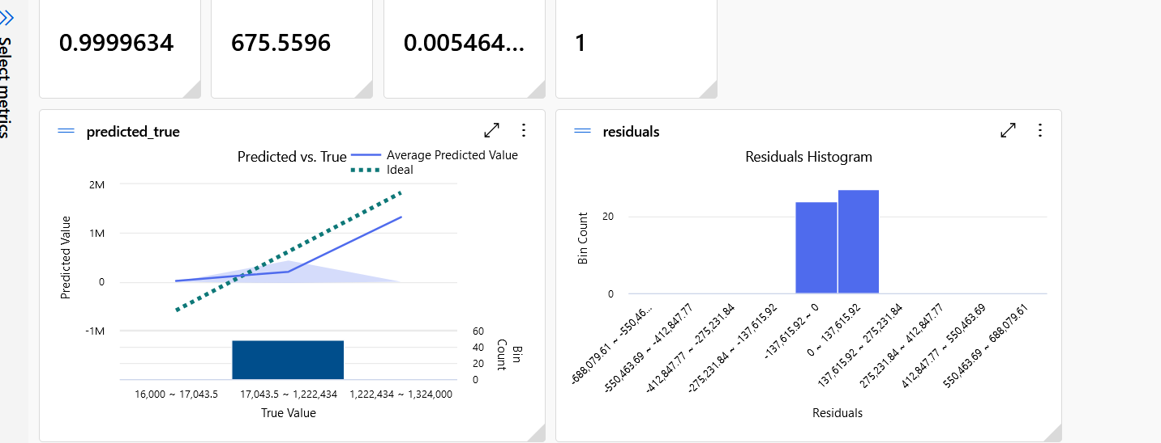

Slide 5
Based on these experiments we decided to select a model and a process that use regression and then used designer
to create our final model
I am not sure which one Becky’s model used so at this point use her details

