Slide 1
Using CNNs to analyse neutron reflectivity data

Slide 2
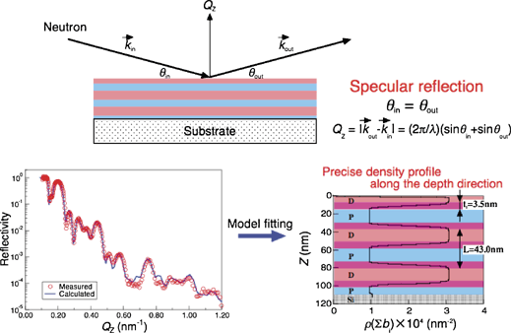
The Problem

Slide 3
What I used
Keras with Tensorflow backend
Google Cloud Compute Engine: 2vCPUs, nVidia K80 GPU

Slide 4
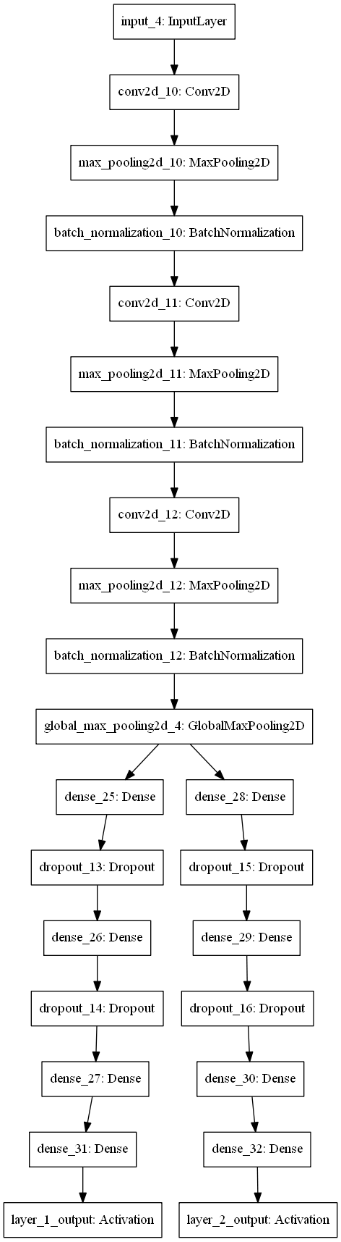

Architecture

Slide 5
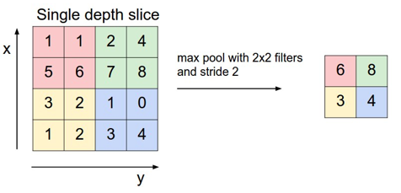
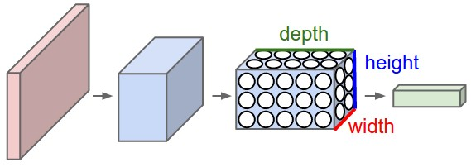
CNNs

Slide 6
Batch normalisation
What
Normalises activation layer output
Adds two trainable parameters
Why
Reduces internal covariance shift
More independence between layers
Higher learning rate
Less overfitting
Notes:
-subtract mean, divide by SD
-SGD might undo if it minimises loss. beta: mean shift, gamma: SD
-

Slide 7
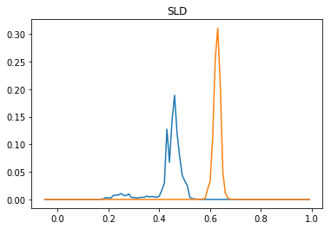
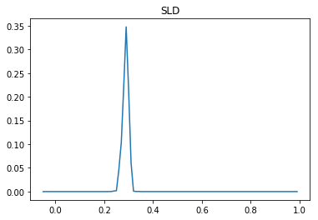
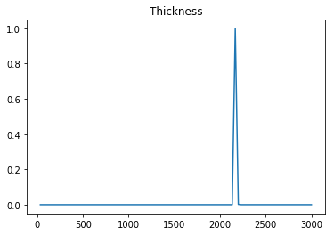
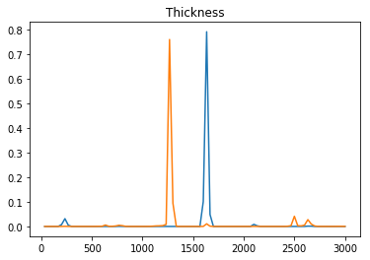
Results: The good

Slide 8
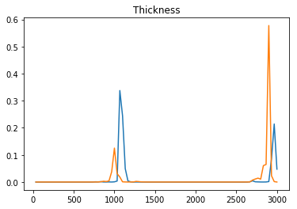
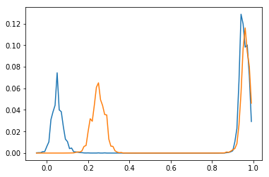
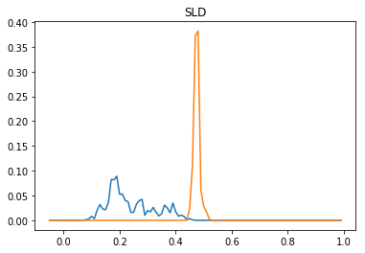
The bad

Slide 9
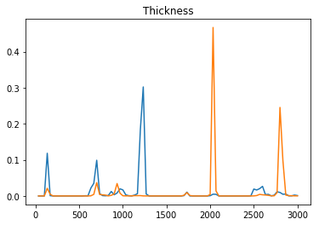
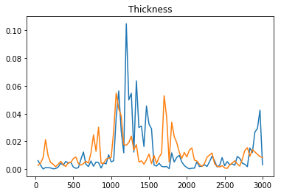
The ugly

Slide 11
Next steps
More data
Domain confusion
Network ensembles

