Slide 1


Slide 2
Barcodes – LO
To understand what a barcode is and why they are used
To create own working barcode design

Slide 3
Video
https://www.youtube.com/watch?v=VbHzx4nWqWY

Slide 4
Designing barcodes
We are going to be designing our own barcodes. But first, take a look at these:
http://www.ucreative.com/inspiration/these-japanese-barcodes-are-so-kawaii-2/

Slide 5
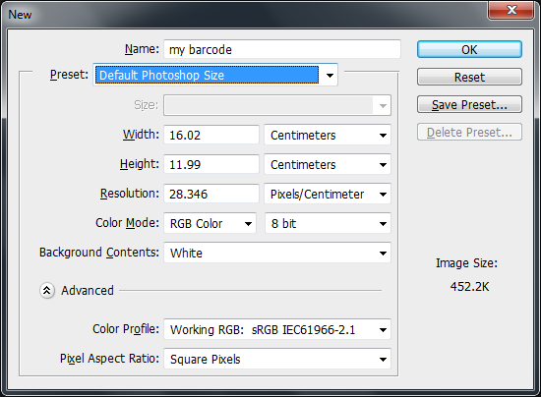
New Photoshop document
Open Photoshop
Create a new document using page size ‘Photoshop default’

Slide 6
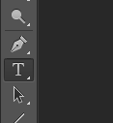
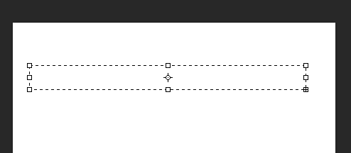
Text box
Choose the text tool
Draw a text box

Slide 7
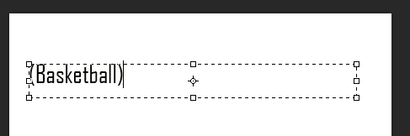
Choose your theme
Type a word or short phrase related to the hobby or theme you are going to design your barcode for.
Put the word in brackets

Slide 8
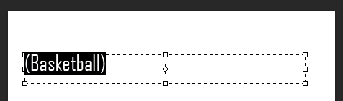
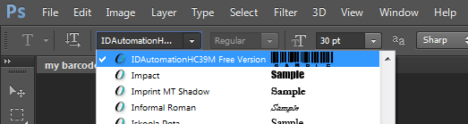
Generate your barcode
Highlight your entire word
Change the font to ‘ID Automation’

Slide 9
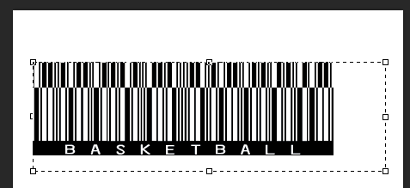
Resize your barcode
Your text should look something like this now:
With the barcode still highlighted, change the font size so it is nice and big (try anything between size 20 & 30)

Slide 10
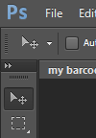
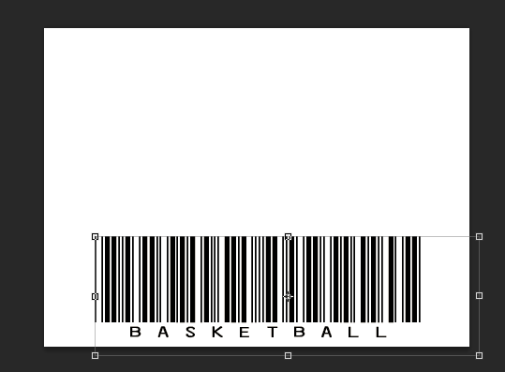
Position your barcode
When you are happy with its size, click on the Move tool…
…and position your barcode centre, bottom.
At this stage, check the barcode scans!

Slide 11
Create your design

Slide 12
Create your design
You will now create your barcode design according to the following rules:
Use black and white only (it scans better)
There must be a clear, unaffected strip across your barcode for scanning
Your barcode must be functional (ie, it must successfully scan)

Slide 13
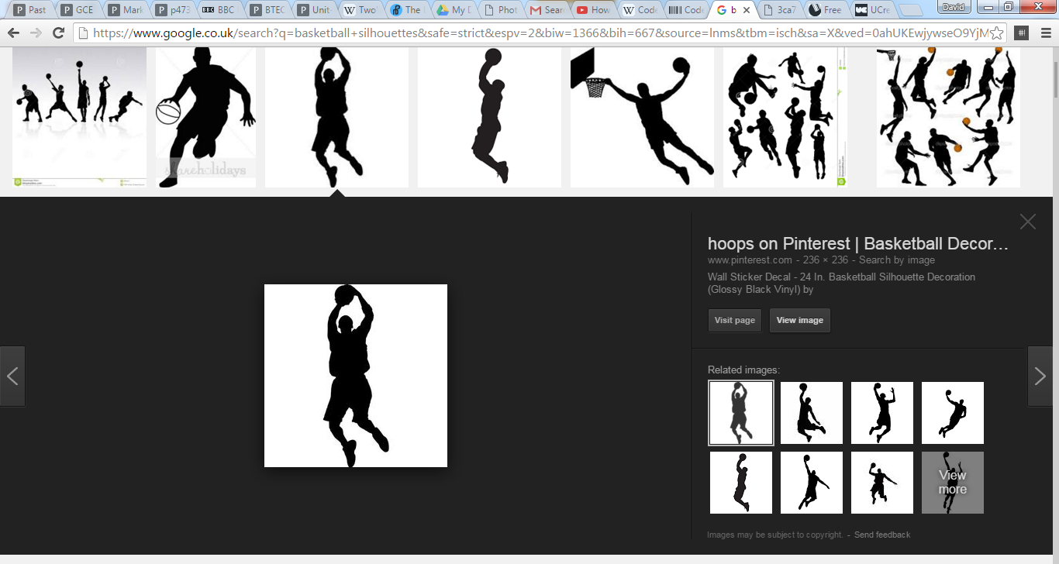
Find silhouettes
Based on your theme, search Google images for black silhouettes

Slide 14
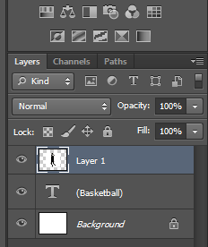
Paste silhouettes
Copy each silhouette you want to use
Paste each on a new layer in your Photoshop document

Slide 15
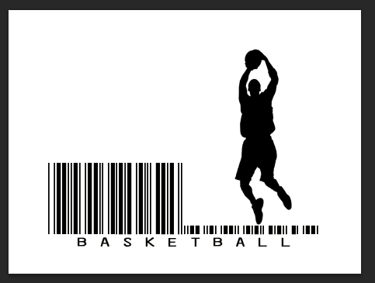
Adjust silhouette
Most silhouettes will have an area of white space surrounding them that will obscure the barcode layer:

Slide 16
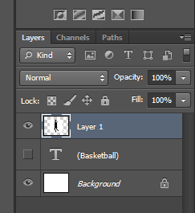
Adjust silhouettes
To get rid of the whitespace…
Make sure the silhouette layer is visible
and highlighted in blue.

Slide 17
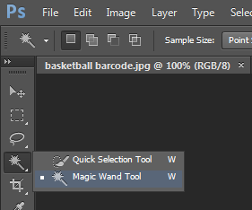
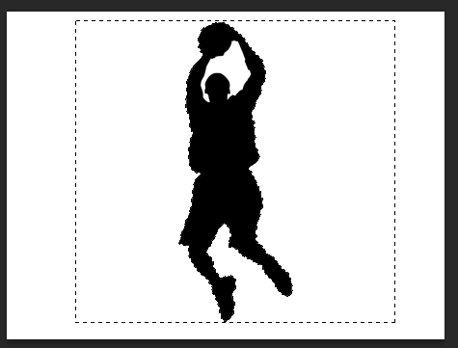
Adjust silhouettes
Click on the Magic Wand tool.
Click on an unwanted white area next to the
silhouette.
The white areas should now be
highlighted.
Press delete on the keyboard to
Delete the whitespace.

Slide 18
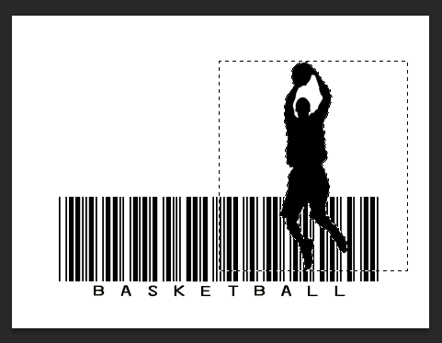
Adjust silhouette
Your silhouette should now allow the barcode layer to show through:

Slide 19
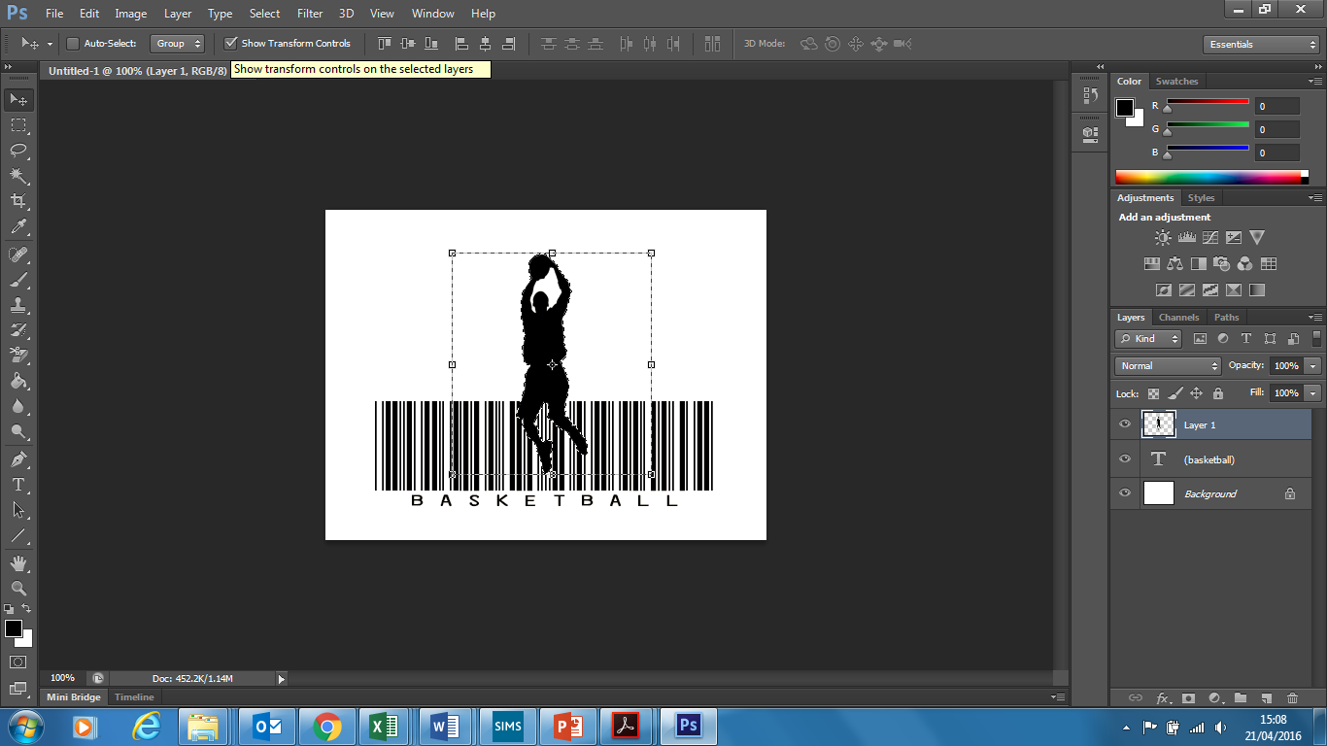
Adjust silhouettes
Now use the Move Tool to reposition your silhouette
And the Transform controls to resize as necessary.

Slide 20
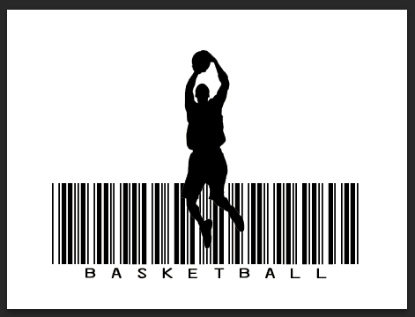
Finished silhouette

Slide 21
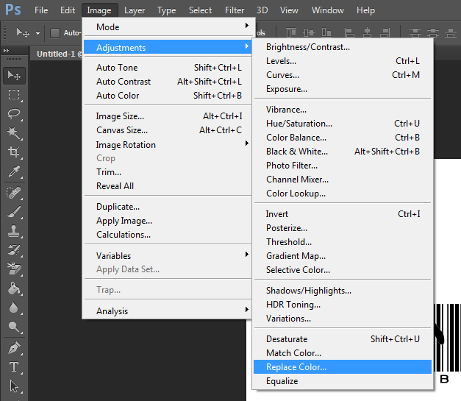
Enhancements White silhouette
To make your silhouette white
instead of black, click on
Image/Adjuments/Replace Color:

Slide 22
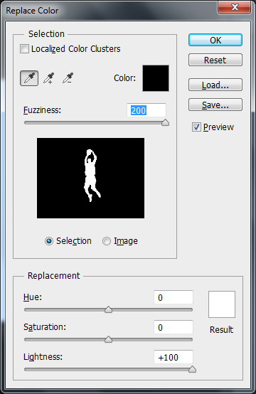
Enhancements White silhouette
Make sure your silhouette is white in the
preview pane.
Change the result color box to white.
Click ok.

Slide 23
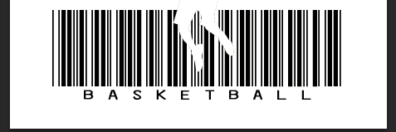
Finished white silhouette

Slide 24
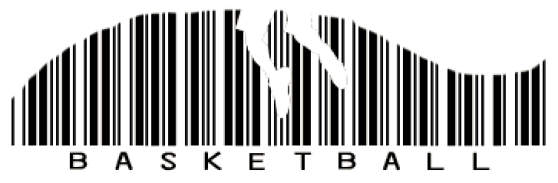
Finishing touches
On a new layer, paint using black and/or white paint over parts of the barcode to make it more dynamic:

Slide 25
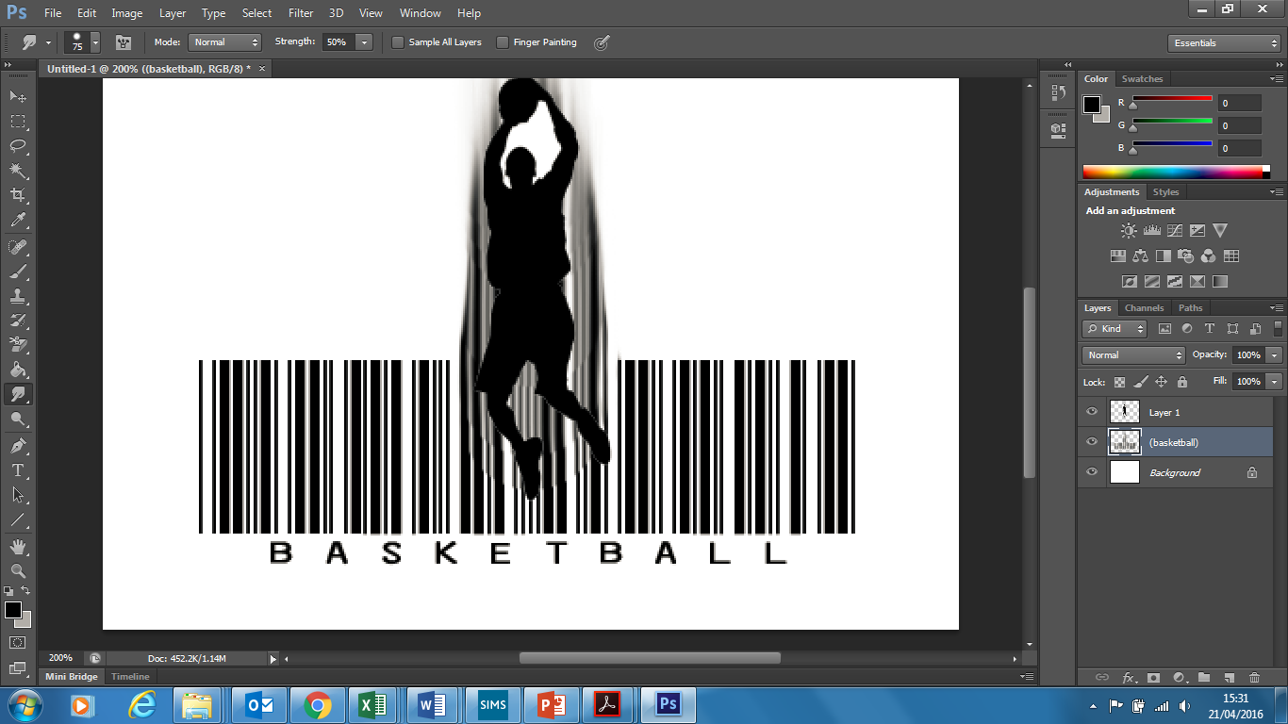
Finishing touches
Try smudging or blurring part of the barcode layer:

Slide 26
Remember!
Remember to keep a horizontal area of your barcode completely clear to allow a barcode scanner (such that you find on a phone) to successfully scan.

Slide 27
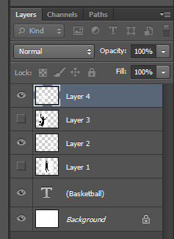
Finishing off
Hide unnecessary layers

Slide 28
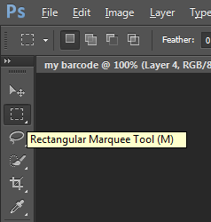

Finishing off
Use the Rectangular Marquee tool to select your final barcode image:

Slide 29
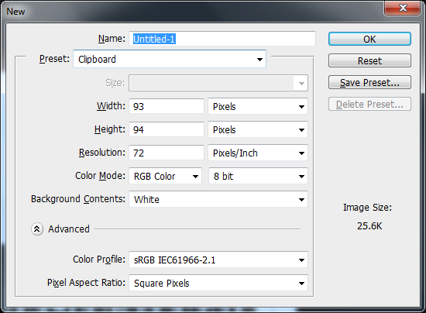
Finishing off
Copy this area use ‘Edit/Copy Merged’.
Create a new document.
Leave the ‘Preset’ size as ‘Clipboard’.

Slide 30
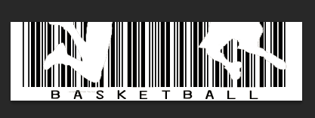
Finishing off
Paste into the new document.
This is your finished barcode design.
Export it as a JPEG (File/Save As).
You can use your barcode wherever you can use a JPEG image (websites, Word documents, etc).

Slide 31
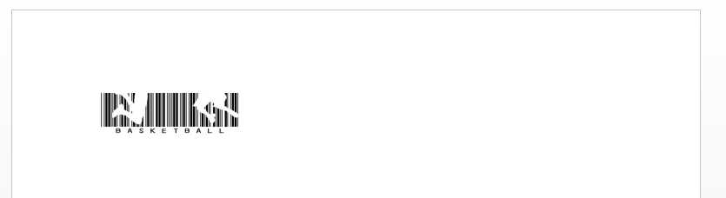
Using your barcode
Create a new Word document.
Import your barcode image.
Resize it so it is a few centimetres across (keep the aspect ratio).
Print it out and scan it to see if it works.

