Slide 1
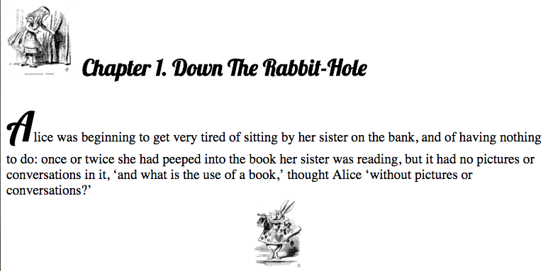
MCOSS2WED
CSS: Pseudo-Elements

Slide 2
What are pseudo-elements?
Pseudo-elements allow you to style part of an element rather than the whole.
For example, you could style the first letter of a paragraph differently from the rest.

Slide 3
What are pseudo-elements?
A list of current (CSS3) pseudo-elements:
::after
::before
::first-letter
::first-line
::selection
::backdrop

Slide 4
What are pseudo-elements?
The syntax is (note the double colon):
selector::pseudo-element {
property: value;
}

Slide 5
What are pseudo-elements?
Eg:
p::first-letter {
font-size: 3em;
font-family: "Lobster", cursive;
}

Slide 6
Preparation
Start a new HTML document
Create a css directory and blank CSS file
Create an images directory

Slide 7
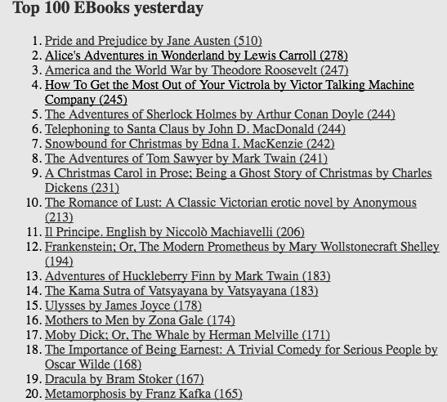
Preparation
Browse to www.gutenberg.org
Download a book in plain text
This will act as your content

Slide 8
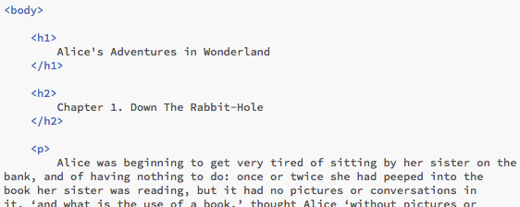
Content
Copy a few paragraphs of text into your HTML document (include a chapter heading).
Break it up into headings & paragraphs.
See pseudo-example1.html

Slide 9

Fonts
Add a couple of contrasting Google fonts to your HTML <head>…</head> section.
See pseudo-example2.html

Slide 10
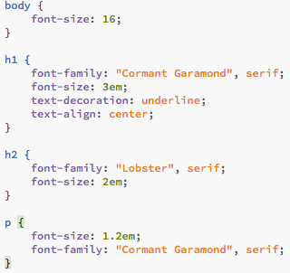
Style
Create some style for headings, h1, h2 and paragraphs, p, using your CSS file.
See pseudo-example2.css

Slide 11

::before
Now, in your CSS file, add a style section for the first letter of each paragraph.
Make sure that the style is very different from the normal paragraph style.
See pseudo-example3.css

Slide 12
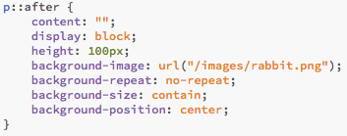
::after
We can style using ::after in the same way.
We can add any content we like to these pseudo-elements including images.
Grab a small image appropriate to your text.
Try using the ::after pseudo-element like this:
See pseudo-example4.css

Slide 13
Pseudo-Challenge 1
Can you add a small graphic before your chapter headings?

Slide 14
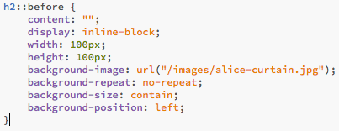
Pseudo-Challenge 1
How you could have done it:
See pseudo-example5.css

Slide 15
Summary
Pseudo-elements are used to style part of an element.
The style used for a pseudo-element can be diverse or as subtle as any other CSS styling.
Styling can include content such as text and images.
A pseudo-element is selected using the syntax:
selector::pseudo-element { … }

