Slide 1

MCOSS2WED
CSS: Duotone emulation

Slide 2


Overview
Duotone is a combination of an image (traditionally B+W or greyscale) with a semi-transparent block of a single colour.

Slide 3





Overview
Duotone has become increasingly popular over the last couple of years.

Slide 4
Objective
We are going to emulate duotone processing using CSS.
No image manipulation is involved in Photoshop, etc…
…unless you want to.

Slide 5
Preparation
Create a new HTML page
Create a CSS directory and file
Create an images directory
Download 4-6 images and copy into your newly-created images directory.

Slide 6
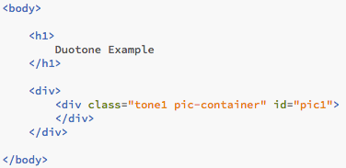
HTML structure
Create the HTML structure using DIVs:
Duo-example1.html

Slide 7
HTML structure
Pay close attention to the classes and IDs.
Duo-example1.html

Slide 8
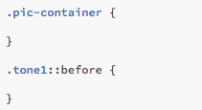
CSS
Add some sections to your CSS file.
Duo-example2.css

Slide 9
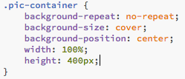
CSS
Set up the picture container in CSS:
Duo-example3.css

Slide 10

CSS
Add a picture for ID pic1 in CSS:
Duo-example3.css

Slide 11
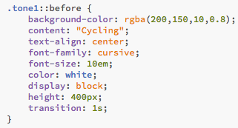
CSS
Now for the colour overlay.
Duo-example4.css

Slide 12
CSS
Using the double colon (::) is the new way in CSS3 to select a pseudo-element such as before and after.
A pseudo-element is a state or condition that the element can be in.
See https://developer.mozilla.org/en-US/docs/Web/CSS/Pseudo-elements

Slide 13
CSS
We used the before property of the .tone1 selector.
This will ensure that our colour overlay gets placed in the div element before anything else.
Without this, the overlay would be hidden or out of place.
Duo-example4.css

Slide 14
CSS
The content property can be blank (or just a space between the quotes.)
However, it needs to be present for our example to work.
Duo-example4.css

Slide 15
CSS
This line ensures that the whole element is filled with whatever the style for ‘.tone1’ is.
Duo-example4.css

Slide 16
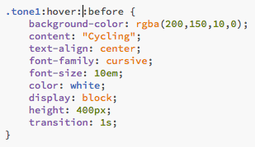
CSS
We can, of course, add hover styling.
In this case, we are just decreasing opacity of the background colour to 0.
Duo-example5.html & css

Slide 17

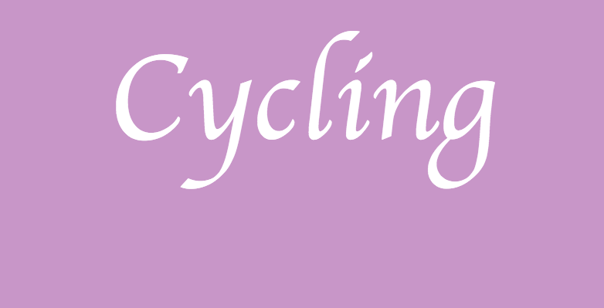
CSS
Rather than making the colour block transparent on hover, you could do the opposite by changing the opacity to 1 instead of 0.
Duo-example6.html & css

Slide 18
Summary
We can fake a duotone image using a block of colour.
This was achieved by:
using the before pseudo-element, and
displaying the content of the element as a block with a semi-transparent background-color.

