Slide 1
JUnit
Jia Ying Wang
2017/10/5

Slide 2
Tools
Latest JDK
Windows http://download.oracle.com/otn-pub/java/jdk/8u144-b01/090f390dda5b47b9b721c7dfaa008135/jdk-8u144-windows-x64.exe
macOS http://download.oracle.com/otn-pub/java/jdk/8u144-b01/090f390dda5b47b9b721c7dfaa008135/jdk-8u144-macosx-x64.dmg
Linux http://download.oracle.com/otn-pub/java/jdk/8u144-b01/090f390dda5b47b9b721c7dfaa008135/jdk-8u144-linux-x64.rpm
Latest Eclipse
https://www.eclipse.org/downloads/

Slide 3
Why JUnit
Used for unit testing to check the correctness of the logic of code
Convenient and fast
Mass check

Slide 4
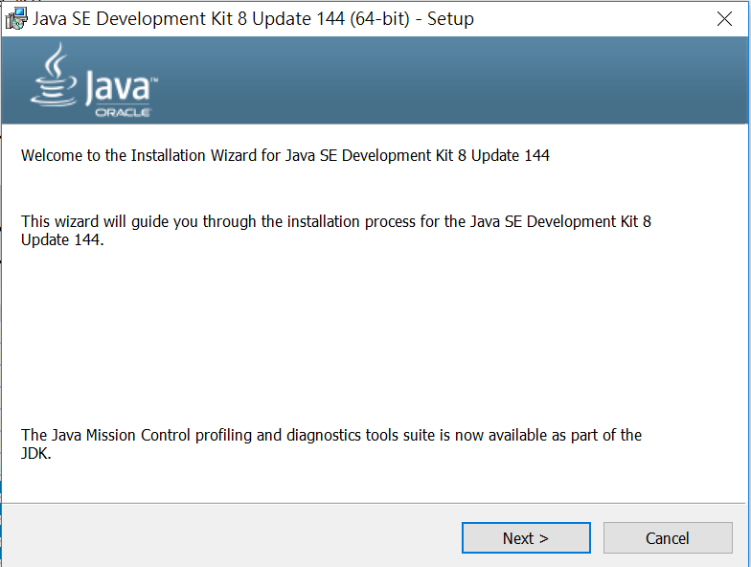
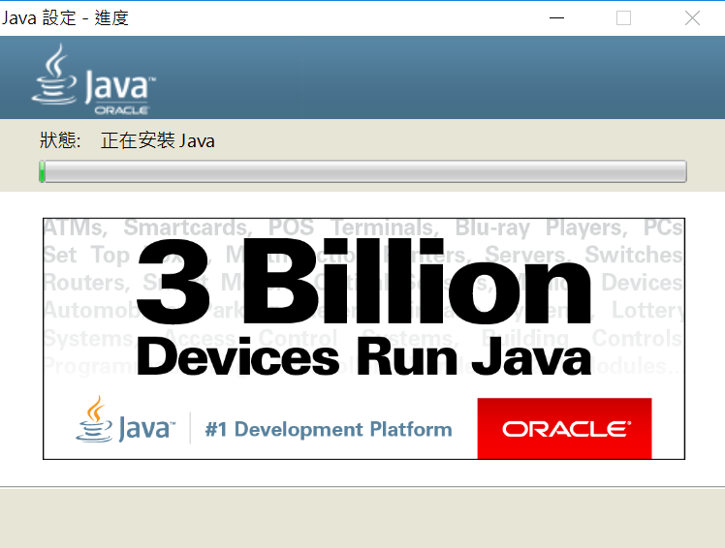
Install JDK and JRE

Slide 5
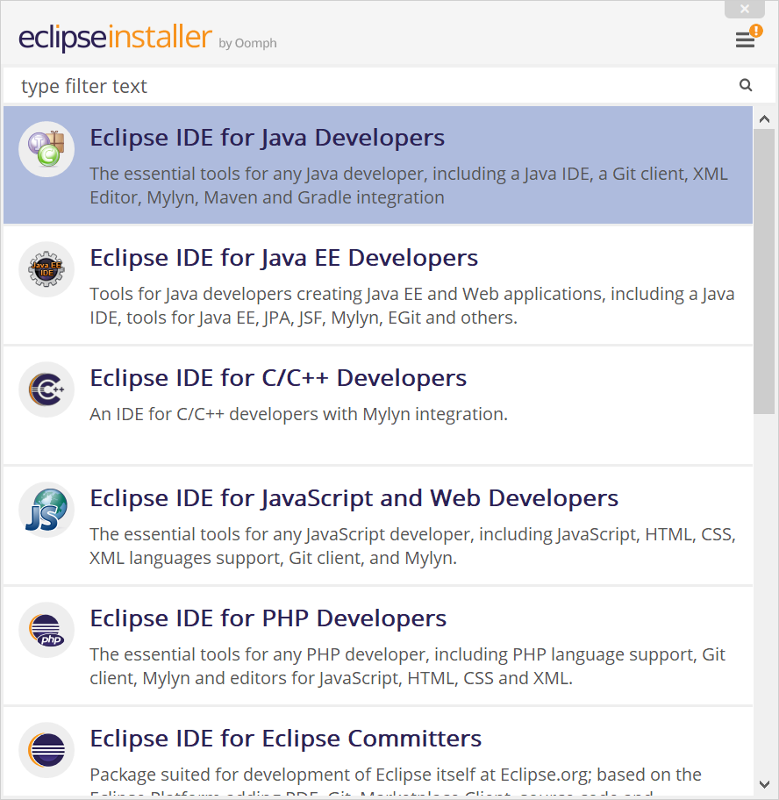
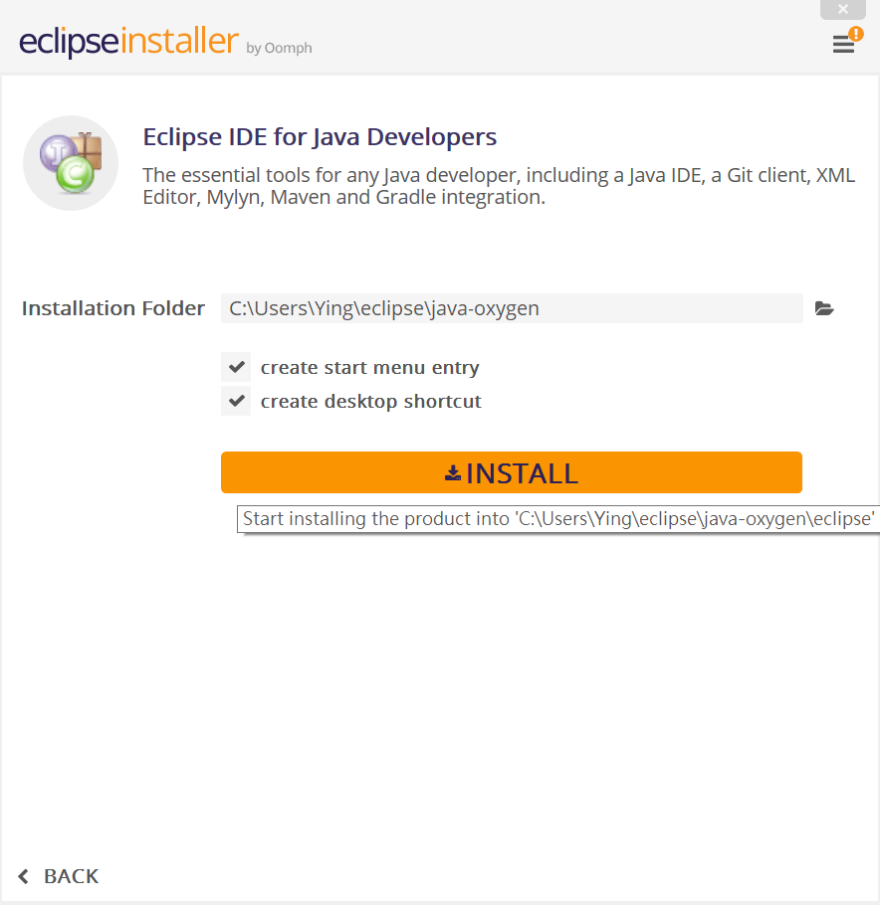
Install Eclipse

Slide 6
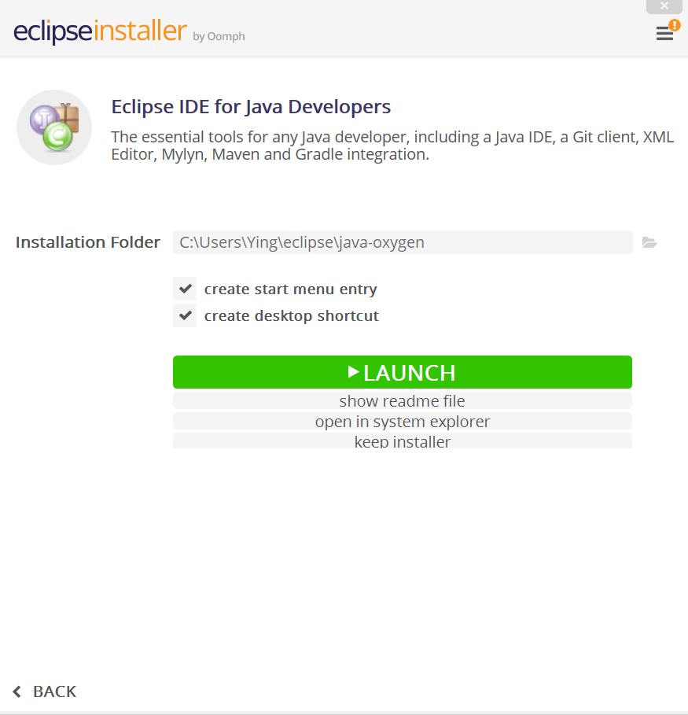
Launch Eclipse

Slide 7
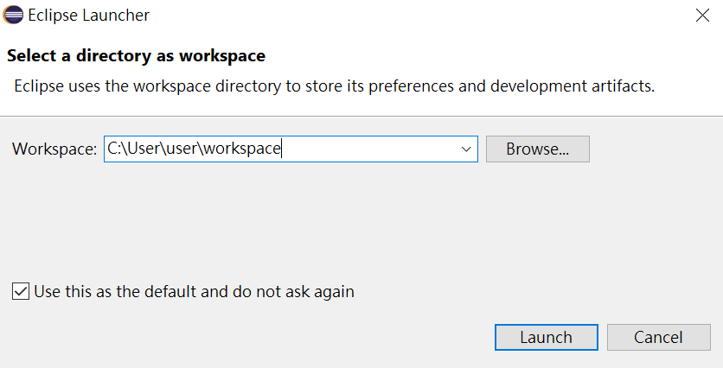
Setting workspace

Slide 8
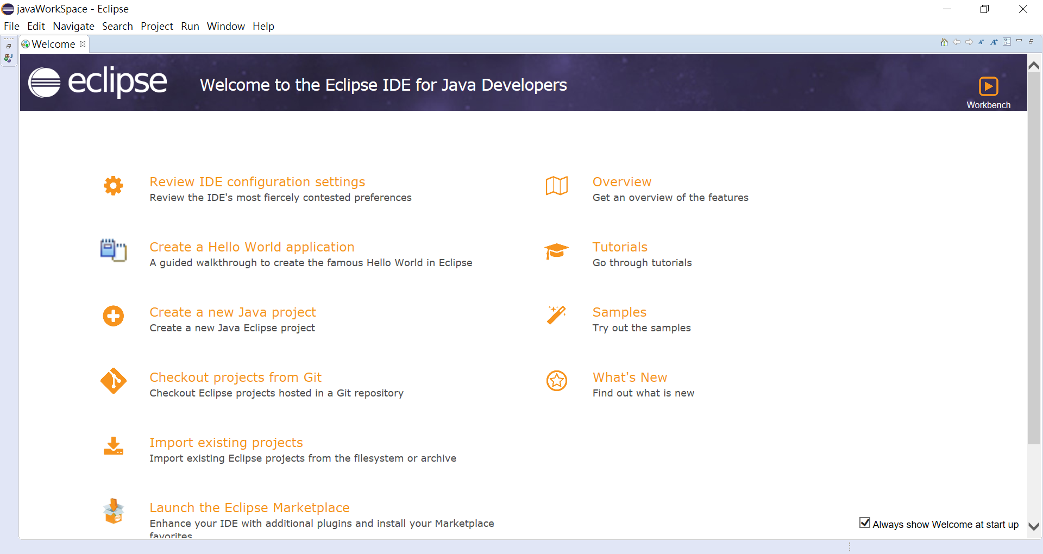
Launch Eclipse

Slide 9
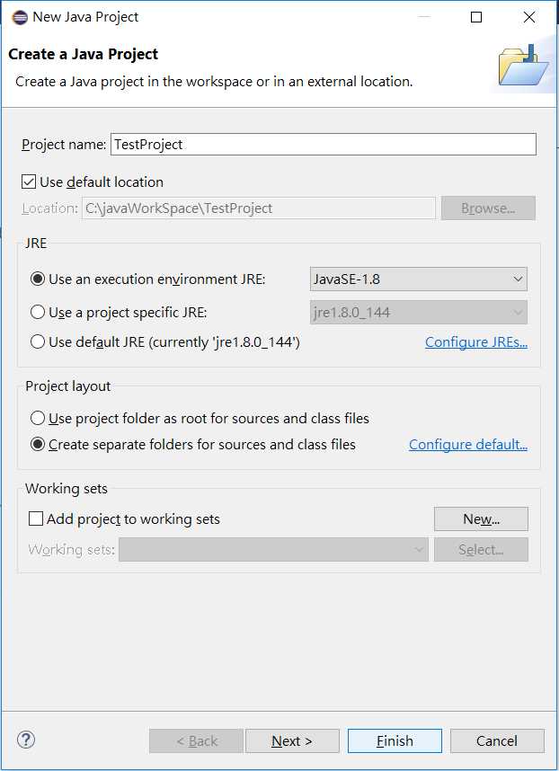
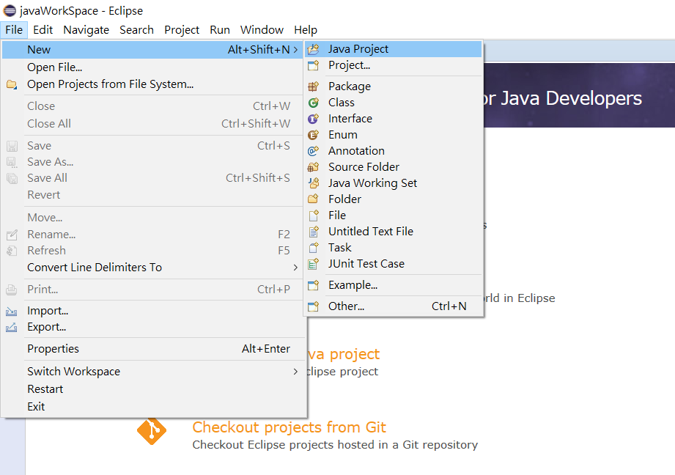
Create JAVA Project

Slide 10
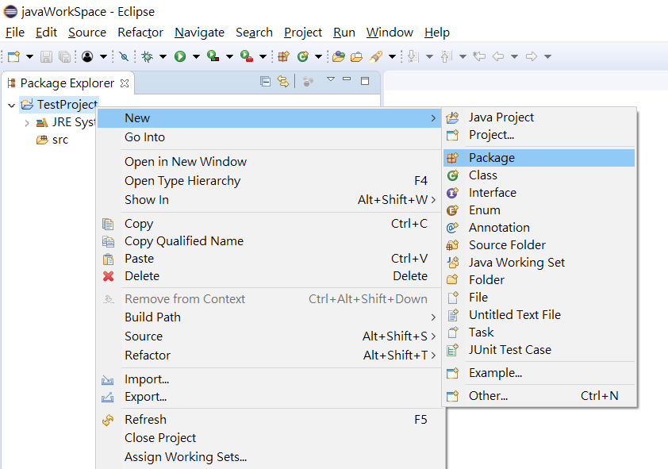
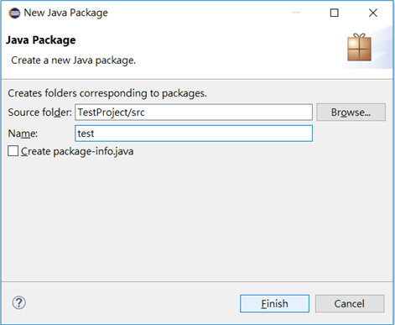
Close Welcome Page & Create Package

Slide 11
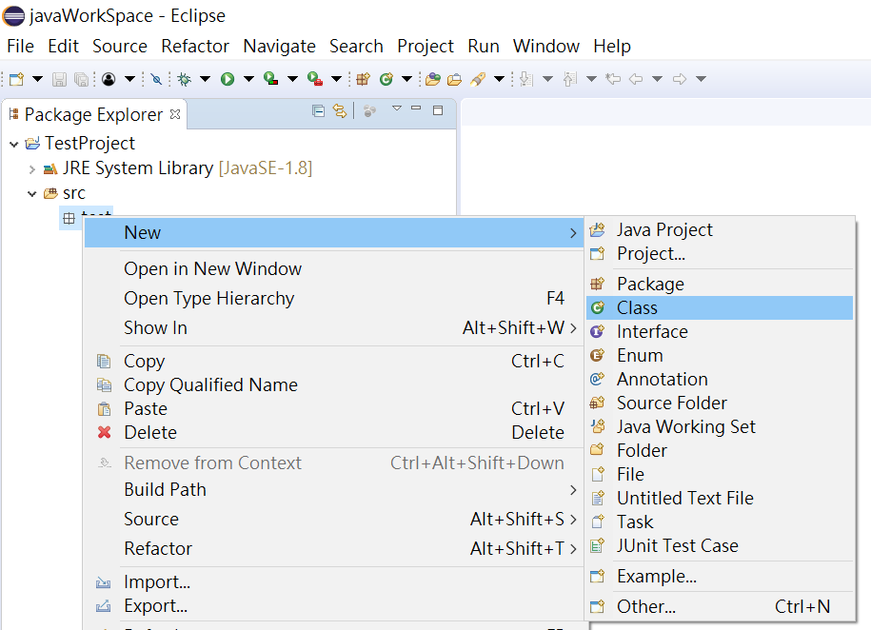
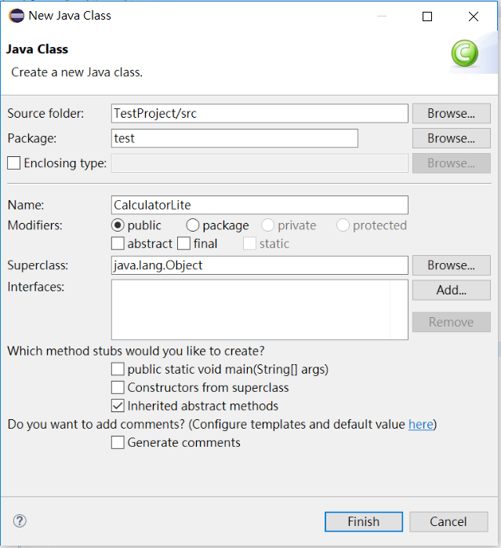
Create Class

Slide 12
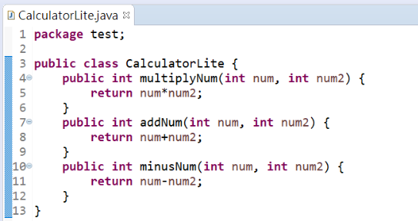
Write Code

Slide 13
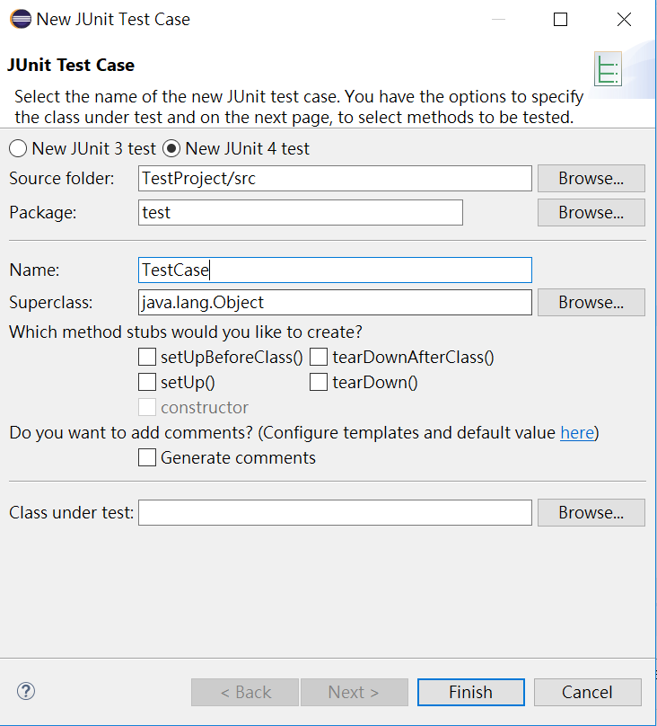
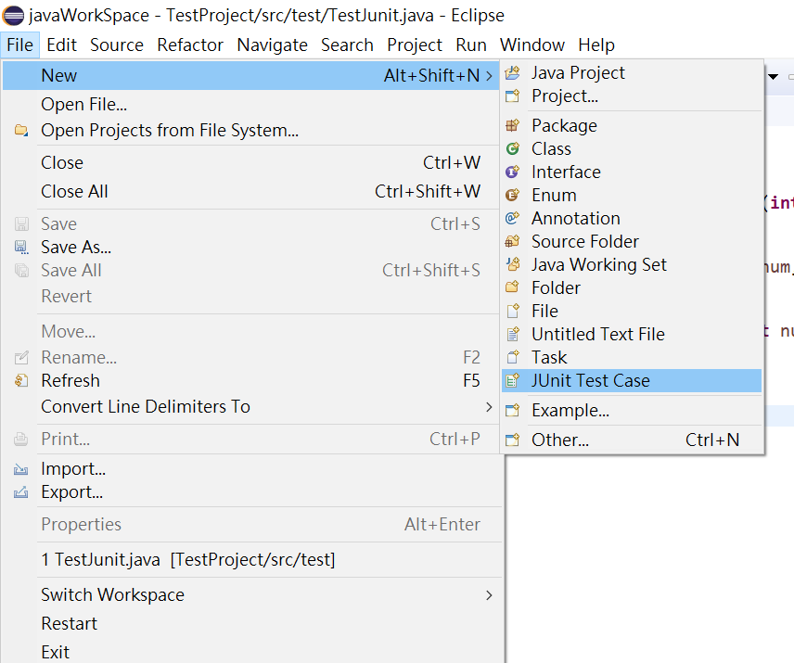
Create Test Case

Slide 14
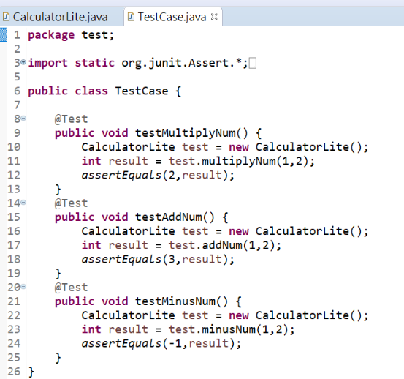
Create Test Case
Annotations
@Test - Test Case Method
@Before – Executed once before each unit test method
@After - Executed once after each unit test method
@BeforeClass – Executed once before unit test
@AfterClass – Executed once after unit test
@Ignore – The method which below this annotation should be ignored unit test
Notes:
@TEST 下方的Public Void為測試案例
@BEFORE 下方的Public Void為測試案例
@BEFORECLASS 下方的Public Void為測試案例
@AFTER 下方的Public Void為測試案例
@AFTERCLASS 下方的Public Void為測試案例

Slide 15
Annotations
BeforeClass
TestCase1
AfterClass
TestCase1@Test
After
TestCase2
Before
TestCase2@Test
After
Before

Slide 16
Assert Method
void assertEquals（boolean expected, boolean actual）
Asserts that two Variable or equation are equal
void assertTrue（boolean expected, boolean actual）
Asserts that a condition is true
void assertFalse（boolean condition）
Asserts that a condition is false
void assertNotNull（Object object）
Asserts that an object isn't null
void assertNull（Object object）
Asserts that an object is null
void assertSame（boolean condition）
Asserts that two objects refer to the same object
void assertNotSame（boolean condition）
Asserts that two objects do not refer to the same object
void assertArrayEquals（expectedArray, resultArray）
Asserts that two int arrays are equal

Slide 17
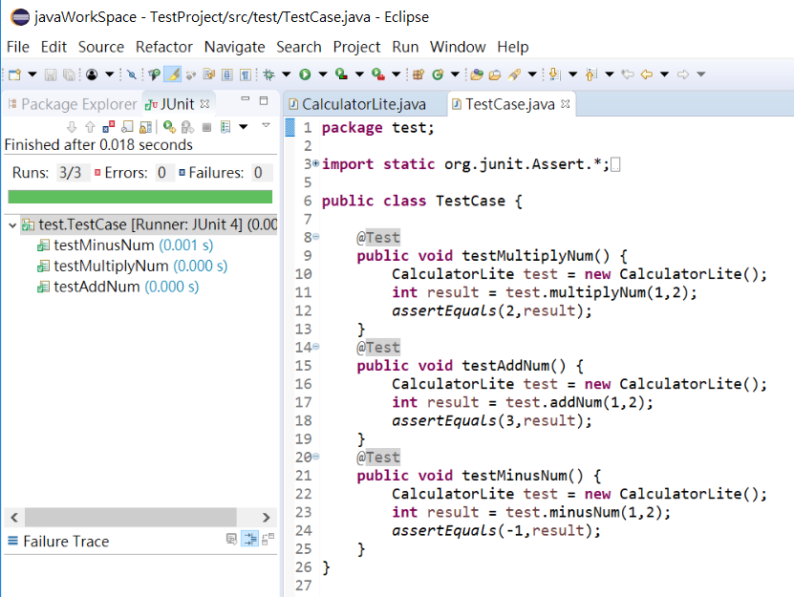
Start Testing

Slide 18
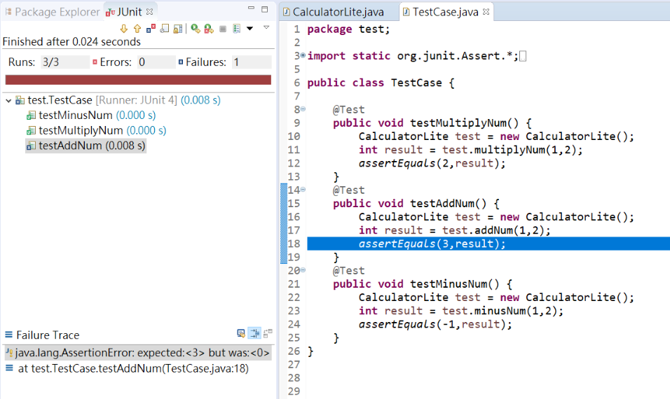
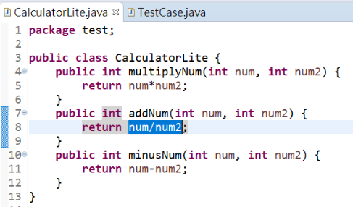
If encountering an error…

Slide 19
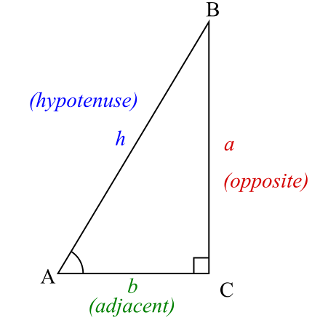
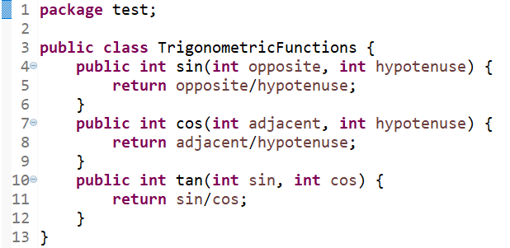
Lab1
Use JUnit to test sin, cos and tan method

Slide 20
Lab2
sin
Input Output
1, 2 0.5
2, 1 “Error!” string message
cos
Input Output
0.3, 0.5 0.6
1, 2 0.5
-3, -1 “Error!” string message

Slide 21
Lab3
tan
Input Output
0.3, 0.5 0.6
1, 0 “Not defined” string message
2, 1 “Error!” string message

Slide 22
Lab
Create project named “Lab1” and package “ntou.cs.calculator”
Add “TrigonometricFunctions.java” to your project
Change method type to “String” and parameter type to “double”
Use JUnit to create complete test cases to test methods sin, cos, and tan
Conduct the unit test and capture the screenshot of JUnit test results
Revise the source code to let all test cases pass and capture the screenshot of JUnit test results again
Zip your JUnit test code, revised source code, and the TWO screenshots of JUnit test results into a file (format: YourID-Lab-1.zip)
Finally upload the zip file to TronClass “實習一”

