Slide 1
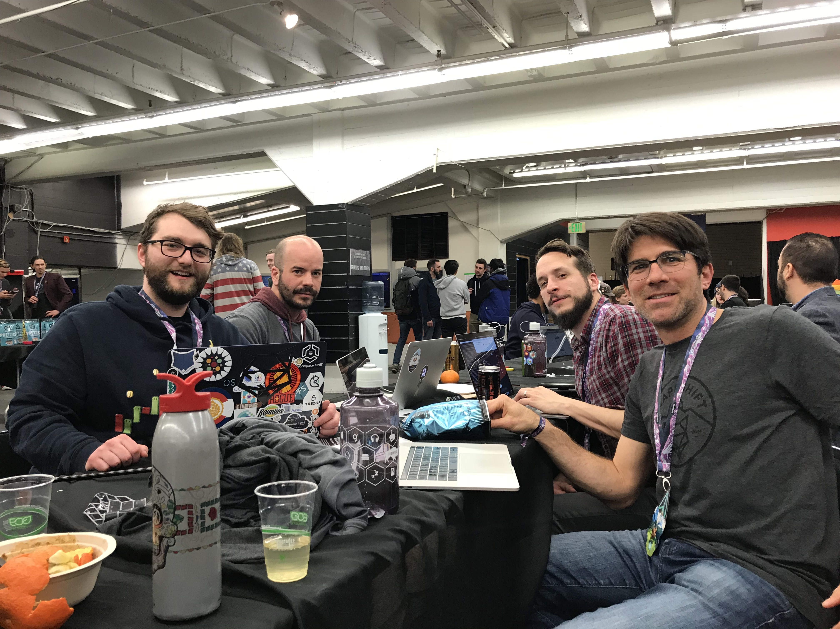
ETHBackpack [bkp] on-chain (main net) professional certificate verification
Team:
SEAN [System Engineer]
Josh [Senior Software Engineer]
Peter [full stack web developer]
Ron [security engineer]
https://github.com/screenpeaker/ETHBackpack

Slide 2

how do I manage proof of professional certifications?

Slide 3


ETHBACKPACK!

Slide 4
What is ETHBackpack?
ERC-721 Compliant token
Built with OpenZeppelin
Web3
Token URI contains Certification ID’s
Notes:
Solution: ERC721
Vendor (Google, Amazon, Cisco etc.) MINTS a 721 coin from their verified address to the student’s ETH Address
Student can show potential employer’s their verification wallet + tokens
Certified Bitcoin Professional (CBP) is used in this demo (working on chain)

Slide 5
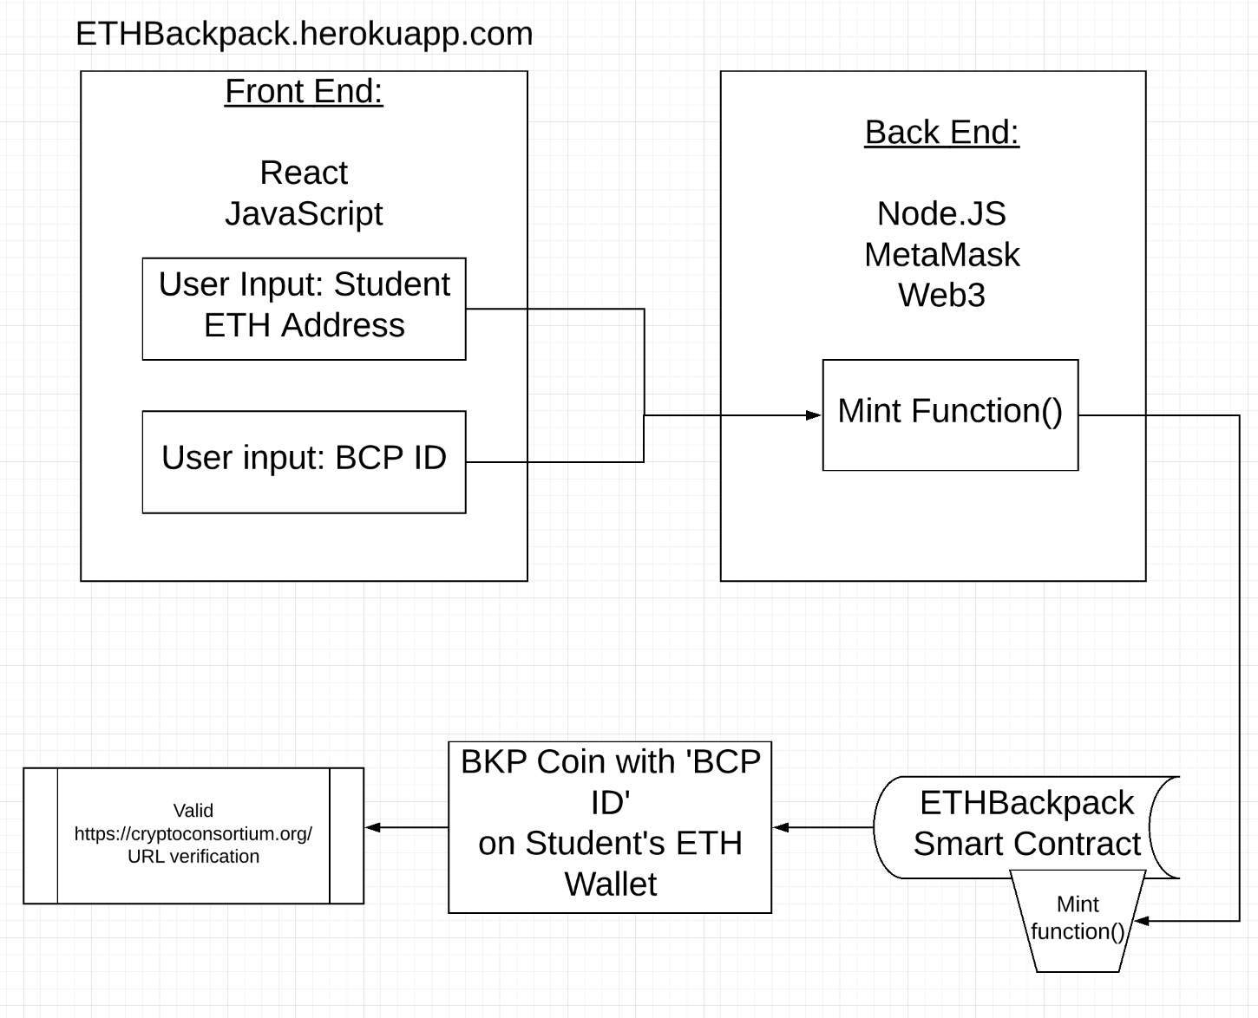

Slide 6


Bounties Chased:
OpenZeppelin
Build ERC-721compliant tokens
SALT Meerkat
to watch for deployments on the contract

Slide 7

Cost to deploy on main
Cost to create contract:
0.05208362 Ether ($6.49)
Cost to mint a token:
0.00362982 Ether ($0.45)
1st Class Post Office Rate ($0.49)
https://etherscan.io/address/0x86488654b8a318870b9d1efa7b23fc97503e8589

Slide 8
Demo
http://ethbackpack.herokuapp.com/
You can go here!!
See contract on chain:
https://etherscan.io/tx/0x66d5698a37f116d5716e0aaf95074e36e9764b7904f5c88dc11b31b5d8380dab
https://rinkeby.etherscan.io/address/0x95707d79e803c3ff32ecc0cf223af6416c2b90ad
Sean’s BackPack with BKP Tokens
https://rinkeby.etherscan.io/token/0x95707d79e803c3ff32ecc0cf223af6416c2b90ad?a=0x41FF2c09C4fAE81267Bd4feA1814Bac711C19004

Slide 9
Future plans:
Security best practices
More documentation
Hardware wallet integration
Support more certifications
Extended information hashing [experimental]

