Slide 1

World Happiness Report Analysis
Computational Methods and Data Analysis – 4MM451
Andre Boiko

Slide 2
Contents
Dataset Overview
Descriptive Statistics
EDA
Correlation Analysis
Hypothesis Testing
Multiple Linear Regression
Bonus: Regression Tree
Conclusion

Slide 3
1. Dataset Overview
The dataset originates from the World Happiness Report, a global survey that ranks 156 countries based on self-reported well-being. The happiness scores are derived from the Cantril ladder, where respondents rate their current life on a scale from 0 (worst possible) to 10 (best possible). The data comes from the Gallup World Poll and reflects survey results collected between 2013 and 2016.
Each record represents a country and includes the following key variables:
• Score – the average life evaluation reported by citizens (target variable) • GDP per capita – a measure of economic production per person • Social support – whether individuals feel they have support in times of need • Healthy life expectancy – expected years of life in good health • Freedom to make life choices – perceived autonomy in daily life decisions • Generosity – willingness to help others and donate • (Removed) Perceptions of corruption – dropped due to missing data
The six explanatory variables were designed to account for differences in happiness scores between countries by comparing each nation to a theoretical baseline called Dystopia –
benchmark country with lowest global scores.

Slide 4
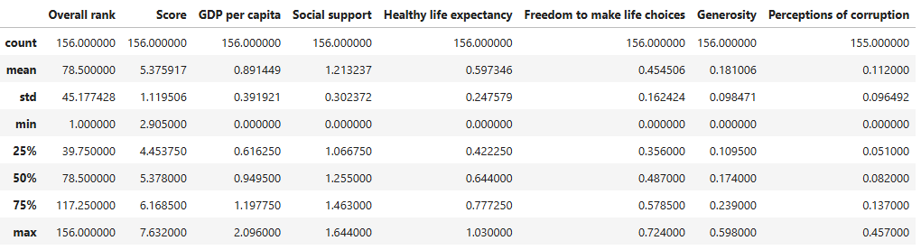
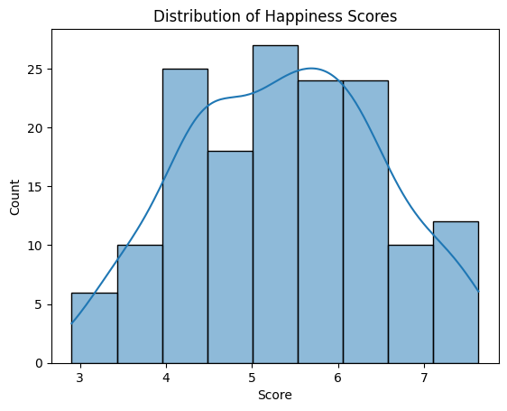
2. Descriptive Statistics
Mean happiness score is 5.38, ranges from 2.91 to 7.63.
GDP per capita: 0.00 to 2.10, high standard deviation, reflecting global economic inequality.
Social support and healthy life expectancy show tighter clustering but still meaningful variation.
Happiness scores are fairly symmetrically distributed, with most countries scoring between 4.5 and 6.5.

Slide 5
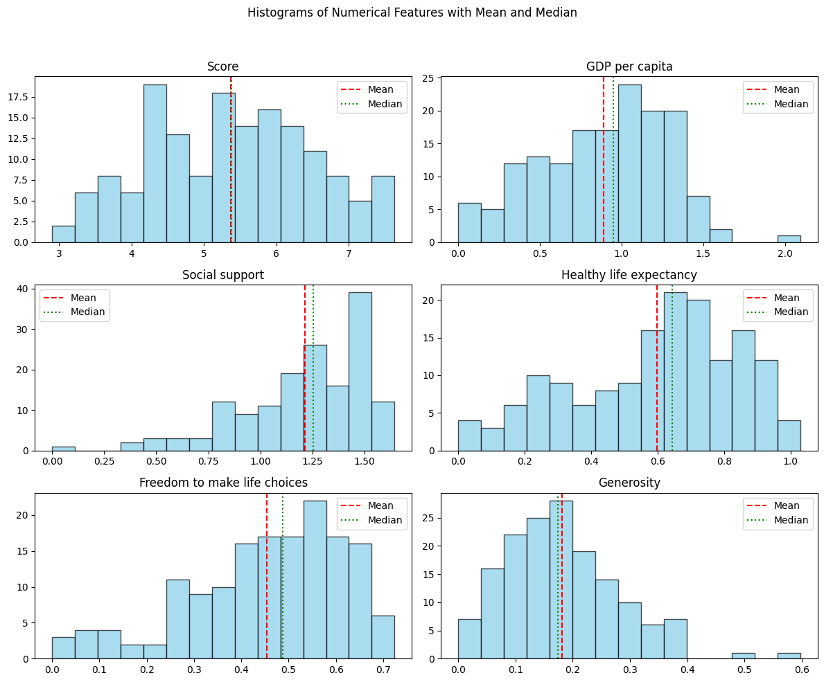
2. Exploratory Data Analysis (EDA)
Mean (red) and Median (green) help reveal skewness
GDP per capita and Generosity are right-skewed
Happiness Score is fairly symmetric
Skewed variables may impact regression results
Skewed variables can distort regression results by violating assumptions, amplifying outliers, and making interpretation less reliable.
Notes:
We did not transform skewed variables (e.g., with log) because our primary goal was interpretability, not prediction accuracy.
You’re doing explanatory analysis, not model optimization
The skew was not extreme enough to require transformation
Transforming variables makes interpretation harder (e.g., log-GDP)

Slide 6
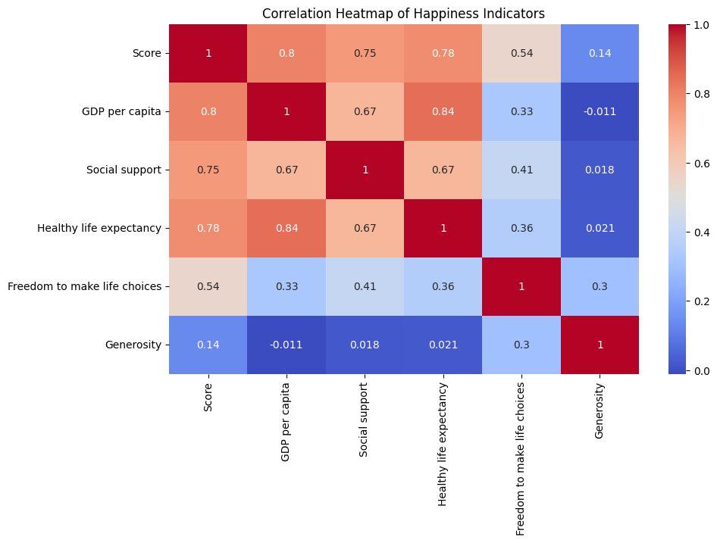
3. Correlation Analysis
Notable correlations:
`GDP per capita` and `Healthy life expectancy` are highly correlated (0.79)
`Social support` and `Score` also show strong correlation (0.74)
This suggests that economic and health-related indicators are key drivers of happiness.

Slide 7
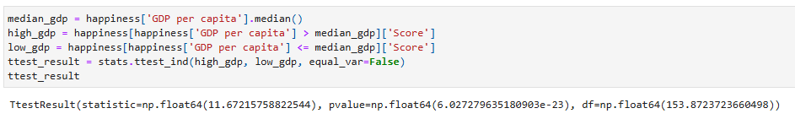
4. Hypothesis Testing
H0: No difference in happiness between high- and low-GDP countries
Result: p-value < 0.05 → Reject H0
Conclusion: High-GDP countries tend to be significantly happier.

Slide 8
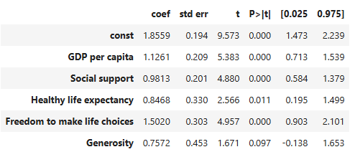
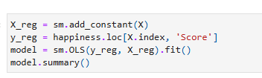
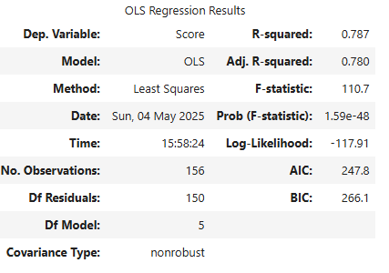
5. Multiple Linear Regression
The model has a strong fit (R² = 0.787)
Significant predictors: GDP per capita, Social support, Healthy life expectancy, and Freedom to make life choices
Generosity had a weaker effect and was not statistically significant at the 5% level

Slide 9
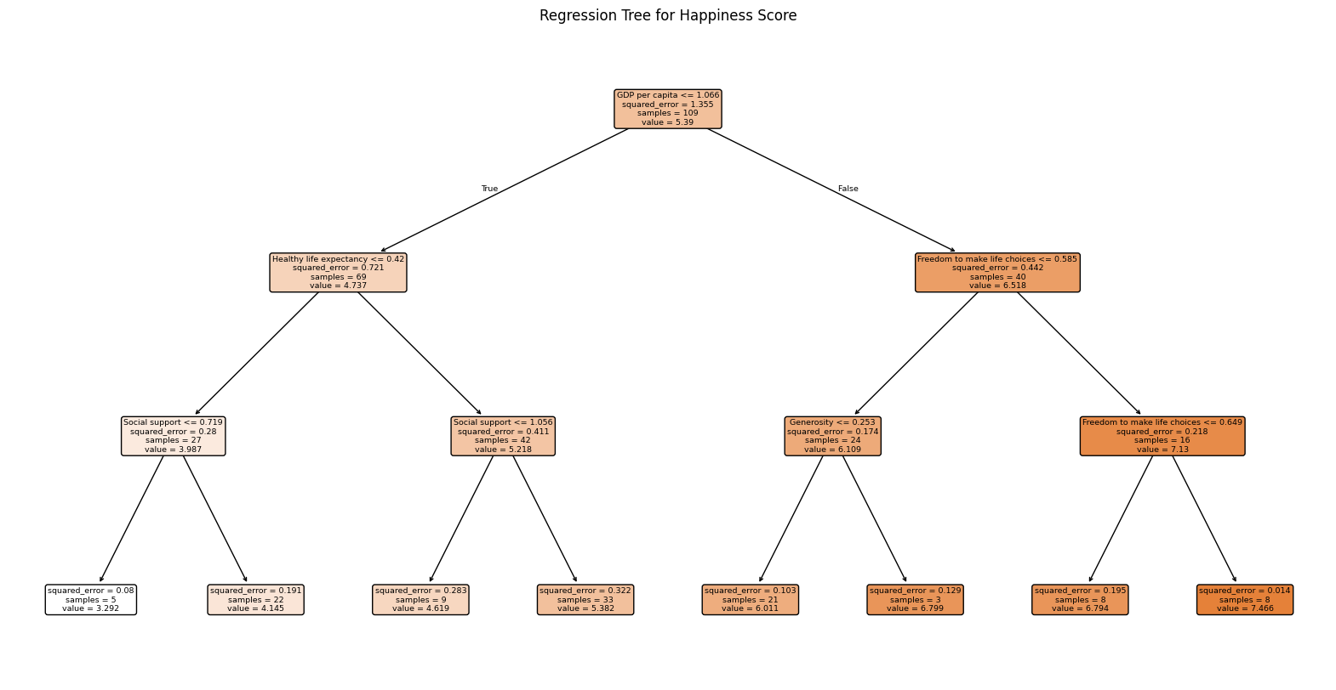
7. Regression Tree
This shows that GDP is the most important factor in separating low- vs. high-happiness countries.
Countries with higher GDP are split based on freedom and generosity.
Countries with lower GDP are further split by life expectancy and social support.
Decision trees capture non-linear relationships and variable interactions.
The model achieved a test MSE of 0.436, which is quite good.
The final leaf nodes show predicted happiness scores for each subgroup.
score of ~7.4 for countries with high GDP, high freedom, and good support.

Slide 10
8. Conclusion
High GDP per capita, freedom, and social support are the most influential variables
Both regression models confirm consistent findings across methods
The regression tree achieves a solid MSE of 0.436, indicating good predictive performance
RMSE: 0.66 - model’s predictions are off by about 0.66 happiness points: reasonable (happiness 0-10 scale)
While results are interpretable and aligned with theory, caution is needed due to possible endogeneity and omitted variables
explanatory variable is correlated with the error term
If happier people are also more productive, and that boosts GDP → Then GDP and happiness are mutually influencing each other meaning that GDP isn’t strictly independent, and this creates endogeneity.
Or if a third variable (let’s say “education” affects both GDP and happiness)
As we are doing just a explanatory analysis → we sohuldnt’ worry

Slide 11
Thank you.
Computational Methods and Data Analysis – 4MM451
Andre Boiko

