Slide 1




AI integration with collaborative
digital tools for critical editions
Troy A. Griffitts
Virtual Manuscript Room Collaborative Research Environment
13th International Congress of Coptic Studies · Göttingen · Friday 31 July 2026
International Association for Coptic Studies

Slide 2
One edition, eleven stages
1. Cataloguing
2. Imaging
3. Indexing
4. Transcribing
5. Collating
6. Regularizing
7. Setting variant units
8. Versional evidence
9. Ordering readings
10. Textual history (CBGM)
11. Publication
Blue = AI integrated today (6) Gold = CBGM local stemma — just landed
AI integration with collaborative digital tools for critical editions · ICCS XIII, Göttingen 2026
2

Slide 3
The question
Can AI be a legitimate assistant at every stage — without eroding the accountability that makes an edition authoritative?
Assist everywhere. Author nothing that becomes the edition.
AI integration with collaborative digital tools for critical editions · ICCS XIII, Göttingen 2026
3

Slide 4
Six integration points, today
• Indexing — locate the biblical passage on each manuscript page
• Transcribing — first-pass diplomatic text — useful even where scholars will (rightly) challenge it
• Collating — language-aware alignment across Hebrew · LXX Greek · Latin · Coptic · Syriac
• Regularizing — propose orthographic normalisations for human review
• Setting variant units — group aligned columns into variation units
• Versional evidence — align a translation back to its Greek / Hebrew Vorlage
AI integration with collaborative digital tools for critical editions · ICCS XIII, Göttingen 2026
4

Slide 5
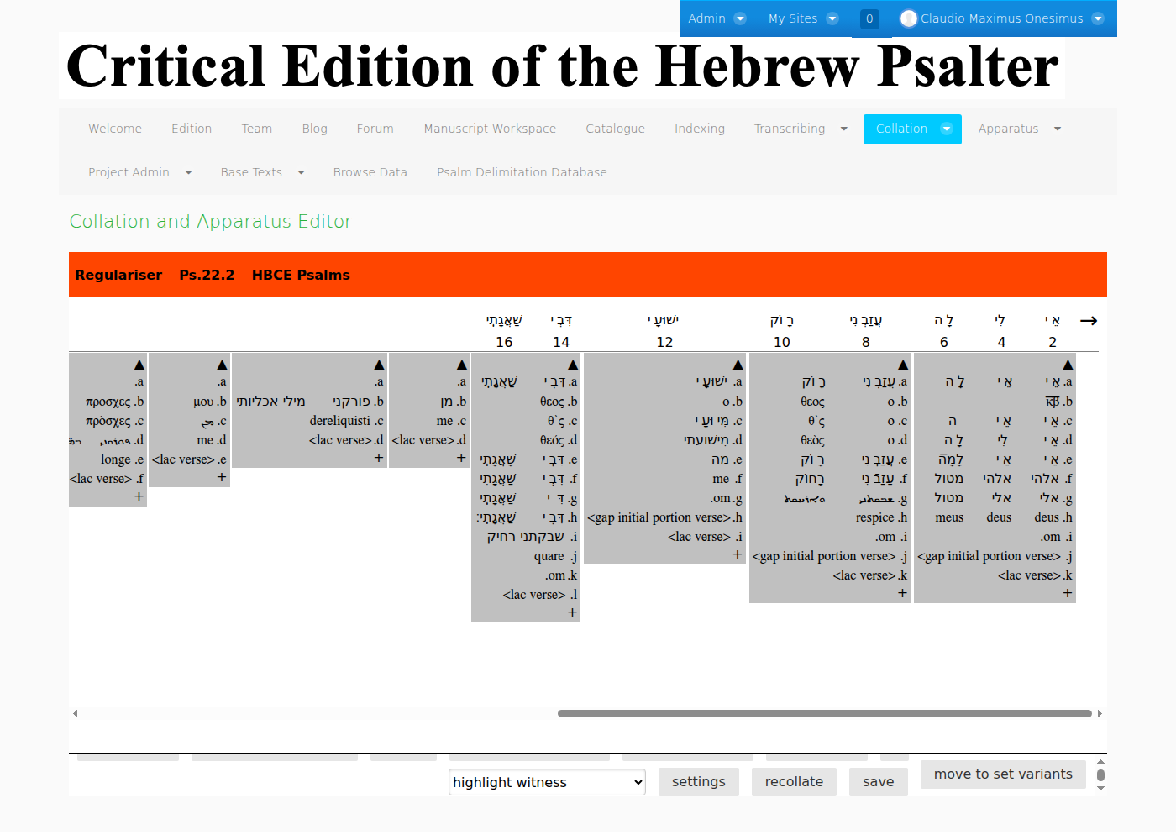
Live demo — Psalm 22:2, five languages
Drew Longacre's Hebrew Bible Critical Edition of the Psalms, in the VMRCRE collation editor
AI integration with collaborative digital tools for critical editions · ICCS XIII, Göttingen 2026
5

Slide 6
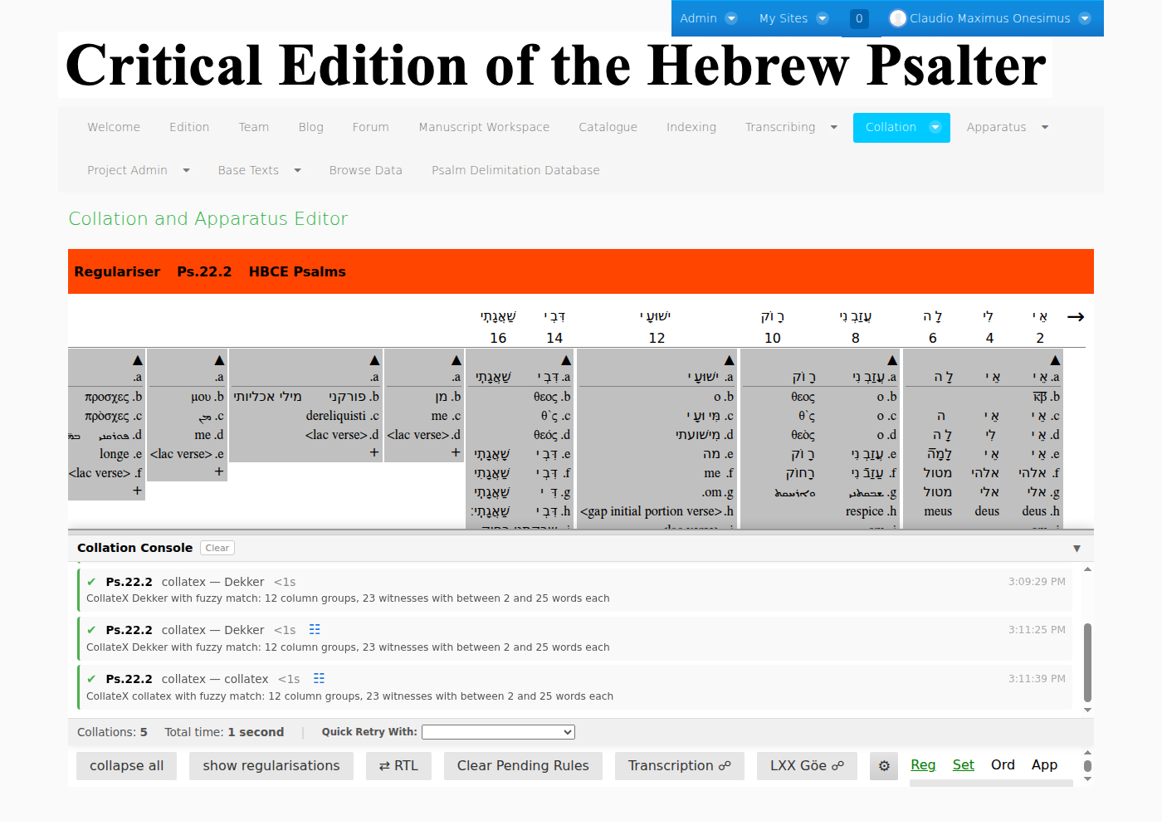
Before — CollateX alignment
Baseless, token-level: the alignment sprawls to 37 columns
AI integration with collaborative digital tools for critical editions · ICCS XIII, Göttingen 2026
6

Slide 7
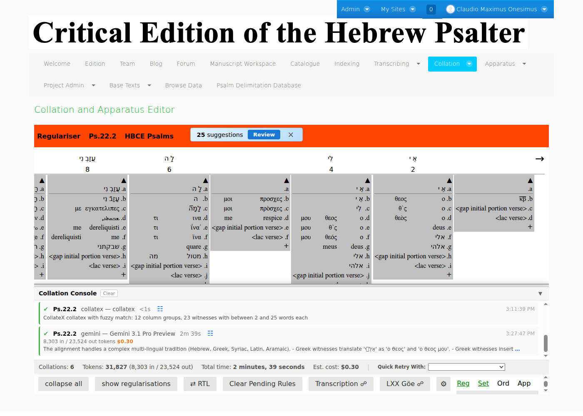
After — language-aware AI alignment
Same verse, 26 columns · $0.30 · 2m39s · every run logged with model + cost
AI integration with collaborative digital tools for critical editions · ICCS XIII, Göttingen 2026
7

Slide 8
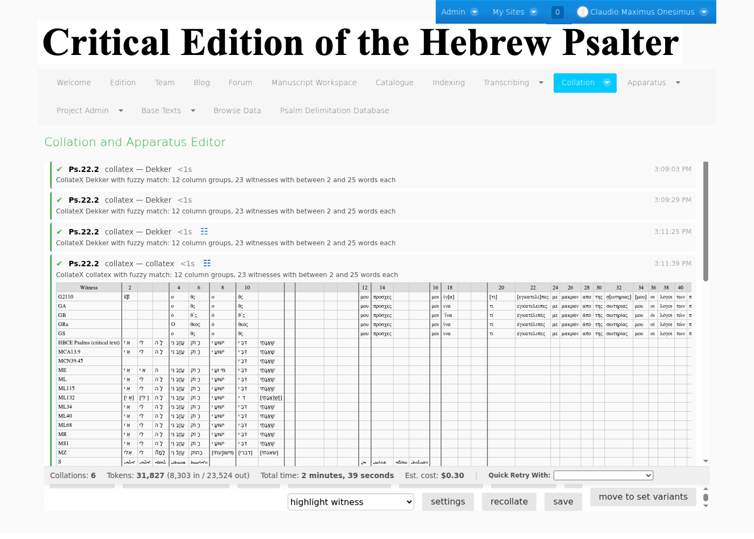
The width is the argument
37 → 26 columns: fewer, better-motivated variation units
AI integration with collaborative digital tools for critical editions · ICCS XIII, Göttingen 2026
8

Slide 9
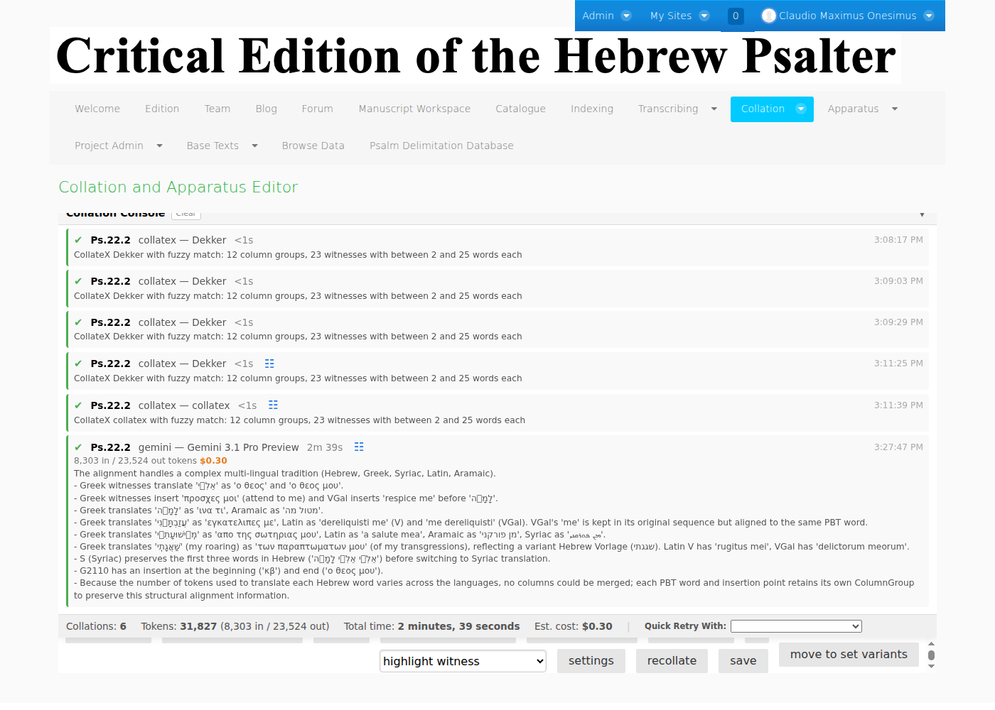
It shows its reasoning
Groups ⲟ ⲑⲉⲟⲥ ⲙⲟⲩ to Hebrew אלי — and states a Vorlage judgment openly
AI integration with collaborative digital tools for critical editions · ICCS XIII, Göttingen 2026
9

Slide 10
Lesson 1 — gate every answer
AI is eager to please, and guesses persuasively. Never trust the prose — check it against a mechanical invariant.
Collation gate: tokens missing · tokens added · input words silently changed
If any input token was altered without being reported, reject the whole result.
AI integration with collaborative digital tools for critical editions · ICCS XIII, Göttingen 2026
10

Slide 11
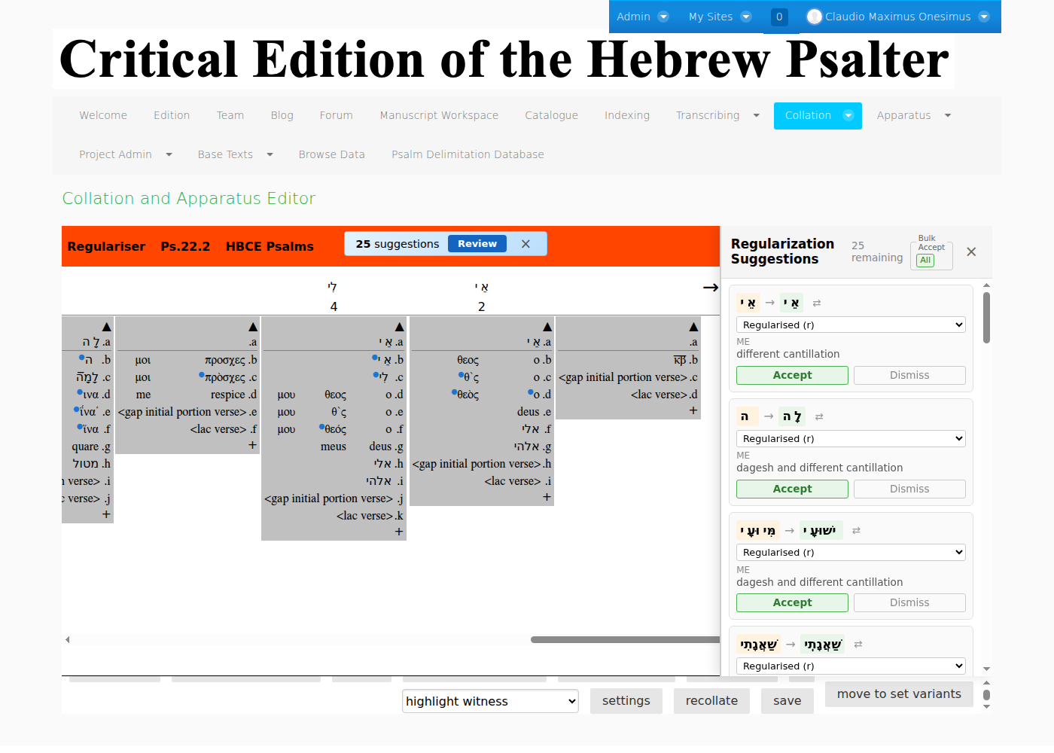
AI proposes; a human accepts
Regularisation suggestions — each Accept / Dismiss by an editor. Nothing auto-commits.
AI integration with collaborative digital tools for critical editions · ICCS XIII, Göttingen 2026
11

Slide 12
Lesson 2 — prefer AI that writes tools
AI is non-deterministic. Move the non-determinism to one-time authoring:
• Don't — ask the model to redo the task by hand every time
• Do — have it write deterministic code you review, keep, and improve
AI integration with collaborative digital tools for critical editions · ICCS XIII, Göttingen 2026
12

Slide 13
AI joins the contribution ethos
• A named, accountable member — its own userID; every action in the usage log — who, what, which model, what it cost
• Bring-Your-Own-Key — three tiers, user → project → system; whose budget pays is always explicit
• Enriches the shared research dataset — many teams draw on it for their own projects — it is not poured into one edition
AI integration with collaborative digital tools for critical editions · ICCS XIII, Göttingen 2026
13

Slide 14
The pattern generalizes — CBGM local stemma
Deterministic
coherence digest
Model registry
· BYOK
AI proposes
only the DAG
Edge-by-edge review
cost + tokens logged
→
→
→
• The hardest judgment in the pipeline — for each variation unit, which reading is the source of which — the CBGM local stemma (locstem)
• Grounded on evidence it cannot invent — seeded from pre-genealogical coherence; the model proposes only the edges (Lesson 1)
• A first-class NTVMR citizen — logs in with NTVMR credentials; decisions round-trip to the shared project-data store
Same architecture as collation — a new stage, not a new system.
AI integration with collaborative digital tools for critical editions · ICCS XIII, Göttingen 2026
14

Slide 15
Assist everywhere. Author nothing.
AI as a legitimate assistant across the editing pipeline.
Troy A. Griffitts · VMRCRE / NTVMR · coptot.manuscriptroom.com

