Slide 1

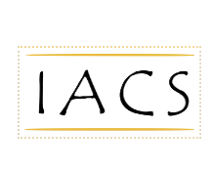
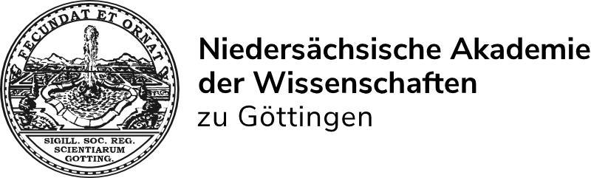

International Association for Coptic Studies (IACS) 13th International Congress of Coptic Studies Göttingen, 27 July – 1 Aug 2026
International Association for Coptic Studies

