Slide 1
Probabilistic Inversion
Perry Oddo
10/23/15

Slide 2
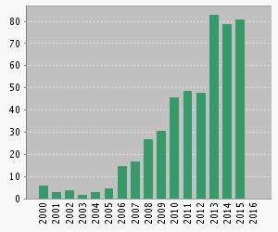
Probabilistic Inversion
Mathematical concept used in uncertainty analysis
Few citations prior to 2000 [Web of Science]
Bernard Kraan & Roger Cooke, Delft University of Technology

Slide 3
Background to PI
Problem:
Uncertainty analysis often requires an understanding of the distribution of uncertain model parameters
Some parameters are not physically observable/quantifiable but may produce observable outcomes
Expert elicitation can be used to inform uncertainties where experimental data on model outcomes are scarce or conflicting

Slide 4
Probabilistic Inversion, defined
“…the objective of [Probabilistic Inversion] is to take a distribution representing the uncertainty on certain observables, and to translate this uncertainty to...target variables of a certain model.” –Kraan 2002
?
Observable elicitation variable
Unobservable target variable

Slide 5
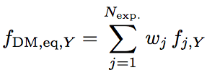
Expert Elicitation
Aggregates experts’ uncertainty of elicitation variable into uncertainty distribution of Decision Maker (DM):
where:
Y = elicitation variable
ω_{i} = weight of expert j
f_{j},Y = density estimation for variable Y

Slide 6

(More) intuitive example of PI – Later plume spread
The later plume spread, σ_{y}, for a downwind distance, z, can be modeled by:
where: A_{y} and B_{y} are unobservable target variables
σ_{y} is observable phenomenon → becomes elicitation variable

Slide 7
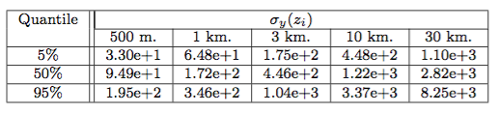
Example of Probabilistic Inversion – Later plume spread
Expert input comes in the form of quantile estimations for plume spreads at different downwind distances:
*Important to note: expert data does not depend on any particular model

Slide 8
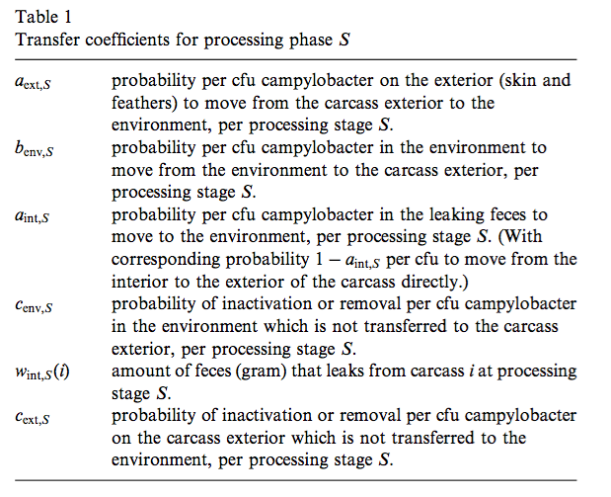
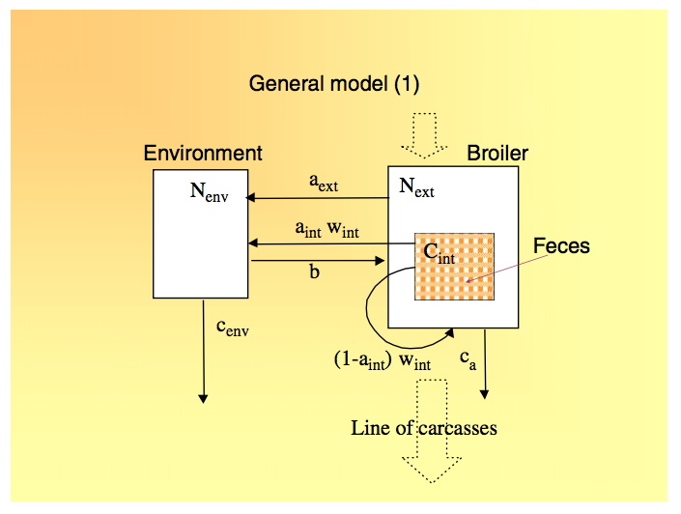
Cooke et al. 2006 – Probabilistic Inversion for chicken processing lines

Slide 9
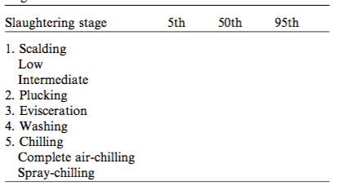
Problem setup
Assume mass balance – bacteria can be transferred to/from chicken and environment or can be inactivated/removed
Assume hypothetical initial conditions:
Number of infected campylobacters internally and externally
Experts queried about amount of bacteria on each carcass at the end of each processing stage:

Slide 10
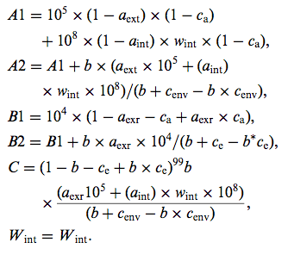
Transfer coefficients
target variables
Expert distributions
elicitation variables

Slide 11
Transfer coefficients
target variables
Expert distributions
elicitation variables
“The probabilistic inversion problem may now be expressed as follows: find a joint distribution over the transfer coefficients, such that the quantiles of the quantities on left hand sides of the above equations agree with the decision maker’s quantiles.”

Slide 12
How to “pull back” expert uncertainty onto target variables?
Sample re-weighting:
Choose initial joint distribution for target variables such that:
Some samples fall into each interquantile interval
Samples are physically possible
Draw N samples from joint distribution and compute campylobacter abundances
Re-weight samples so that if they are re-sampled they agree with the quantile constraints of the experts

Slide 13
Weighting methods
Variable 2
5%
50%
95%
Iterative Proportional Fitting (IPF) vs. PARameter fitting for uncertain models (PARFUM)
Iteratively adjust weighting until quantile constraints are satisfied
Algorithms are fast but may not converge if too many quantile cells are infeasible
0.19
0.02
0
0
0.21
5%
.24
.17
0.01
0
0,37
Variable 1
50%
0
0
0.34
0.52
0.86
95%
0
0.4
0.25
0.31
0.71
0.45
0.58
0.70
0.83

Slide 14
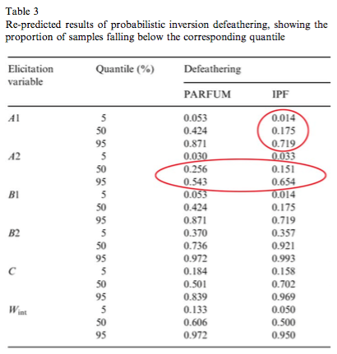
Results
Iterative Proportional Fitting (IPF) vs. PARameter fitting for uncertain models (PARFUM)
Iteratively adjust weighting until quantile constraints are satisfied
Algorithms are fast but may not converge if too many quantile cells are infeasible

Slide 15
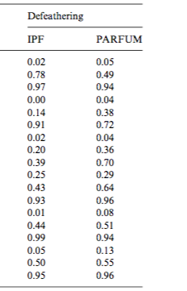
Results
Iterative Proportional Fitting (IPF) vs. PARameter fitting for uncertain models (PARFUM)
Iteratively adjust weighting until quantile constraints are satisfied
Algorithms are fast but may not converge if too many quantile cells are infeasible

Slide 16
Conclusions
First model lacked important transfer mechanism
Evaluating experts’ rationale lead to model revision and better fits between distributions
Probabilistic Inversion is an effective way to map uncertainties about observable phenomena onto uncertain variables

Slide 17
References
Bedford T, Cooke R (2001) Probabilistic inversion techniques for uncertainty analysis. Probabilistic Risk Analysis (Cambridge University Press). Available at: http://dx.doi.org/10.1017/ CBO9780511813597.017.
Cooke RM, Nauta M, Havelaar AH, van der Fels I (2006) Probabilistic inversion for chicken processing lines. Reliability Engineering & System Safety 91(10–11):1364–1372.
Du C, Kurowicka D, Cooke RM (2006) Techniques for generic probabilistic inversion. Computational Statistics & Data Analysis 50(5):1164–1187.
Kraan BCP, Cooke RM, TU Delft: Electrical Engineering, Mathematics and Computer Science, TU Delft, Delft University of Technology (2002) Probabilistic inversion in uncertainty analysis: and related topics. Available at: http://resolver.tudelft.nl/uuid:5b12d2ca- c167-4038-969a-7f70078657ef.
Kraan BCP, Cooke RM (2000) Uncertainty in compartmental models for hazardous materials — a case study. Journal of Hazardous Materials 71(1–3):253–268.

