Slide 1

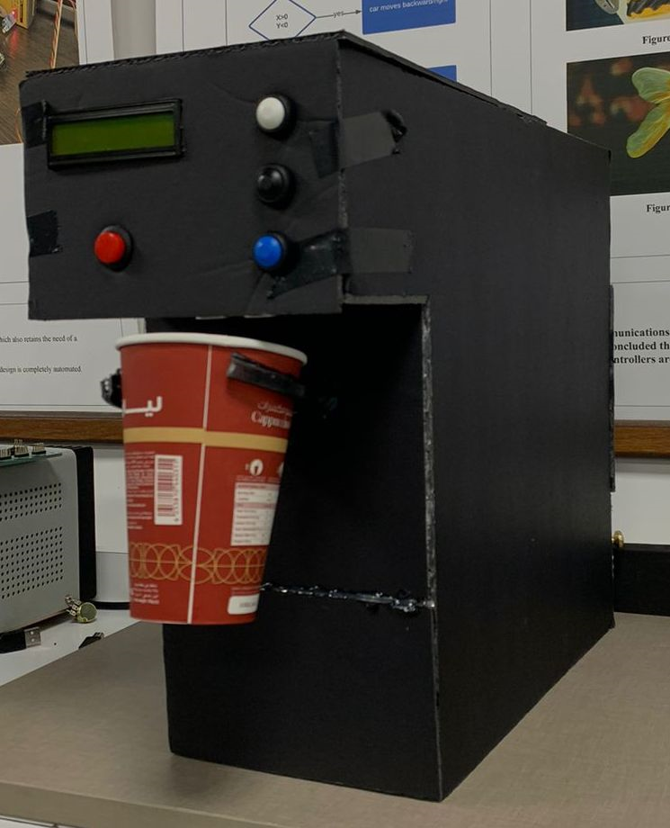
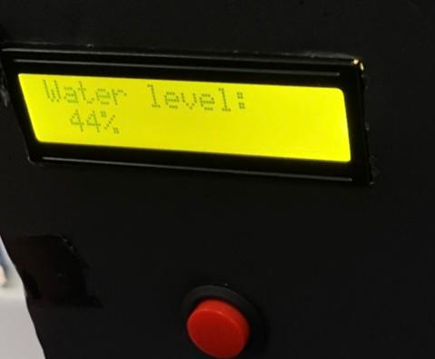
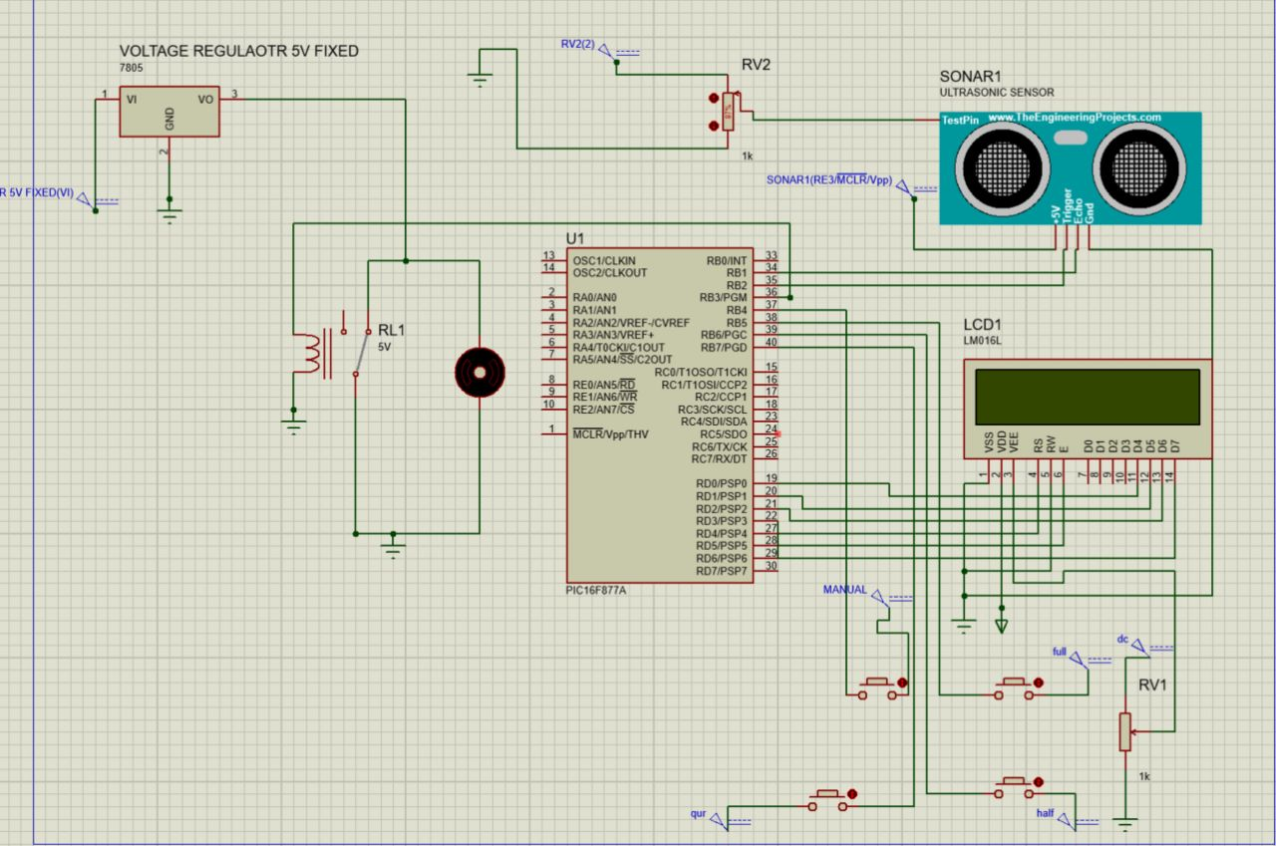
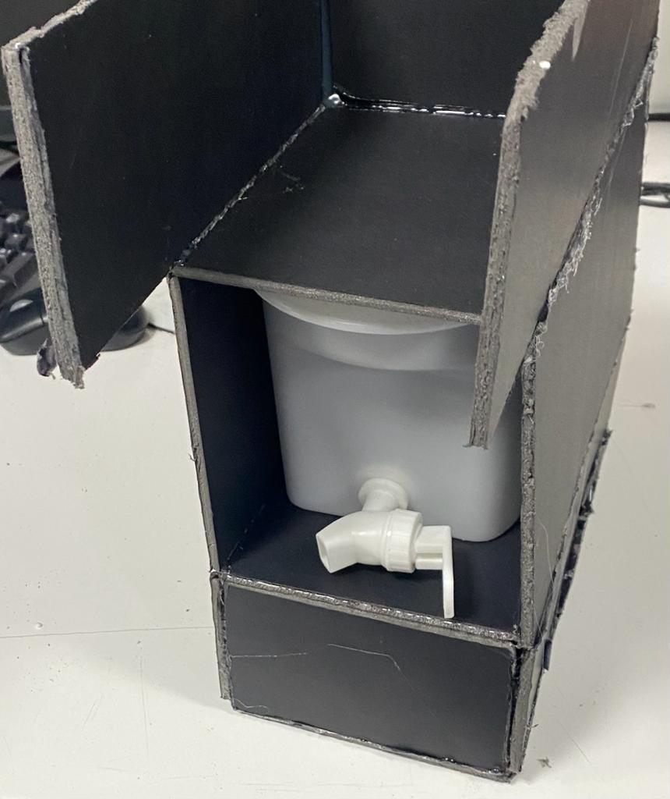
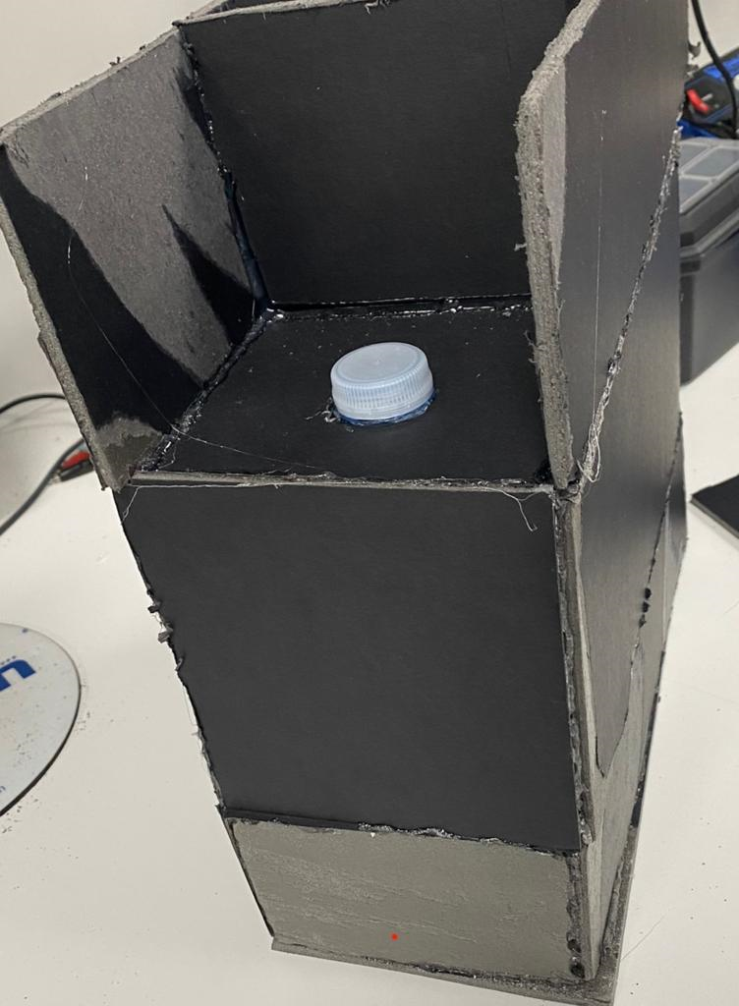
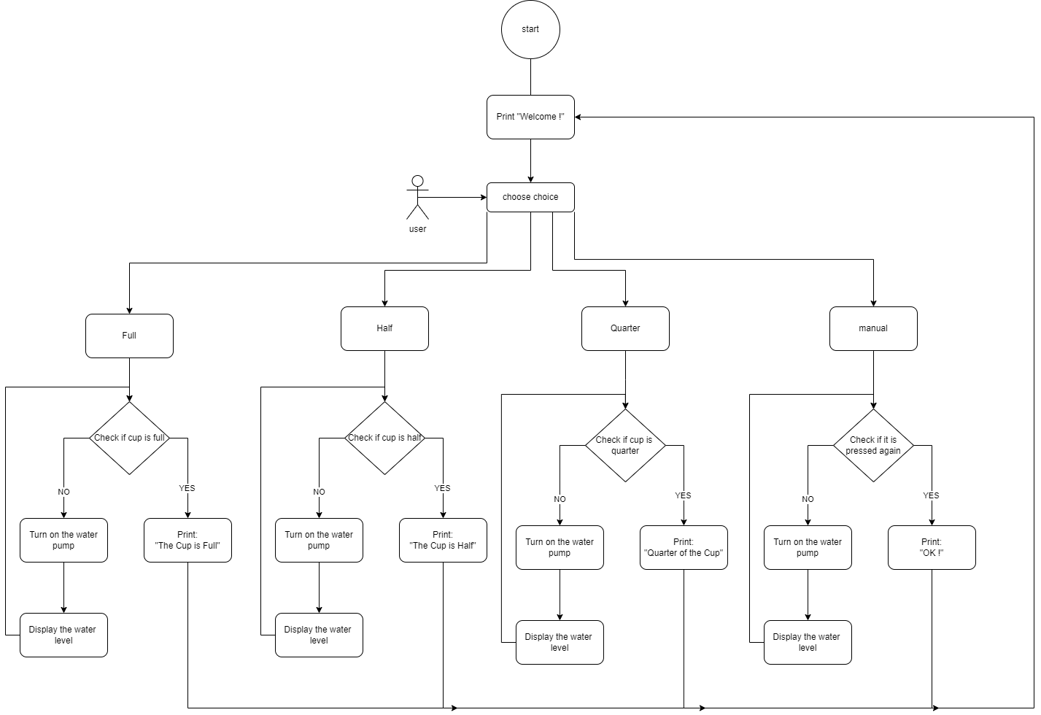
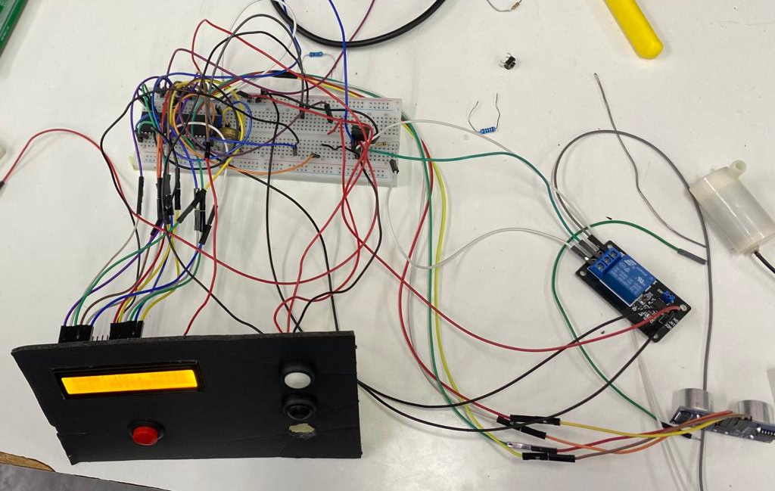
Automated Water Filling
Machine
A.Mitwalley, M.Alhaddar and M.Qasem
Supervisor: Dr. Belal Sababha
Embedded Systems Final Design Project, Fall 2022
King Abdullah II School of Engineering
Princess Sumaya University for Technology
Introduction
An automatic filling water cup embedded system is a device that automatically fills a cup with water by what choice the user presses (full, half, quarter and manual) for any disposable cup size. It uses sensors and a microcontroller to detect the presence of a cup and then activates a pump to fill the cup with water and show the percentage of the water amount in the cup on a LCD display. The system can be programmed to dispense a specific amount of water and can be integrated into a larger system such as a vending machine or water dispenser. The device is designed to be efficient, convenient and easy to use.
Results
This is our final design for the system after the connections and designing. This is our automated filling water machine.
Figure 3: Final Design.
Figure 4: display the reading
Figure 5: From Inside.
Figure 6: Connections
Design
This project is designed by the following components:
Mainly a PIC16f877A interfaced with:
Ultrasonic sensor, LCD display, DC motor water pump, tube, relay and voltage regulator. The Proteus design show the circuit design and the flowchart show how it works.
Figure 1: Circuit Design.
Figure 2 Flowchart.
Conclusion
The automatic filling water cups embedded system is a device that utilizes various components to automatically fill any disposable size cups with water. The ultrasonic sensor is used to detect the presence of a cup, the LCD display is used to show the status of the system, the DC water pump is responsible for pumping water, the relay is used to control the power to the pump, the voltage regulator is used to regulate the voltage supplied to the system, and the press buttons are used to manually control the system.
This feature makes it more versatile and can be used in multiple scenarios, such as in offices, homes, or public places. This system is also very versatile and can be used in a variety of settings. It is a great solution for anyone looking for a convenient and efficient way to dispense water.

