Slide 1
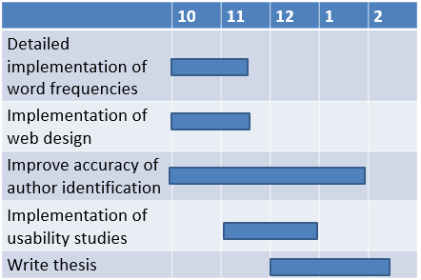
Author Identification Using NLP 自然言語処理を用いた筆者特定 s1260227 Kento Miura, Supervisor: John Blake
Ｓｅａｌ
or Ｓｉｇｎａｔｕｒｅ
1. Summary of the Research
(Motivation/background and Goal)
3. Current Results and Status
I made a prototype of a readability calculator and a word frequency calculator.
-The prototypes were created using Bash and python.
- The frequency calculator needs to be further improved.
- I would like to try using this tool in practice.
- Make the design easy to read
Work to make the UI easier to understand.
- I understand the basic regular expressions, but
I need to improve it a little more.
My research was motivated by my curiosity to know how much anonymity can be guaranteed on the Internet.
The purpose of this research is to develop useful tools for Digital Forensics and to improve their functions and UI.
My task is to improve the accuracy of author matching and to evaluate the usability of the website.
Frequency of word usage
- We will examine the frequency of word usage in two prepared documents.
Readability
- We measure the readability (decomposition of words by lexical level) of two prepared documents.
To achieve this function, we compare the vocabulary levels of the prepared samples, and The similarity rate is calculated according to the distribution of the vocabulary of the documents to be compared.
4. Remaining Tasks and Tentative Schedule
Things to do
- Detailed implementation of word frequency functions
- Implementation of web design
- Conducting usability studies
- Improving from usability studies
- Writing a Graduation Thesis
2. Approach/Methodology
Tools used: some web frameworks
(maybe Vue or Svelte) [1], Regex [2], Bash [3], Python [4].
Some web frameworks was used to create basic prototype of the author specific site
Create multimedia resources and regular expressions.
I create multimedia resources and regular expressions to add.
While I make the website easy to use
References
Some frameworks images
[1] Man page of Bash
https://linuxjm.osdn.jp/html/GNU_bash/man1/bash.1.html
[2] Python for NLP: Developing an Automatic Text Filler using N-Grams
https://stackabuse.com/python-for-nlp-developing-an-automatic-text-filler-using-n-grams/

Slide 2
 | 10 | 11 | 12 | 1 | 2
Detailed implementation of word frequencies
Implementation of web design
Improve accuracy of author identification
Implementation of usability studies
Write thesis

