Slide 1
Ajax
A - Asynchronous
JA - JavaScript
X - XML
Ajax basically user for creating a Rich Internet Application. Since it provides the multiple threads at a time.

Slide 2
Components of Ajax
HTML:
This technology is use for creating the layouts.
CSS:
This technology is use for styling the layout.
JavaScript:
This technology is use for creating the business logics.
DOM:
This technology is use for accessing the elements of HTML and CSS. Also it is required to merging the business logic to the layouts.
XMLHttpRequest:
JavaScript object that performs asynchronous interaction with the server.

Slide 3
Synchronous Vs Asynchronous
Synchronous:
In this process HTML page make a request using HTTP protocol which takes the data from HTML page to server and vice-versa. This process is single thread. It means only one request can be made at a time.
Asynchronous:
In this process HTML page make a request using HTTP protocol which takes the data from HTML page to server and vice-versa. This process is multi-thread. It means more than one request can be made at a time.

Slide 4
XMLHttpRequest
An object of XMLHttpRequest is used for asynchronous communication between client and server.
It performs following operations:
Sends data from the client in the background
Receives the data from the server
Updates the webpage without reloading it.
XMLHttpRequest object has some predefined properties and methods.

Slide 5
XMLHttpRequest
Methods:
abort()
getAllResponseHeaders()
getResponseHeader( headerName )
open( method, URL )
open( method, URL, async )
open( method, URL, async, userName )
open( method, URL, async, userName, password )
send( content )
setRequestHeader( label, value )
Properties:
onreadystatechange
readyState
responseText
responseXML
status
statusText

Slide 6
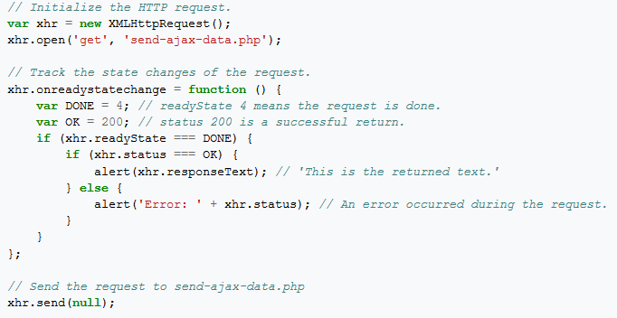
Simple Example

Slide 7
readyState
It represents the state of the request. It ranges from 0 to 4.
0 = UNOPENED open() is not called.
1 = OPENED open is called but send() is not called.
2 = HEADERS_RECEIVED send() is called, and headers and status are available.
3 = LOADING Downloading data; responseText holds the data.
4 = DONE The operation is completed fully.
Status
100 =
200 =
300 =
400 =
500 =
https://en.wikipedia.org/wiki/List_of_HTTP_status_codes

Slide 8
Thank you
Author: Basant Sharma

