Slide 1
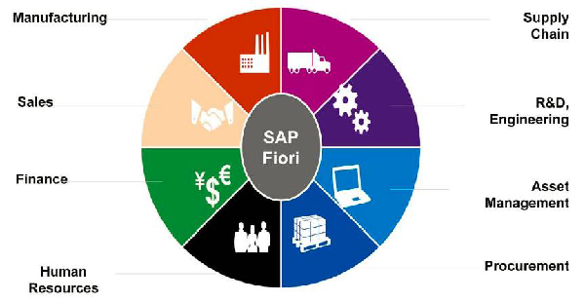
Fiori
SAP Fiori is a new user experience (UX) for SA P software and applications. It basically based on SAP UI5 and Open UI5.
The word Fiori is derived from Italian word flower.

Slide 2
Functional Areas
Manufacturing
Supply Chain
Sales
R&D Engineering
Finance
Assets Management
Human Resource
Procurement

Slide 3
SAP Design Principle
Role Based
Responsive (HANA)
Simple (1-1-3 scenario [1 user, 1 usercase, 3 screens])
Seamless Experience (Common language for all)
Delightful (ECC 6.0)

Slide 4
SAP Fiori Apps
Transactional Apps (Leave Request, Travel Request, Purchase Order.)
Fact sheets (key and contextual information in business operations.)
Analytical Apps (Provide role-based real time information of business)

Slide 5
Prerequisites to Learn SAP Fiori
ABAP program and objects
HTML5
JavaScript
SAP UI5
ERP Implementation experience
OData and SAP NetWeaver Gateway
SAP HANA

Slide 6
MVC
MVC stands for
Model
View
Controller
The Model basically consist of database, View is related to look & feel and Controller contains the business logic.
In the Fiori MVC is basically like this
Model – Odata services
View - XML, HTML, CSS files
Controller - JS files

Slide 7
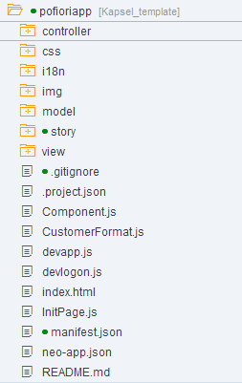
Folder Structure of Fiori Application

Slide 8
Thank you
Author: Basant Sharma

