Slide 1

Project Title - Seasonal Agriculture Performance Analysis
Student Name –Shivam Maurya
College Name- Arya College Of Engineering
AICTE STU ID : STU69ef58f1ec3ba1777293553

Slide 2

PROBLEM STATEMENT
Agricultural activities are influenced by seasonal variations in environmental conditions, farming practices, resource availability and market conditions. As a result, agricultural performance may differ from one season to another. However, raw agricultural data does not clearly explain how agricultural performance changes across seasons or what patterns can be observed in different seasonal conditions. The problem is to analyse the given agricultural dataset and investigate seasonal differences in agricultural performance by identifying meaningful patterns, trends, relationships and variations within the available data.

Slide 3
Project Description
This project analyzes agricultural data across different seasons to identify patterns, trends, and variations in agricultural performance. The dataset includes information about farming practices, environmental conditions, crop production, resource usage, and economic outcomes.
The project involves data cleaning, exploratory data analysis, statistical analysis, and visualization to compare agricultural performance across seasons and identify important relationships and unusual patterns. The findings will be used to develop meaningful, evidence-based insights and recommendations for better seasonal agricultural planning.

Slide 4

WHO ARE THE END USERS?
Farmers – For better seasonal farming decisions
Agricultural Researchers – To study seasonal patterns and trends
Government & Agricultural Organizations – For data-driven agricultural planning
Agricultural Planners – To support resource and crop planning
Farm Cooperatives & NGOs – To support farmers through data-driven insights
Agricultural Businesses – To understand seasonal production and market trends

Slide 5

Technology Used
Python – Data Analysis & Processing
Pandas & NumPy – Data Cleaning & Analysis
Matplotlib & Seaborn – Data Visualization
Jupyter Notebook – Analysis & Documentation
Statistical Analysis – Seasonal Comparison & Insights

Slide 6
RESULTS
Kharif recorded the highest average yield (5.63 tonnes/ha) but also the highest average water usage (6,102.20 m³).
Zaid showed the highest average disease & pest risk (52.01%) and the lowest water efficiency (4.41 tonnes/1,000 m³).
Sugarcane achieved the highest average yield (46.64 tonnes/ha) and average profit (₹817,187.99).
Drip irrigation recorded the highest average yield (6.58 tonnes/ha) among the irrigation methods analyzed.
Profitability varied considerably across crops, with Wheat, Rice and Maize showing negative average profits.
Overall, the analysis highlights the importance of crop selection, efficient irrigation, pest management, and seasonal resource planning.

Slide 7
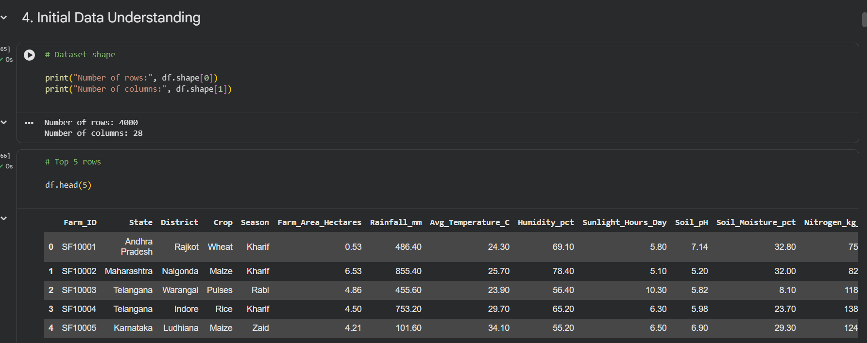
RESULTS
Dataset was successfully loaded and analyzed.
The dataset structure, dimensions, and data types were examined.
Missing values and duplicate records were identified and handled before analysis.

Slide 8
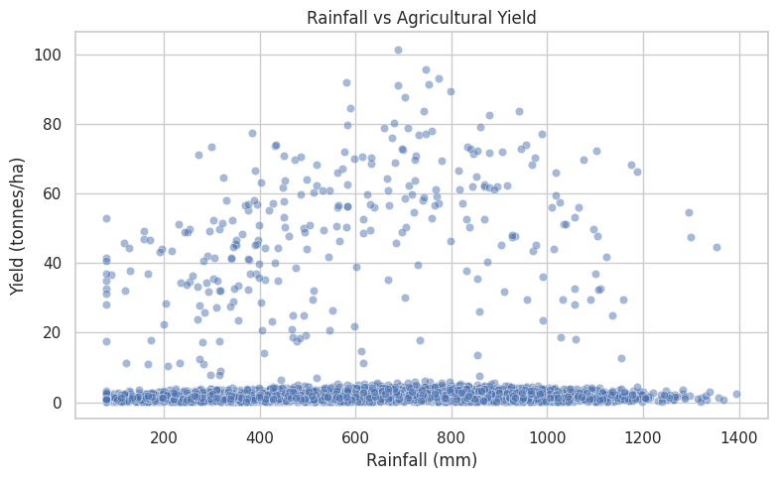
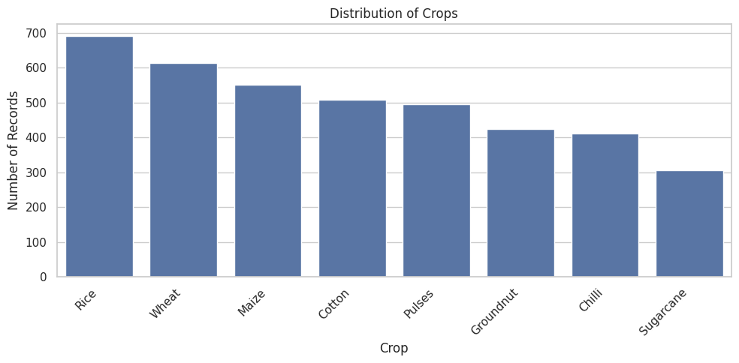
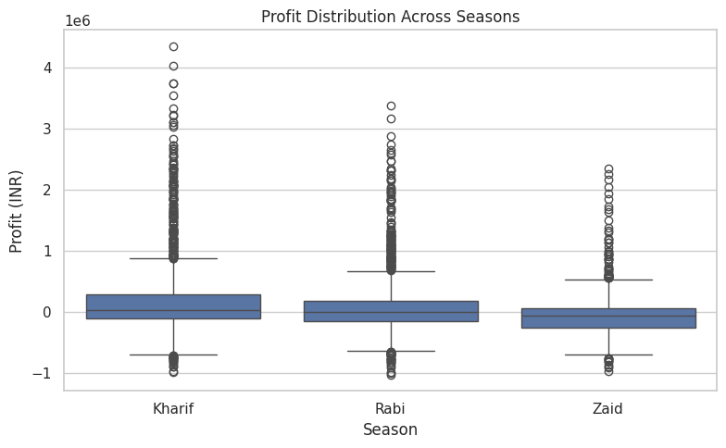
RESULTS
Descriptive statistics were used to understand agricultural performance.
Yield, profit, rainfall, water usage, and other variables were explored.
Univariate and bivariate analysis helped identify important patterns and variations.

Slide 9
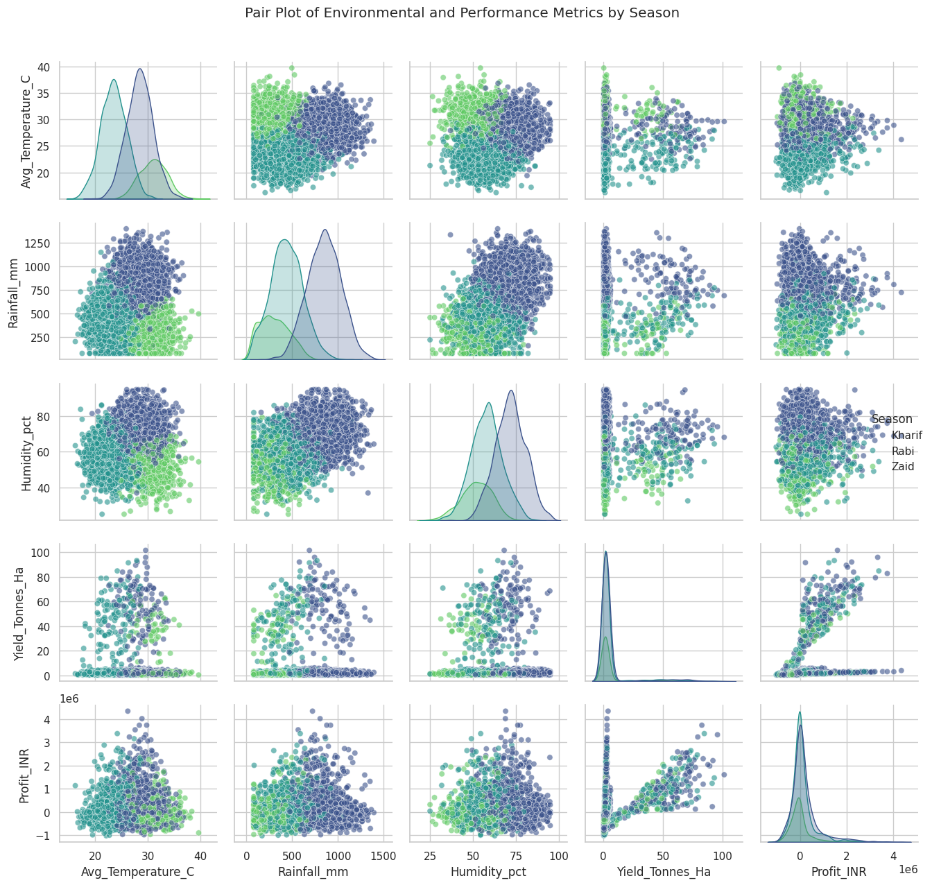
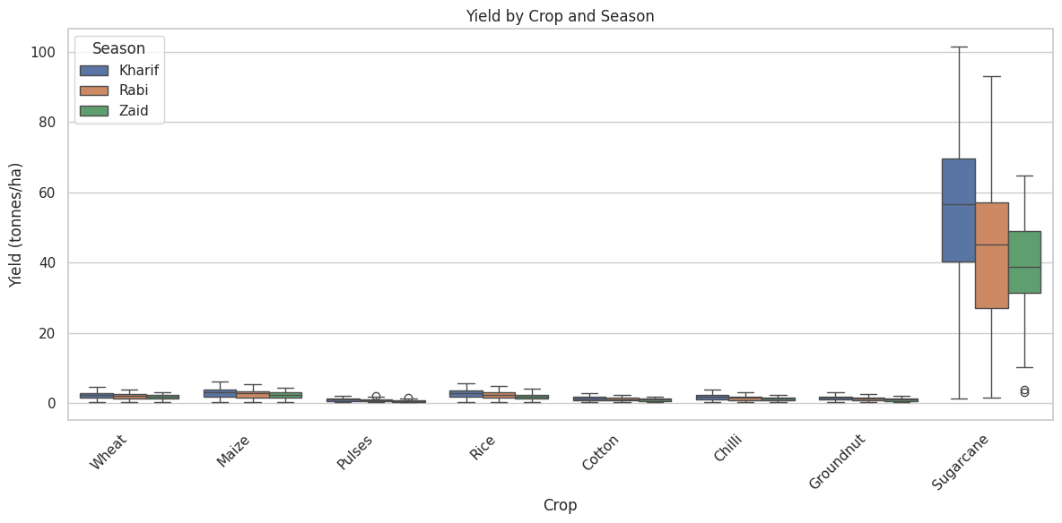
RESULTS
Seasonal analysis showed differences in yield, water usage, and risk.
Kharif recorded the highest average yield, while Zaid showed higher pest risk.
Correlation and multivariate analysis were used to understand relationships among agricultural variables.

Slide 10
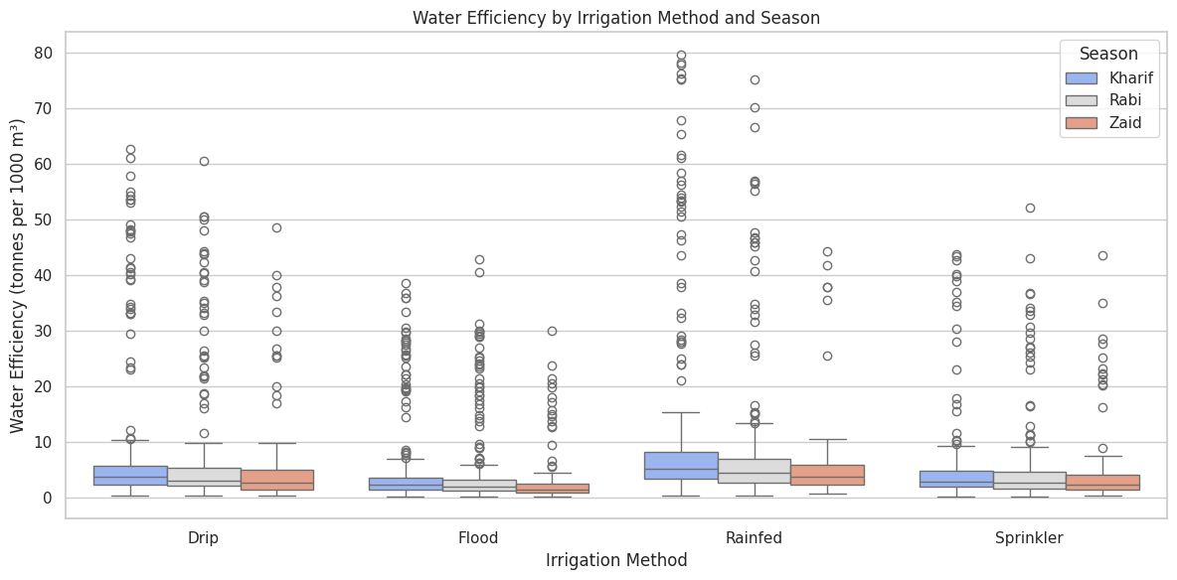
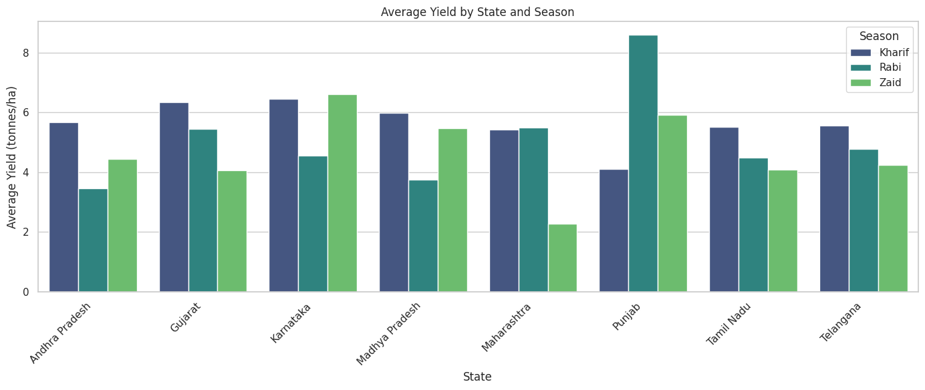
RESULTS
Drip irrigation recorded the highest average yield (6.58 tonnes/ha).
Sugarcane showed the highest average yield (46.64 tonnes/ha) and average profit (₹817,187.99).
Kharif had the highest average water efficiency (5.89 tonnes/1,000 m³). .

Slide 11
Future scope
Integrate real-time weather and market-price data for more accurate agricultural analysis.
Use machine learning models to predict crop yield, profitability, and disease/pest risk.
Expand the dataset with more regions, crops, and multiple years to improve reliability.
Develop a real-time agricultural dashboard for farmers and planners to monitor key indicators.
Include detailed soil, rainfall, irrigation, and resource-use data for deeper analysis.
Build a decision-support system to recommend suitable crops, irrigation methods, and resource allocation.

Slide 12
GitHub Link
https://github.com/scriptedbyshivam/vois-x-edunet

Slide 13

VOIS Course completion certificate -
Course name- Data Visualization

Slide 14
Thank you
.
.

