Slide 1

Project Title - Healthcare Analytics for Doctor Visits: An Exploratory Data Analysis
Student Name – Shivam Maurya
College Name – Arya College Of Engineering
AICTE STU ID : STU69ef58f1ec3ba1777293553

Slide 2
PROBLEM STATEMENT
Healthcare providers struggle to efficiently allocate resources and predict patient utilization due to a lack of insights into what drives medical behavior. Using a dataset of 5,190 patients, this analysis aims to determine how socioeconomic factors (income, gender) and health conditions (illness scores, chronic status) interactively impact the frequency of doctor visits and overall health outcomes.
Key Focus Areas
• Socioeconomic Impacts: Investigate why over 50% of the population lacks private insurance despite the majority not qualifying for low-income or elderly government subsidies.
• Gender and Health Disparities: Address why females report significantly higher average days of reduced activity (~0.98 days) than males (~0.74 days) due to illness.
• Utilization Drivers: Model the strong correlation between high illness scores, reduced functional days, and the increased frequency of clinical visits.
Goal
To build a predictive framework that forecasts hospital utilization rates and guides policymakers in creating targeted healthcare interventions and insurance subsidies.

Slide 3
Project Description
1. Introduction
This project focuses on leveraging data analytics and statistical modeling to understand patient behavior and healthcare utilization. Using a comprehensive dataset of 5,190 patients, the project analyzes how demographics, socioeconomic status, and health indicators interact to influence the frequency of doctor visits and functional health outcomes. The insights generated from this project are designed to assist healthcare administrators, insurance providers, and policymakers in optimizing medical resource allocation, designing targeted public health interventions, and refining insurance subsidy frameworks.
2. Dataset Architecture & Variables
The primary data is ingested from a Healthcare Analytics for Doctor Visits.csv file, consisting of 5,190 rows and 13 columns with no missing entries. The variables are structured as follows:
Target Variable
• visits: The number of doctor visits recorded for a patient over a specific period (ranging from 0 to 9).
Demographic & Socioeconomic Features
• gender: Categorical variable (female, male).
• age: Normalized continuous variable representing the age of the patient.
Health Status Indicators
• illness: An ordinal score (0 to 5) indicating the number of illnesses experienced by the patient.
• reduced: The number of days the patient's activity was reduced due to illness (ranging from 0 to 14 days).

Slide 4
Insurance, Benefits, & Chronic Conditions
• Private: Binary status (yes, no) indicating whether the patient has private health insurance.
• Freepoor: Binary status (yes, no) indicating government-subsidized free healthcare due to low income.
• Freerepat: Binary status (yes, no) indicating government-subsidized free healthcare due to old age, disability, or veteran status.
• Nchronic / Lchronic: Binary indicators (yes, no) signifying whether the patient suffers from non-chronic or long-term chronic medical conditions.
3. Analytical Workflow & Methodology
The project implements a structured data science pipeline divided into three major stages:
Phase 1: Exploratory Data Analysis (EDA) & Data Quality Assessment
• Null Value Scanning: Verified that the dataset contains a 100% completion rate across all columns, ensuring high internal validity without the need for data imputation.
• Univariate Analysis: Analyzed value distributions for health indicators, medical visits, and demographic splits.
• Multivariate & Group Segmentation: Grouped variables to discover specific societal trends, such as evaluating how financial metrics (income) map against health insurance types, or how gender impacts functional productivity days (reduced).
• Correlation Mapping: Plotted a comprehensive correlation heatmap using Spearman/Pearson coefficients to identify multi-collinearity and gauge the linear impact of variables on the target metric (visits).

Slide 5
Phase 2: Core Data Insights & Breakthrough Findings
• The Insurance Coverage Gap: Pie-chart distributions revealed a significant gap in the healthcare safety net. While only 10.1% of patients receive free medical care due to low income, and only 21.0% qualify via old age/disability, over half the population (55.7%) lacks private insurance. This highlights a massive "missing middle" segment vulnerable to sudden medical costs.
• Gender-Based Productivity Vulnerabilities: Aggregation showed that females suffer far more functional limitations from health dips than males. Females logged total reduced activity days significantly higher than males, translating to an average of 0.98 reduced days per female compared to 0.74 days per male.
• Illness-to-Visit Elasticity: Line graphs mapping illness scores directly against mean clinical visits established a predictable upward curve.
Patients with an illness score of 0 average only 0.08 visits, whereas patients with an illness score of 5 skyrocket to 0.81 visits, confirming illness as a heavy primary feature for predictive models.
Phase 3: Next Steps & Advanced Implementations (Roadmap)
• Feature Engineering: Binning continuous variables (age, income) into specific socio-demographic brackets to uncover non-linear patterns.
• Predictive Modeling: Developing a Count Regression framework (such as a Poisson or Negative Binomial regression model, or Random Forest Regressor) optimized to handle the discrete, right-skewed nature of the visits variable.
• Statistical Testing: Deploying Two-Sample T-tests and Chi-Square tests to validate that the variations in health vulnerabilities across genders and income groups are statistically significant and not a product of random chance.

Slide 6

Who are the end users
1. Healthcare Administrators and Hospital Managers
• How they use it: To predict patient inflow and plan hospital staffing, bed capacity, and clinical resources.
• Key benefit: They can use the model to anticipate spikes in doctor visits from heavily vulnerable patient segments (e.g., those with high illness scores or chronic conditions) and reduce wait times.
2. Public Health Officials and Policymakers
• How they use it: To design targeted healthcare safety nets, subsidies, and outreach programs.
• Key benefit: The data exposes the "missing middle"—the 55.7% of citizens who have no private insurance but do not qualify for low-income or elderly government aid. Policymakers can use these insights to adjust qualifying thresholds for programs like freepoor or freerepat.
3. Corporate HR and Occupational Health Managers
• How they use it: To manage workforce productivity and wellness benefits.
• Key benefit: Because the project highlights that women face higher rates of reduced activity days due to illness (0.98 days vs. 0.74 days for men), corporate end-users can tailor specialized employee wellness programs or flexible leave policies to address these specific demographic health vulnerabilities

Slide 7
Technology Used
  This data science project is built primarily on the Python ecosystem, leveraging robust open-source libraries within an integrated development environment.
  1. Programming Language & Platform
  • Python: The foundational language used for data manipulation, analysis, and visualization.
  • Jupyter Notebook / Google Colab: The cloud-based and local interactive computing environments used to write code, display output datasets, and visualize real-time graph renders.
  2. Core Data Science Libraries (Python)
  • Pandas: Used for data manipulation, ingestion, cleaning, mapping categorical string data, and row/column slicing (e.g., executing .info(), .describe(), .isnull().sum(), and .groupby()).
  • NumPy: Employed for background scientific computing, vectorization, and handling mathematical operations on arrays and structural data.
  • Matplotlib: The underlying data visualization library used to configure the canvas sizes, chart titles, layouts, and label alignments.
  • Seaborn: Built on top of Matplotlib, this was specifically used to construct high-level, statistically sound graphs such as:
  • sns.histplot and sns.countplot (for demographic distributions).
  • sns.barplot (to aggregate metric categories).
  • sns.heatmap (to audit null entries and output the correlation matrices).

Slide 8
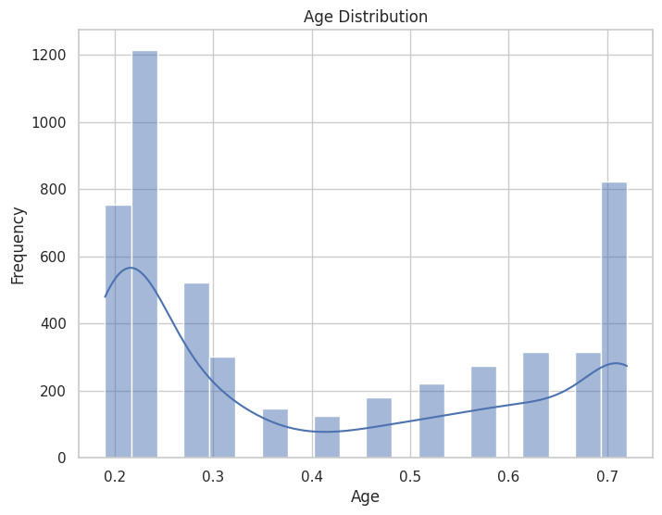
RESULTS

Slide 9
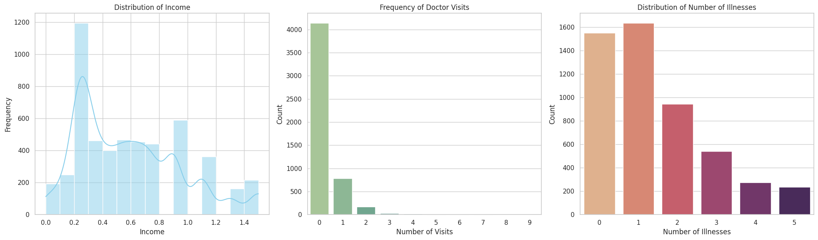
RESULTS

Slide 10
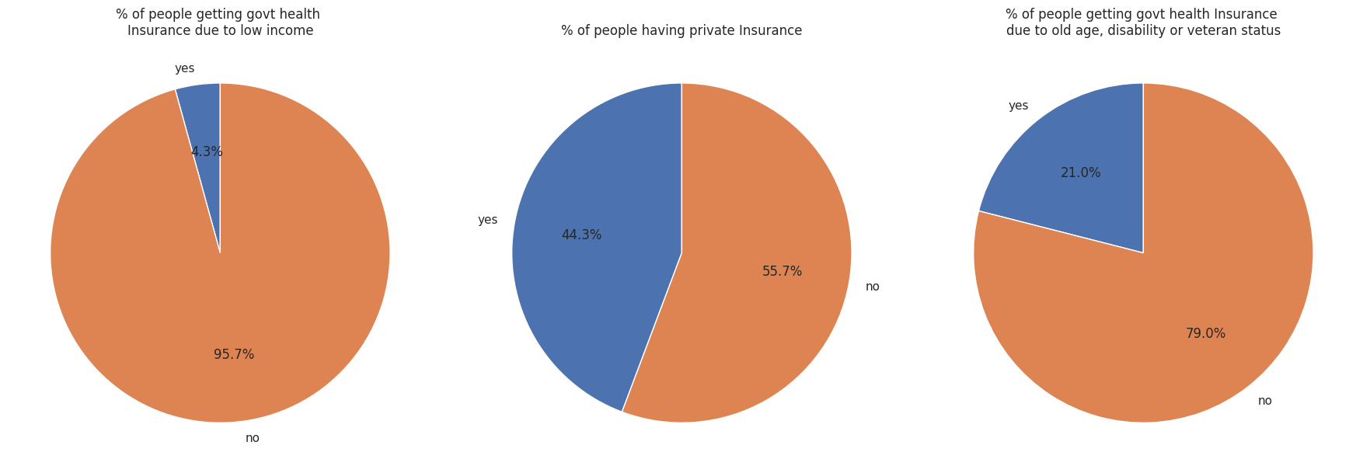
RESULTS

Slide 11
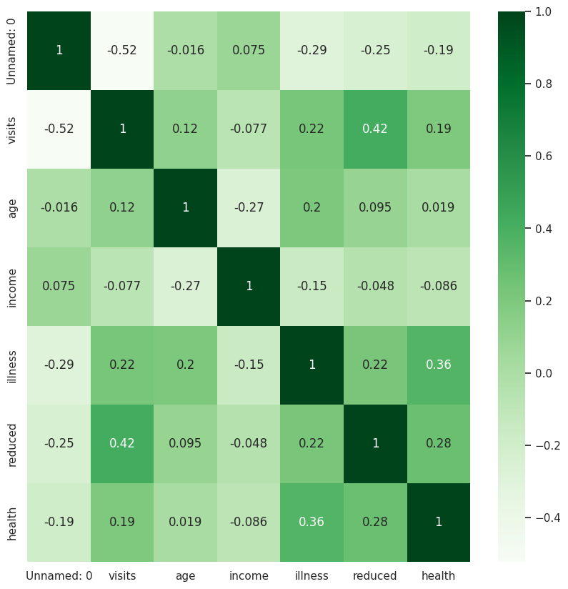
RESULTS

Slide 12
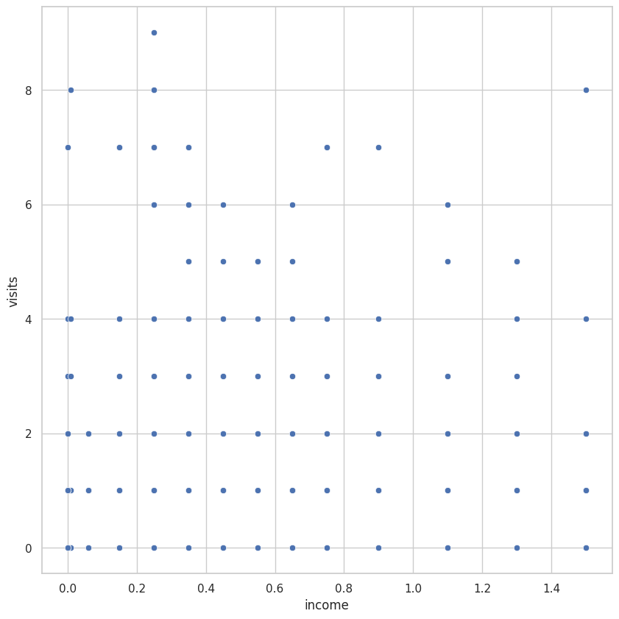
RESULTS

Slide 13
Future scope
1. Predictive & Prescriptive Advanced Modeling
• Advanced Regressors: Implement Machine Learning models (such as Poisson regression, Negative Binomial regression, Random Forest, or XGBoost) specifically optimized to forecast discrete clinical visits based on patient health matrices.
• No-Show and Readmission Risk Modeling: Integrate patient appointment histories to train classification algorithms that flag high-risk individuals prone to missing visits or requiring immediate secondary admission.
2. IoT & Real-Time Data Streaming Integrations
• Wearable and Remote Monitoring Stream: Connect real-time telemetric data feeds from personal health trackers (e.g., smartwatches monitoring heart rates, sleep cycles, and daily active steps) to instantly adjust the functional deficit metric (reduced) dynamically, rather than relying on delayed patient self-reporting.
• Instant Risk Flagging: Upgrade the backend framework to compute automated triage notifications, triggering high-priority alerts to healthcare managers when an uninsured, high-risk, multi-illness profile exhibits critical degradation patterns.

Slide 14

VOIS Course completion certificate -
Course name- Data Visualization

Slide 15
Thank you
Github link- https://github.com/scriptedbyshivam/vois-x-tirtc
.
.

