Slide 1
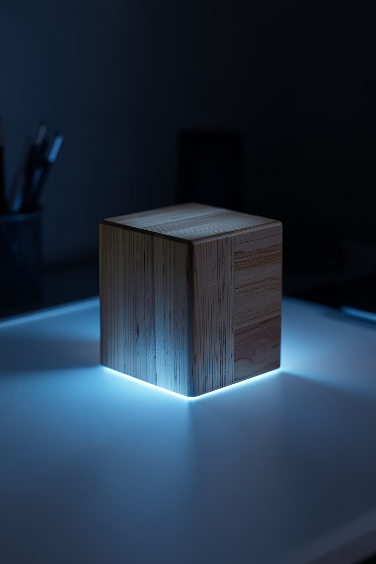
IOT CAPSTONE PROJECT
FlipFocus
A Physical Pomodoro Gadget with Real-Time Cloud Analytics
Nipun Lakhera · Sahil Raikwar · Mo Zaid Sheikh · Shivansh Nigam
Guide: Mr. Mahendra K. Ahirwar | Co-Guide: Mr. Sanjay Singh

Slide 2
The Focus Deficit
📱 Digital Fragmentation
🚫 No Historical Data
Phone timers create notification loops — a quick glance becomes a 20-minute distraction.
Physical timers can't track long-term productivity.
FlipFocus: The Solution
Distraction-Free Hardware
Tactile Dial Control
Physical cube — no screens.
Potentiometer switches profiles.
Instant Feedback
Cloud Sync
Buzzer + LED + LCD alerts.
Firebase streams data live.

Slide 3
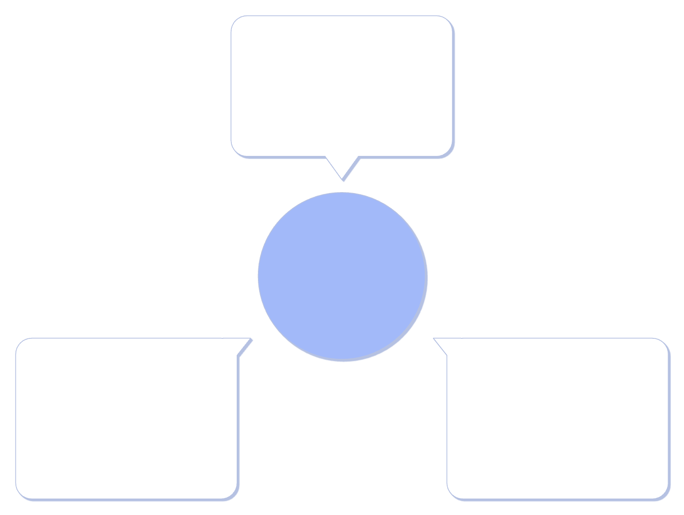
System Architecture
Edge Layer (ESP32)
Reads dial, controls buzzer/LED/LCD
Three-layer IoT Pipeline
UI Layer (Dashboard)
Cloud Layer (Firebase)
Glassmorphic UI shows live & historical analytics
Realtime DB sync over 2.4GHz
ESP32 handles local control while Firebase syncs data to the dashboard.
Four Academic Profiles
1
2
Assignment Work
Exam Prep
Syncs to /profiles/assignment
Syncs to /profiles/examprep
3
4
Core Coding
Total Break
Syncs to /profiles/corecoding
Syncs to /profiles/totalbreak

Slide 4
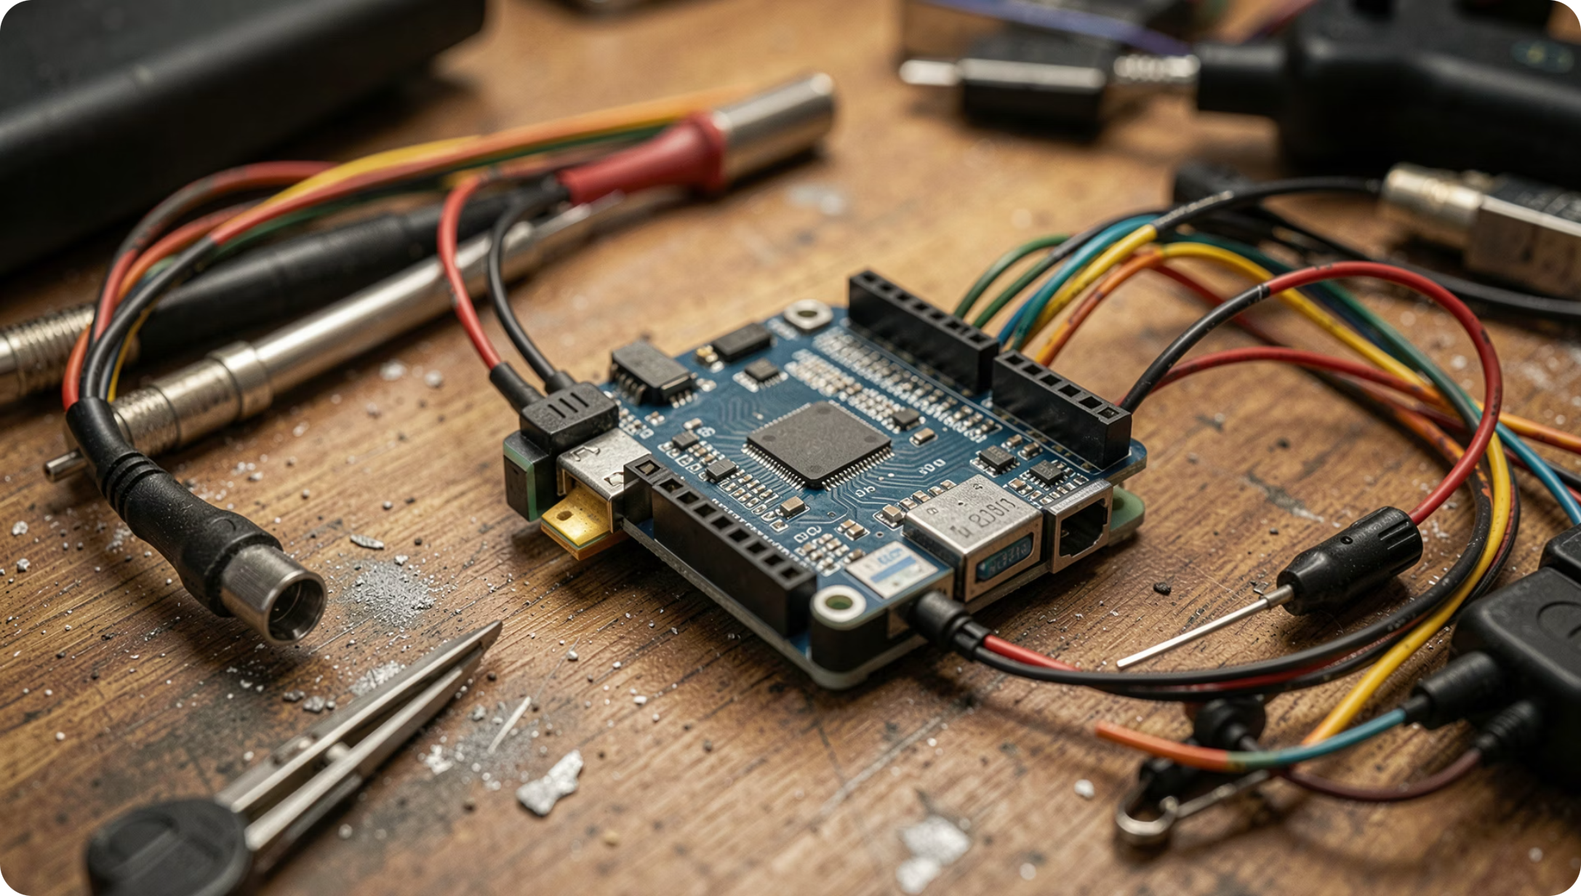
Engineering Feasibility
🔬 Technical Viability
ESP32 + Firebase ESP Client — async streaming keeps hardware loops lag-free.
📈 Operational Scalability
Schemaless database allows on-the-fly profile changes. Unseeded days default to zero.

Slide 5
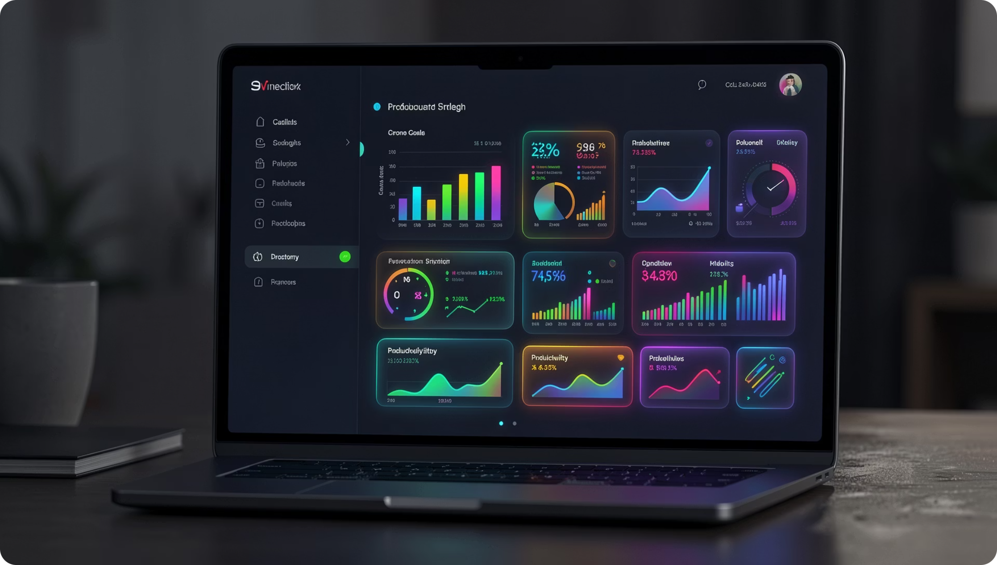
Live Analytics Dashboard
📊 Granular Productivity Auditing
Dropdown selector pulls historical data from Firebase to visualize study patterns.
Live Mode
Historical Archive
Active metrics with neon glow on running card.
Past week's time distribution across all profiles.

Slide 6
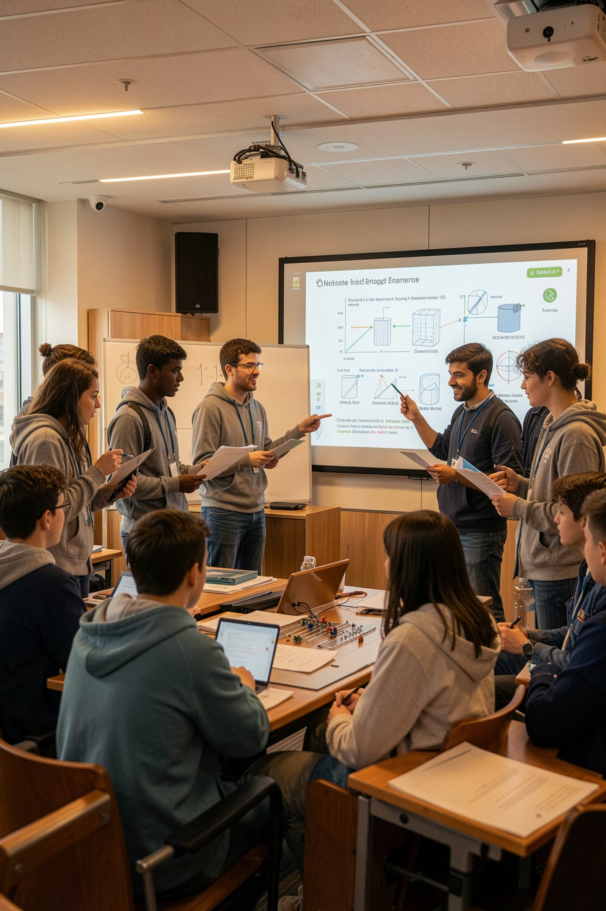

Thank You
FlipFocus is an end-to-end IoT solution — from physical hardware to cloud analytics.
👥 Team overAI
🔗 Live Demo
Nipun Lakhera · Sahil Raikwar
Mo Zaid Sheikh · Shivansh Nigam
flipfocusiot.vercel.app
📂 Repository
github.com/scriptsledge/flipfocus
Open to questions and feedback from the review panel.

