Slide 1
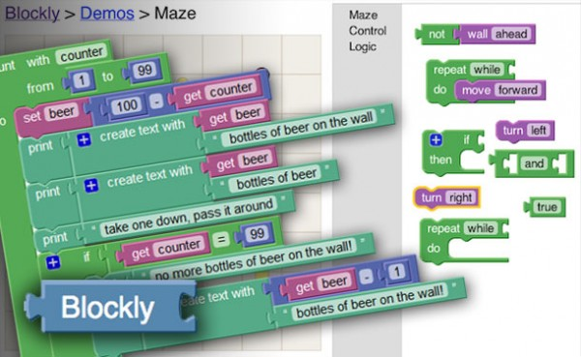
Google Blockly

Slide 2
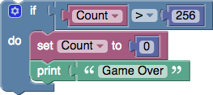
Blockly
Blockly is a visual editor that allows users to write programs by plugging blocks together.
Developers can integrate the Blockly editor into their own web applications to create User Interfaces for novice users.
if (Count > 256) {
Count = 0;
alert("Game Over");
}

Slide 3
Blockly - games
https://blockly-games.appspot.com/
Blockly Games is a series of educational games that teach programming.
It is designed for children who have not had prior experience with computer programming.
By the end of these games, players are ready to use conventional text-based languages.
All code is open source.

Slide 4
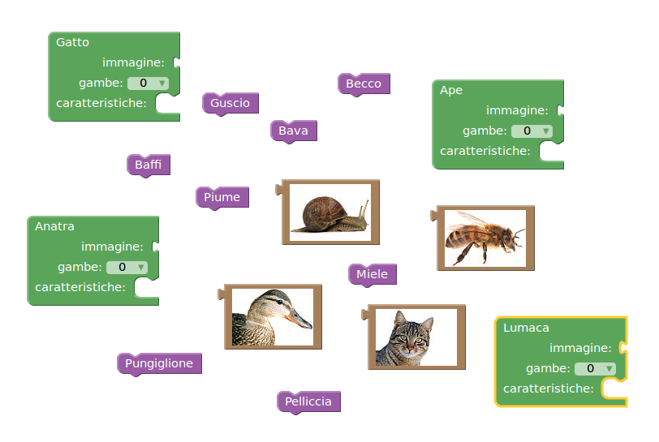
Puzzle Game

Slide 5
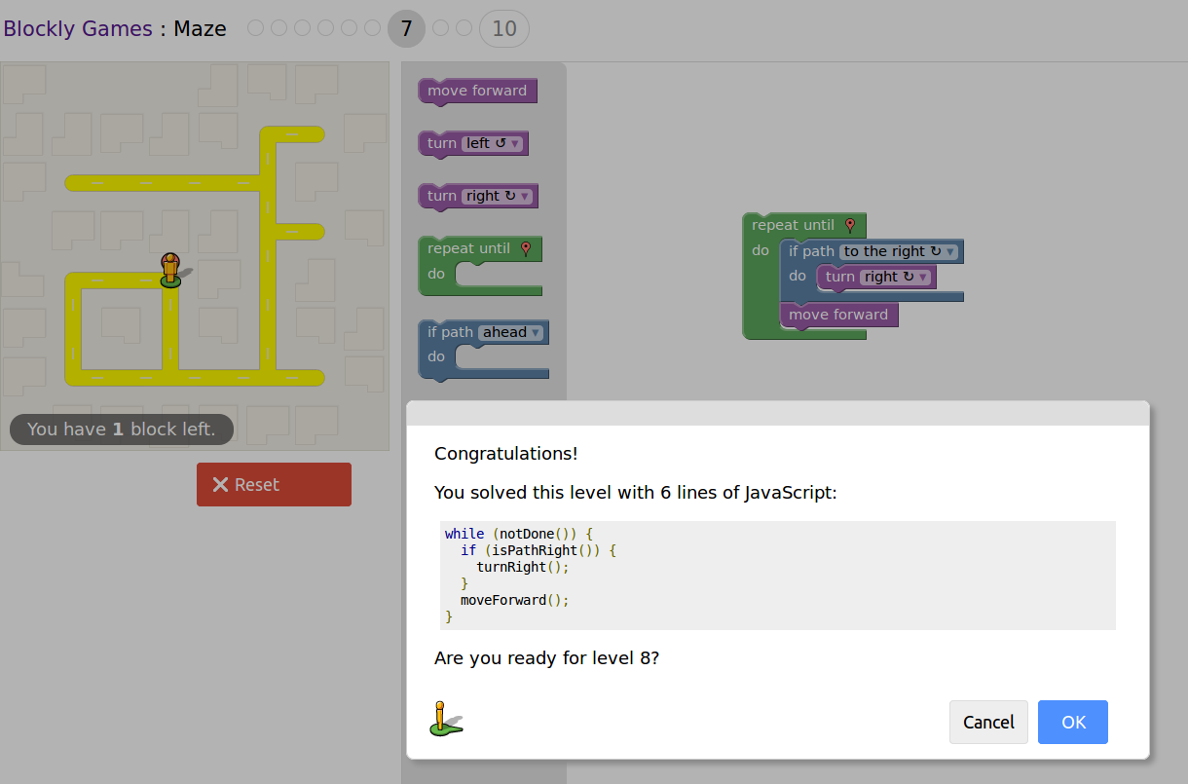

Slide 6
Examples
Blockly is being used by hundreds of projects as a visual editor.
  App Inventor
    IDE for Android apps from MIT.
    http://appinventor.mit.edu/explore/
  CODE.ORG
    K-12 computer science.
    https://code.org/
  Wonder Workshop
    Robots for play and education.
    https://www.makewonder.com/
  Other examples …
    https://developers.google.com/blockly/about/examples

Slide 7
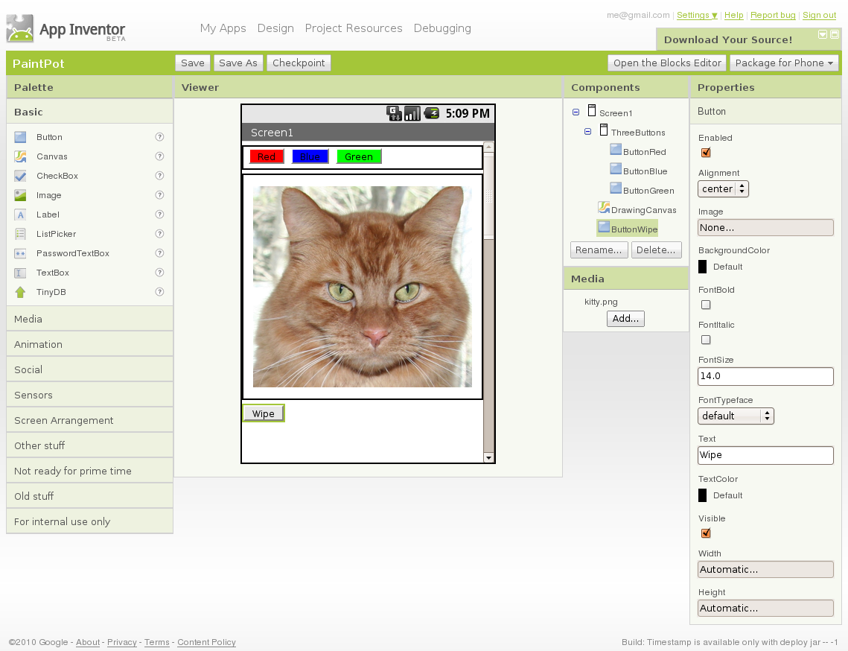
App Inventor

Slide 8
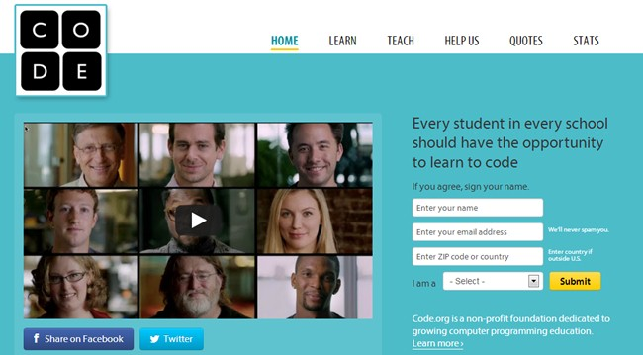
CODE.ORG

Slide 9
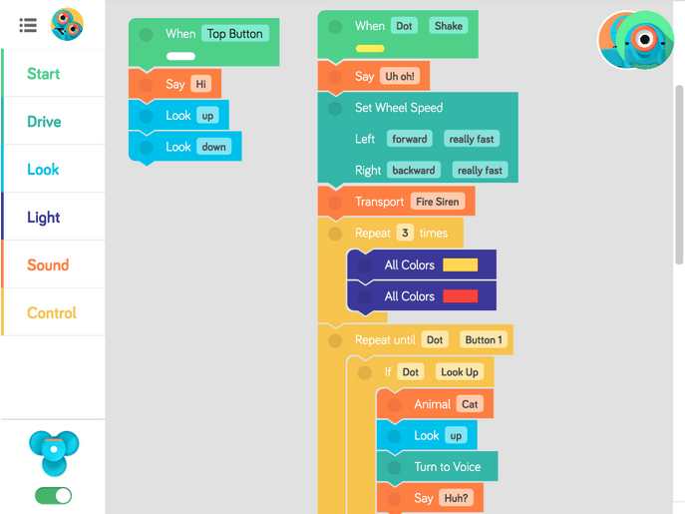
  Wonder Workshop

Slide 10
Developers web site
https://github.com/google/blockly-games/wiki
Google's Blockly Games is based on the Blockly library. All code is free and open source.
Blockly Library
  https://developers.google.com/blockly/
FAQ
  https://developers.google.com/blockly/about/faq

Slide 11
Blockly library
Blockly is a visual editor that allows users to write programs by plugging blocks together. Developers can integrate the Blockly editor into their own web applications to create a great UI for novice users.
A user might create a program like this:
https://developers.google.com/blockly/

Slide 12
Blockly in your application
Blockly is designed to easily install into your web application.
Users drag blocks around, Blockly generates code, your application does something with that code.
From your application's point of view Blockly is just a textarea in which the user types syntactically perfect JavaScript, Python, Dart, or other language.
Blockly is 100% client-side, requiring no support from the server.
Everything is open source.

Slide 13
Download & test
Download code
  https://github.com/google/blockly/zipball/master
Test
  Point your browser at demos/fixed/index.html and verify that blocks can be dragged around.

Slide 14
Your Test Demo
Modify the web page at demos/generator/index.html changing static HTML and default blockly blocks
Documentation at https://developers.google.com/blockly/installation/injecting-fixed-size

Slide 15
… next
Can you develop your own application starting from examples like this one?
https://blockly-demo.appspot.com/static/demos/generator/index.html
Documentation at
https://developers.google.com/blockly/installation/code-generators

Slide 16
Custom Blocks
In order to interface with an external application, you must create custom blocks to form an API.
For example, when creating a drawing program, you might need to create a "draw circle of radius R" block.
In most cases the easiest approach is to just find a really similar block which already exists, copy it, and modify it as needed.

Slide 17
Define a Block
Create a block: specify its shape, labels, and connection points.
The Block Factory is the easiest way to write this code.
https://developers.google.com/blockly/custom-blocks/block-factory

Slide 18
Define a new block - example
Blockly.Blocks['text_length'] = {
init: function() {
this.setHelpUrl('http://www.dii.unipr.it');
this.setColour(160);
this.appendValueInput('VALUE')
.setCheck('String')
.appendField('length of');
this.setOutput(true, 'Number');
this.setTooltip('Returns number of letters in the provided text.');
}
};

Slide 19
Init Function
(creates the block's shape)
setHelpUrl
setColour
setOutput
setPreviousStatement
setNextStatement
appendDummyInput, appendValueInput, appendStatementInput
setCheck
setAlign
appendField
setInputsInline
setTooltip
setMutator
setDeletable
setEditable
setMovable
onchange
data
https://developers.google.com/blockly/custom-blocks/defining-blocks

Slide 20
Uncompressed Mode
https://developers.google.com/blockly/hacking/building
When developing Blockly, use uncompressed mode.
Core
  <script src="blockly_compressed.js"></script>
  <script src="blockly_uncompressed.js"></script>
Blocks
  <script src="blocks_compressed.js"></script>
  <script src="blocks/logic.js"></script>
  <script src="blocks/loops.js"></script>
  <script src="blocks/math.js"></script>
  …
Language
  <script src="msg/js/en.js"></script>
  <script src="msg/messages.js"></script>

Slide 21
Playground
The playground is a useful tool.
Point your browser at tests/playground.html
In playground:
  All code is uncompressed
  All the default blocks
  All the language generators (JavaScript, Python and Dart).

Slide 22
Build a Visual Programming Editor
http://jlcreations.com/create-visual-programming-editor-blockly/
Files to modify:
  index.html
  blockly.html
  blocks.js
  javascript.js

Slide 23
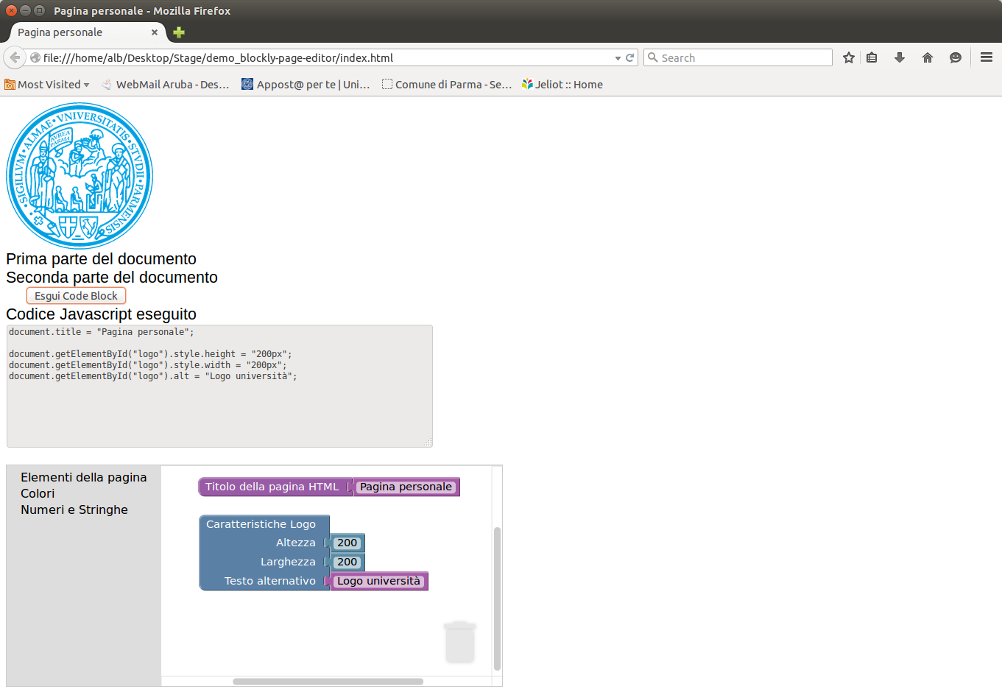
Example

Slide 24
index.html (layout pagina)
<html>
<head>
<title>Esempio Blockly - Javascript</title>
<link rel="stylesheet" type="text/css" href="styles.css" />
<script type="text/javascript">
// function that gets called once Blockly frame loads
window.blockly_loaded = function(blockly) {
return window.Blockly = blockly;
}
// function chiamata dal bottone button_run
function esegui() {
// recupero il codice Javascript derivante dai blocchi
code = window.Blockly.JavaScript.workspaceToCode();
// visualizzo il codice
document.getElementById("js_codice").value = code;
// eseguo il codice
eval(code);
}
</script>
</head>
<body>
<img id="logo" src="logo.gif" alt="logo unipr" style="width:100px; height:100px">
<div id="parte_1">Prima parte del documento</div>
<div id="parte_2">Seconda parte del documento</div>
<button id="button_run" onclick="esegui()"> Esegui Code Block</button>
<form>
Codice Javascript eseguito<br>
<textarea name="js_codice" id="js_codice" readonly rows="10" cols="80">Codice</textarea>
</form>
<div id="blockly_editor">
<!-- Blockly will be injected in the iframe below //-->
<iframe id="blockly" src="blockly.html" width="100%"></iframe>
</div>
</body>
</html>

Slide 25
blockly.html (blocchi)
<!DOCTYPE html>
<html>
<head>
<meta charset="utf-8">
<script src="blockly/blockly_uncompressed.js"></script>
<script src="blockly/generators/javascript.js"></script>
<script src="blockly/msg/js/en.js"></script>
<script src="javascript.js"></script>
<script src="blocks.js"></script>
<style>
...
</style>
<script>
function init() {
Blockly.inject(document.body, {toolbox: document.getElementById('toolbox')});
// Let the top-level application know that Blockly is ready.
window.parent.blockly_loaded(Blockly);
}
</script>
</head>
<body onload="init()">
<xml id="toolbox" style="display: none">
<category name="Elementi della pagina">
<block type="titolo_documento"></block>
<block type="caratteristiche_logo"></block>
<block type="carattertiche_elemento"></block>
</category>
<category name="Colori">
<block type="color_red"></block>
...
</category>
<category name="Numeri e Stringhe">
<block type="numero"></block>
<block type="stringa"></block>
</category>
</xml>
</body>
</html>

Slide 26
blocks.js (layout blocchi)
Blockly.Blocks['carattertiche_elemento'] = {
init: function() {
this.setHelpUrl('http://www.w3schools.com/tags/tag_div.asp');
this.setColour(65);
this.appendDummyInput()
.appendField("Caratteristiche elemento");
this.appendValueInput("NUMERO")
.setCheck("Number")
.appendField("numero");
this.appendValueInput("TESTO")
.setCheck("String")
.appendField("testo");
this.appendValueInput("COLORE")
.appendField("colore");
this.setTooltip('');
}
};
Blockly.Blocks['stringa'] = {
init: function() {
this.setHelpUrl('http://www.w3schools.com/html');
this.setColour(300);
this.appendDummyInput()
.appendField(new Blockly.FieldTextInput("il tuo testo"), "stringa");
this.setOutput(true, "String");
this.setTooltip('');
}
};
...

Slide 27
javascript.js (codice blocchi)
Blockly.JavaScript['carattertiche_elemento'] = function(block) {
var value_numero = Blockly.JavaScript.valueToCode(block, 'NUMERO', Blockly.JavaScript.ORDER_ATOMIC);
var value_testo = Blockly.JavaScript.valueToCode(block, 'TESTO', Blockly.JavaScript.ORDER_ATOMIC);
var value_colore = Blockly.JavaScript.valueToCode(block, 'COLORE', Blockly.JavaScript.ORDER_ATOMIC);
var nome = "parte_" + value_numero;
var code = 'document.getElementById("' + nome + '").innerHTML = "' + value_testo + '";\n';
code += 'document.getElementById("' + nome + '").style.color = "' + value_colore + '";\n';
return code;
};
Blockly.JavaScript['numero'] = function(block) {
var code = parseFloat(block.getFieldValue('NUM'));
return [code, Blockly.JavaScript.ORDER_ATOMIC];
};
Blockly.JavaScript['stringa'] = function(block) {
var text_text = block.getFieldValue('stringa');
var code = text_text;
return [code, Blockly.JavaScript.ORDER_NONE];
};
Blockly.JavaScript['caratteristiche_logo'] = function(block) {
var value_altezza = Blockly.JavaScript.valueToCode(block, 'ALTEZZA', Blockly.JavaScript.ORDER_ATOMIC);
var value_larghezza = Blockly.JavaScript.valueToCode(block, 'LARGHEZZA', Blockly.JavaScript.ORDER_ATOMIC);
var value_al = Blockly.JavaScript.valueToCode(block, 'AL', Blockly.JavaScript.ORDER_ATOMIC);
var code = 'document.getElementById("logo").style.height = "' + value_altezza + 'px";\n';
code += 'document.getElementById("logo").style.width = "' + value_larghezza + 'px";\n';
code += 'document.getElementById("logo").alt = "' + value_al + '";\n';
return code;
};
...

