Slide 1
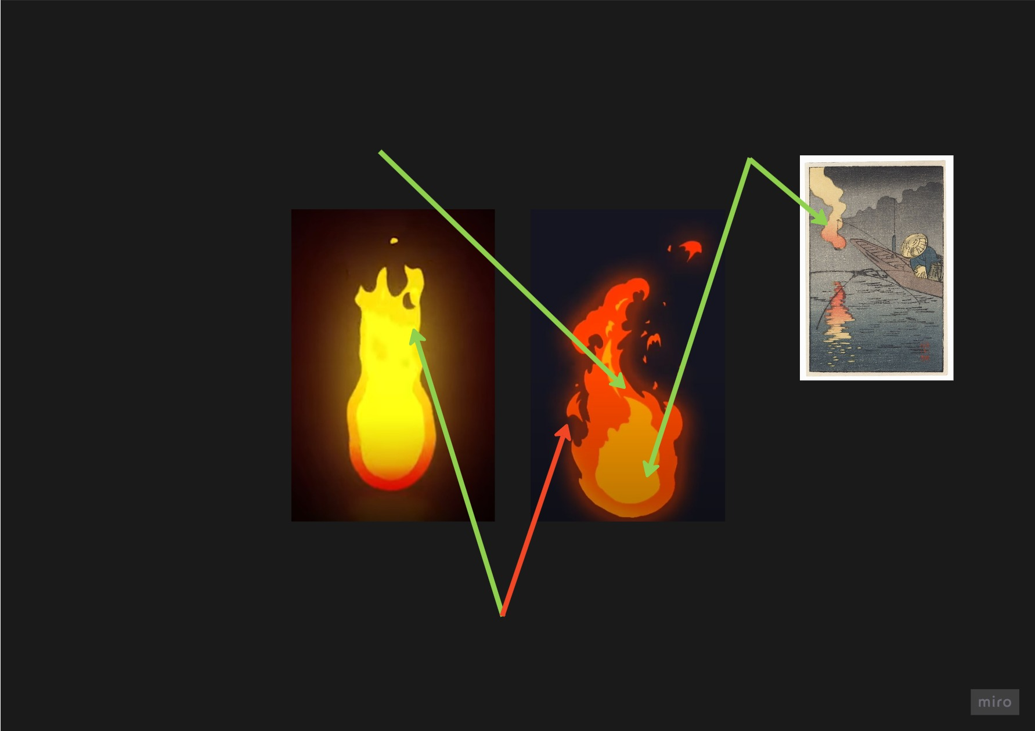
General Environmental Effect Guidelines
Simple two color scheme, maybe some light gradients
Muted Colors like in the wood block prints
Generally reduced,
minimalistic effects
that get across what they are supposed to be, but are not taking the attention from the action
Visually, effects should orient on the woodblock print style. Make them flat (2D) and minimalistic. They should look like they could exist on a piece of paper
Reduced shape complexity, more like in the left than like in the right

Slide 2
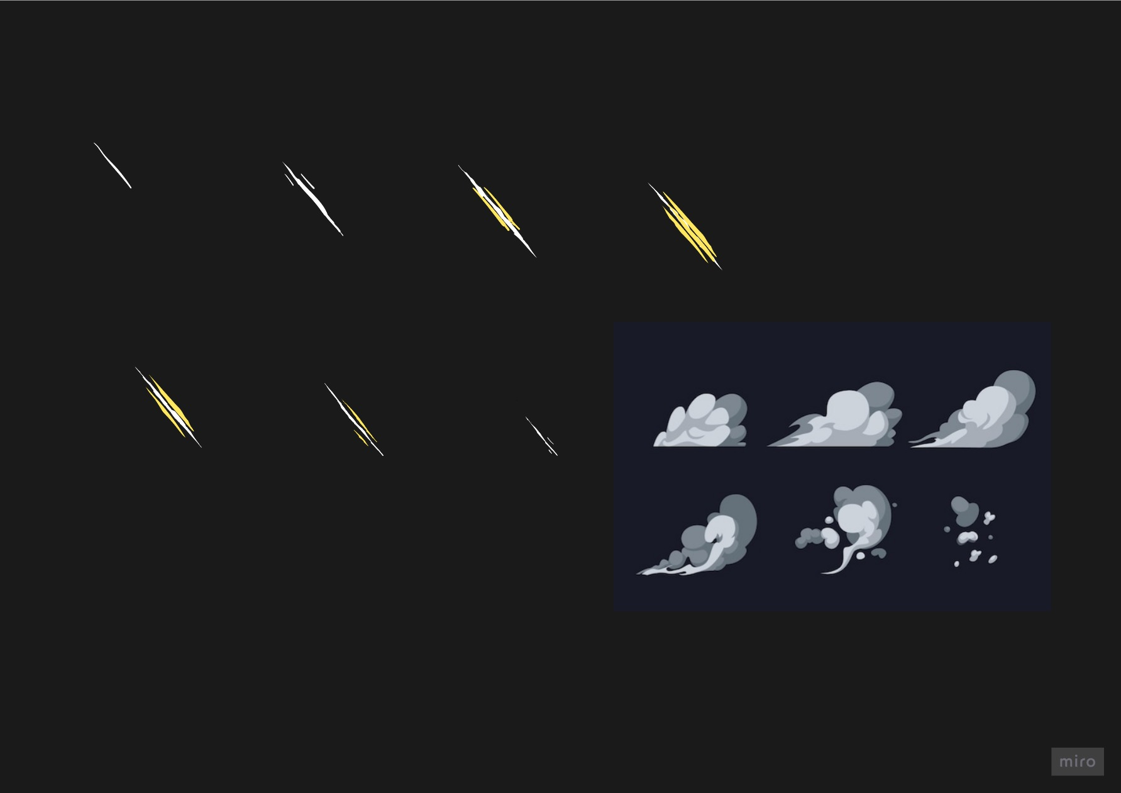
Action Effect Guidelines
Flipbook Animations
Minimal 2D effects
Basecolor + Accent Color
Maybe Shading

Slide 3
Keywords
Stylized, cartoony/toon, cel-shaded
Traditional 2d
flipbook animations / Sub UV animations

