Slide 1
Android
Lesson 5 by Callum Taylor

Slide 2
Introduction
All code and presentation slides can be found over at https://github.com/scruffyfox/AndroidCourse
Twitter/app.net/github: @scruffyfox
http://(blog.)callumtaylor.net

Slide 3

Introduction
https://github.com/scruffyfox/AndroidCourse/tree/Lesson-5

Slide 4
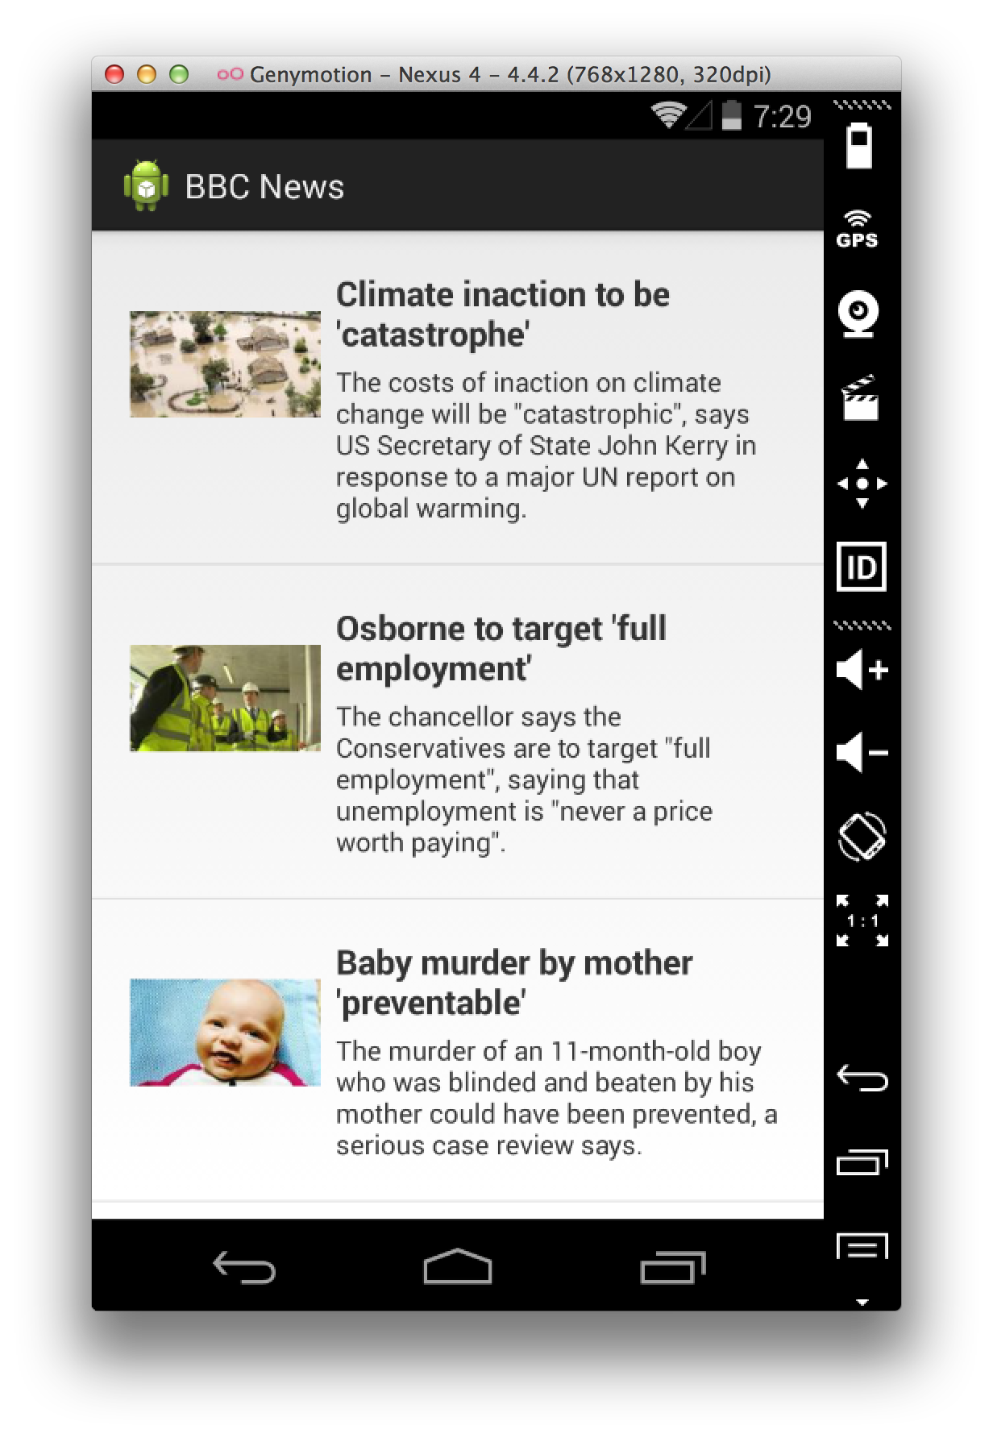

What we’re going to make
Notes:
This is what we’re going to make today

Slide 5
What we’re going to make
Activity menu options
Shared preferences
Web Views
Loading images efficiently
Notes:
This is what we’re going to make today

