Slide 1
Android
Lesson 6 by Callum Taylor

Slide 2
Introduction
All code and presentation slides can be found over at https://github.com/scruffyfox/AndroidCourse
Twitter/app.net/github: @scruffyfox
http://(blog.)callumtaylor.net

Slide 3

Introduction
https://github.com/scruffyfox/AndroidCourse/tree/Lesson-6

Slide 4
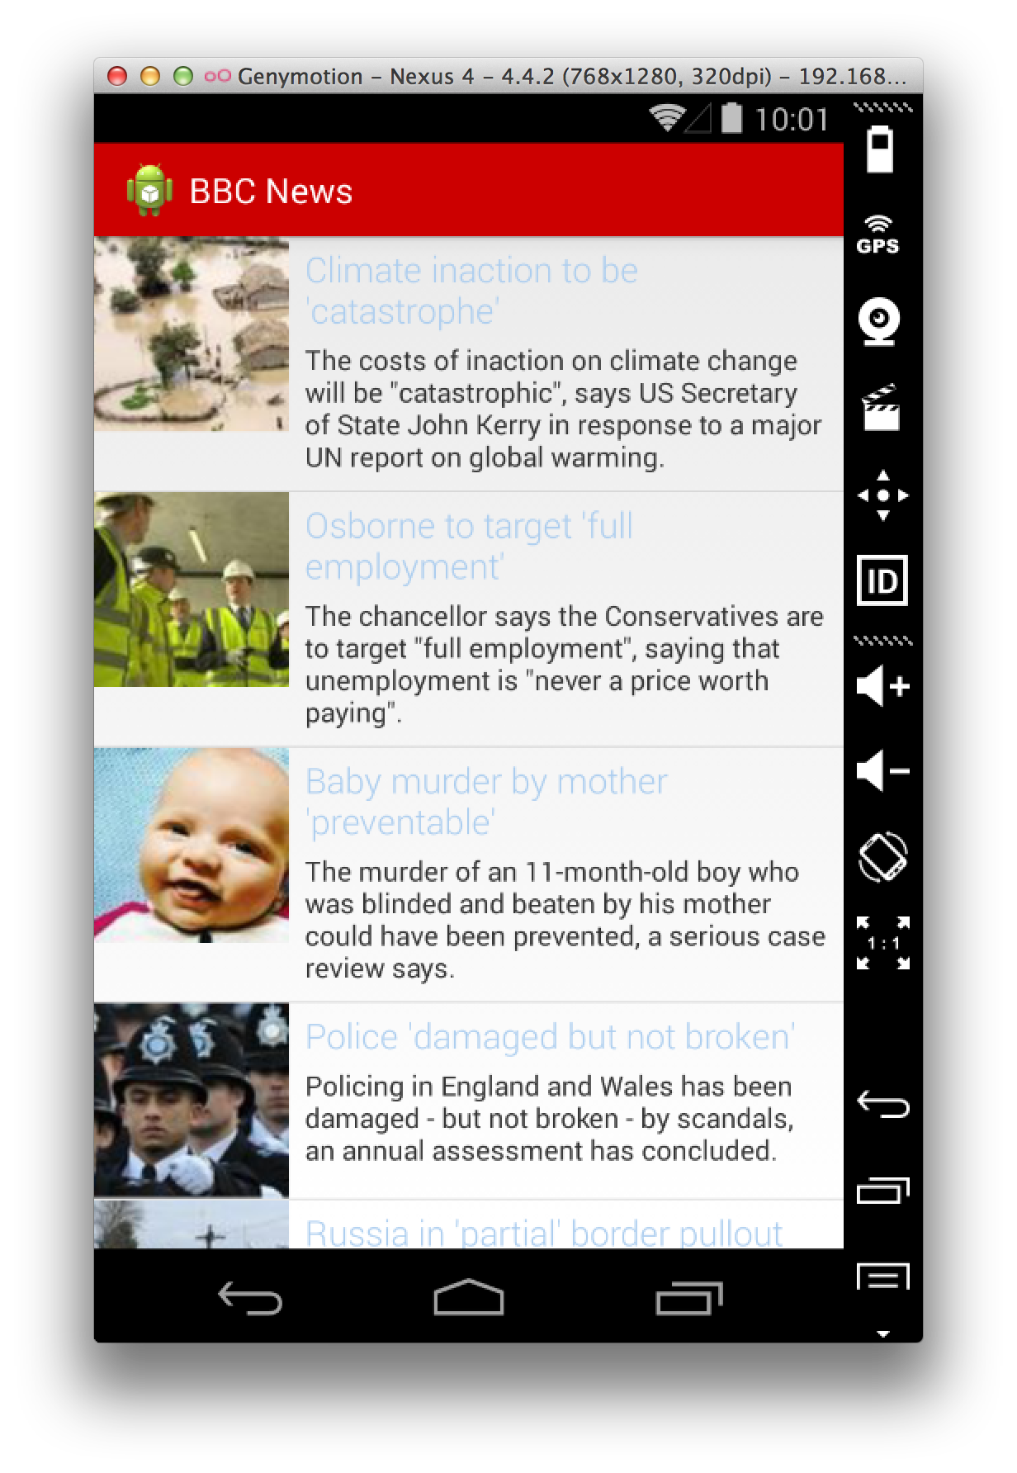

What we’re going to make
Notes:
This is what we’re going to make today

Slide 5
What we’re going to make
Styling
Exporting
Notes:
This is what we’re going to make today

Slide 6
Styling
@style/StyleName
Notes:
Styles are another form of resources that you can provide to your activies and views, similarly to how css is used to style html pages.

Slide 7
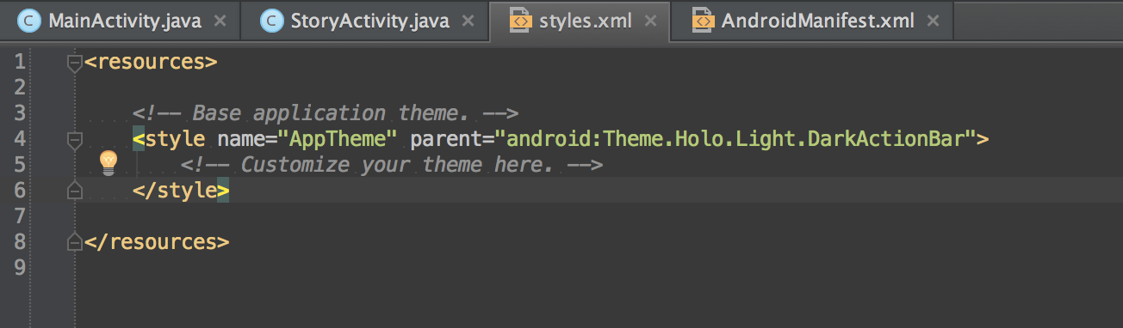
Styling
Notes:
By default in your application you will have a default theme in your res/styles.xml file called “AppTheme”
You can see that there are 2 properties, a “name” and a “parent”
Name is self explanitory, but parent is a theme that you can override, in this case we’re overriding the Dark Action bar style.
So far you have seen something like @android:id/ in this case its just using “android:”, but using “@android:style/” will still work.

Slide 8
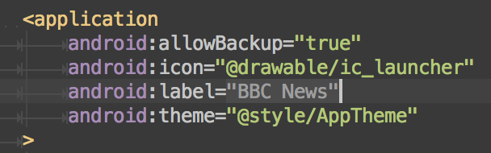
Styling
Notes:
This theme is applied to all of our activities by being set in the application node. You can set a specific theme for a specific activity by moving it to the activity node.

Slide 9
Hierarchy
AppTheme
ActionBarStyle
drawable/color
reference
background
titleTextStyle
background
textColor
textSize
drawable/color
drawable/color
dimension

