Slide 1
Android
Lesson 3 by Callum Taylor

Slide 2
Introduction
All code and presentation slides can be found over at https://github.com/scruffyfox/AndroidCourse
Twitter/app.net/github: @scruffyfox
http://(blog.)callumtaylor.net

Slide 3

Introduction
https://github.com/scruffyfox/AndroidCourse/tree/Lesson-3

Slide 4
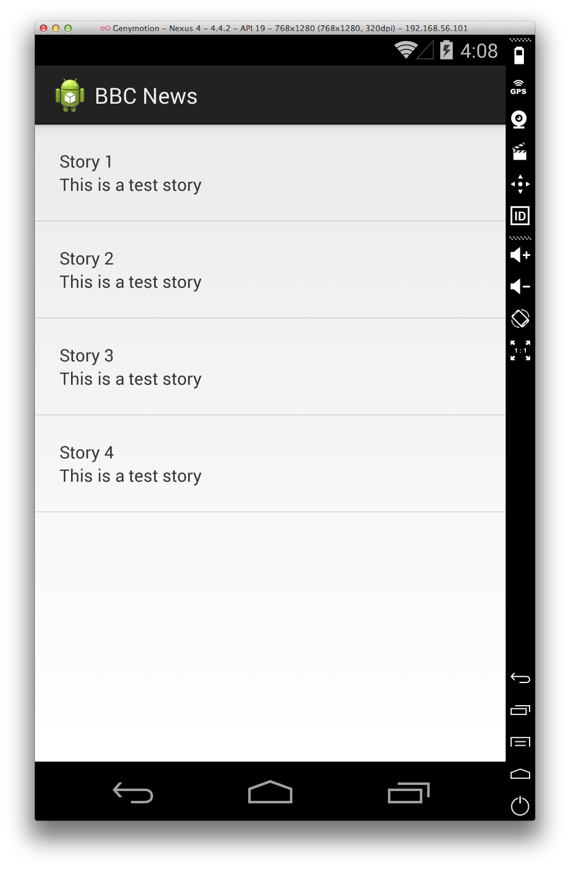
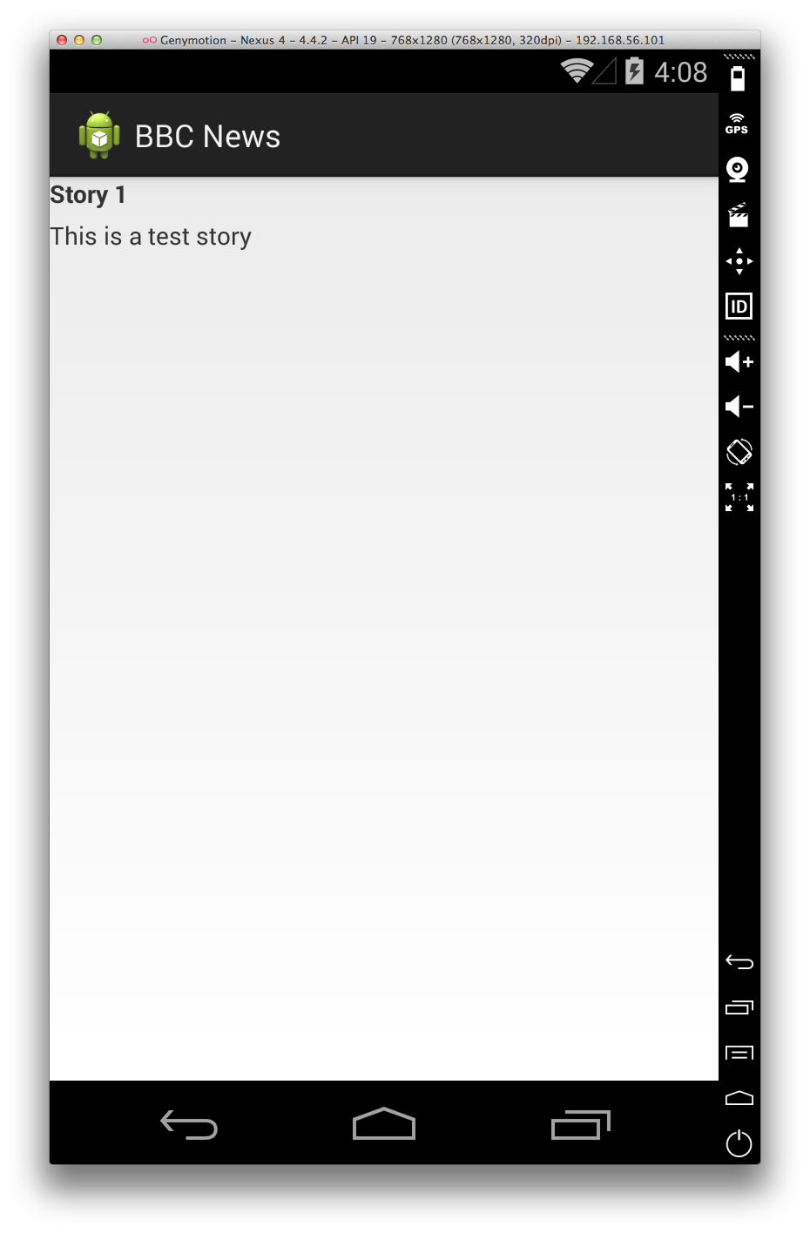
What we’re going to make
Notes:
This is what we’re going to make today
It might not look like much, but there’s a lot of stuff we’ll be covering that’s not UI based

Slide 5
What we’re going to make
Models
Refactoring code
Serializable
Passing data from one activity to another
Notes:
This is what we’re going to make today

Slide 6
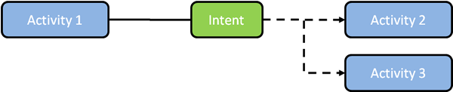
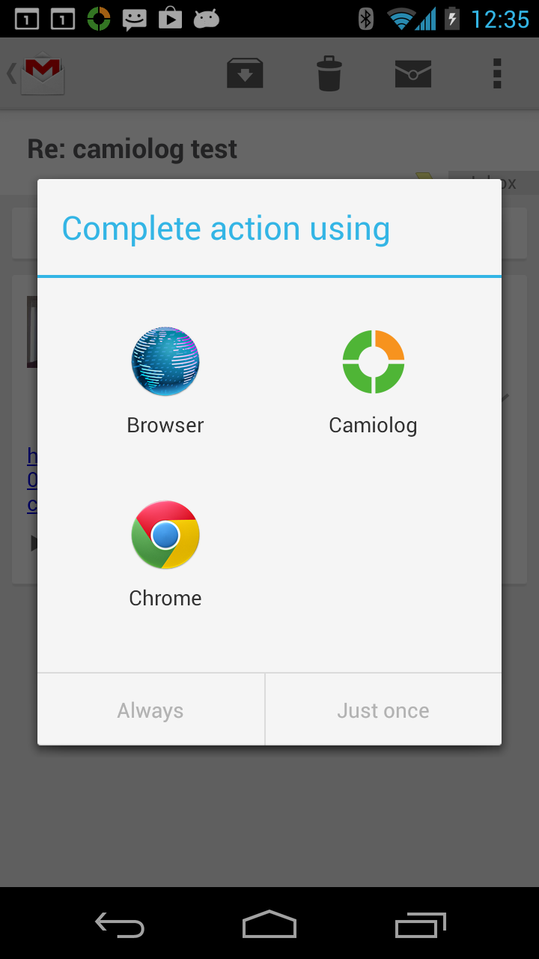
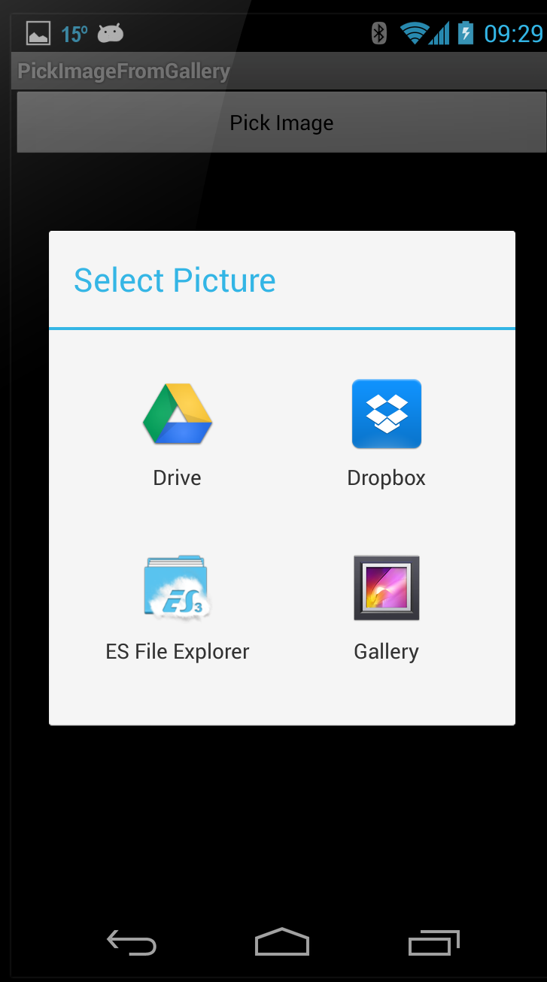
Intents
Notes:
The way activities work in android is by using intents.
Intents is like a middle man between a transaction which deals with passing data from one activity to another, starting an activity that doesn’t belong to your app, or prompting the user to complete a specific action such as share

